Slide 1
FORWARD CHAINING
[COVID-19 DIAGNOSIS]
ThanhVi Dang

Slide 2
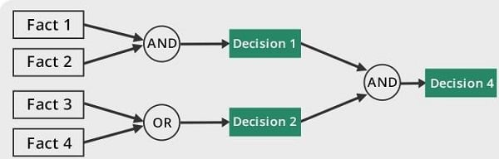
FORWARD CHAINING
Expert System Domain of AI
Uses Inference engine
A method of reasoning
Bottom up approach

Slide 3
PROBLEM BACKGROUND
Limitations relating to Covid-19 Diagnosis:
Accuracy of diagnosis
Efficiency of diagnosis
Challenging to keep knowledge base up-to-date.
Various opinions/significance of symptoms
Overdiagnosis/misdiagnosis
Lack of understanding in patients’ medical history
The need for speed and reliability

Slide 4
PROBLEM STATEMENT
How to improve and enhance the accuracy and efficiency of COVID-19 Diagnosis Using Forward Chaining?
This project aims to use the application of forward chaining (and Random Forest) to identify potential Covid-19 positive cases based on patient’s reported input on symptoms, health preconditions, and exposure risks.

Slide 5
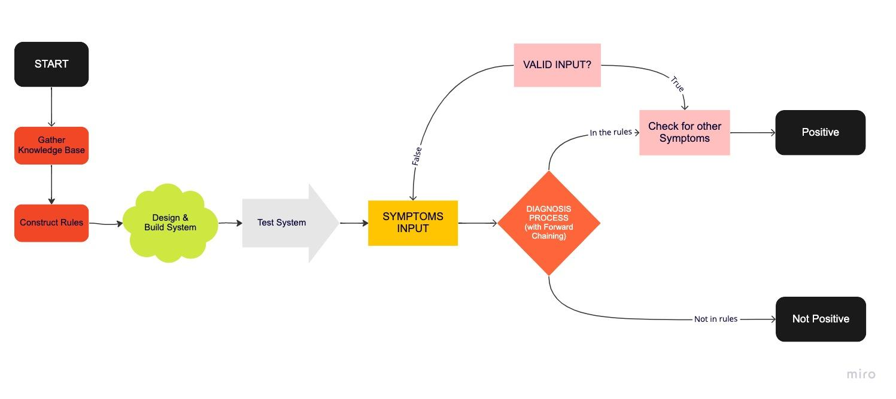
PROJECT FLOWCHART

Slide 6
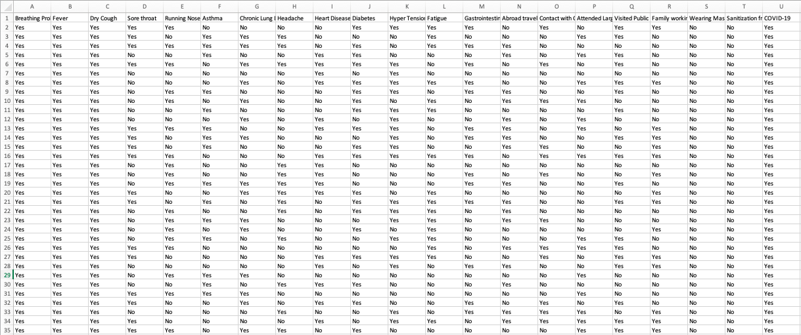
DATA SET
"Symptoms and COVID Presence (May 2020)" (Kaggle) - 5,435 observations and 21 variables

Slide 7
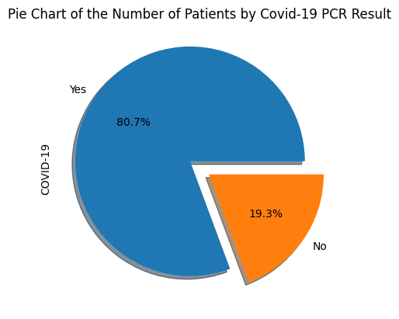
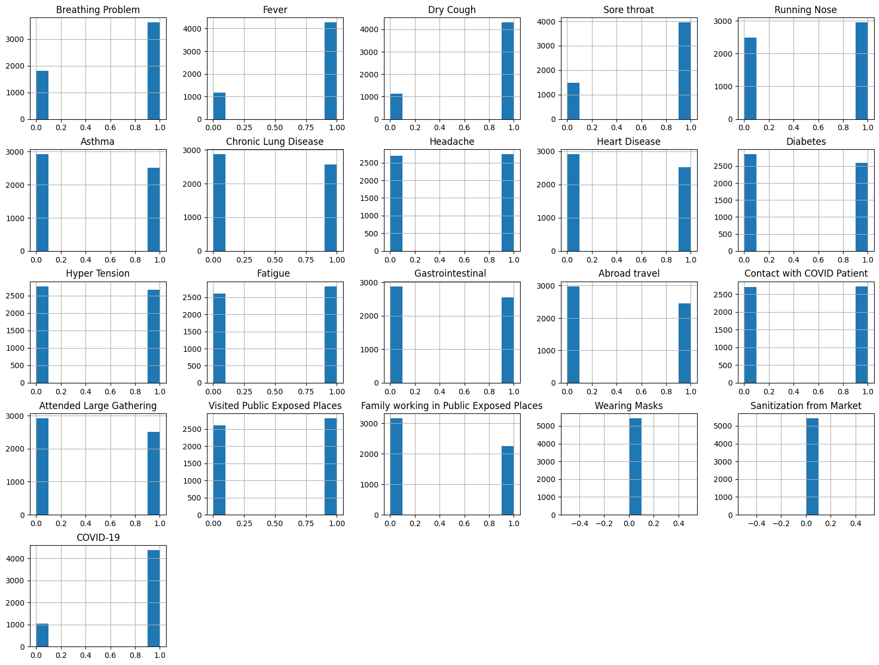
Data Info

Slide 8
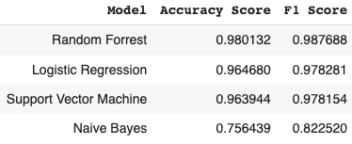
Classification Methods
Random Forest, Logistic Regression, Support Vector Machine, and Naive Bayes

Slide 9
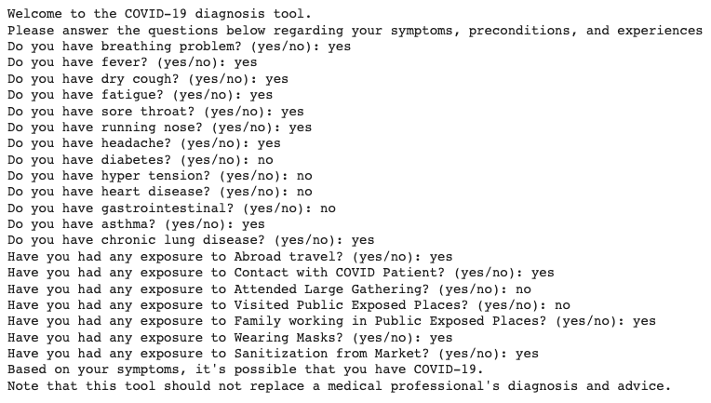
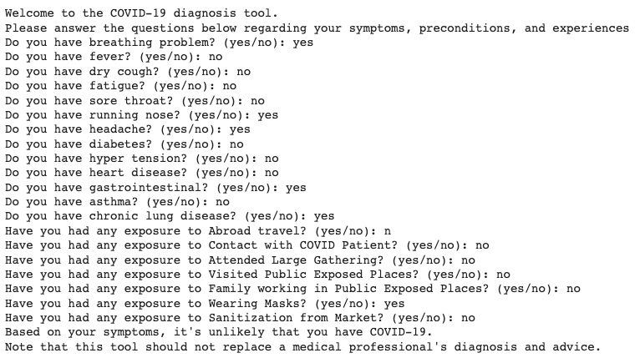
Forward Chaining Results

Slide 10
Limitations and Further Research
Limitations
Further Research
May not be representative of the entire population
Limited rule-based system
Does not take into account of false positive cases
Model performs on larger and more diverse dataset.
Incorporating in more advanced ML model
Refine rule-base system by adding other factor (vaccination status, etc.)

Slide 11
THANK YOU!

