Slide 1

Basics
Thuong Le

Slide 2
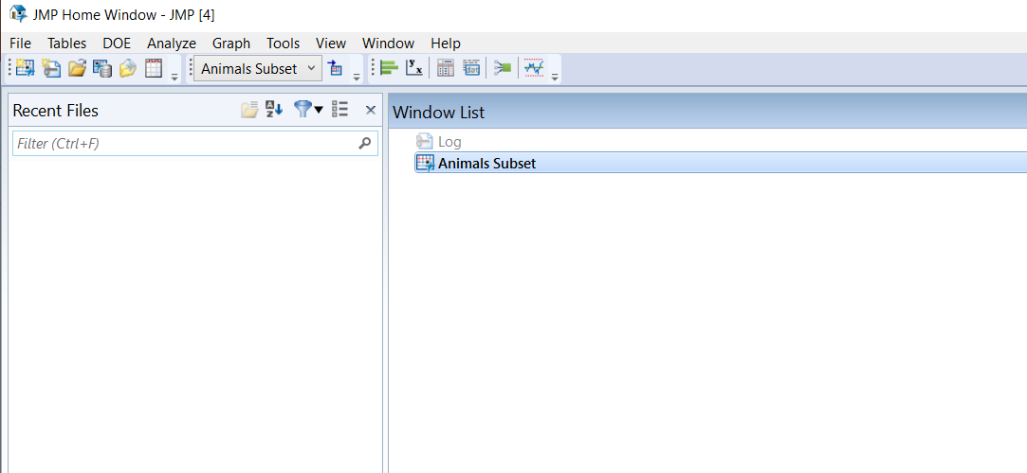
Main interface
Files opened in the past
Files currently in use

Slide 3
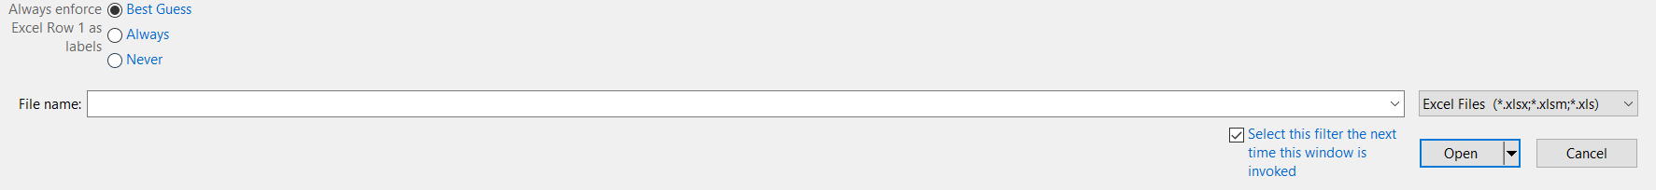
Import from Excel
File → Open
Copy and paste directly from Excel
First, create new empty data table: File → New → Data Table
Paste data from Excel: Edit → Paste With Column Names or Ctrl + Shift + V

Slide 4
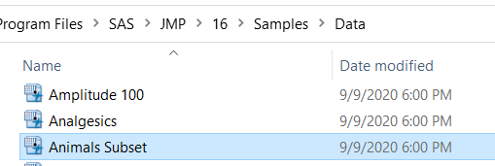
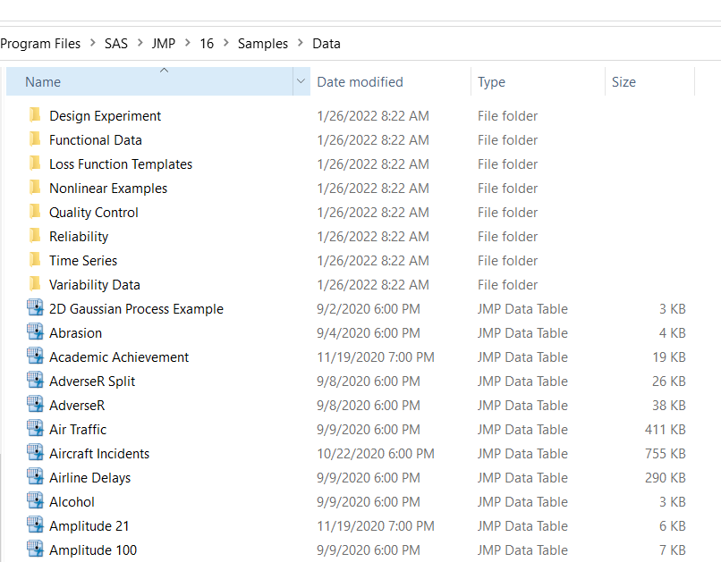
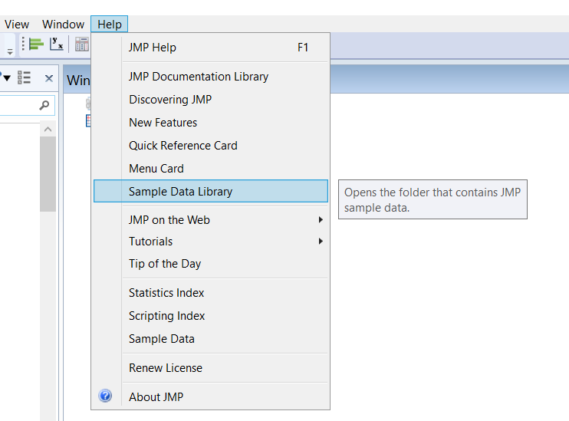
Sample data library for practice
From main JMP interface, go to
Help → Sample Data Library

Slide 5
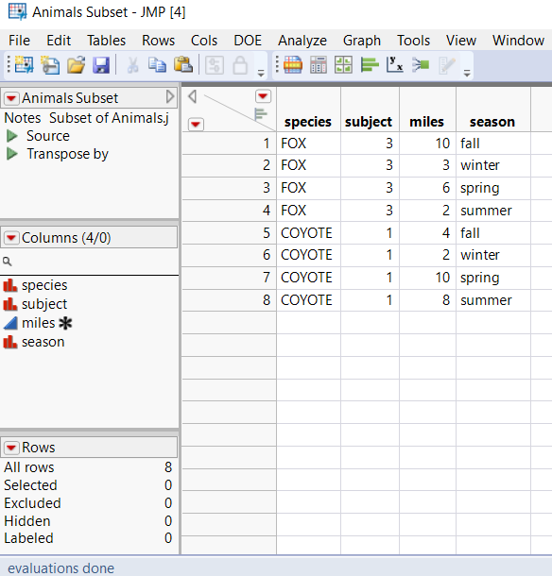
Table Overview
Table properties and info are on the left side panel, include:
# of rows
# of columns
Column names list
Other saved functions
Etc.

Slide 6
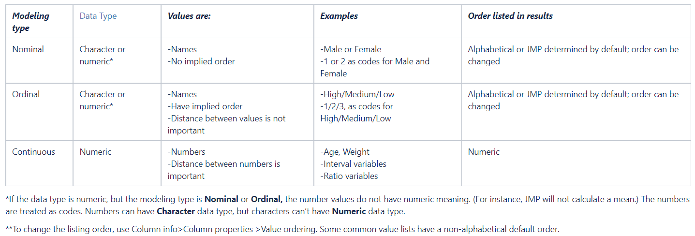
Data/Modeling types

Slide 7
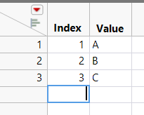
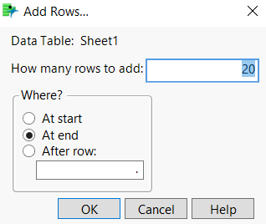
Add new Row
Directly click and type in the empty row below current table
Rows → Add Rows…, then specify the # of rows and their locations

Slide 8
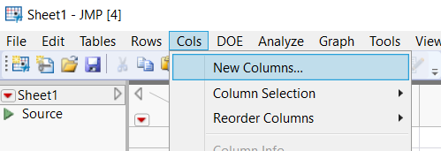
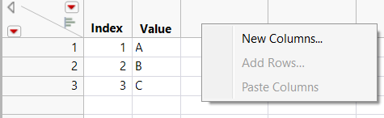
Add new Column
Once data table is open
Cols → New Columns…
Right click on the empty columns in the data table and choose “New Columns”
Or directly, click on the empty column, it will create a new column with default name

Slide 9
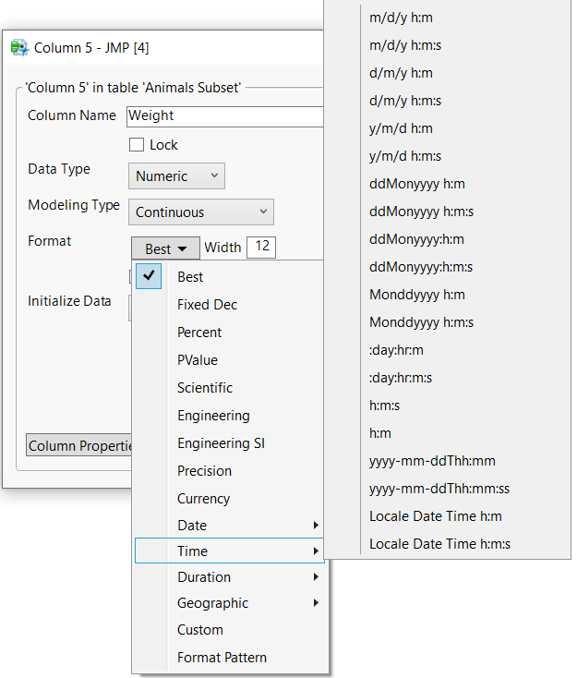
Format new Column
Depending the type of data,
you may need to select the right format

Slide 10
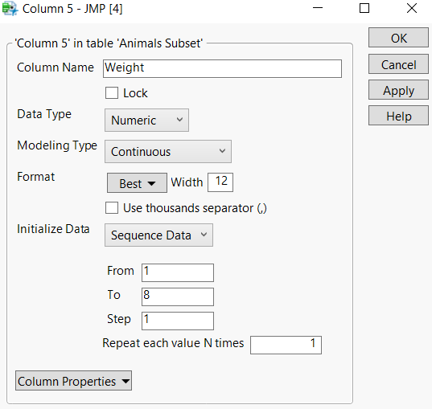
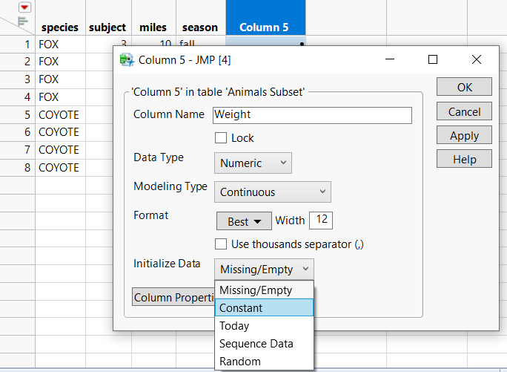
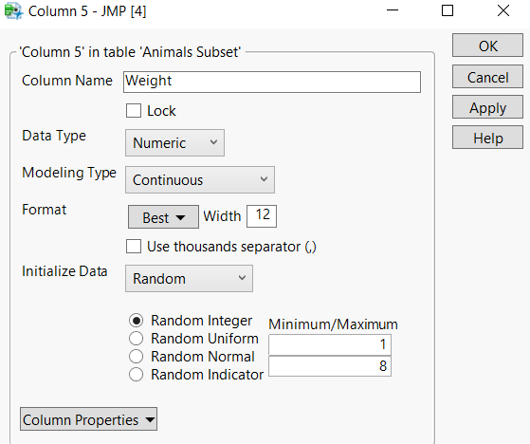
Initialize new Column
Empty
Constant
Today
Sequence Data
Random

Slide 11
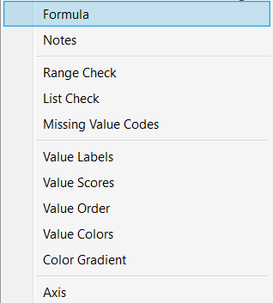
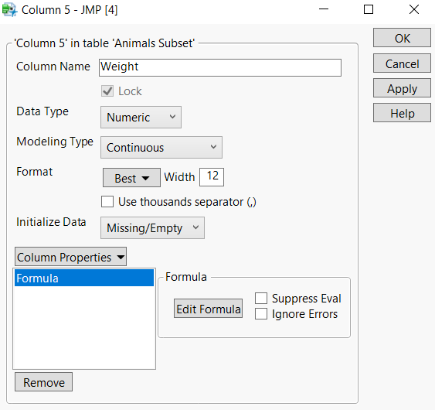
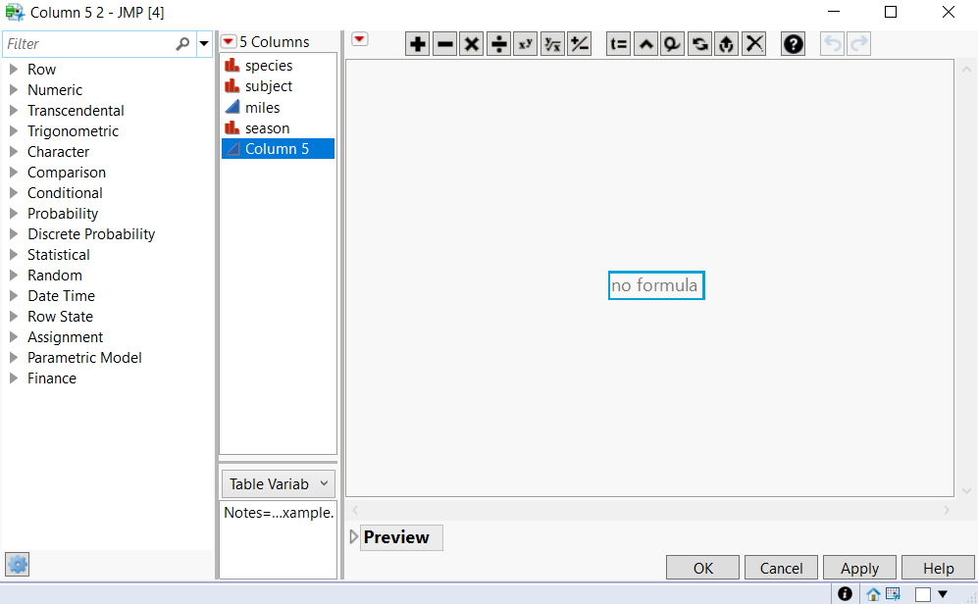
Column with formula
The data of this column is based on some computation
Choose Column Properties → Formula → Edit Formula

Slide 12
Formula
All available formulas are on the left panel
Or you can search by typing in the search bar on top

Slide 13
Common Formula
LEFT, RIGHT, SUBSTR
CONTAINS
NUM
AND, OR, IF, FOR, WHILE, FOR EACH
SUM, MEAN
SHORT DATE: get date only, not time
IN HOURS, IN DAYS, IN MINUTES…
WEEK OF YEAR, TIME OF DAY
IS MISSING, IS EMPTY

Slide 14
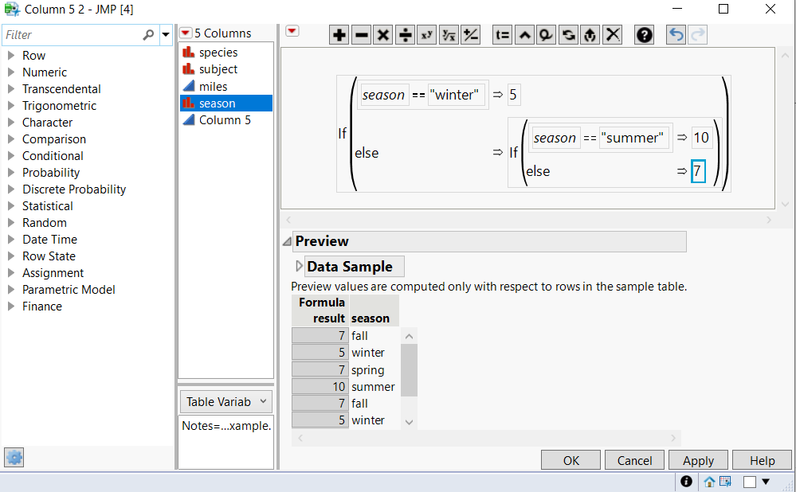
Example
You can preview the result before click OK

Slide 15
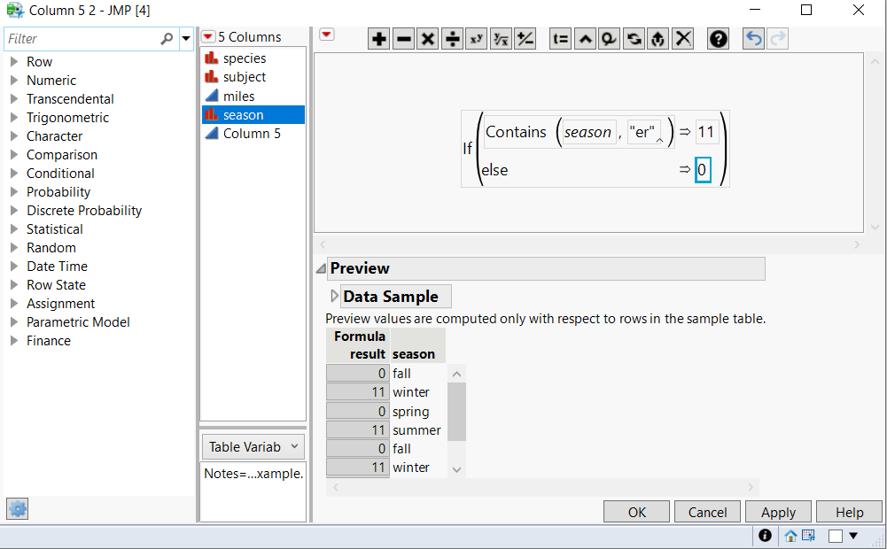
Example

Slide 16
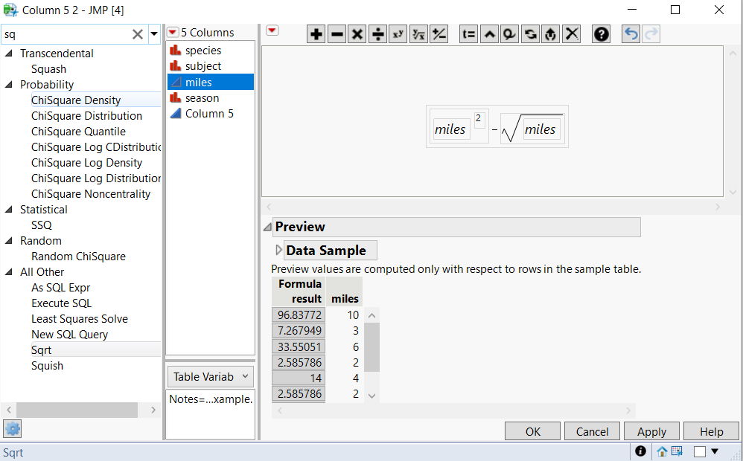
Example

Slide 17
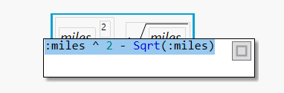
Formula Editing
Double click on this formula

Slide 18
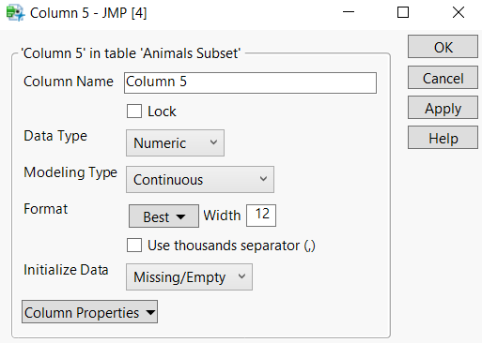
Column Properties
Common properties:
Value Colors: color cells based on their values
Value Order: pre-defined order for each value
Spec Limits
Control Limits
Sigma

Slide 19
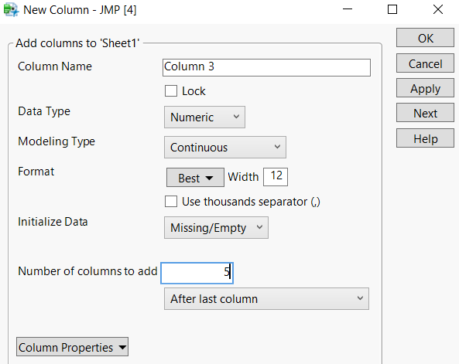
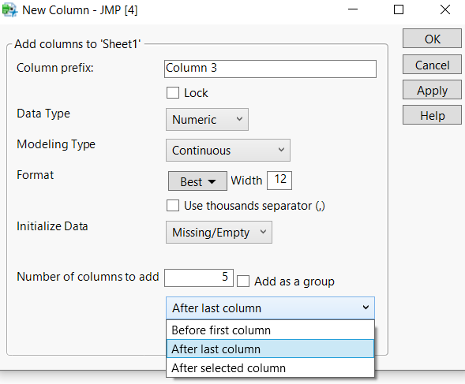
Add Multiple Columns
Cols → New Columns…→ type in the # of columns you want to add
You can choose where new columns will be placed

Slide 20
Functions

Slide 21
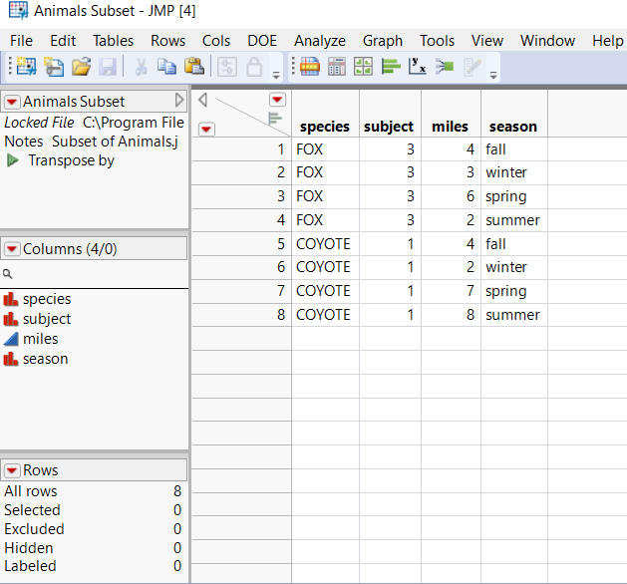
Tables Subset
Subset means taking samples from current table
Sample file name: Animal Subset
This table has:
4 columns
8 rows
3 columns with Nominal Types
column “miles” with Continuous type

Slide 22
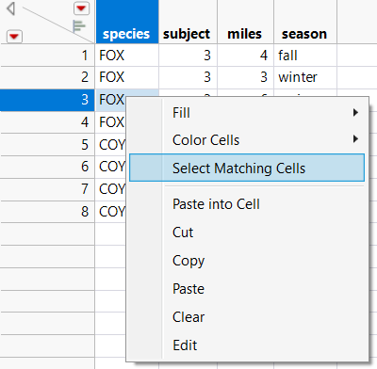
Tables Subset
Task: create a table (from current table) that has “Species” FOX only
Manually, select all 4 rows that has “FOX” value in “Species” column
Click and drag mouse across 4 rows
Or manual click on each row while pressing Ctrl key
Or right click on 1 of “FOX” cells and
choose “Select Matching Cells”

Slide 23
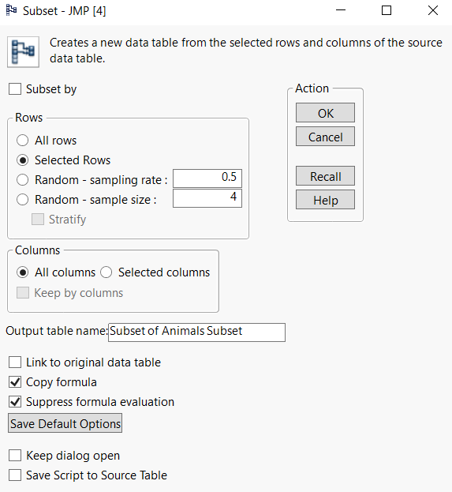
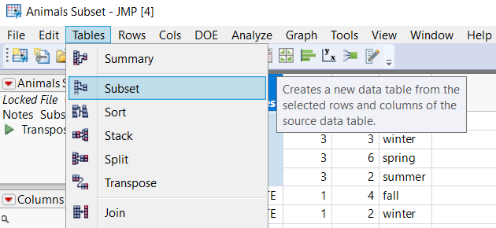
Tables Subset
Task: create a table (from current table) that has “Species” FOX only
Then, Tables → Subset
There are many options to choose and change
Once done, click OK

Slide 24
Table Subset
Exercise:
Create a table that has “season” summer only
Create a duplicate table
Create a duplicate table without column “miles”
Get 30% sample size
Create a table that has “miles” >= 6

Slide 25
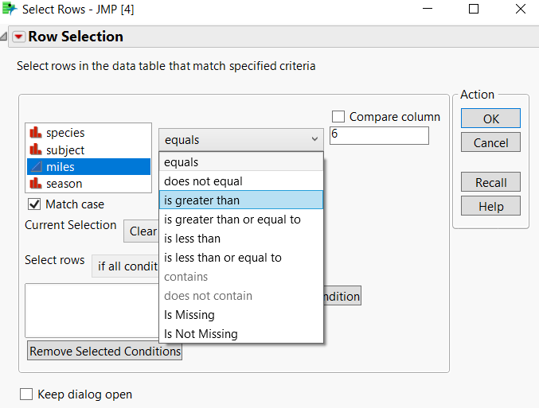
Pro tips
There is a RECALL button in every window
Allow us to quickly use the last setup for the same function

Slide 26
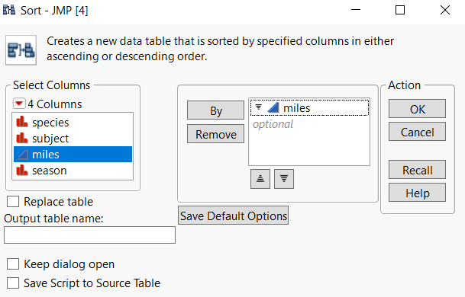
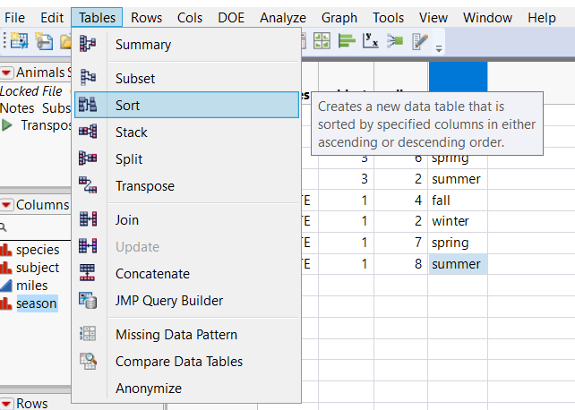
Tables Sort
Tables → Sort
Create a new table, if checked and close original table

Slide 27
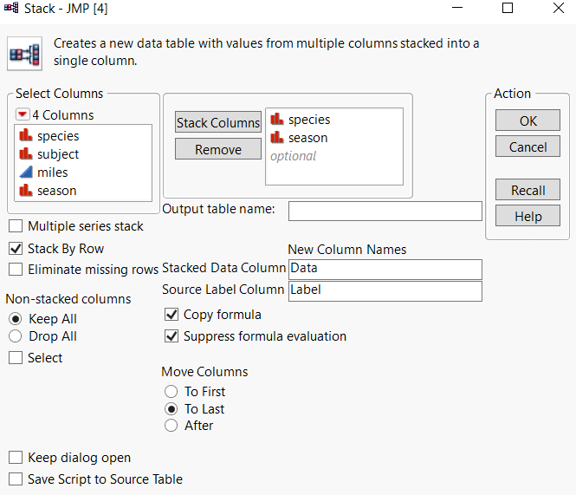
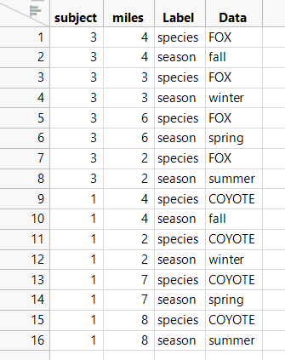
Tables Stack
Stack 2 or more columns into 1 column
Tables → Stack
Self explore ☺

Slide 28
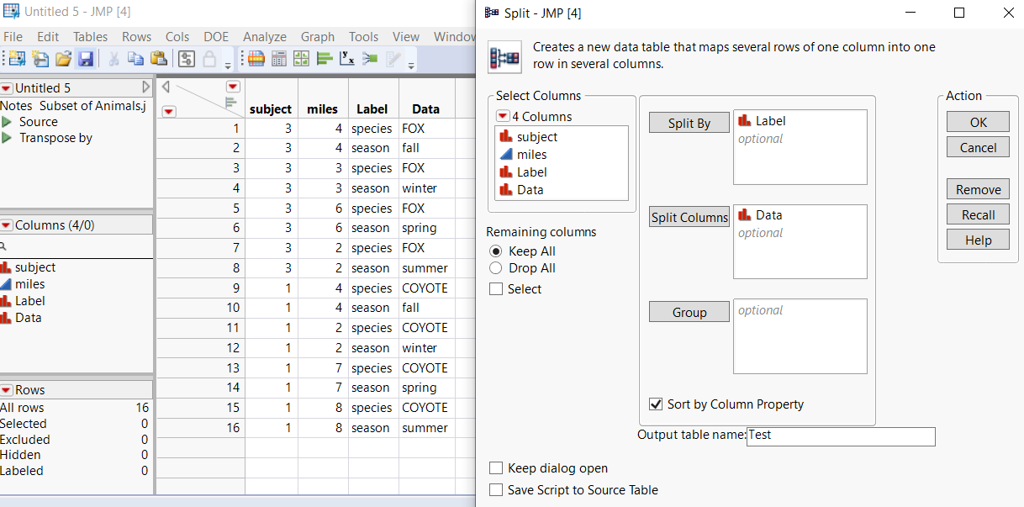
Tables Split
Reverse of table stack, split 1 column into 2 or multiple columns
Tables → Split

Slide 29
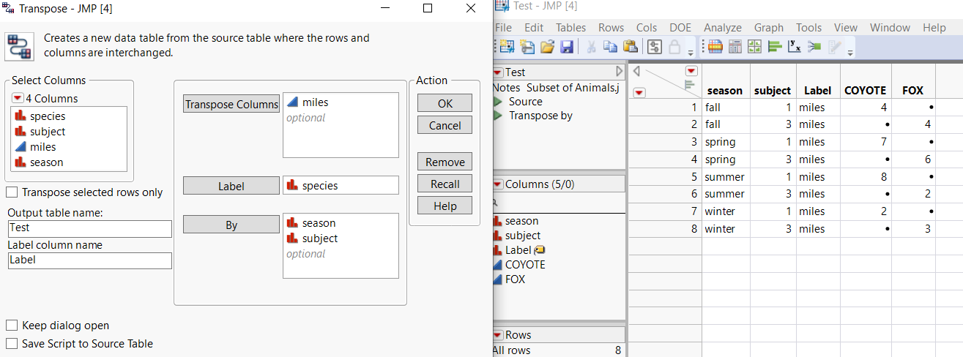
Tables Transpose
Rows become Columns and vice versa
Tables → Transpose

Slide 30
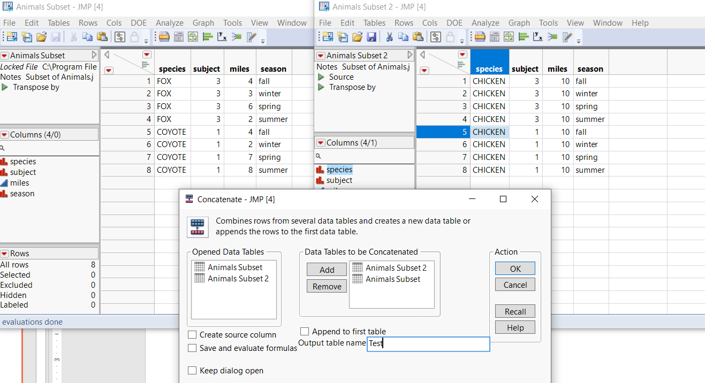
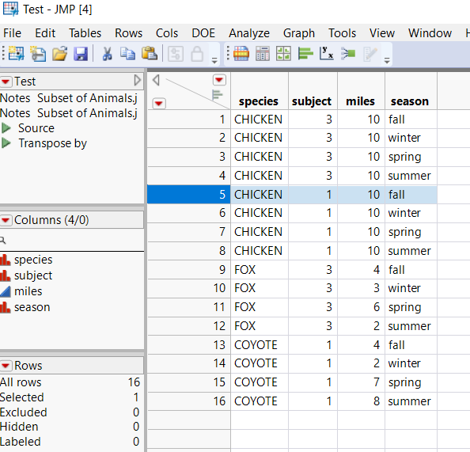
Tables Concatenate
Combines rows from multiple data tables into one
Tables → Concatenate
***First, create table Animal Subset 2 by Subset function***

Slide 31
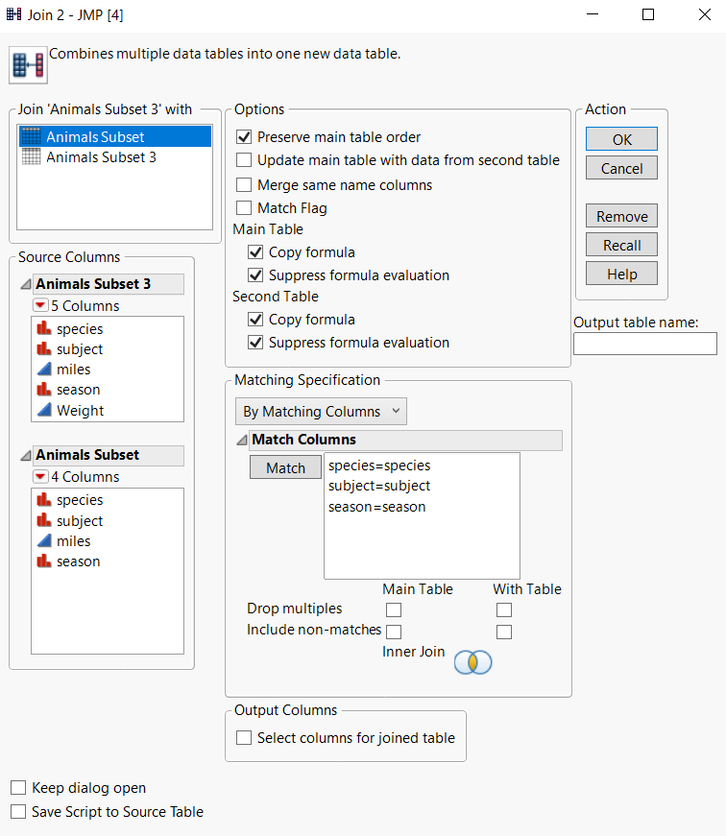
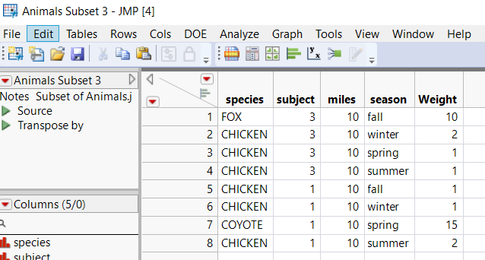
Tables Join
Combine multiple data tables together
Based on some conditions
Tables → Join
Very important!!!

Slide 32
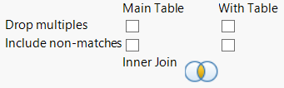
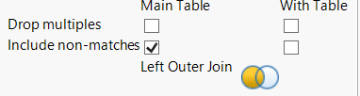
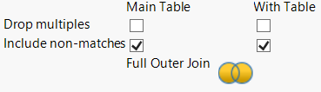
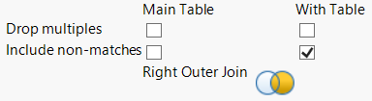
Tables Join
Notice how the result will be different when we check boxes
Read more here: https://towardsdatascience.com/what-is-the-difference-between-an-inner-and-an-outer-join-in-sql-5b5ec8277377

Slide 33
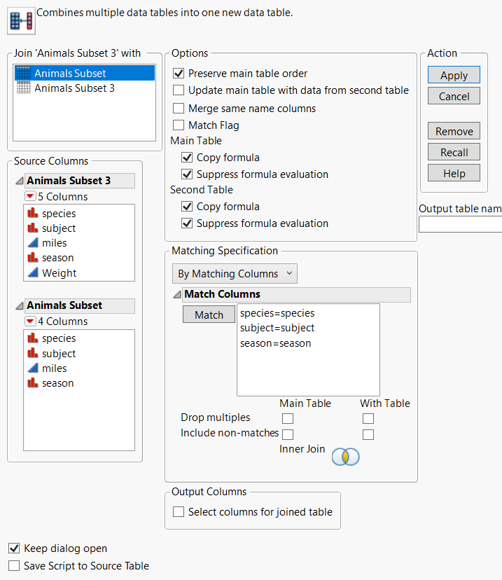
Exercise
Try 4 different join to see the result
Pro tips: to do it faster
Use RECALL button
Use “Keep dialog open”

Slide 34
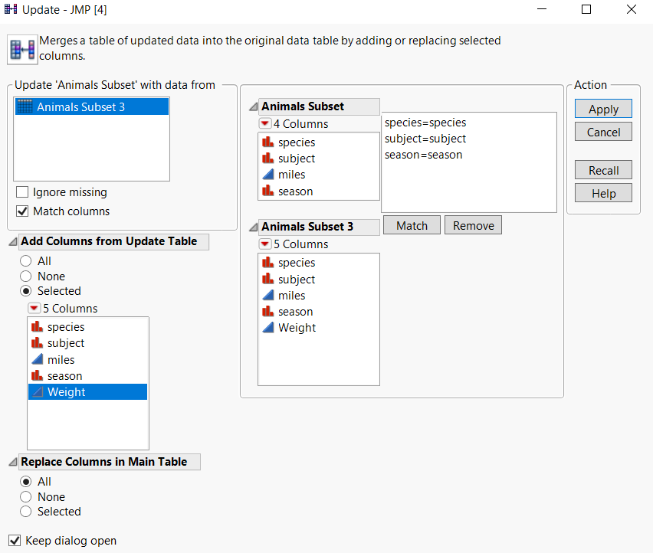
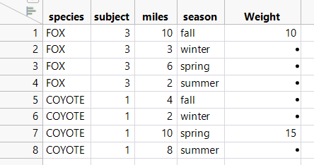
Table Update
Tables → Update
Look similar?

Slide 35
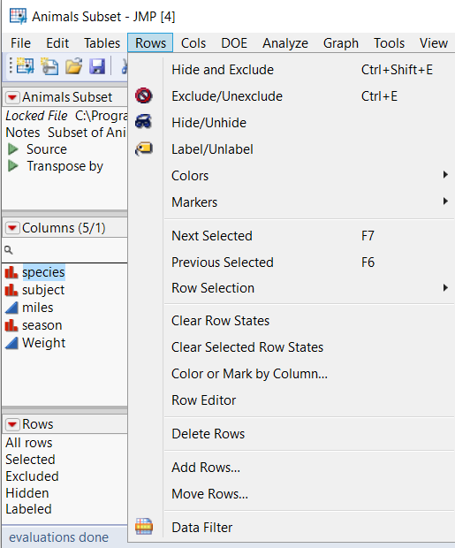
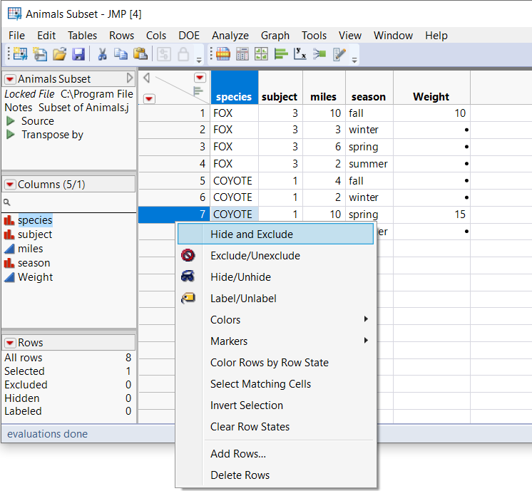
Rows Function
Can be accessed through Menu Rows
Or right click on the left side of any row

Slide 36
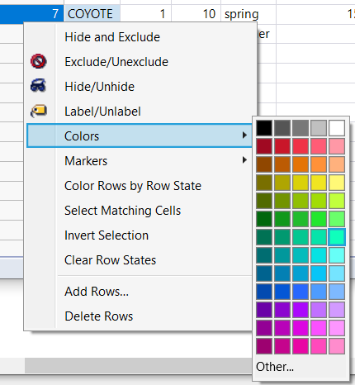

Common row functions
Hide/Unhide = Hide/Display selected rows on chart or graph
Exclude/Unexclude = Exclude/Include selected rows when perform statistical calculation
Hide and Exclude
Colors: choose display color for selected rows on chart or graph
Markers: choose display icons for selected rows on chart or graph
Delete Rows

Slide 37

Common row functions
Invert Row Selection: very useful when combine with “Select Matching Cells” in a large data file
For example, how to select rows that don’t have winter season? Select FAST, not manually

Slide 38


Rows Selection
Flexible or multiple rows selection conditions
Once done, click “Add condition”

Slide 39

Row Selections
Select Duplicate Rows: first, you need to select with column to find duplicates
Select Randomly…
Name Selection in Column… will explain in graph section

Slide 40




Columns Function
Recode: quick way to replace current column with new value OR create a new column based on current column values

Slide 41
Analysis

Slide 42


Tabulate
Analyze → Tabulate
Or you can choose from quick Menu bar

Slide 43


Tabulate
Drag and drop interface
Multiple statistical functions

Slide 44



Local Data Filter
Choose which data to view/summarize

Slide 45


Make into data table
After done with the tabulate, we can convert this to a data table to further work on it → Make into data table

Slide 46


Table Summary
Similar functions with Tabulate but less user-friendly ☺

Slide 47
Graphing

Slide 48

Graph Builder
Commonly used, very versatile
Go to Graph → Graph Builder

Slide 49

Chart types
More options here
Drag and drop columns into this space

Slide 50

Exercise

Slide 51
Exercise

Slide 52
Variability Chart
The variability charts show the relationships between factors and a response

Slide 53

Distribution
Go to Analyze → Distribution
Creates a histogram for current data table

Slide 54

Fit Y by X
The Fit Y by X platform analyzes the pair of X and Y variables that you specify
There are the four types of analyses:
Bivariate fitting
One-way analysis of variance
Logistic regression
Contingency table analysis
Go to Analyze → Fit Y by X

Slide 55

Fit Y by X

Slide 56



Name Selection in Column
When you see something abnormal/outliers in the chart that you’d like to investigate further or mark for further analysis.
You can choose those points, right click and choose Name Selection in Column → and fill in the info/name
This will create a new column with the inputted values

Slide 57


Other graphs
Control charts
Pareto plots
Profiler

Slide 58
Tips

Slide 59


Copying chart/analysis for sharing
Use Selection tool in JMP
Then select the chart or analysis
you’d like to copy
Ctrl + C
Go to Word/Excel/Powerpoint, etc.
Go to Paste → Paste Special → Picture (Enhanced Metafile)
The picture will still be very clear no matter how much you scale it

