Slide 1
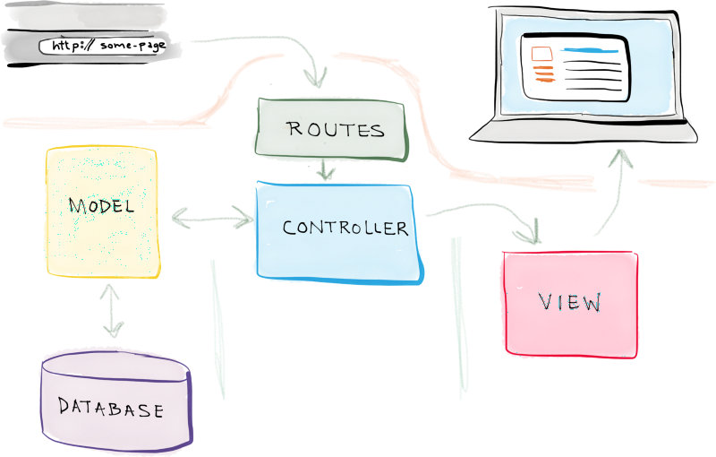
MVC

Slide 2
Why React?
building large applications with data that changes over time.

Slide 3
React
V in MVC
Props
State
JSX
Gulp convert JSX → JS
Browserify
Flux
Firebase & React Router
Hello World
Todo list

Slide 4
Component
A component as a collection of HTML, CSS, JS, and some internal data.
Pure JavaScript or JSX

Slide 5
Fundament Aspects
JSX – Allows us to write HTML like syntax which gets transformed to lightweight JavaScript objects.
Virtual DOM – A JavaScript representation of the actual DOM.
React.createClass – The way in which you create a new component.
render (method) – What we would like our HTML Template to look like.
ReactDOM.render – Renders a React component to a DOM node.

Slide 6
State
state – The internal data store (object) of a component.
getInitialState – The way in which you set the initial state of a component.
setState – A helper method for altering the state of a component.

Slide 7
Props
props – The data which is passed to the child component from the parent component.
propTypes – Allows you to control the presence, or types of certain props passed to the child component.
getDefaultProps – Allows you to set default props for your component.

Slide 8
Component LifeCycle
componentWillMount – Fired before the component will mount
componentDidMount – Fired after the component mounted
componentWillReceiveProps – Fired whenever there is a change to props
componentWillUnmount – Fired before the component will unmount

Slide 9
Events
onClick
onSubmit
onChange

Slide 10
Gulp & Browserify
JSX → JS
Concat + Minimize
CommonJS: chuan trien khai trong NodeJS chia chuong trinh thanh cac module con
Browserify: modular

Slide 11
Webpack
Why does webpack exist?
  “Webpack, at its core, is a code bundler. It takes your code, transforms and bundles it, then return a brand new version of your code.”
What problem is this thing solving?
Three main things:
  Entry point or Root JS file
  Which transform
  Which location

Slide 12
Webpack
webpack.config.js
module.exports
  entry
  module
  output
  plugins
Packages:
  npm install -g webpack
  npm install –save-dev html-webpack-plugin

Slide 13
Babel
Transform
  JSX → JS
  ES2015, 2016, etc → modern day JavaScript
Packages:
  babel-core: itself
  babel-loader: webpack loader
  babel-preset-react: transform JSX → JS
  npm install --save-dev babel-core babel-loader babel-preset-react
.babelrc file

Slide 14
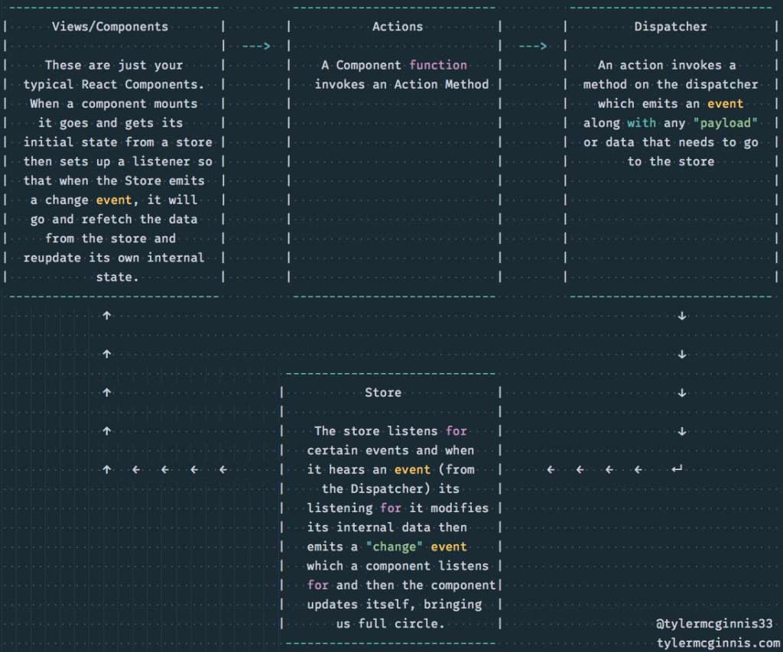
Flux

Slide 15
Flux
pay-load: phần dữ liệu được truyền không bao gồm header or metadata của gói tin.
VD: một tàu trở dầu có thể mang được 20 tấn dầu, nhưng trọng lượng thực sự của đoàn tàu sẽ lớn hơn như vậy = tàu + dầu + những người làm việc trên tàu + … Khách hàng chỉ quan tâm và trả tiền cho số dầu trở được - đây chính là pay-load.
Object.assign(target, source[s]): copy từ đối tượng nguồn tới đối tượng đích.
require('react/lib/Object.assign') có sẵn trong React

Slide 16
Flux
Không nên áp dụng cho các ứng dụng nhỏ.
Chỉ hữu ích khi xây dựng các ứng dụng lớn phức tạp và dữ liệu luôn thay đổi.

Slide 17
Example
Mot chuong trinh cho phep nguoi dung nhap cong viec, sau do cap nhat cong viec moi vao list cac cong viec.
  bind: https://www.sitepoint.com/bind-javascripts-this-keyword-react/
Checkbox hien thi trang thai hien tai.

Slide 18
References
http://tylermcginnis.com/reactjs-tutorial-a-comprehensive-guide-to-building-apps-with-react/

