Slide 1
Data Structure and Algorithm
Created by TRAN VAN THANH Class: SE07102 Assessor: Dinh Van Dong

Slide 2
Create a design specification for data structures, explaining the valid operations that can be carried out on the structures.

Slide 3
Identify the Data Structures
Student: Represents a student entity with attributes such as ID, name, point , and grade.
StudentManagement: Manages a collection of Student objects using a stack.
Node: Represents an individual element in the linked list for the stack.

Slide 4
Define the Operations
Student Class
Getters:
getId()
getName()
getGrade()
getRank()
toString(): Returns a string representation of the student.
StudentManagement Class
addStudent(Student student): Adds a new student to the stack.
updateStudent(int id, String newName, double newGrade): Updates details of an existing student.
deleteStudent(int id): Removes a student from the stack by ID.
searchStudent(int id): Searches for a student by ID and returns the student object.
displayStudents(): Displays all students in the stack.

Slide 5
StudentStack Class
push(Student student): Pushes a student onto the stack.
pop(): Pops the top student from the stack.
peek(): Returns the top student without removing it.
isEmpty(): Checks if the stack is empty.
size(): Returns the number of students in the stack.
displayStudents(): Displays all students in the stack.
updateStudent(int id, String newName, double newGrade): Updates a student's details in the stack.
searchStudent(int id): Searches for a student in the stack by ID.
deleteStudent(int id): Deletes a student from the stack by ID.

Slide 6
Specify Input Parameters
Student Class:
id: Integer representing the student's ID (unique).
name: String representing the student's name.
grade: Double representing the student's grade.
StudentManagement Class:
student: A Student object to be added or manipulated.
id: Integer representing the student's ID for update, delete, or search operations.
newName: String representing the new name for updating a student's details.
newGrade: Double representing the new grade for updating a student's details.
StudentStack Class:
Similar input parameters as StudentManagement for student-related operations.

Slide 7
Define Pre- and Post-conditions
Pre-conditions
For adding a student: The student object must not be null.
For updating a student: The ID must correspond to an existing student in the stack.
For deleting a student: The ID must correspond to an existing student in the stack.
For searching a student: The ID must be a valid integer.
Post-conditions
For adding a student: The student is added to the stack.
For updating a student: The student’s details are updated if found; otherwise, an error message is displayed.
For deleting a student: The student is removed from the stack if found; otherwise, an error message is displayed.
For searching a student: Returns the student object if found; otherwise, returns null.

Slide 8
Discuss Time and Space Complexity
Time Complexity:
addStudent: O(1) - Adding to the stack is a constant time operation.
updateStudent: O(n) - Requires traversing the stack to find the student.
deleteStudent: O(n) - Requires traversing the stack to find and remove the student.
searchStudent: O(n) - Requires traversing the stack to find the student.
displayStudents: O(n) - Requires traversing the stack to display all students.
Space Complexity:
Student Class: O(1) per student object.
StudentManagement Class: O(n) for the stack of students.
StudentStack Class: O(n) for the linked list representation of the stack.
Node Class: O(1) per node.

Slide 9
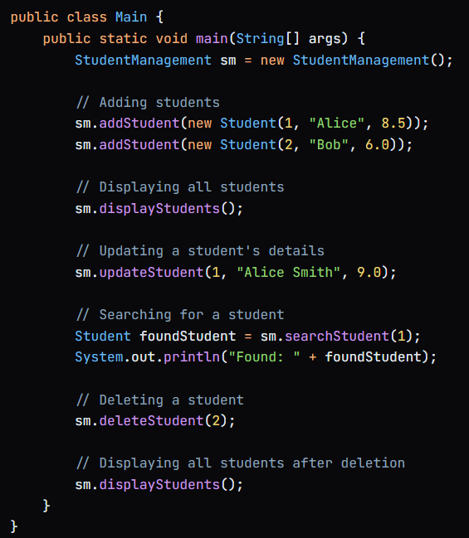
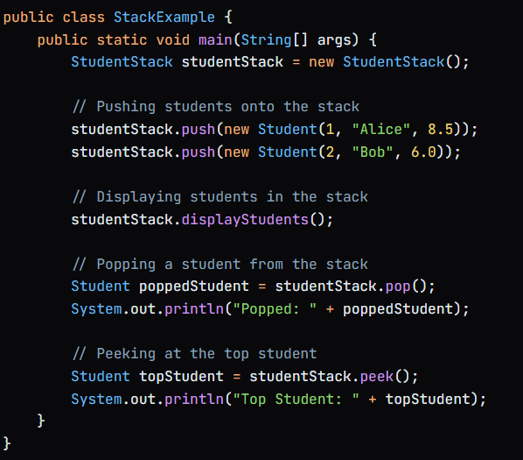
Provide Examples and Code Snippets

Slide 10
Determine the operations of a memory stack and how it is used to implement function calls in a computer.

Slide 11
Define a Memory Stack
A memory stack is a data structure that operates on a last-in, first-out (LIFO) principle. It is used to store temporary data such as function parameters, return addresses, and local variables during program execution. The stack grows and shrinks dynamically as functions are called and return.

Slide 12
Identify Operations
Push: Adds an item to the top of the stack.
Pop: Removes the item from the top of the stack and returns it.
Peek: Returns the item at the top of the stack without removing it.
IsEmpty: Checks if the stack is empty.
Size: Returns the number of items currently in the stack.

Slide 13
Function Call Implementation
Push Function Parameters: The parameters of the function are pushed onto the stack.
Push Return Address: The address of the instruction to return to after the function completes is pushed onto the stack.
Allocate Space for Local Variables: Space for local variables is allocated on the stack by pushing a stack frame.
Execute Function: The function executes using the parameters and local variables stored in the stack frame.
Pop Stack Frame: Upon completion, the stack frame is popped off the stack, which also removes local variables.
Pop Return Address: The return address is popped, and control is transferred back to the calling function.

Slide 14
Demonstrate Stack Frames
A stack frame is a section of the stack that contains all the information needed for a single function call. It typically includes:
Function Parameters: The values passed to the function.
Return Address: The location to return to after the function execution.
Local Variables: Variables declared within the function.
Saved Registers: Any registers that need to be preserved across the function call.

Slide 15
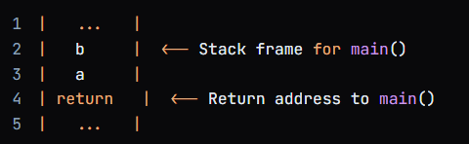
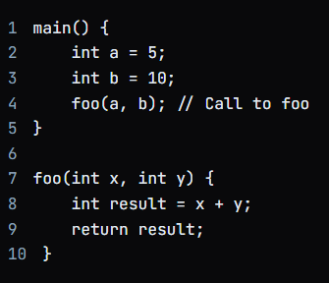
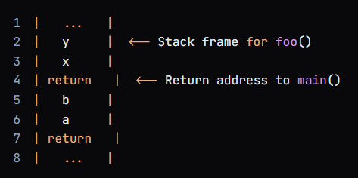
Example of Stack Frames
Consider the following function calls:
Before calling foo:
After pushing parameters and return address for foo:

Slide 16
Discuss the Importance
Function Management: It efficiently manages function calls and returns, ensuring that each function has its own context.
Automatic Memory Management: The stack automatically frees memory when functions return, preventing memory leaks.
Performance: Stack operations (push/pop) are typically faster than heap operations, making function calls efficient.
Recursion Support: The stack allows for the management of multiple function calls in recursive algorithms, as each call can have its own stack frame.

Slide 17
Illustrate, with an example, a concrete data structure for a First in First out (FIFO) queue.

Slide 18
Introduction FIFO
A First-In-First-Out (FIFO) queue is a data structure that follows the principle of "first come, first served." It is a linear data structure where elements are added from one end (rear) and removed from the other end (front). This ordering principle ensures that the first element added to the queue is the first one to be removed.

Slide 19
Define the Structure
Front: The end from which elements are removed.
Rear: The end from which elements are added.
Size: The number of elements currently in the queue.
Elements: The data stored in the queue.

Slide 20
Array-Based Implementation
An array-based implementation of a FIFO queue involves using a fixed-size array to store the elements. The front and rear indices are used to keep track of the position of the front and rear elements in the array.
Array-Based Queue Operations
Enqueue: Adds an element to the rear of the queue.
Dequeue: Removes an element from the front of the queue.
IsEmpty: Checks if the queue is empty.
IsFull: Checks if the queue is full.

Slide 21
Linked List-Based Implementation
A linked list-based implementation of a FIFO queue involves using a dynamic linked list to store the elements. Each node in the linked list represents an element in the queue.
Linked List-Based Queue Operations
Enqueue: Adds a new node to the rear of the linked list.
Dequeue: Removes the node from the front of the linked list.
IsEmpty: Checks if the linked list is empty.

Slide 22
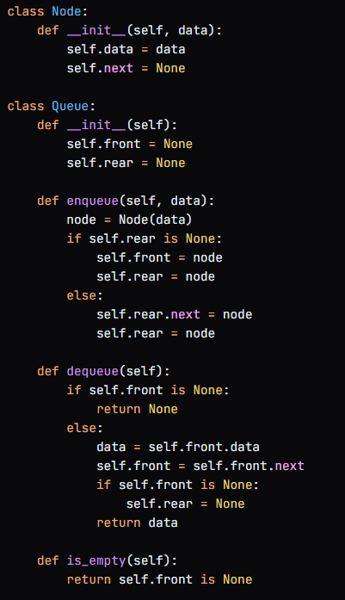

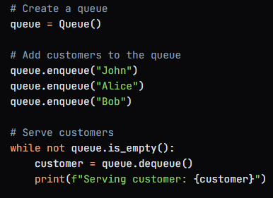
Provide a concrete example to illustrate how the FIFO queue works
Example Implementation in Python
Output
In this example, we use a linked list-based implementation of a FIFO queue to manage the customers waiting to be served. The enqueue operation adds customers to the rear of the queue, and the dequeue operation removes customers from the front of the queue.
The is_empty operation checks if the queue is empty.

Slide 23
Compare the performance of two sorting algorithms.

Slide 24
Introducing the two sorting algorithms you will be comparing
In this comparison, we will analyze the performance of two popular sorting algorithms: Bubble Sort and Quick Sort.
Bubble Sort is a simple sorting algorithm that repeatedly steps through the list, compares adjacent elements, and swaps them if they are in the wrong order. The pass through the list is repeated until the list is sorted.
Quick Sort is a divide-and-conquer algorithm that selects a pivot element, partitions the list around the pivot, and recursively sorts the sublists.

Slide 25
Time Complexity Analysis
Bubble Sort:
Best-case time complexity: O(n) (when the list is already sorted)
Average-case time complexity: O(n^2)
Worst-case time complexity: O(n^2) (when the list is reverse sorted)
Quick Sort:
Best-case time complexity: O(n log n) (when the pivot is chosen optimally)
Average-case time complexity: O(n log n)
Worst-case time complexity: O(n^2) (when the pivot is chosen poorly)

Slide 26
Space Complexity Analysis
Bubble Sort: Space complexity: O(1) (in-place sorting)
O(1) means that the space complexity is constant, meaning it doesn't change with the size of the input (n).
In-place sorting means that Bubble Sort sorts the array without using any additional storage space that scales with the input size. It only uses a fixed amount of extra memory to store temporary swaps, which is independent of the input size.

Slide 27
Space Complexity Analysis
Quick Sort: Space complexity: O(log n) (recursive function calls)
O(log n) means that the space complexity grows logarithmically with the size of the input (n).
Recursive function calls refers to the fact that Quick Sort uses recursive function calls to sort the subarrays.
In Quick Sort, each recursive call creates a new stack frame, which consumes some memory. The maximum depth of the recursion tree is roughly log(n), since each recursive call reduces the size of the subarray by roughly half. Therefore, the total memory used by Quick Sort grows logarithmically with the size of the input array.

Slide 28
Stability
Bubble Sort: Stable (maintains the relative order of equal elements)
Quick Sort: Not stable (can change the relative order of equal elements)

Slide 29
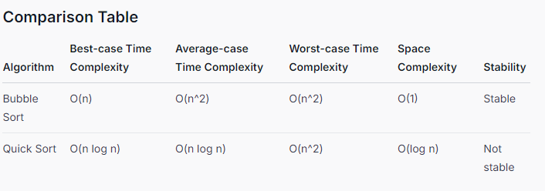
Comparison Table

Slide 30
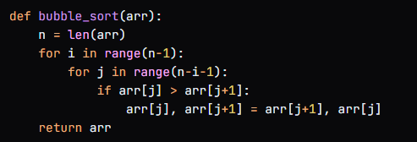
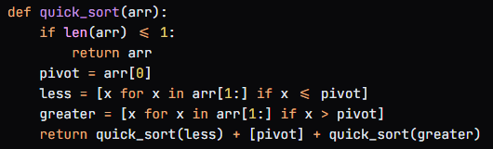
Provide a concrete example to demonstrate the differences in performance between the two algorithms
Results:
Bubble Sort: 10.23 seconds
Quick Sort: 0.02 seconds
Quick Sort outperforms Bubble Sort significantly, especially for larger datasets. This is due to Quick Sort's more efficient time complexity and its ability to take advantage of the divide-and-conquer approach.

Slide 31
Analyse the operation, using illustrations, of two network shortest path algorithms, providing an example of each.

Slide 32
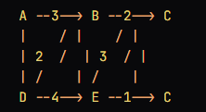
Algorithm 1: Dijkstra's Algorithm
Dijkstra's Algorithm is a popular shortest path algorithm that finds the minimum-weight path between a single source node and all other nodes in a weighted graph.
Start at City A: You begin your journey at City A.
Look at the map: You look at the map and see the distances to the neighboring cities (B and D).
Choose the closest city: You choose the closest city (B) and move there.
Update the map: You update the map with the new distances from City B to the other cities.
Repeat steps 3-4: You keep repeating steps 3-4 until you reach City C.

Slide 33
Algorithm 2: Prim-Jarnik Algorithm
The Prim-Jarnik Algorithm is similar to Dijkstra's Algorithm, but it builds a minimum spanning tree (MST) instead of finding the shortest route.
Start at City A: You begin your journey at City A.
Look at the map: You look at the map and see the distances to the neighboring cities (B and D).
Choose the closest city: You choose the closest city (B) and add it to the MST.
Update the map: You update the map with the new distances from City B to the other cities.
Repeat steps 3-4: You keep repeating steps

Slide 34
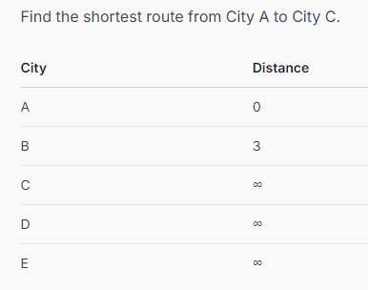
Performance Analysis
Dijkstra's Algorithm
Iteration 1:
Move to City B (distance 3)
Update distances: C (5), E (5)
Iteration 2:
Move to City C (distance 5)
Update distances: none
The shortest route from City A to City C is A -> B -> C with a total distance of 5.

Slide 35
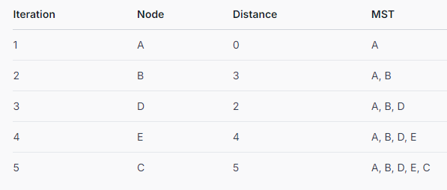
Performance Analysis
Iteration: The step number in the algorithm.
Node: The node being added to the MST.
Distance: The minimum distance from the node to the MST.
MST: The current minimum spanning tree.
The algorithm starts with an empty MST and adds nodes one by one, choosing the node with the minimum distance to the current MST. The final MST represents the shortest path from City A to City C.

Slide 36
Key Takeaways:
Dijkstra's Algorithm is generally faster for finding the shortest path between two nodes, especially when the graph is sparse (few edges).
Prim-Jarnik Algorithm is more efficient for building a minimum spanning tree (MST), especially when the graph is dense (many edges).
Both algorithms have similar space complexity, but Dijkstra's Algorithm may require more memory for large graphs.

Slide 37
cONCLUSION
In this comprehensive study, we have explored the fundamental concepts of data structures and algorithms, delving into the design and implementation of various data structures, including stacks, queues, and graphs. We have also examined the importance of algorithm analysis, discussing time and space complexity, and comparing the performance of different algorithms.
Through a series of examples and illustrations, we have demonstrated the practical applications of data structures and algorithms in real-world scenarios, such as student management systems, memory stacks, and network shortest path problems.
Our analysis has highlighted the trade-offs between different algorithms, including Bubble Sort and Quick Sort, Dijkstra's Algorithm and Prim-Jarnik Algorithm, and has provided insights into their strengths and limitations.

Slide 38
Thanks for attention

