Slide 1
Data Structure and Algorithm
Created by TRAN VAN THANH Class: SE07102 Assessor: Dinh Van Dong

Slide 2
I. A stack ADT, a concrete data structure for a First In First out (FIFO) queue.

Slide 3
Stack ADT for a FIFO Queue
A stack is inherently a Last In First Out (LIFO) data structure, while a queue operates on a First In First Out (FIFO) principle. However, you can simulate a FIFO queue using two stacks. Here’s how you can implement a FIFO queue using stack ADTs.

Slide 4
Overview
To implement a queue using two stacks, we can use:Stack A: Used for enqueue operations (adding elements).
Stack B: Used for dequeue operations (removing elements).
Operations
Enqueue (Adding an element):
Push the element onto Stack A.
Dequeue (Removing an element):
If Stack B is empty, pop all elements from Stack A and push them onto Stack B (this reverses the order, simulating FIFO).

Slide 5
There are mainly three steps in the algorithm:
Choose a Pivot: Select an element from the array as the pivot. The choice of pivot can vary
Partition the Array: Rearrange the array around the pivot. After partitioning, all elements smaller than the pivot will be on its left, and all elements greater than the pivot will be on its right.
Recursively Call: Recursively apply the same process to the two partitioned sub-arrays (left and right of the pivot).

Slide 6
B. a concrete data structure for a First In First out (FIFO) queue
A queue is a linear data structure that follows the First In First Out (FIFO) principle, meaning that the first element added to the queue will be the first one to be removed.
Key Operations:
Enqueue: Add an element to the rear of the queue.
Dequeue: Remove an element from the front of the queue.
Peek: View the front element without removing it.
isEmpty: Check if the queue is empty.
size: Get the number of elements in the queue.

Slide 7
2. Linked List-Based Implementation
In a linked list-based implementation, we use nodes to store the elements of the queue. Each node contains the data and a reference to the next node. This implementation allows for dynamic sizing.Key Operations:Enqueue: Add an element to the end of the list.
Dequeue: Remove an element from the front of the list.
Peek: View the front element without removing it.
isEmpty: Check if the queue is empty.
size: Get the number of elements in the queue.

Slide 8
II. Two sorting algorithms.
Sorting algorithms are essential for organizing data in a specific order, typically ascending or descending. Here, we will discuss two popular sorting algorithms: Merge Sort and Quick Sort.

Slide 9
1. Merge Sort
Overview: Merge Sort is a Divide and Conquer algorithm that recursively divides an array into single-element subarrays and then merges them in sorted order.
Steps:
Divide: Split the array into two halves.
Conquer: Recursively sort both halves.
Combine: Merge the two sorted halves.

Slide 10
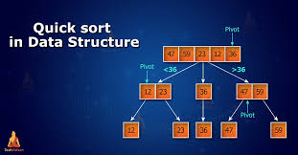
2. Quick Sort

Slide 11
Quick Sort is an efficient sorting algorithm that uses the Divide and Conquer approach. It selects a 'pivot' element and partitions the array into subarrays based on whether elements are less than or greater than the pivot.
Steps:
Choose a Pivot: Select an element as the pivot.
Partition: Rearrange the array so that elements less than the pivot are on the left, and those greater are on the right.
Recursively Sort: Apply the same process to the left and right subarrays

Slide 12
III. Two network shortest path algorithms.

Slide 13
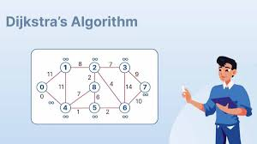
1. Dijkstra's Algorithm

Slide 14
Dijkstra’s algorithm is a popular algorithm for solving many single-source shortest path problems having non-negative edge weight in the graphs i.e.,
For each neighboring node, calculate the tentative distance through the current node and update it if it's smaller than the previously recorded distance.
Repeat until all nodes have been processed.

Slide 15
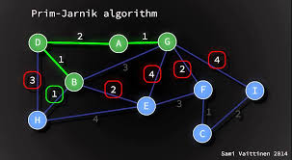
2. Prim-Jarnik Algorithm
The Prim-Jarnik algorithm (or Prim's algorithm) is a greedy algorithm used to find the Minimum Spanning Tree (MST) of a weighted undirected graph,.
How It Works
Initialization: Start from an arbitrary vertex and mark it as part of the MST.

Slide 16
Edge Selection: Repeatedly choose the smallest edge that connects a vertex in the MST to a vertex outside of it.
Repeat: Continue until all vertices are included.
Applications: Commonly used in network design and optimization problems requiring a minimum spanning tree.

Slide 17
ConClusion
In summary, understanding data structures like stacks and queues, along with sorting algorithms such as Quick Sort and Merge Sort, is fundamental in computer science. Additionally, algorithms for finding the shortest paths, like Dijkstra's and Bellman-Ford, are crucial for efficient network routing and optimization. Mastering these concepts equips developers and computer scientists with the tools necessary to solve complex problems effectively.

Slide 18


