Slide 1
Data Structure and Algorithm
Created by TRAN VAN THANH Class: SE07102 Assessor: Dinh Van Dong

Slide 2
I. A stack ADT, a concrete data structure for a First In First out (FIFO) queue.

Slide 3
Stack ADT for a FIFO Queue
A stack is inherently a Last In First Out (LIFO) data structure, while a queue operates on a First In First Out (FIFO) principle. However, you can simulate a FIFO queue using two stacks. Here’s how you can implement a FIFO queue using stack ADTs.

Slide 4
Overview
To implement a queue using two stacks, we can use:Stack A: Used for enqueue operations (adding elements).
Stack B: Used for dequeue operations (removing elements).
Operations
Enqueue (Adding an element):
Push the element onto Stack A.
Dequeue (Removing an element):
If Stack B is empty, pop all elements from Stack A and push them onto Stack B (this reverses the order, simulating FIFO).
Pop the top element from Stack B

Slide 5
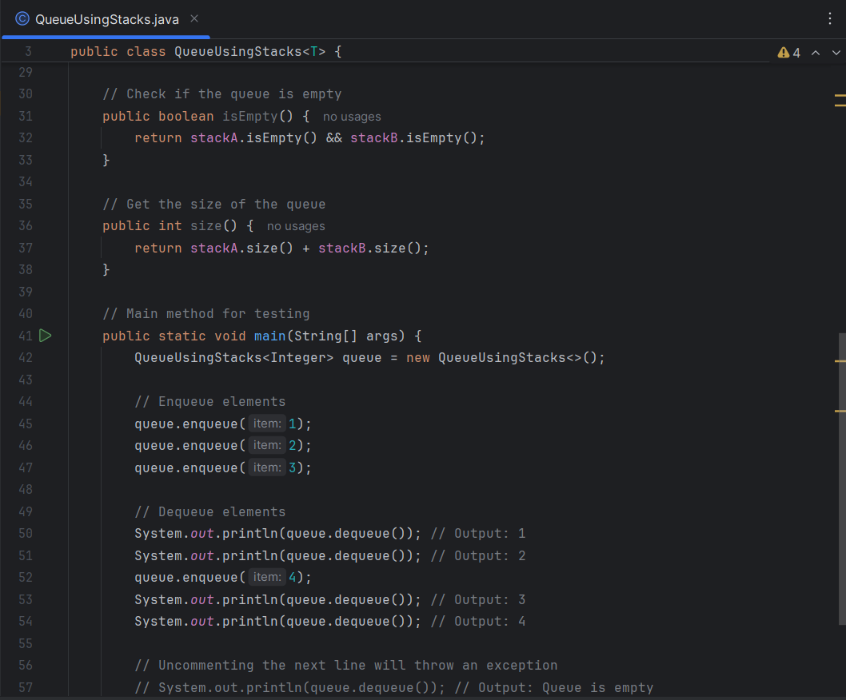
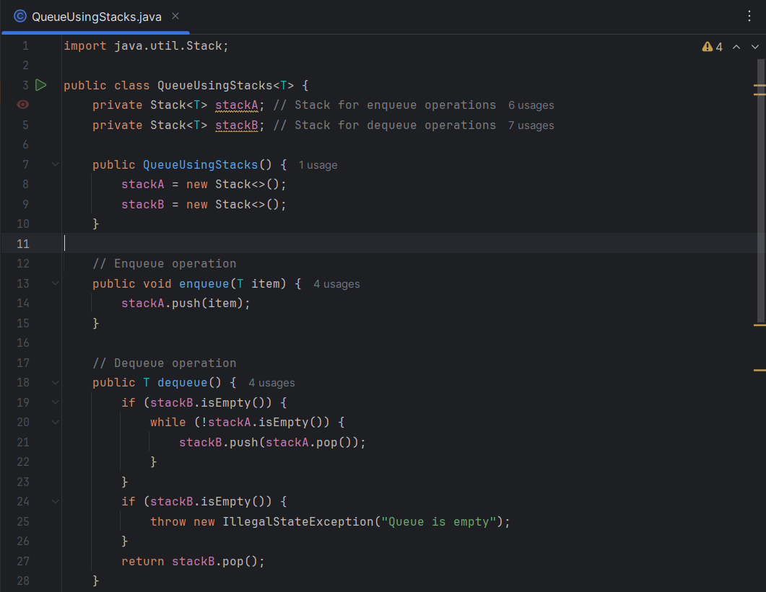

Slide 6
B. a concrete data structure for a First In First out (FIFO) queue
A queue is a linear data structure that follows the First In First Out (FIFO) principle, meaning that the first element added to the queue will be the first one to be removed. 1. Array-Based Implementation
In an array-based implementation, we use a fixed-size array to store the elements of the queue. We maintain two pointers: one for the front of the queue and one for the rear.
Key Operations:
Enqueue: Add an element to the rear of the queue.
Dequeue: Remove an element from the front of the queue.
Peek: View the front element without removing it.
isEmpty: Check if the queue is empty.
size: Get the number of elements in the queue.

Slide 7
2. Linked List-Based Implementation
In a linked list-based implementation, we use nodes to store the elements of the queue. Each node contains the data and a reference to the next node. This implementation allows for dynamic sizing.Key Operations:Enqueue: Add an element to the end of the list.
Dequeue: Remove an element from the front of the list.
Peek: View the front element without removing it.
isEmpty: Check if the queue is empty.
size: Get the number of elements in the queue.

Slide 8
II. Two sorting algorithms.
Sorting algorithms are essential for organizing data in a specific order, typically ascending or descending. Here, we will discuss two popular sorting algorithms: Merge Sort and Quick Sort.

Slide 9
1. Merge Sort
Overview: Merge Sort is a Divide and Conquer algorithm that recursively divides an array into single-element subarrays and then merges them in sorted order.
Steps:
Divide: Split the array into two halves.
Conquer: Recursively sort both halves.
Combine: Merge the two sorted halves.
Time Complexity:
Best Case: O(n log n)
Average Case: O(n log n)
Worst Case: O(n log n)

Slide 10
2. Quick Sort
Overview: Quick Sort is an efficient sorting algorithm that uses the Divide and Conquer approach. It selects a 'pivot' element and partitions the array into subarrays based on whether elements are less than or greater than the pivot.
Steps:
Choose a Pivot: Select an element as the pivot.
Partition: Rearrange the array so that elements less than the pivot are on the left, and those greater are on the right.
Recursively Sort: Apply the same process to the left and right subarrays.
Time Complexity:
Best Case: O(n log n)
Average Case: O(n log n)
Worst Case: O(n²) (occurs when the smallest or largest element is always chosen as the pivot)

Slide 11
III. Two network shortest path algorithms.

Slide 12
1. Dijkstra's Algorithm
Dijkstra's algorithm is widely used for finding the shortest paths from a single source node to all other nodes in a weighted graph. It operates under the assumption that all edge weights are non-negative. The algorithm works by maintaining a priority queue of nodes, where the node with the smallest tentative distance is processed first. Use a priority queue to repeatedly extract the node with the smallest distance.
For each neighboring node, calculate the tentative distance through the current node and update it if it's smaller than the previously recorded distance.
Repeat until all nodes have been processed.
Dijkstra's algorithm is efficient for sparse graphs and has a time complexity of O((V+E)log⁡V)O((V+E)logV), where VV is the number of vertices and EE is the number of edges

Slide 13
2. Prim-Jarnik Algorithm
The Prim-Jarnik algorithm (or Prim's algorithm) is a greedy algorithm used to find the Minimum Spanning Tree (MST) of a weighted undirected graph, minimizing the total edge weight while connecting all vertices.How It Works
Initialization: Start from an arbitrary vertex and mark it as part of the MST.
Edge Selection: Repeatedly choose the smallest edge that connects a vertex in the MST to a vertex outside of it.
Repeat: Continue until all vertices are included.
Characteristics
Time Complexity:
Using a priority queue: O(Elog⁡V)O(ElogV)
Using an adjacency matrix: O(V2)O(V2)
Applications: Commonly used in network design and optimization problems requiring a minimum spanning tree.

Slide 14
ConClusion
In summary, understanding data structures like stacks and queues, along with sorting algorithms such as Quick Sort and Merge Sort, is fundamental in computer science. Additionally, algorithms for finding the shortest paths, like Dijkstra's and Bellman-Ford, are crucial for efficient network routing and optimization. Mastering these concepts equips developers and computer scientists with the tools necessary to solve complex problems effectively.

Slide 15


