Slide 1
EAS508 Project 2
Minimizing Test Misclassification Rate
Nicholas Cruz, Sean Grzenda, Priya Patil

Slide 2
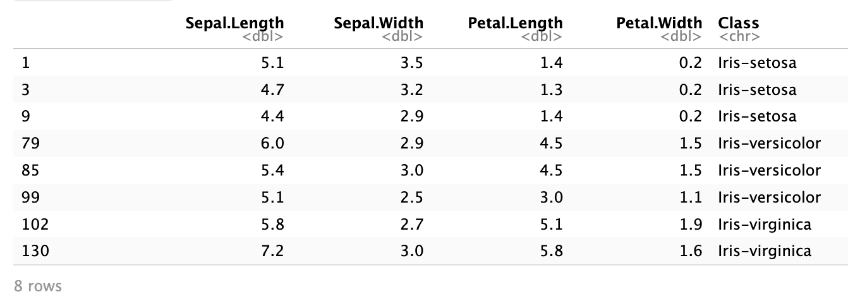
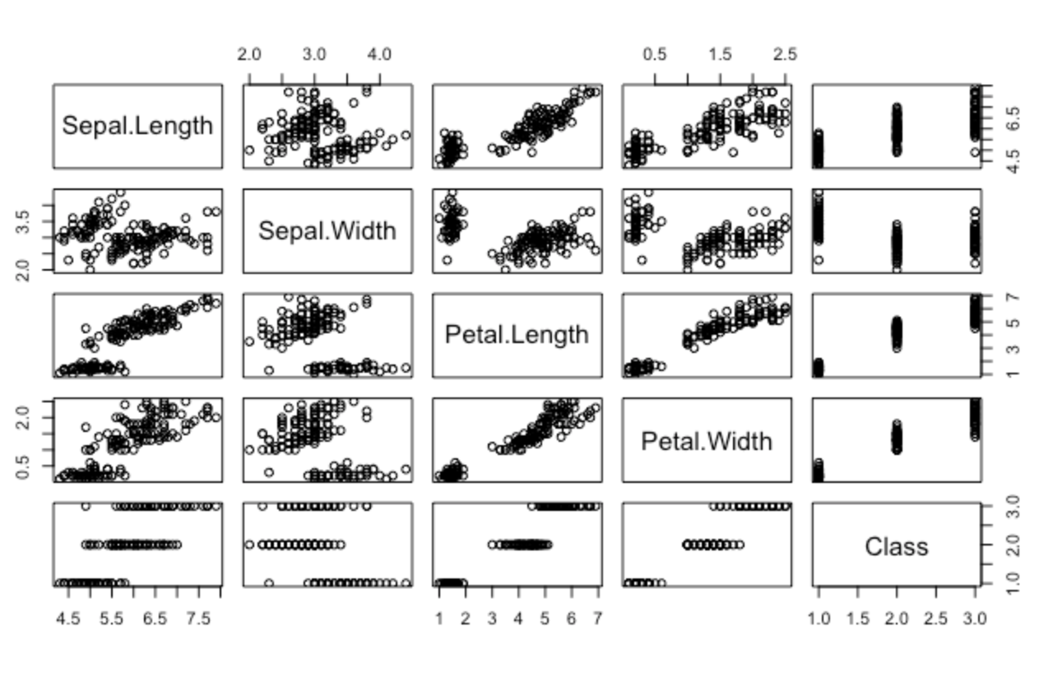
Iris Dataset
The Iris Dataset contains various measurements of setosa, versicolor, and virginica flowers.
Quantitative Predictors: Sepal.Length, Sepal.Width, Petal.Length, Petal.Width
Qualitative Response: Class

Slide 3
Objective and Approach
Build predictive model that minimizes test misclassification rate
Use 4 models: LDA, QDA, KNN, and Random Forest
Assess performance using 10-fold cross validation
5

Slide 4
Cross Validation
split dataset into 10 subdivisions
errors=[]
for each subdivision i:
use i as test, use remaining for train
create model
measure misclassification rate, store in errors
average errors
5

Slide 5
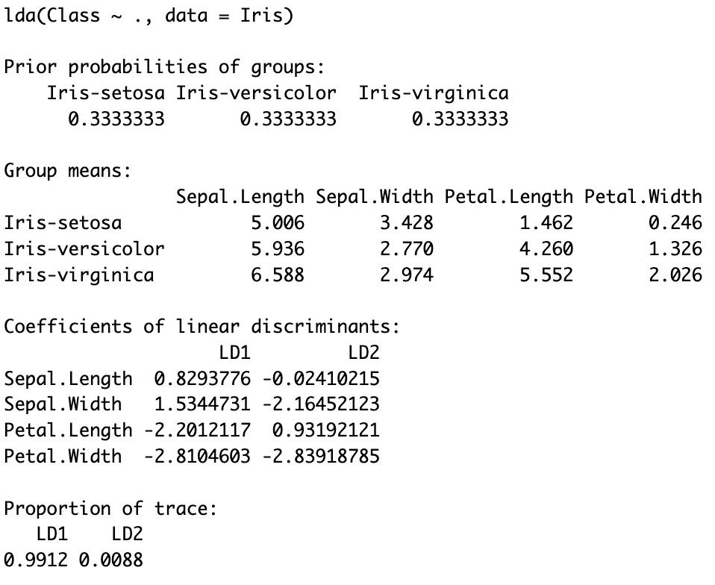
LDA
2% misclassification rate

Slide 6
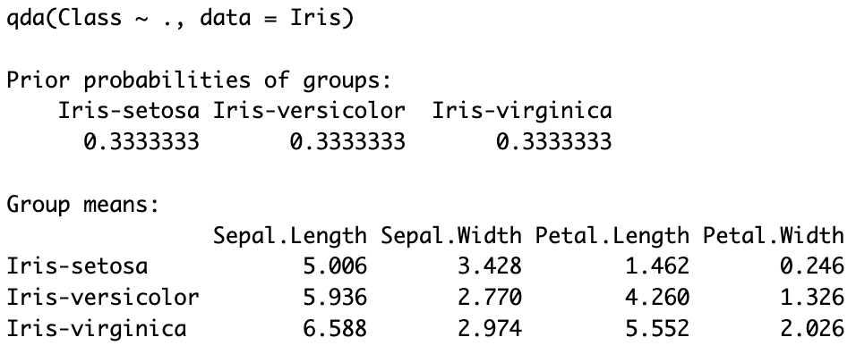
QDA
2% misclassification rate

Slide 7
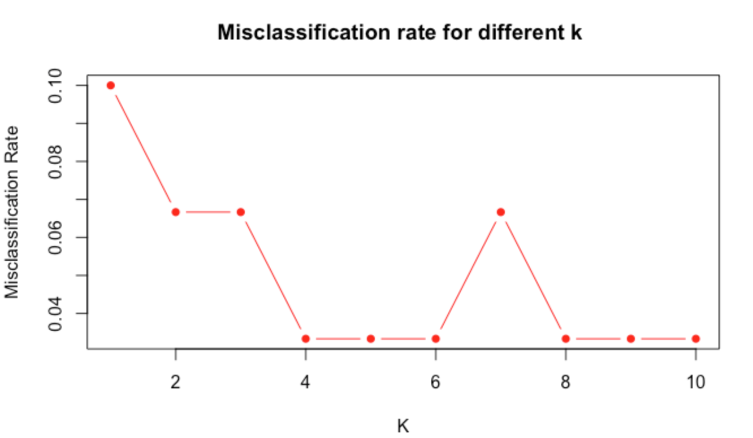
KNN
4% misclassification rate
Find “best” k using cross validation
Find misclassification rate of best model

Slide 8
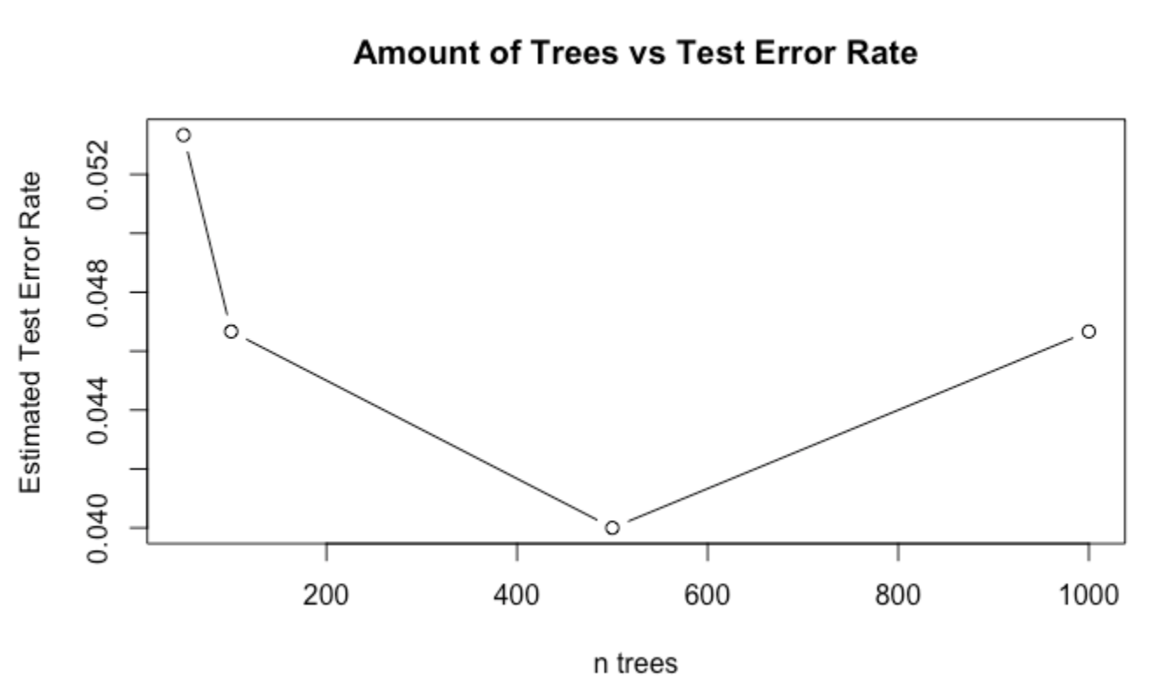
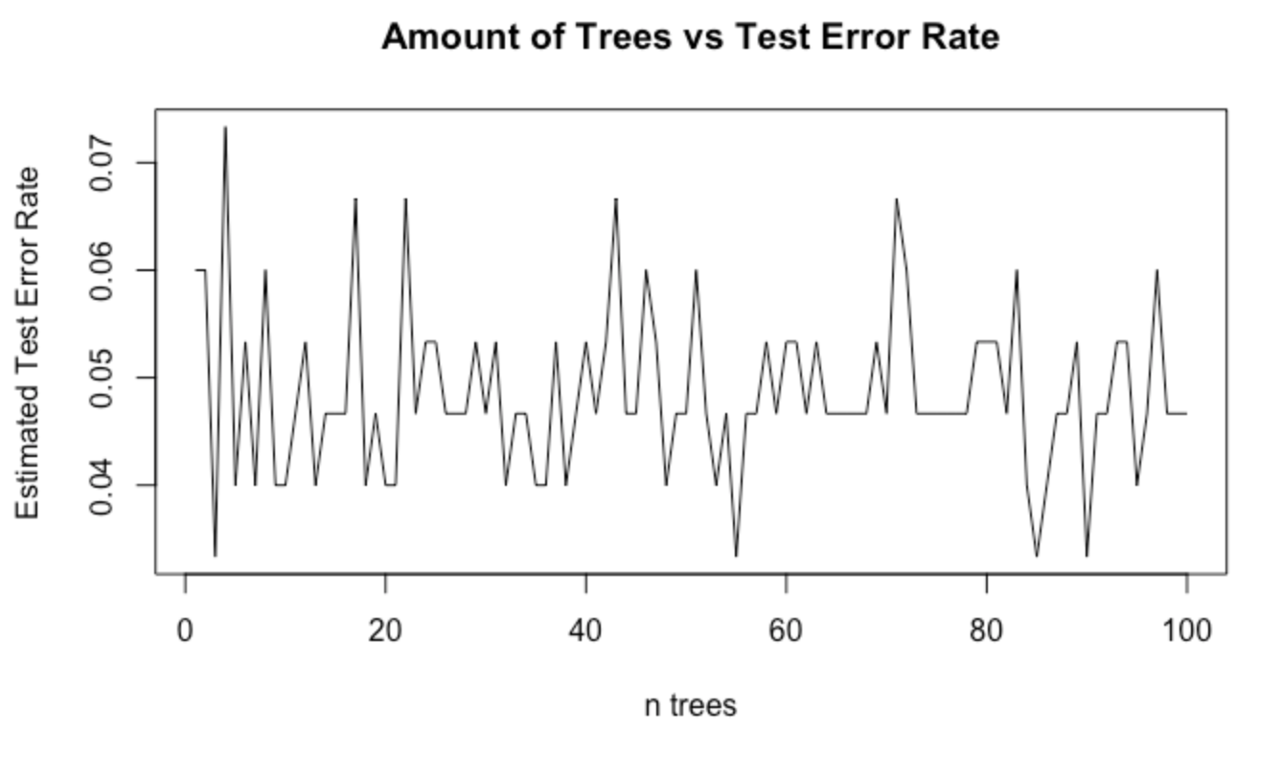
Random Forest
3% misclassification rate
Find “best” number of trees
Find misclassification rate of best model
Note. The number of trees is one of several parameters we could have altered

Slide 9
Conclusion
LDA and QDA had lowest misclassification rate of 2%
The classes are easily separable by linear regions
KNN tends to dominate LDA when the decision boundary is highly non-linear
Random Forest does not perform well on small amount of predictors and observations
If we had more data, we’d see more variation in misclassification rates
5

Slide 10

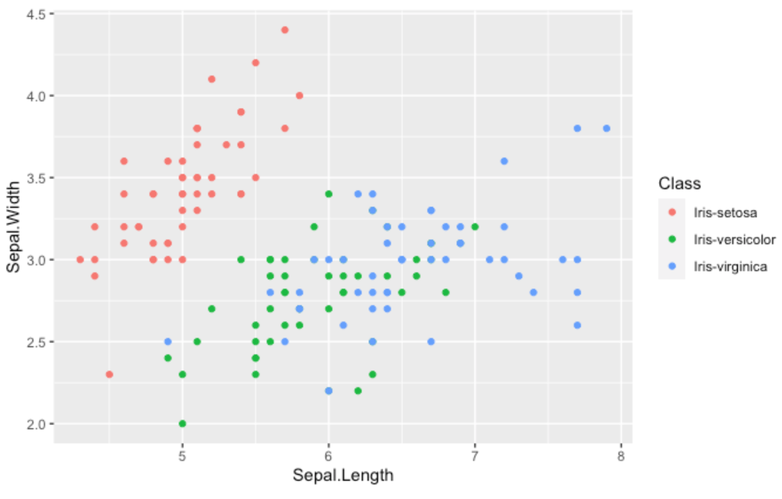
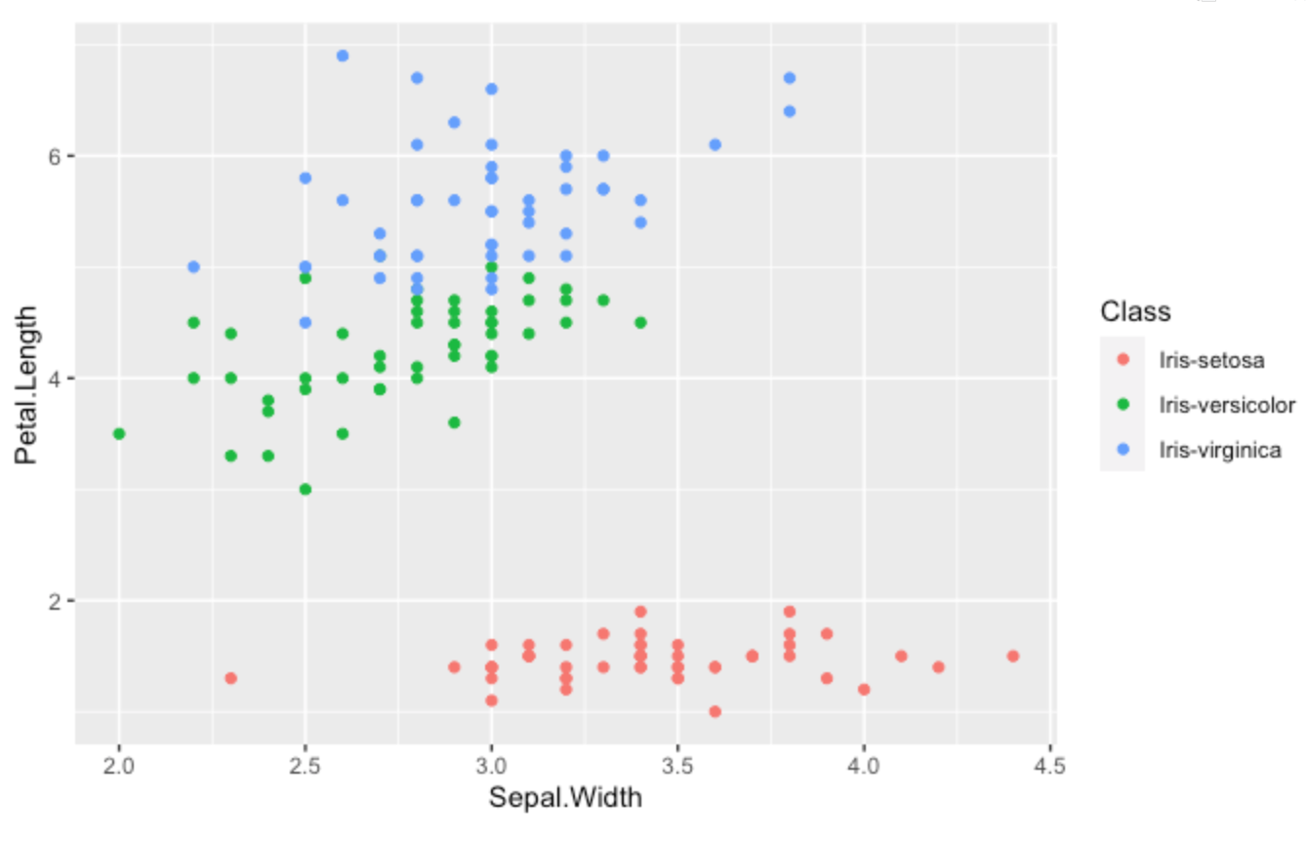
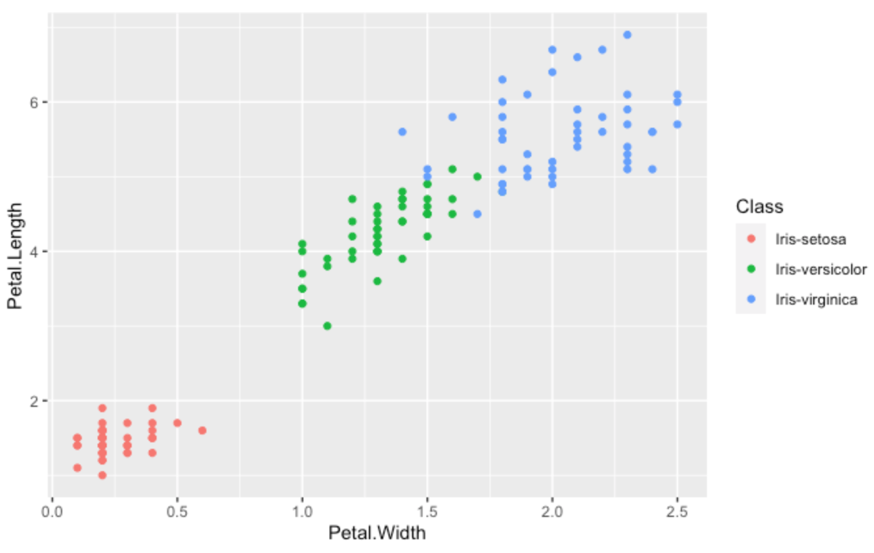
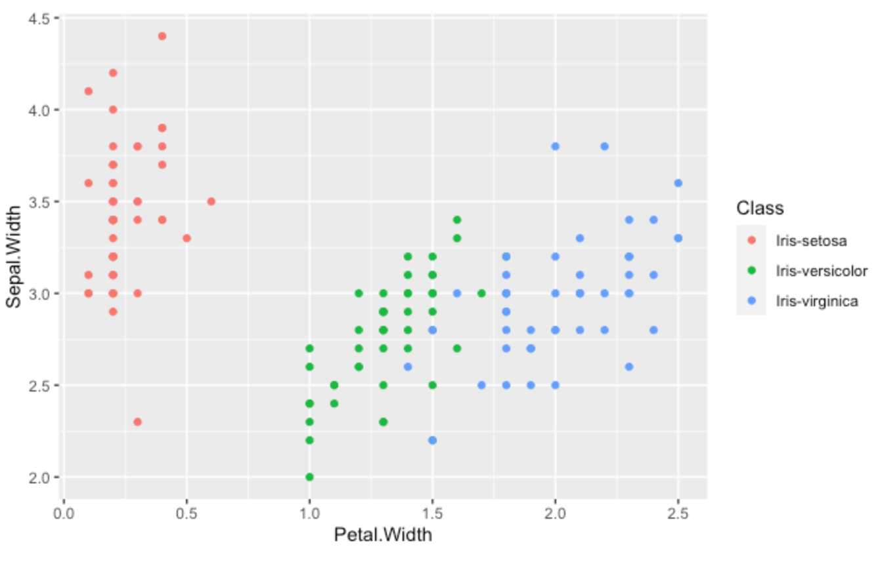
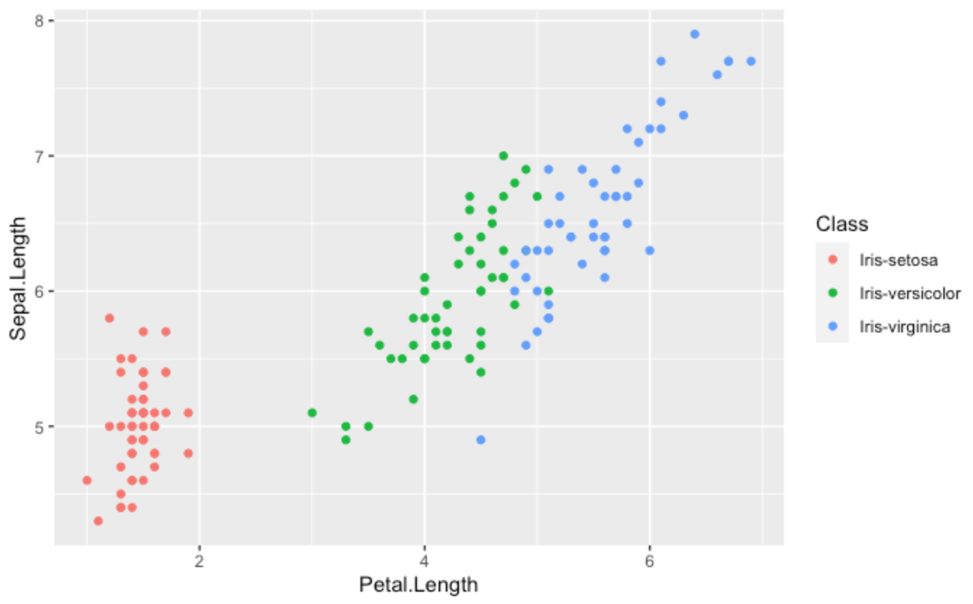
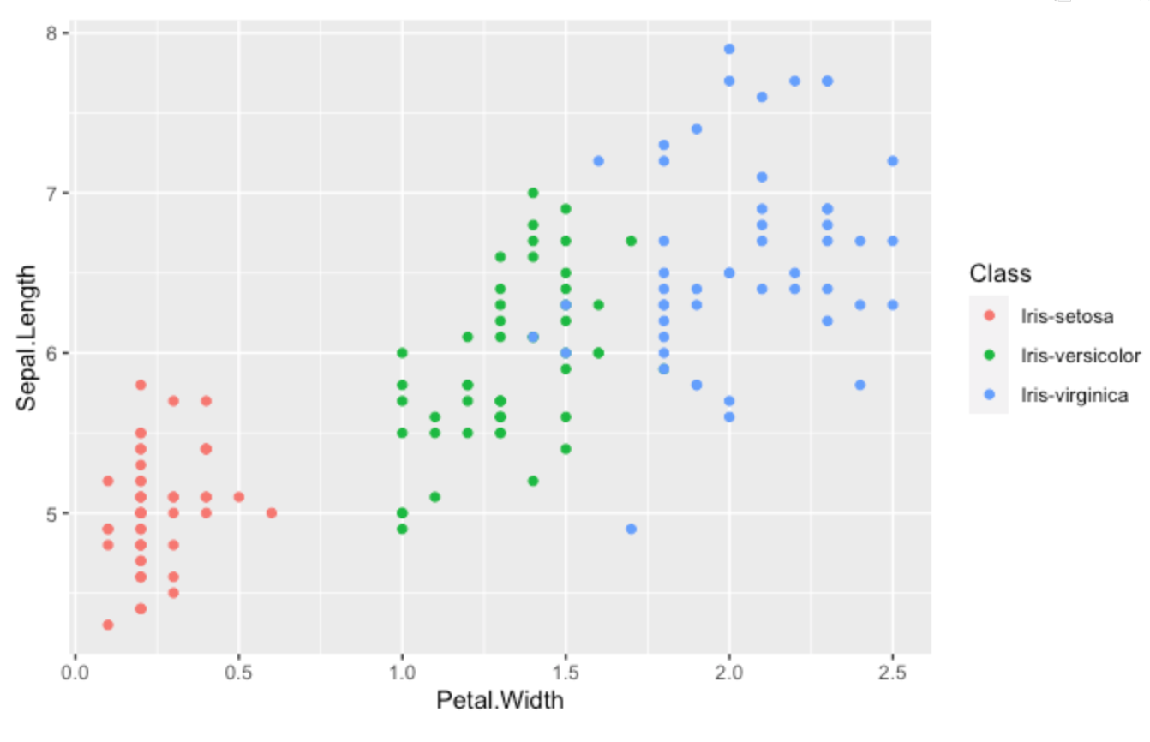
Full-width Photo

Slide 11
Thank you!

