Slide 1
Thanisha N
Final Project
3/21/2024 Annual Review

Slide 2
PROJECT TITLE
TEXT SUMMARIZER USING DEEP LEARNING
3/21/2024 Annual Review

Slide 3


AGENDA
Problem Statement
Project Overview
End Users
Solution and valuable proposition
Special features in the Solution
Modelling
Result
3/21/2024 Annual Review

Slide 4

PROBLEM STATEMENT
Develop an advanced text summarization system leveraging deep learning techniques, specifically employing a stacked LSTM architecture with attention mechanism for enhanced summarization performance. The objective is to create a model capable of generating accurate and concise summaries of input text documents. The developed text summarization system aims to provide a valuable tool for automating the process of summarizing textual content, thereby assisting in tasks such as document summarization, news aggregation, and content extraction in various domains.
3/21/2024 Annual Review

Slide 5

PROJECT OVERVIEW
The project aims to develop an advanced text summarization system using deep learning techniques, specifically leveraging a stacked Long Short-Term Memory (LSTM) architecture with attention mechanism for enhanced summarization performance. Text summarization plays a crucial role in extracting key information from large volumes of textual data, facilitating tasks such as document summarization, news aggregation, and content extraction. The proposed system will preprocess the input text data, including cleaning and tokenization, followed by the design and training of a sophisticated encoder-decoder architecture. The encoder component will process the input text, while the decoder component will generate concise and coherent summaries by attending to relevant parts of the input using the attention mechanism. The model's performance will be evaluated using standard metrics such as ROUGE scores to assess the quality of generated summaries compared to reference summaries. Upon successful training and evaluation, the text summarization model will be deployed into real-world applications, where it will seamlessly integrate with existing systems and frameworks for text processing and analysis. Ultimately, the project aims to provide a valuable tool for automating the summarization process, thereby improving efficiency and accuracy in extracting key insights from textual data across various domains.
3/21/2024 Annual Review

Slide 6

WHO ARE THE END USERS?
1. Researchers and Academics: Researchers and academics can leverage the text summarization system to quickly extract key insights and findings from extensive research papers, enabling them to stay updated with the latest advancements in their fields.
2. Journalists and News Agencies: Journalists and news agencies can use the system to summarize lengthy articles, press releases, and news reports, facilitating faster news dissemination and aiding in content curation for their audiences.
3. Content Aggregators: Content aggregators and online platforms can integrate the system to automatically summarize user-generated content, blog posts, and articles, enhancing user experience by providing concise summaries and reducing information overload.
4. Legal Professionals: Legal professionals can benefit from the system's ability to summarize legal documents, contracts, and case briefs, enabling them to quickly extract relevant information and make informed decisions.
5. Students and Educators: Students and educators can utilize the system to summarize textbooks, lecture notes, and academic articles, facilitating efficient study sessions and knowledge acquisition.
6. Business Analysts: Business analysts can leverage the system to summarize market research reports, customer feedback, and business documents, enabling them to extract actionable insights and make informed business decisions.
7. Healthcare Professionals: Healthcare professionals can use the system to summarize medical journals, patient records, and research papers, aiding in literature review processes and keeping up-to-date with the latest medical advancements.
3/21/2024 Annual Review

Slide 7

SOLUTION
The implemented solution utilizes a stacked Long Short-Term Memory (LSTM) architecture with attention mechanism to develop an advanced text summarization system. Data preprocessing techniques including cleaning, tokenization, and sequence padding are applied to prepare the input text data. The encoder-decoder architecture processes the input text, generating concise summaries by focusing on relevant information through the attention mechanism. Training is conducted using early stopping techniques to prevent overfitting, and the model's performance is evaluated using ROUGE scores. Upon successful training, the model is deployed into real-world applications, seamlessly integrating with existing text processing systems to automate summarization tasks and enhance information extraction efficiency.
3/21/2024 Annual Review

Slide 8
VALUABLE PROPOSITION
The developed text summarization system offers a sophisticated solution for automating the summarization process of large volumes of textual data. By leveraging a stacked LSTM architecture with attention mechanism, the system excels in generating concise and informative summaries while maintaining coherence and relevance. Its ability to handle varying lengths of input text and focus on key information through attention mechanism ensures accurate summarization across diverse datasets. The integration of early stopping techniques during training enhances model performance and prevents overfitting, while evaluation using standard metrics such as ROUGE scores ensures the quality of generated summaries. Deployed into real-world applications, the system seamlessly integrates with existing text processing frameworks, offering an efficient and scalable solution for document summarization, news aggregation, and content extraction tasks across diverse domains.

Slide 9

THE WOW IN YOUR SOLUTION
The text summarization system's standout feature lies in its utilization of a stacked Long Short-Term Memory (LSTM) architecture with attention mechanism, which allows it to capture intricate details and nuances within the input text while generating concise and informative summaries. This advanced architecture enables the system to not only process large volumes of textual data efficiently but also to focus on key information dynamically, leading to highly accurate and contextually relevant summaries. Additionally, the integration of early stopping techniques during training ensures optimal model performance, while the seamless deployment and integration into real-world applications underscore its practical utility and scalability. Overall, the system's ability to combine cutting-edge deep learning techniques with robust evaluation methodologies makes it a standout solution for automating text summarization tasks, offering immense value across diverse domains and applications.
3/21/2024 Annual Review

Slide 10
MODELLING
The text summarization model is built upon a sophisticated encoder-decoder architecture, featuring stacked Long Short-Term Memory (LSTM) layers with attention mechanism. The encoder processes the input text, producing contextual representations of the information. Stacked LSTM layers within the encoder enable the model to capture complex dependencies and patterns within the text data efficiently. The attention mechanism in the decoder component allows the model to dynamically focus on relevant parts of the input text while generating the summary. By attending to salient information, the model ensures that the generated summaries are concise and informative. The use of early stopping techniques during training enhances model performance and prevents overfitting. Overall, the model's architecture and attention mechanism enable it to generate high-quality summaries that accurately capture the essence of the input text, making it a powerful tool for text summarization tasks.
3/21/2024 Annual Review

Slide 11
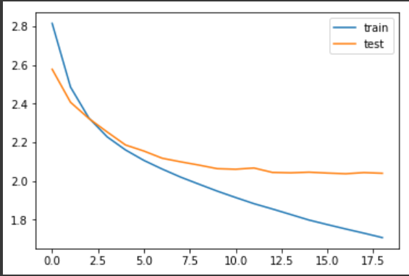
RESULTS
Demo Link
3/21/2024 Annual Review

Slide 12
