Slide 1

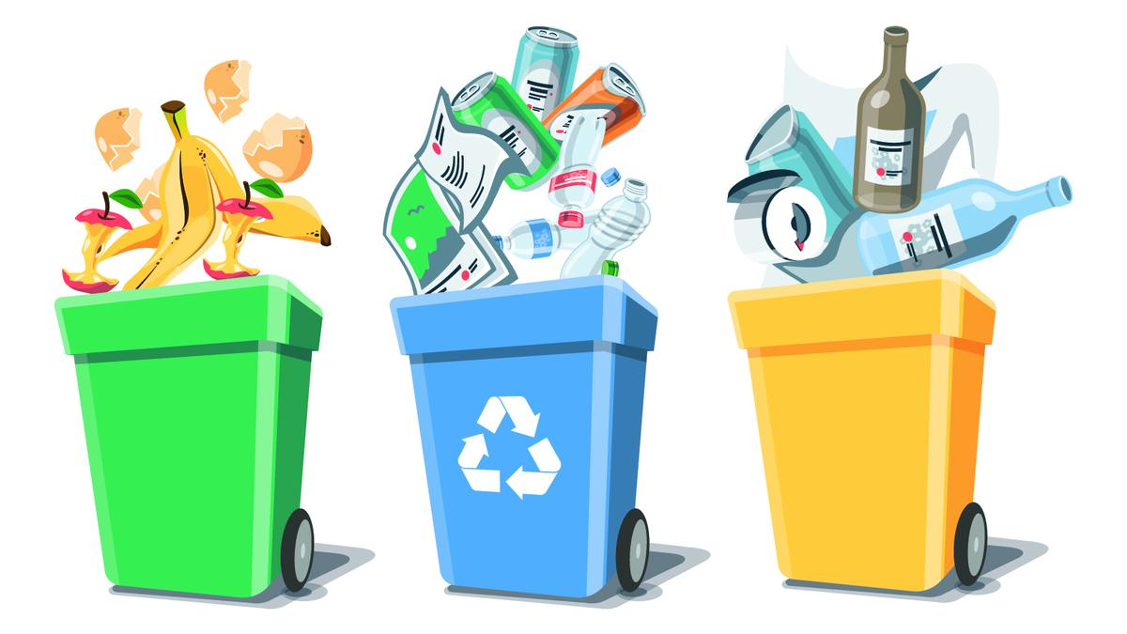
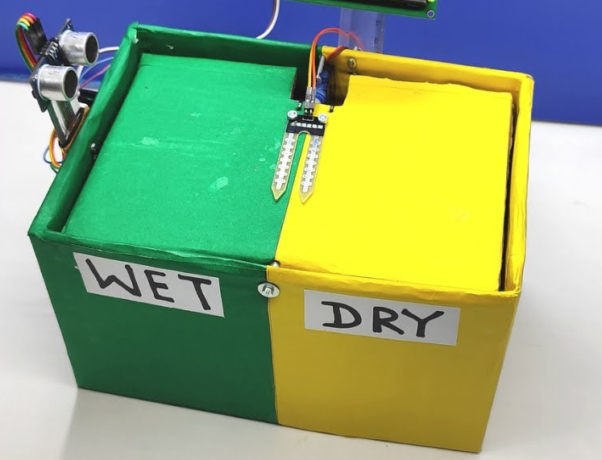
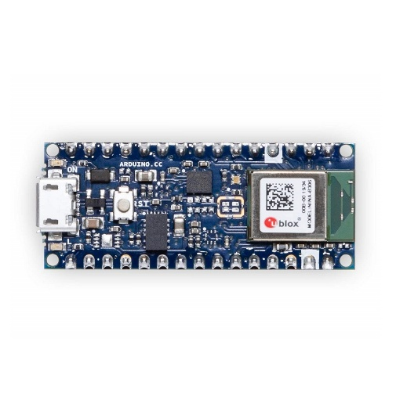
Smart Waste Segregation using Arduino BLE
Course Project
Thanish Nasir – 24502 | Sindhura – 22706 | Sathvik - 24626
Edge AI
Notes:
Understanding consumption, its hidden costs, and a path to sustainability.
“Think of the last three things you bought. How many were necessary?”
We are consuming more than ever, yet happiness levels remain stagnant.
World’s economy has grown exponentially, but so has resource depletion.

Slide 2
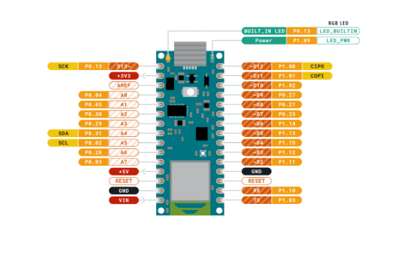
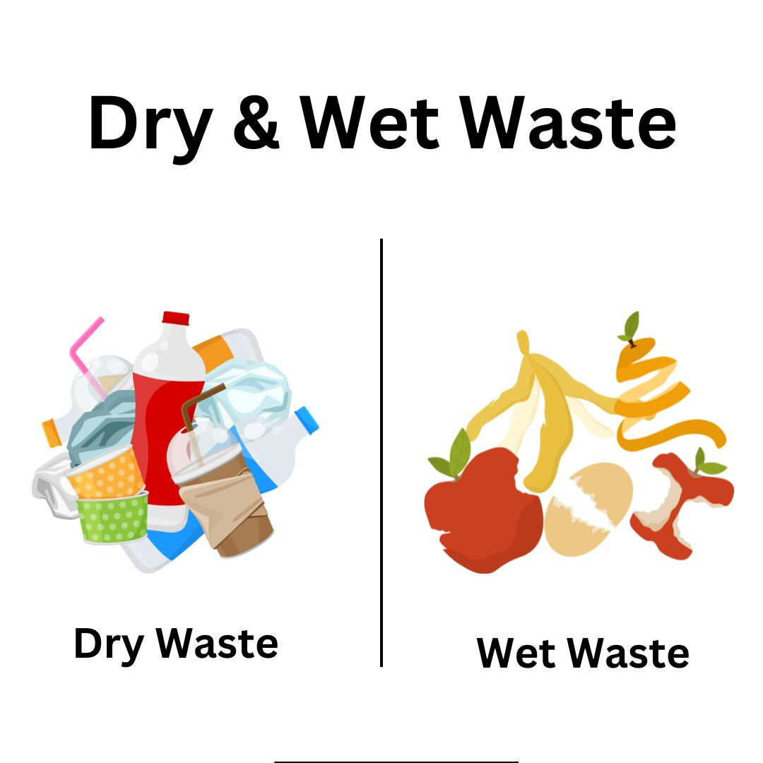
Introduction
Problem Statement
Waste separation is critical for improving recycling efficiency and reducing environmental impact. Traditional manual methods are slow, inconsistent, and labor-intensive.
Today, the world generates over 2 billion tons of solid waste annually. In many regions, waste is dumped into mixed bins, making it difficult to separate organic, recyclable, and non-recyclable materials. Manual segregation at landfills or recycling centers is labor-intensive, slow, expensive, and often inaccurate. As a result, huge amounts of potentially recyclable materials end up in landfills or incinerators, worsening environmental pollution and wasting valuable resources.
Importance of Segregation
Increase recycling efficiency
Reduce contamination in recycling streams
Cut down landfill waste and greenhouse gas emissions
Lower sorting costs and improve worker safety
Support a circular economy, where materials stay in use longer
Edge AI – CP330

Slide 3
Motivation and Objectives
Motivation
We face a growing waste problem where most trash is mixed together, making recycling harder, more expensive, and less effective. Current waste systems often rely on manual sorting, which is slow and prone to mistakes. This project aims to use smart technology — like Edge AI and machine learning — to automatically identify and separate different types of waste. By doing this, we can improve recycling rates, cut down on landfill waste, and help create cleaner, more efficient waste management systems that can work at a large scale in cities and industries.
Objectives
Develop an Edge AI system capable of accurately classifying and separating different types of waste.
Integrate the system on that works offline and uses minimal power.
Test and evaluate performance in terms of classification accuracy, speed, and energy efficiency.
Create a scalable solution that can be implemented in smart bins, recycling stations, or small-scale facilities.
Contribute to reducing landfill waste, improving recycling rates, and supporting global sustainability goals.
Long Term Vision | Impact Potential
Scale the Edge AI waste segregation system to municipal waste management systems across cities. Deploy smart, automated segregation units in households, offices, schools, and public spaces to enable source-level sorting. Expand the technology’s application to industrial waste, hazardous waste, and e-waste segregation. | Increase recycling rates by improving the quality and purity of sorted waste streams. Reduce landfill overflow and the environmental damage caused by improper waste disposal. Cut operational costs for waste management companies by automating labor-intensive tasks. Lower carbon footprint by enhancing the efficiency of recycling and reducing virgin material extraction.
Edge AI – CP330

Slide 4
Methodology
Hardware Setup
Data Collection & Annotation
Model Development
We used an Arduino Nano 33 BLE Sense board, equipped with sensors and connected to an OV7675 camera module, to capture live waste images.
Using Edge Impulse platform to preprocess the data and train a lightweight image classification model for the Arduino Nano’s limited memory and processing power.
Images of wet waste, cardboard, and plastic were collected directly from the device, then labeled to create a focused training dataset.
Performance Evaluation
Real-time Classification & Output
Model Deployment
We tested the system’s accuracy and response speed, identifying areas where lighting, image clarity, or more affected model performance, for further tuning
The trained model was compiled and deployed onto the Nano 33 BLE Sense, enabling it to perform real-time inference without relying on cloud processing.
When waste items were placed in front of the camera, the device classified them and provided classification results
Edge AI – CP330

Slide 5
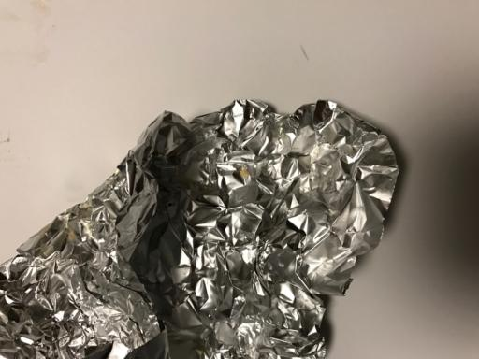
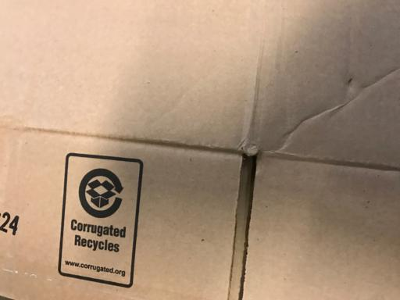
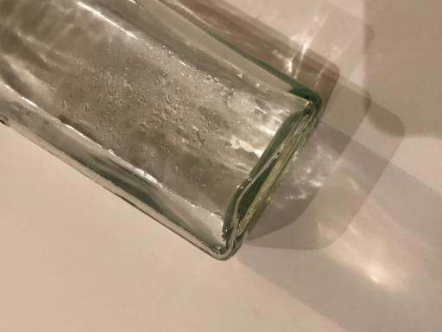
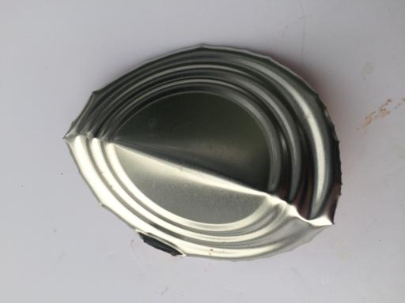
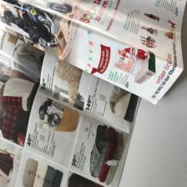
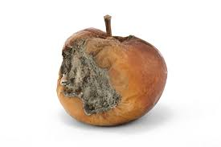
Data Collection
Target Waste Categories We initially worked with six categories, including wet waste, cardboard, plastics, and others, collecting ~100 images per category.
Image Capture Process Phase 1: Collected images using a smartphone to quickly build the base dataset. Phase 2: Captured images directly using the OV7675 camera module connected to the Arduino Nano 33 BLE Sense for real-world, device-specific data.
Data Preparation and Augmentation Applied dimension reduction (resizing) and grayscaling to images to fit within the memory and processing limits of the Edge AI model. Ensured balanced class distribution to avoid bias in training.
Final Dataset Use Uploaded and labeled all data within Edge Impulse’s platform. Used the prepared dataset for training, validation, and deployment.
Edge AI – CP330

Slide 6
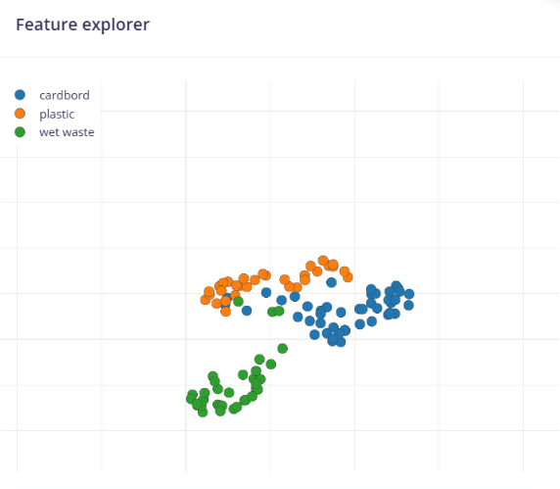
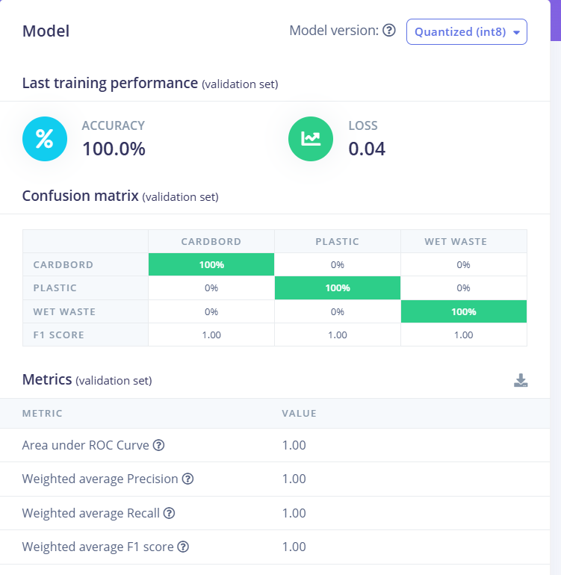
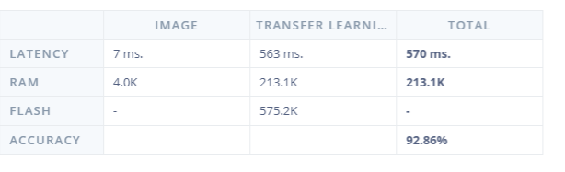
Model Development
We developed and trained the image classification model using Edge Impulse, experimenting with different model architectures, including MobileNet and other lightweight CNNs, to find the best fit for our embedded system.
We performed tuning on Edge Impulse, adjusting parameters like learning rate, number of epochs, and data augmentation strategies to improve model performance and avoid overfitting.
After comparing models, we selected the quantized (int8) version, which provided excellent accuracy (92.86%) while reducing RAM usage by 18% and ROM by 15% compared to the unoptimized (float32) version, making it ideal for the Arduino Nano 33 BLE Sense.
The final model achieved 100% accuracy on the validation set, with perfect precision, recall, and F1 scores across all categories (cardboard, plastic, wet waste), and operated efficiently with a total latency of ~570 ms using the EON compiler.
Edge AI – CP330

Slide 7
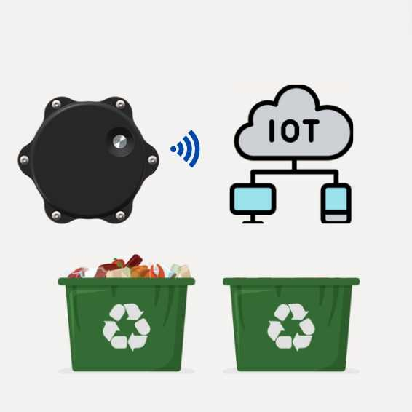
Future Developments
Expand Categories: Increase the number of waste categories (e.g., metals, glass, textiles) to improve real-world sorting capabilities and broaden application scope.
Larger, More Diverse Dataset: Collect and train on a larger, more varied dataset to improve model generalization across lighting, backgrounds, and object variations.
On-device Optimization: Further optimize the model for even lower latency and power consumption, enabling continuous real-time sorting in energy-constrained environments.
Integration with Robotics: Combine the model with robotic arms or conveyor systems to create automated waste sorting lines, increasing recycling efficiency and reducing manual labor.
Scalability & Impact: Deploy at community recycling centers, urban waste facilities, or even home-level smart bins to significantly reduce landfill waste, improve recycling rates, and support circular economy goals.
Edge AI – CP330

