Slide 1

IHACDP
Intelligent Healthcare Analytics and Clinical Decision Support Platform
Offline clinical decision support with statistical risk models
and a local language model
GUIDE
Dr. Vivekanandan M
(53646)
B.Tech, School of Computer Science and Engineering, VIT Chennai · Capstone Project Review
Shiva Charan Ambati
Atla Abhinav Karthik Reddy
Kotha Rithvik Reddy
23BRS1203
23BCE1085
23BCE1582

Slide 2
WHAT WE WILL COVER
Agenda
Problem, motivation, and the Indian primary-care context
Literature review: symptom checkers, ML risk prediction, explainability
01
02
Research gap, objectives, and system architecture
Datasets, methodology, and the observed/imputed wall
03
04
Risk model selection, language model benchmark, SHAP explainability
Results, limitations, future scope, conclusion
05
06
IHACDP
2

Slide 3
CONTEXT · 1 OF 2
Problem Definition and Domain Understanding
Patients describe symptoms in plain English, not clinical vocabulary
Clinical decision support must map free text to structured risk assessment
Language models are fluent but unreliable as diagnostic engines
Statistical models are reliable but opaque to a layperson
CORE PROBLEM
combine both without letting the generator decide outcomes
CONSTRAINT
must run offline, with no patient data leaving the device
IHACDP
3

Slide 4
CONTEXT · 2 OF 2
Motivation: the Indian Primary-Care Context
Primary care is the first and often only point of contact
Consultation time is short; symptom histories are taken rapidly
Connectivity and cloud access are unreliable outside urban centres
Sending health data to remote APIs raises privacy and cost concerns
Self-medication from an OTC counter is common and unguided
An offline, on-device assistant fits this setting directly
IHACDP
4

Slide 5
LITERATURE REVIEW · 1 OF 2
Symptom Checkers and Their Limitations
Public symptom checkers rank conditions from a checklist of symptoms
THE FAILURE MODE
Coverage is skewed to conditions that public datasets happen to carry
46%
Injuries and musculoskeletal complaints are poorly represented
confidence that a head cold
was AIDS
Probabilistic fits misread silence: unmentioned symptoms treated as absent
Naive Bayes on our own data, before
IDF-weighted overlap replaced it
Outputs rarely separate what the patient said from what was assumed
IHACDP
5

Slide 6
LITERATURE REVIEW · 2 OF 2
ML Risk Prediction and Explainability
Supervised models on UCI clinical datasets are a well-established baseline
LogisticRegression, RandomForest and XGBoost dominate tabular clinical risk work
ROC-AUC under cross-validation is the standard selection criterion
SHAP attributes a prediction to individual feature contributions
Explainability literature rarely addresses who the explanation is written for
THE GAP THIS PROJECT SITS IN
Gap between a SHAP plot and a sentence a patient understands
IHACDP
6

Slide 7
WHERE THE FIELD STOPS
Research Gap
Symptom checkers rank conditions but do not quantify chronic disease risk
GAP 1
Risk models quantify but do not read plain-English complaints
GAP 2
LLM health assistants generate diagnoses without statistical grounding
GAP 3
Imputed feature values silently enter explanations as if observed
GAP 4
No offline system unites triage, risk scoring, SHAP and narration
GAP 5
IHACDP targets exactly that junction
IHACDP
7

Slide 8
WHAT WE SET OUT TO BUILD
Objectives and Scope
Accept plain-English symptom descriptions and extract entities deterministically
Triage across 244 conditions using an interpretable ranking, not a fitted classifier
Score five chronic disease risks with cross-validated supervised models
01
02
03
Explain every prediction with SHAP over observed features only
Narrate results with a local language model that never diagnoses
Run fully offline on commodity hardware; no cloud, no build step
04
05
06
IHACDP
8

Slide 9
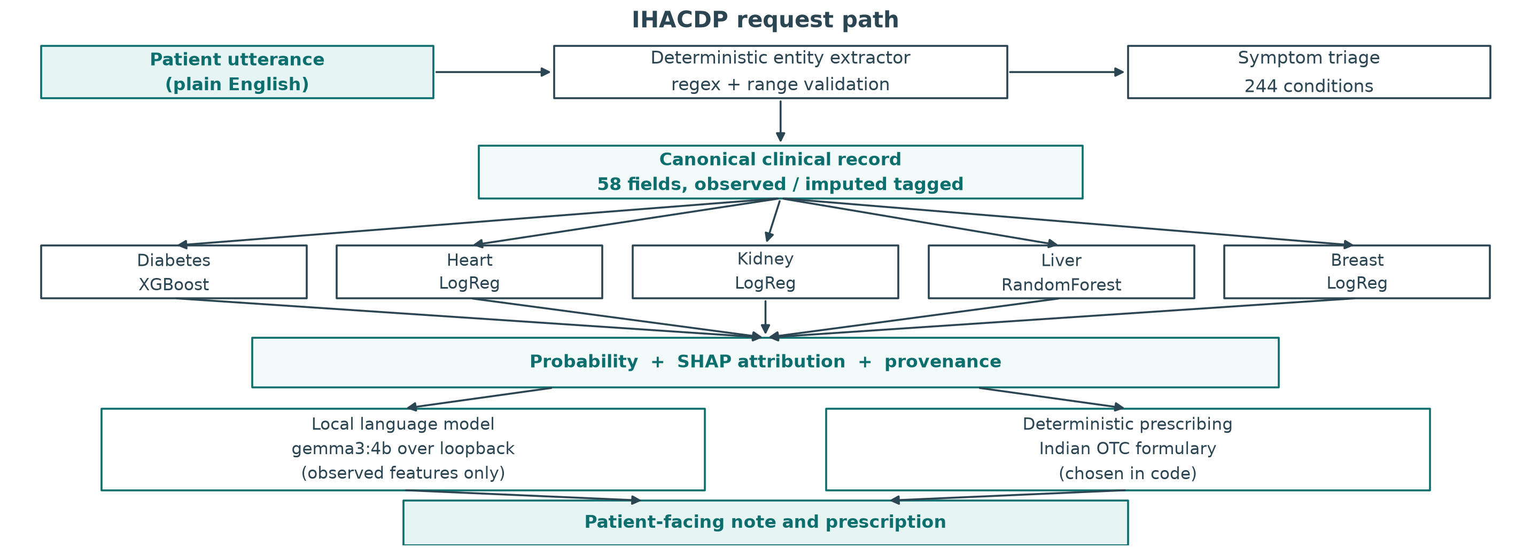
SYSTEM DESIGN
System Architecture: the Request Path
Plain-English input enters a FastAPI endpoint; the system is stateless
Features are tagged observed or imputed; only observed ones cross the wall
Ollama serves gemma3:4b over loopback to narrate, not decide
IHACDP
9

Slide 10
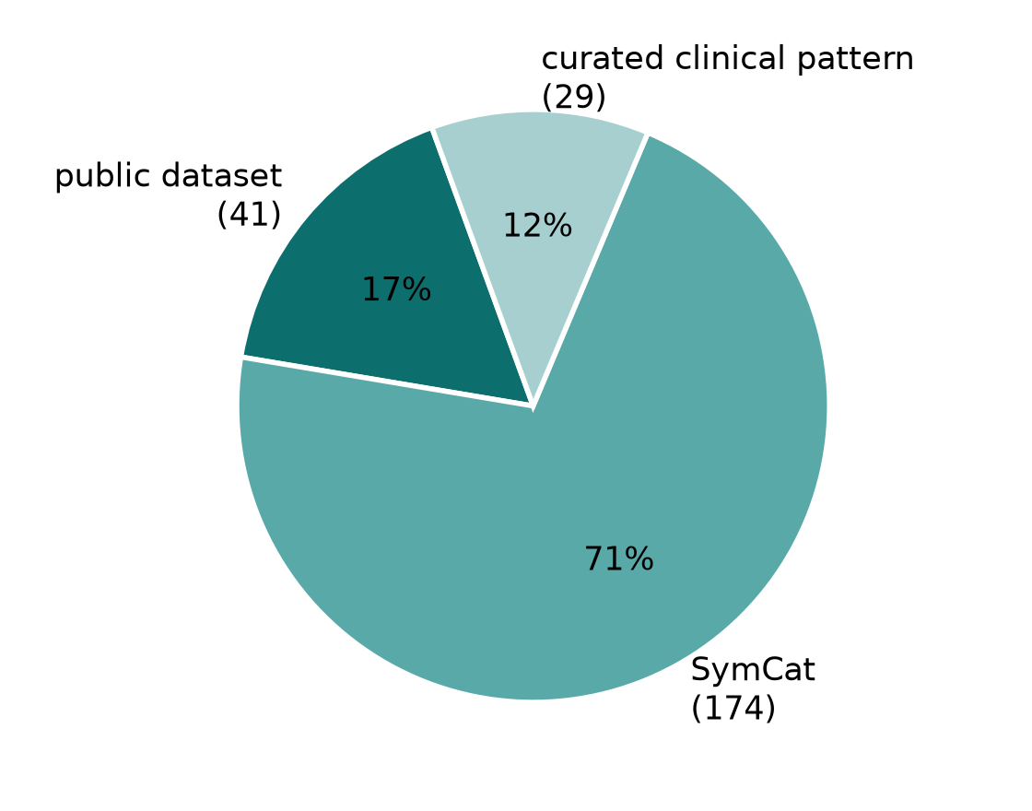
DATA SOURCES
Datasets Used
Source | Dataset | Size | Role
UCI #891 | CDC BRFSS | 75,346 rows | Type 2 Diabetes risk
UCI #45 | Cleveland | 303 rows | Coronary Heart Disease risk
UCI #336 | CKD | 400 rows | Chronic Kidney Disease risk
UCI #225 | ILPD | 583 rows | Chronic Liver Disease risk
UCI #17 | WDBC | 569 rows | Breast Cancer risk
Public matrix | Symptom matrix | 41 conditions | Triage patterns
SymCat | SymCat | 174 conditions | Triage patterns
Curated | Clinical patterns | 29 patterns | Injuries, musculoskeletal
244 TRIAGE CONDITIONS
41 public · 174 SymCat
29 curated clinical patterns
IHACDP
10

Slide 11
METHODOLOGY · 1 OF 2
Deterministic Extraction and the Observed/Imputed Wall
WHAT THE RISK MODEL SEES
WHAT THE NARRATOR SEES
Observed features
+ imputed placeholders
Observed features only
THE
WALL
The language model can only describe evidence the patient actually gave, so a fabricated finding has nothing to be built from.
Imputed values fill the input vector so the model can score a complete record.
Regex entity extraction with range validation; no model parses the input
Prevents fabricated explanations built on statistical placeholders
Determinism makes extraction auditable and reproducible across runs
IHACDP
11

Slide 12
METHODOLOGY · 2 OF 2
Triage Layer: Why IDF Overlap Beat Naive Bayes
244
389
516
conditions
symptoms
unique patterns
MERGED FROM THREE SOURCES
WHY NOT NAIVE BAYES
41
public symptom matrix
Naive Bayes treats an unmentioned symptom as confirmed absent.
174
SymCat
That fit once ranked a head cold as AIDS at 46%. IDF-weighted overlap treats silence as unknown and weights rare symptoms higher.
29
curated clinical patterns
Curated patterns cover injuries and musculoskeletal complaints that no public dataset carries.
IHACDP
12

Slide 13
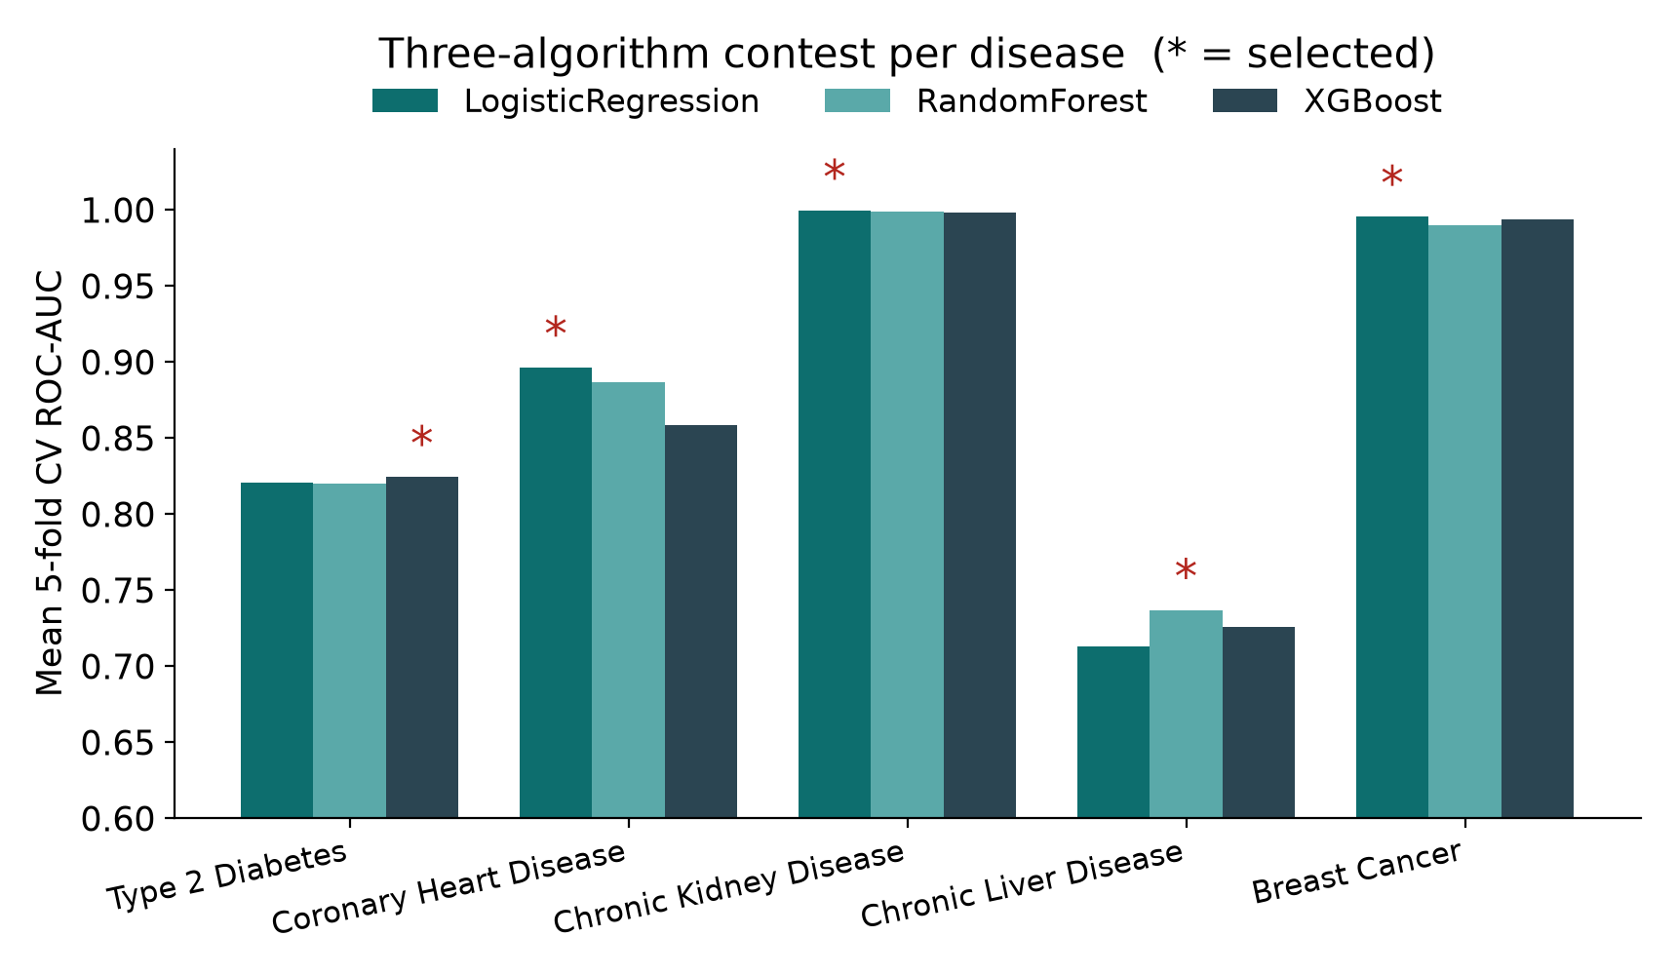
RESULTS · 1 OF 3
Risk Model Selection
Condition | Winning model | ROC-AUC | Accuracy
Type 2 Diabetes | XGBoost | 0.8268 | 0.7490
Coronary Heart Disease | LogisticRegression | 0.9502 | 0.8689
Chronic Kidney Disease | LogisticRegression | 1.0000 | 0.9750
Chronic Liver Disease | RandomForest | 0.7821 | 0.7009
Breast Cancer | LogisticRegression | 0.9954 | 0.9737
Selection by 5-fold cross-validated ROC-AUC across three candidate families
Reported figures come from a held-out 20% test split
IHACDP
13

Slide 14
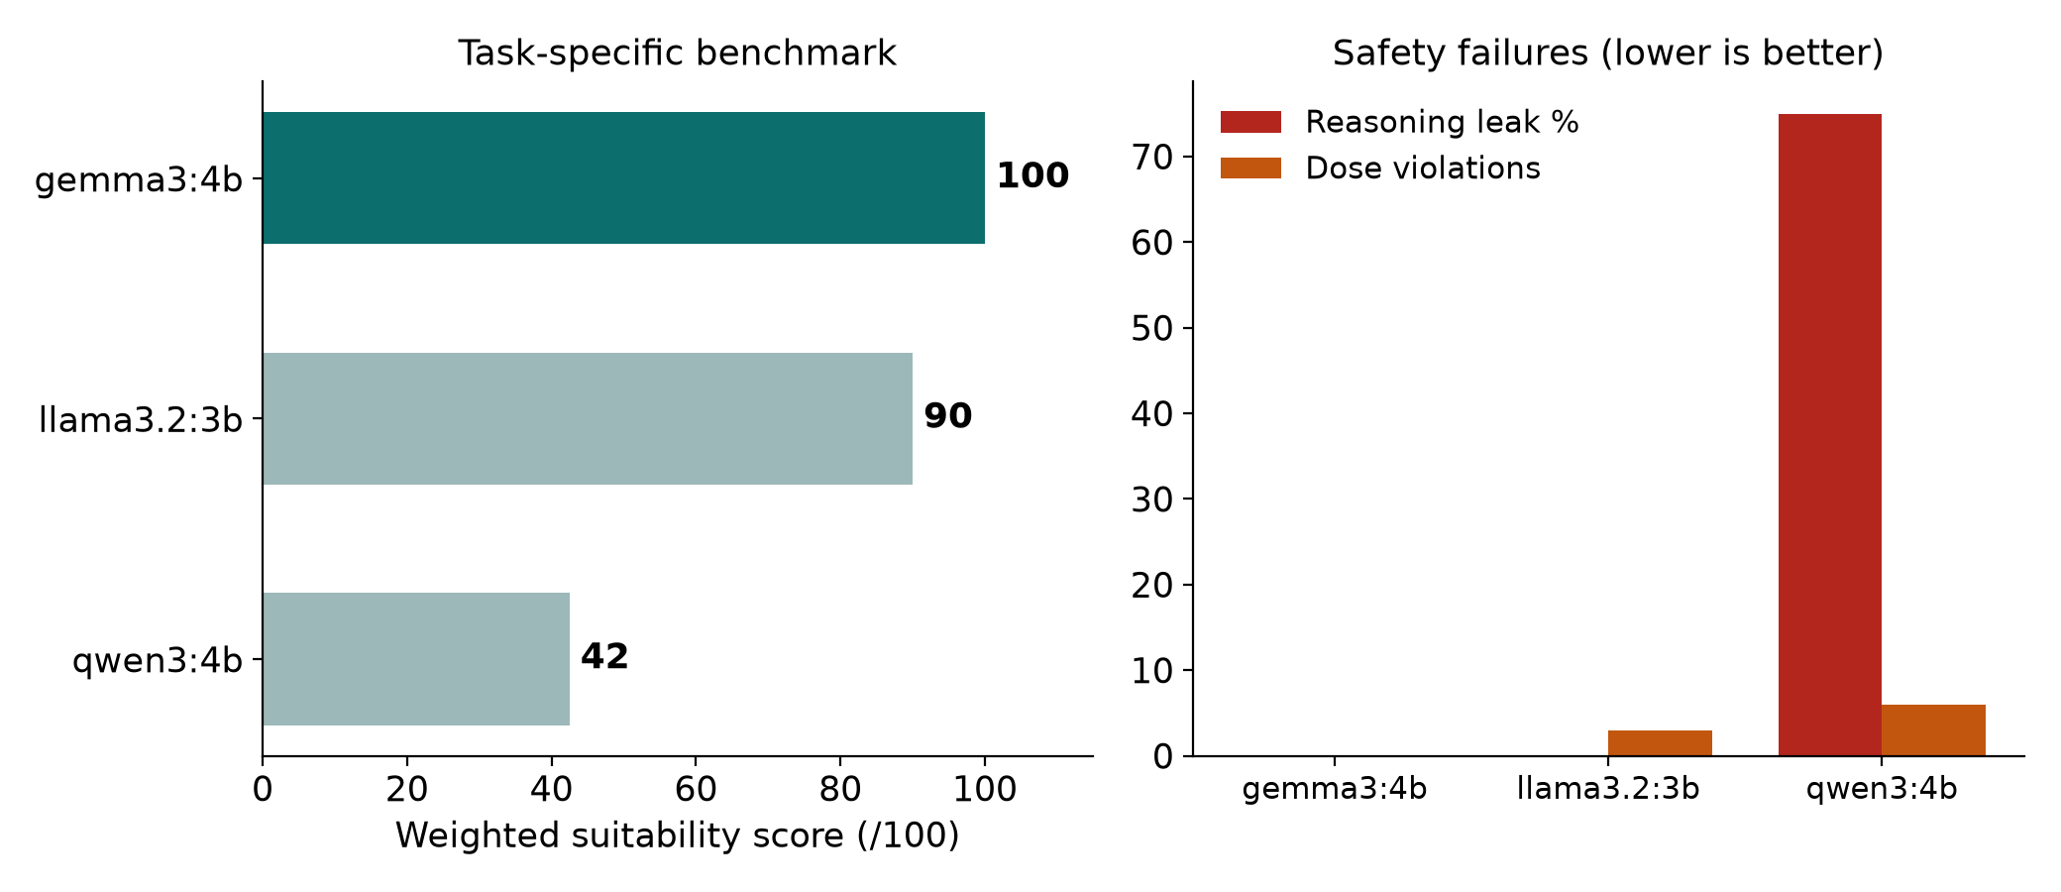
RESULTS · 2 OF 3
Language Model Benchmark
Model | Score | Reasoning leak | Dose violations | Latency
gemma3:4b | 100/100 | 0% | 0 | 4.17s
llama3.2:3b | 90.0 | — | 3 | 2.07s
qwen3:4b | 42.5 | 75% | — | —
gemma3:4b selected · 100 / 100
qwen3:4b emitted chain-of-thought as patient-visible text
Neither think:false nor /no_think suppressed that leak; gemma3:4b selected
IHACDP
14

Slide 15
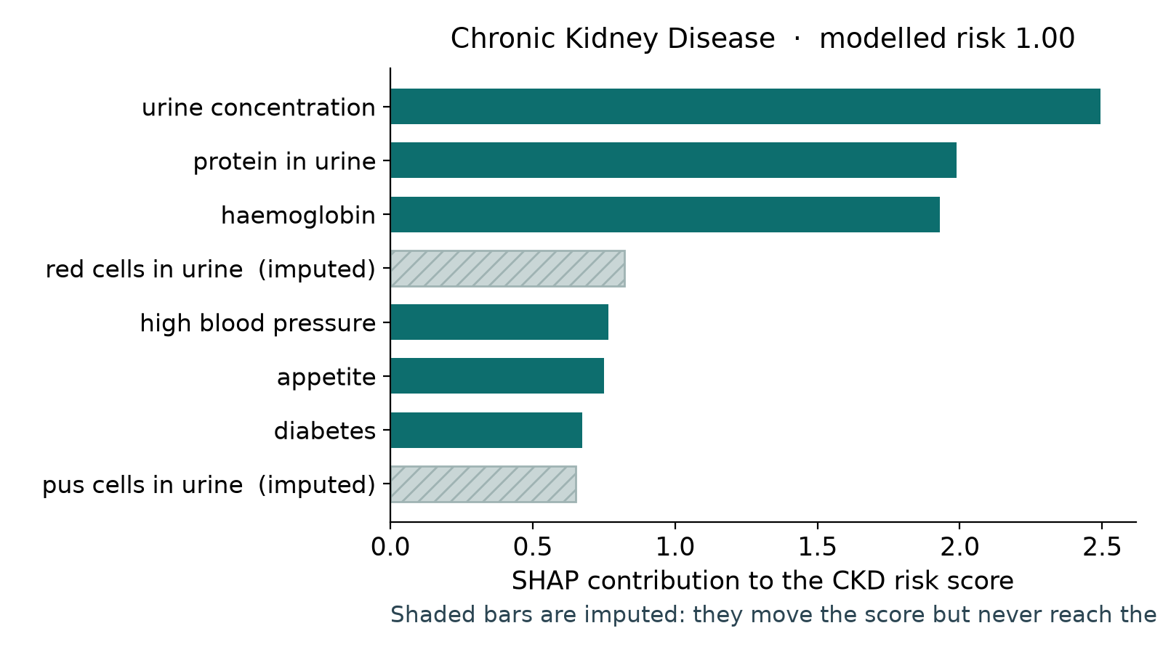
HOW A PREDICTION IS EXPLAINED
Explainability with SHAP: a Worked CKD Example
CKD model is LogisticRegression, AUC 1.0000, accuracy 0.9750 on held-out data
SHAP attributes the risk score to individual input features
Only features tagged observed are eligible to appear in the explanation
Imputed values contribute to the score but are withheld from narration
gemma3:4b converts the surviving attributions into plain-language reasoning
The number comes from the model; the sentence comes from the narrator
IHACDP
15

Slide 16
SAFETY RULES
Deterministic Prescribing and Urgent-Care Escalation
Prescribing is deterministic from a curated Indian OTC formulary
CURATED INDIAN OTC FORMULARY
Dolo 650
Brufen 400
Sinarest
Strepsils
Cetzine
Digene
Electral
Otrivin
Volini
HARD RULE
HARD RULE
no duplicate active ingredients across a suggestion set
no dose emitted on prescription-only drugs
ESCALATION · THESE BYPASS PRESCRIBING ENTIRELY
Appendicitis
Meningitis
Sepsis
Stroke
Suspected fracture
Concussion
They return urgent-care advice instead of any medication.
IHACDP
16

Slide 17
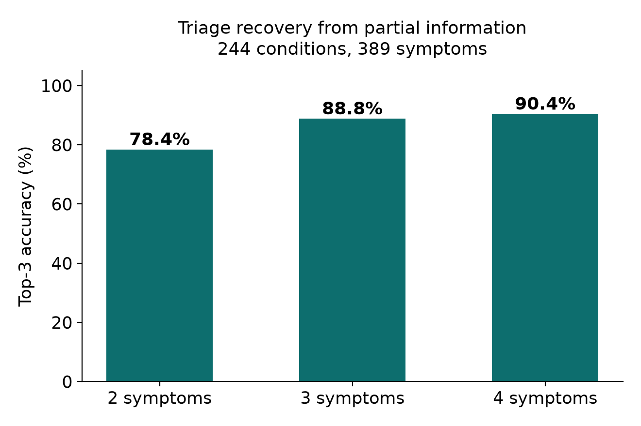
RESULTS · 3 OF 3
Results: Triage Accuracy and System Validation
78.4%
88.8%
90.4%
top-3 from 2 symptoms
top-3 from 3 symptoms
top-3 from 4 symptoms
Five risk models validated on held-out 20% splits, AUC 0.7821 to 1.0000
5,186 lines of code covered by 71 regression tests
Full pipeline runs offline on an 8 GB Apple Silicon Mac
IHACDP
17

Slide 18
WHAT THIS SYSTEM CANNOT DO
Limitations, Stated Honestly
CKD AUC 1.0000 reflects near-linear separability of that dataset, not clinical perfection
ILPD at 0.7821 is genuinely hard; reported unmassaged rather than tuned upward
Cleveland (303), CKD (400), ILPD (583), WDBC (569) are small datasets
Triage coverage is bounded at 244 conditions and 389 symptoms
Top-3 accuracy from 2 symptoms is 78.4%; sparse input degrades ranking
System is stateless: no longitudinal history, no follow-up tracking
IHACDP
18

Slide 19
WHAT COMES NEXT
Future Scope
Extend triage coverage beyond 244 conditions and 389 symptoms
Validate risk models on Indian cohort data rather than UCI splits
01
02
Improve chronic liver disease performance above the 0.7821 baseline
Add multilingual input for Indian languages at the extraction layer
03
04
Evaluate newer small local models against the same task-specific benchmark
Clinical usability study with primary-care practitioners
05
06
IHACDP
19

Slide 20
WRAPPING UP
Conclusion
Statistical models decide; the language model only narrates the decision
Observed/imputed wall keeps explanations grounded in patient-given evidence
Thank you
Five risk models, AUC 0.7821 to 1.0000, selected by cross-validated ROC-AUC
Questions welcome
Triage reaches 90.4% top-3 accuracy from four symptoms
5,186 lines, 71 regression tests, fully offline on 8 GB hardware
IHACDP
20

