Slide 1

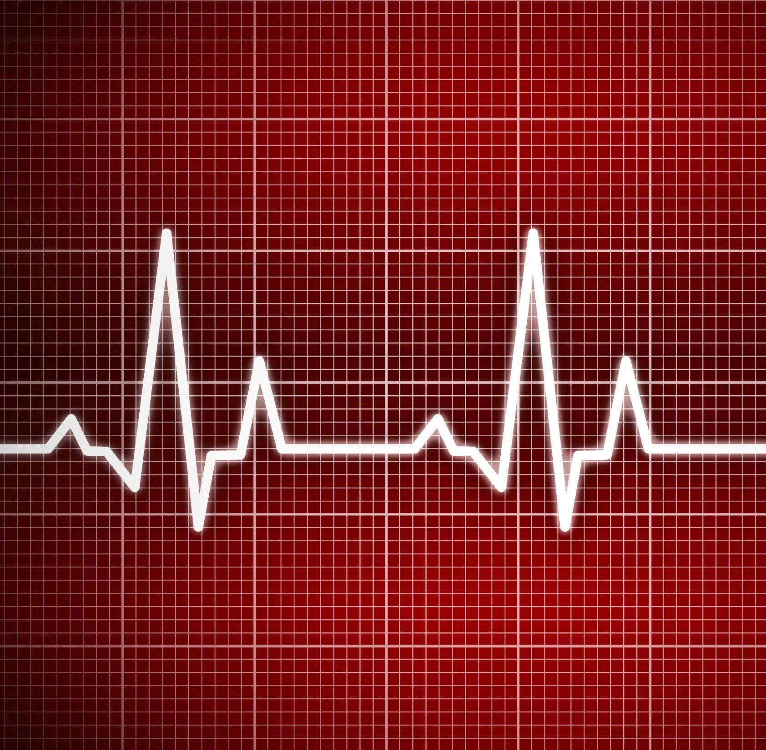
Heart Disease Risk Estimation
PREDICTING HEART FAILURE RISK
--Sai Thanish Voore

Slide 2
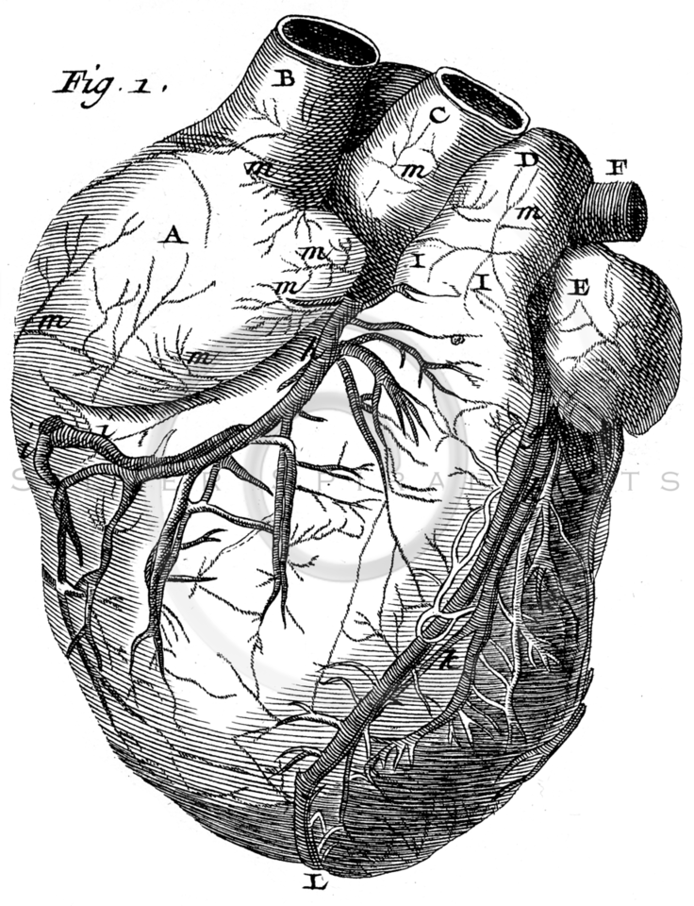
Content
Introduction & Problem Statement
Data
Data Distribution
Exploratory Data Analysis
Principal Component Analysis
Model Structure & Priors
Inference
Results
Future Work

Slide 3
Introduction & Problem Statement
Exploring Bayesian Generalized Linear Models (GLM) for Heart Disease Prediction.
Key objectives:
Predicting Heart Disease Risk: We'll leverage the power of Bayesian modeling to predict the risk of heart disease, a critical healthcare challenge.
Understanding Key Contributors: We aim to unravel the
factors that play the most significant role in heart failure risk.

Slide 4
Data
Our foundation for this analysis is the Heart Failure Prediction dataset, containing 299 observations and 13 clinical covariates.
age | anemia | creatinine | platelets | gender | smoking |  | Death event
66 | 0 | 295 | 26501 | 1 | 0 |  | 1
75 | 1 | 8388 | 27000 | 0 | 0 |  | 1
54 | 1 | 390 | 26588 | 0 | 1 |  | 1
Cardiovascular diseases (CVDs) stand as the primary global cause of death, claiming around 17.9 million lives annually, This dataset offers 12 features to help predict mortality linked to it.
Citation
Davide Chicco, Giuseppe Jurman: Machine learning can predict survival of patients with heart failure from serum creatinine and ejection fraction alone. BMC Medical Informatics and Decision Making 20, 16 (2020). (link)

Slide 5
Data distribution
Initial Step: Standardizing Quantitative Variables
Pre-Processing
First, we will standardize all quantitative variables in the dataset to follow a standard normal distribution (𝑋∼𝖭(0,1)). This transformation offers key benefits in Bayesian analysis:
Standard Normal Distribution
Exploratory data analysis
Shared Priors: Standardization allows us to use common prior distributions for model coefficients, simplifying the modeling process.
Investigate the relationship among the variables
Bayesian model
Simplified Inference: With standardized variables, it's easier to make inferences, like removing variables by setting their coefficients to zero (equivalent to using sample averages).
Model structure and priors
The Markov chain Monte Carlo (MCMC) sampling
Inference from posterior distribution

Slide 6
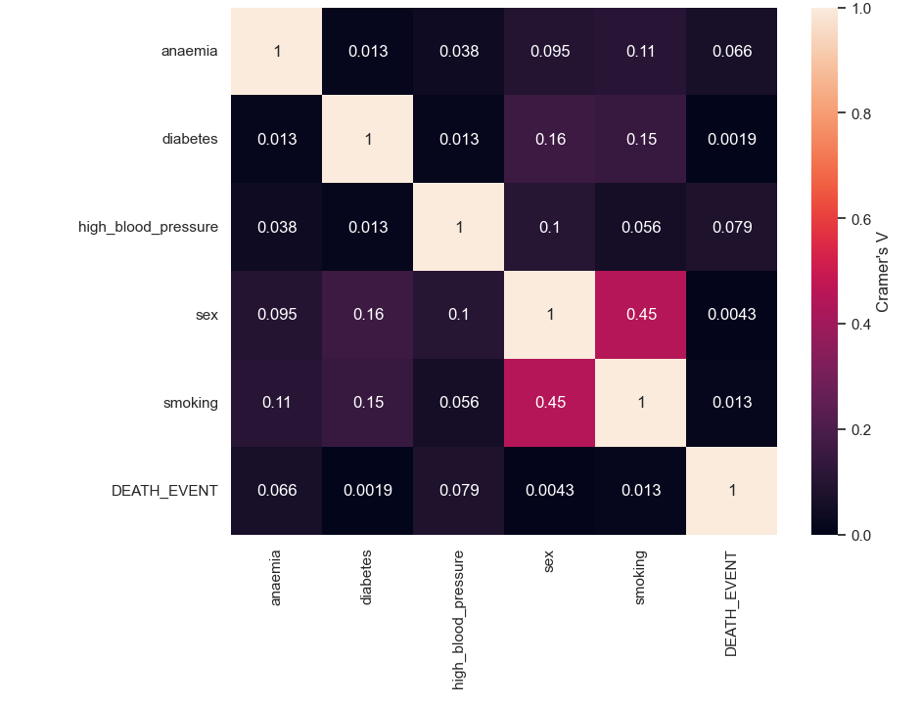
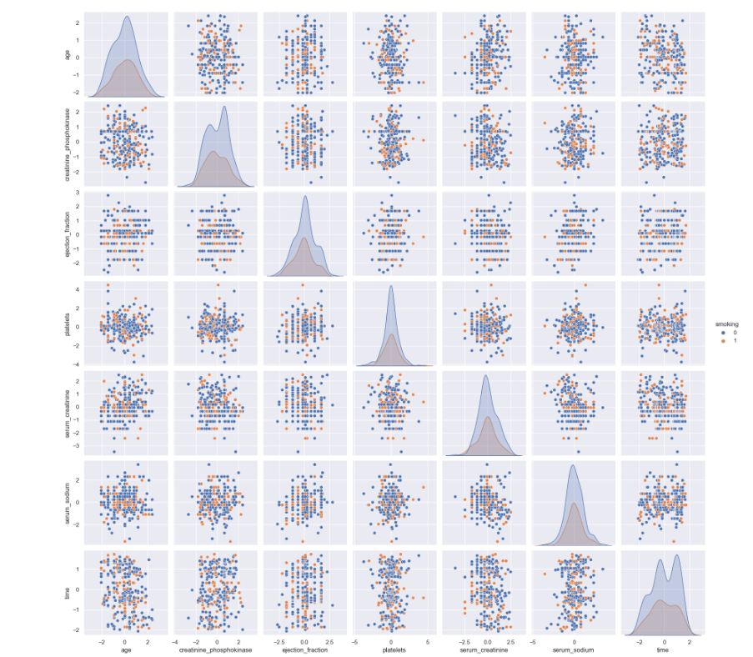
Exploratory Data Analysis
Pre-processing we can set to investigate the relationships among the variables. For binary and quantitative features,
Pre-Processing
Binary Variables
Quantitative variables

Slide 7
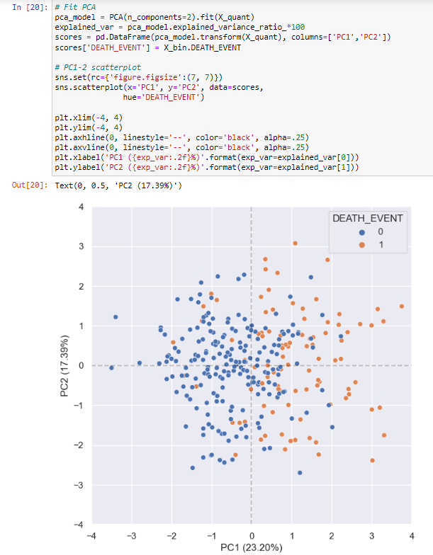
Principal Component Analysis
PCA of the normalized quantitative variables and visualize the scores over the first two principal components. This provides an overview over the sample composition
Pre-Processing
We can also observe that these two PCs capture approximately 40% of the total variation contained in this feature set. On the whole, the Box-Cox transformation seems to preserve predictive information.

Slide 8
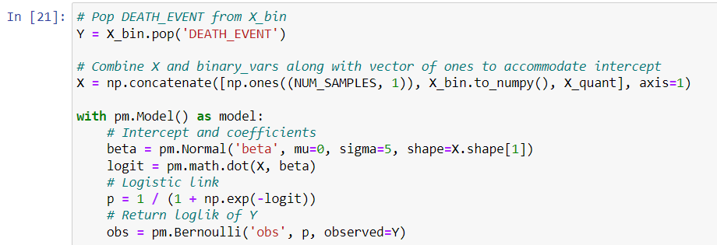
Model Structure and Priors
we'll build a generalized linear model using all features to predict DEATH_EVENT, a binary variable. We'll create a linear model with a logit expression and link it to DEATH_EVENT using a logistic transformation.
Logit expression :𝑙𝑜𝑔(𝑃(𝐷𝑒𝑎𝑡ℎ|𝑋)/1−𝑃(𝐷𝑒𝑎𝑡ℎ|𝑋))=𝛼+𝛽1.𝑋1+𝛽2.𝑋2+...𝛽𝑝.𝑋𝑝
Relation:
Bayesian analysis will determine the relationships between the coefficients (𝛽) and the intercept (𝛼). we can set up the optimization procedure using MCMC

Slide 9
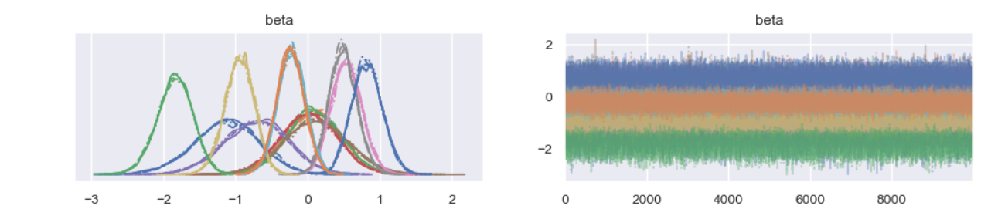
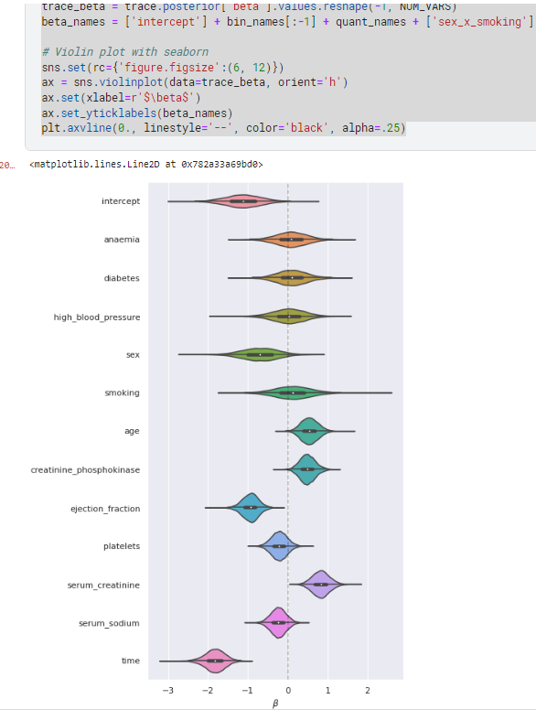
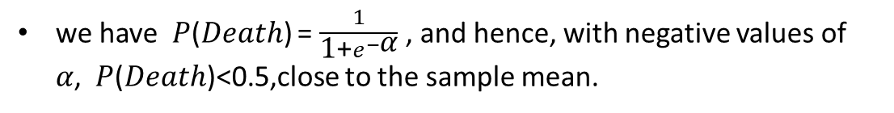
Inference
We can set up the optimization procedure using MCMC. Here Hamiltonian method with maximum a posteriori (MAP) estimation for starting values, look into the sampling trace will help diagnose convergence issues.
we have 𝑃(𝐷𝑒𝑎𝑡ℎ) = $\frac{1}{\text{1}\text{+}e^{−\text{α}}}$, and hence, with negative values of 𝛼, 𝑃(𝐷𝑒𝑎𝑡ℎ)<0.5,close to the sample mean.
The strongest effect over heart failure risk is time, the patient follow-up period

Slide 10
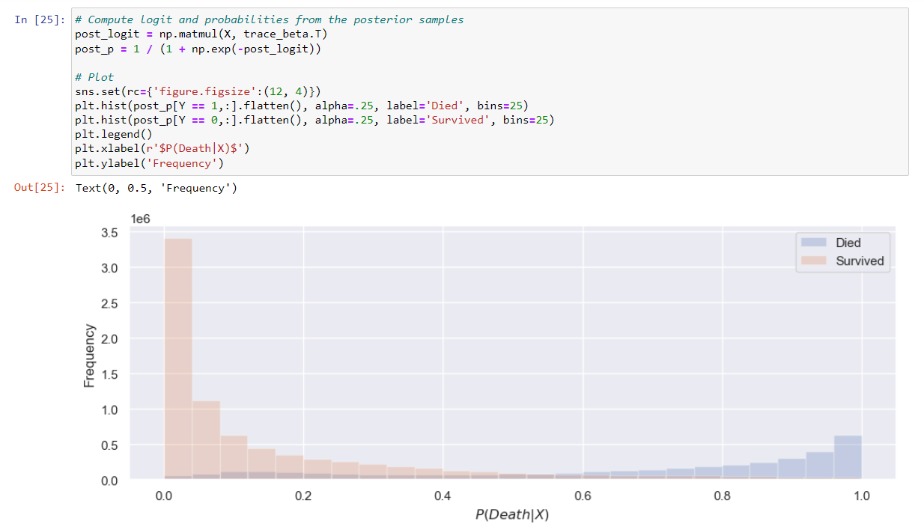
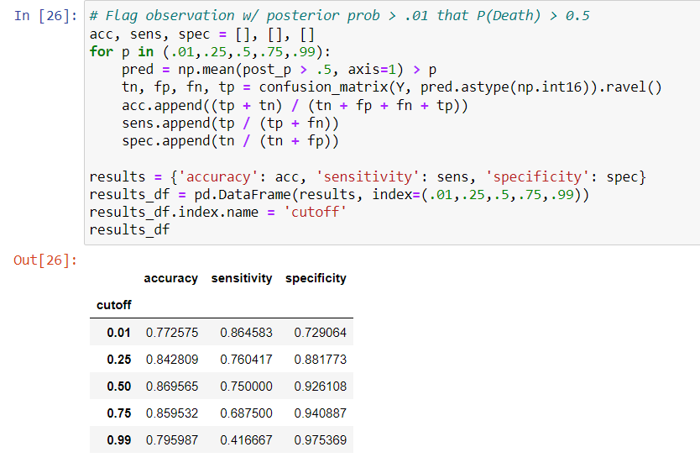
Results
Posterior heart failure probabilities over all observations.
Predicting heart failure for all individuals that have a 1% chance of their risk being over 50%. This is a conservative choice that should boost sensitivity even if decreasing specificity or accuracy.
Indeed, the 1% threshold yielded the highest sensitivity (87.5%) along with a moderate specificity (72.9%).

Slide 11

Future Work
This prediction aims to contribute to the early detection and management of individuals at high risk of cardiovascular diseases, ultimately reducing the global burden of heart-related mortality.
Much more could be done thorough-out this analysis. To list a few recommended steps:
Use a hierarchical model introducing a prior for the 𝛽 prior's 𝜇 and a separate prior for 𝛼
Resolve the dependence between gender and smoking
Produce ROC curve to better understand the sensitivity-specificity trade-off
Experiment with Cox regression for survival analysis
All in all, being able to anticipate 87.5% of the occurrences should be deemed a success.

Slide 12
THANK YOU

