Slide 1

SRI CHANDRASEKHARENDRA SARASWATHI VISWA MAHAVIDHYALAYA (Deemed to be university u/s 3 of UGC act 1956) (Accredited with “A” by NAAC) Enathur, Kanchipuram – 631561. Tamilnadu www.kanchiuniv.ac.in
Student query classification system
Using machine learning
Submitted by
11189A264
Voore Saithanish
11189M011
K.SaiVarun
Guided By
DR.M.SENTHIL KUMARAN
Dept.of CSE
Final Review
Date :01/11/2021

Slide 2
Abstract
Nowadays, A University or educational institute generally receives a bulk of complaints posted by students every day on the issues relates to their academics or any issues relates to their education, because of these bulk of complaints received from the students every day makes it difficult for the university to sort out them and classify them and send to their respective department for resolving the issues. In this project, we work on classifying these complaints based on the classes they belong to using some machine learning algorithms. By capturing some keywords in the complaints, adding some weight to the keywords and classifying the complaint based on these keywords. This classification makes the work easy for the university and saves time which is used to sort them and gives better service for the students. Now they can directly send the complaints to the respective departments with ease and efficient within less amount of time.

Slide 3
Objective
The main aim of this project say that the person should not lose his valuable time and make the work easier by using cutting edge technologies. so in this way, we can design, that the person can raise a complaint and get the solution to his/her complaint. The online system using technologies is the easiest way to solve the complaints raised by the students in bulk amount. Hence using this developed model the complaints can be solved easier and faster by classifying to required departments of the Organization.

Slide 4
Introduction
Nowadays, Educational Institutes are growing day by day more complaints were registered and categorizing them into respective departments making a huge task for the management and it becomes a more consuming time process.
With respective with the Management, there is a lot and bulk of mixed Issues were received and classifying them into different categories of department’s is the main objective of this project and we have designed a model to solve this problem effectively.
We can solve the Complaints related to the students, facing the issues more accurately by classifying them and triggering them to the respective sub-departments and making the work easier.

Slide 5
The Complaints raised by a person related to academic issues are received from a form through a student grievances website, and it is stored in the database table having attributes of Token-Id, Student Name, Student Mail and Complaint data and within the amount of time the complaint gets resolved by sending to the sub-department through notifications and the department then checks the issues based on priority and once the issue is resolved then it sends the notification to the issue raised person, so with this project, we can solve the bulk of complaints efficiently which were stored in the database and once the issue was solved it will be updated and reflected in departments.
The SVM for classification which we were using classifies the issue and divide it into a particular domain and enriching text classification and segmentation processes we can categorize the data to a particular department based on the labels given pre definitely for each respective departments and sends a notification to that department admin.
.

Slide 6
Platform requirements
Software/ Hardware
Software /Hardware
elements
Specifications/
Versions
Intel i3, i5, i7 and above versions.
Processor
Hardware
RAM
2GB
Hard Disk
1TB(not mandatory)
OS
Windows 10
Software
Python IDE
v3.7
Pandas
sklearn matplotlib
Jupyternotebook
Libraries required

Slide 7
Steps
Import libraries
Step
1
Import dataset
Step
2
Data pre-processing
Step
3
Feature engineering(text processing)
Step
4
Splitting the data into train and tests
Step
5
Apply the classification algorithm
Step
6
Evaluating the model
Step
7
7
18 January 2021

Slide 8
Flow chart
First, we extract the Issues from database and export it into csv file.
Importing the required packages for classification.
Then the data is sent through the model for classification algorithm in which we make:
Text Pre-Processing
Segmentation
Stemming
Training the data and testing the data by splitting the given dataset and building the model with better accuracy values.
Then we will be applying our classification algorithm which classifies the issue and assign to the particular department of the organization.
The department will solve the issue and sends the notification to the issue raised student

Slide 9
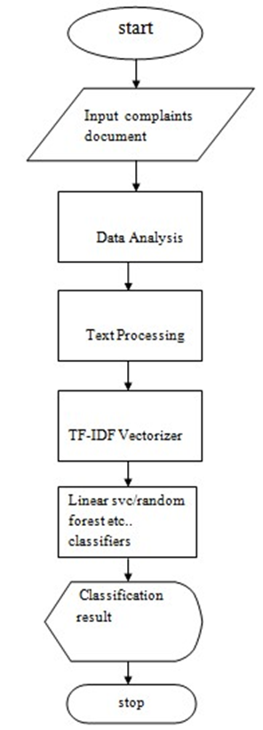
Flow diagram

Slide 10
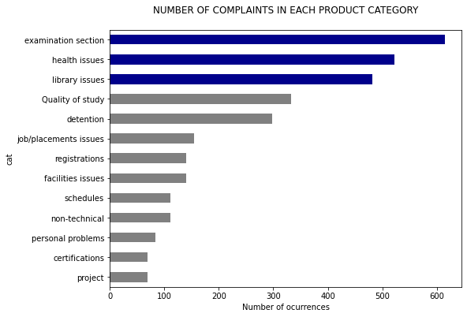
Bar graph for number of queries in each category

Slide 11
Algorithms used
We used four algorithms in this code
There are:
LinearSVC
LogisticRegression
MultinomialNB
RandomForestClassifier
11
*

Slide 12
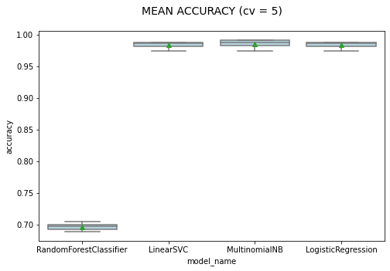
Represents the box plot for different classification models with cross validation = 5

Slide 13
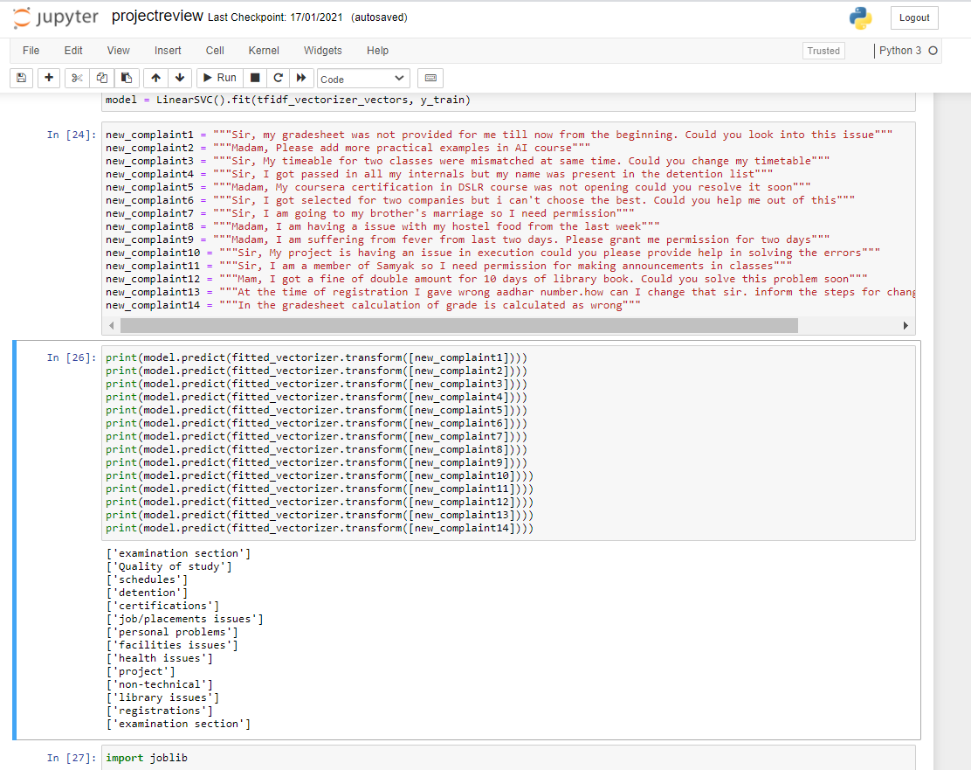
Sample output

Slide 14
Conclusion
A complete Classification model of complaint classification is created which make every complaint system to work efficiently for maintaining of huge and bulk amounts of complaints and maintaining the one-to-one interaction with the issue raiser and resolver for a University. More productivity of work and consuming more time will vanish and helps in the growth of Institutions. An Effective Complaint Classification System using this machine learning classification’s approach combining with TF-IDF (term frequency-inverse document frequency) resulting with an accuracy of 89% and Maintaining of Database in an easier way.

Slide 15

References
https://www.aclweb.org/anthology/D19-5107
https://www.sciencedirect.com/science/article/pii/S1877050920307201
https://www.researchgate.net/publication/330602424_Automatic_complaint_classification_system_using_classifier_ensembles
Akhter, M.P., Jiangbin, Z., Naqvi, I.R., Abdelmajeed, M., Mehmood, A., Sadiq, M.T.: Document-level text classification using single-layer multisize filters convolutional neural network. IEEE Access 8, 42689–42707 (2020)

Slide 16
Thankyou

