Slide 1

NexaLife
Your Life, Our Promise
Presented by D. Krishna Thanmai
Intern at The Hartford
A smart, AI-driven platform for managing the complete life insurance lifecycle—from policy enrollment to claim settlement.

Slide 2

Modernizing Insurance Operations
NexaLife transforms traditional insurance processes into a streamlined digital system, delivering efficiency and accuracy at every touchpoint.
◆ End-To-End Automation
◆ Reduced Processing Time
Streamlines the complete policy lifecycle from application to settlement
Eliminates manual delays and accelerates approval workflows
◆ Fraud Prevention
◆ AI-Assisted Decisions
Validates documents and cross-checks data to minimize fraudulent claims
Intelligent analysis supports faster, more accurate underwriting and claims

Slide 3
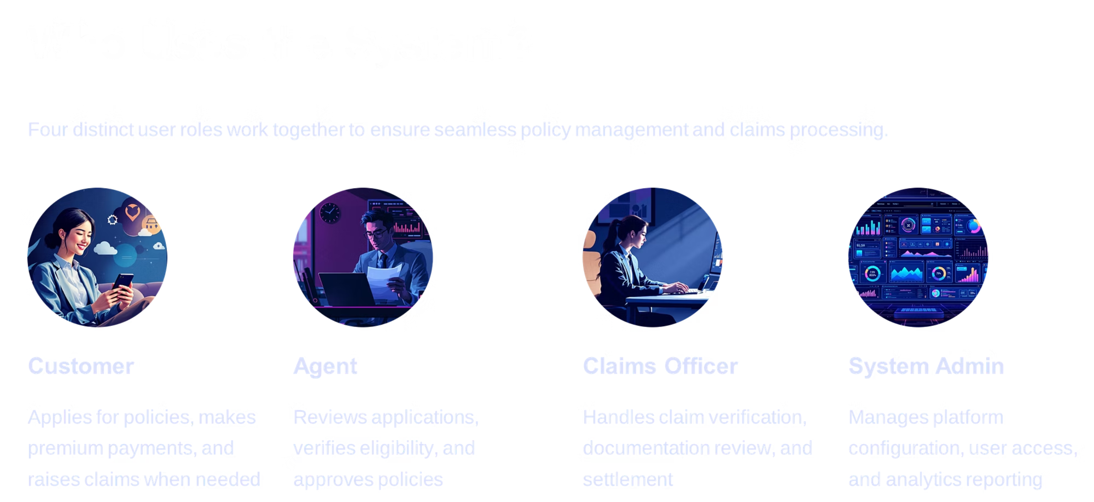

Slide 4
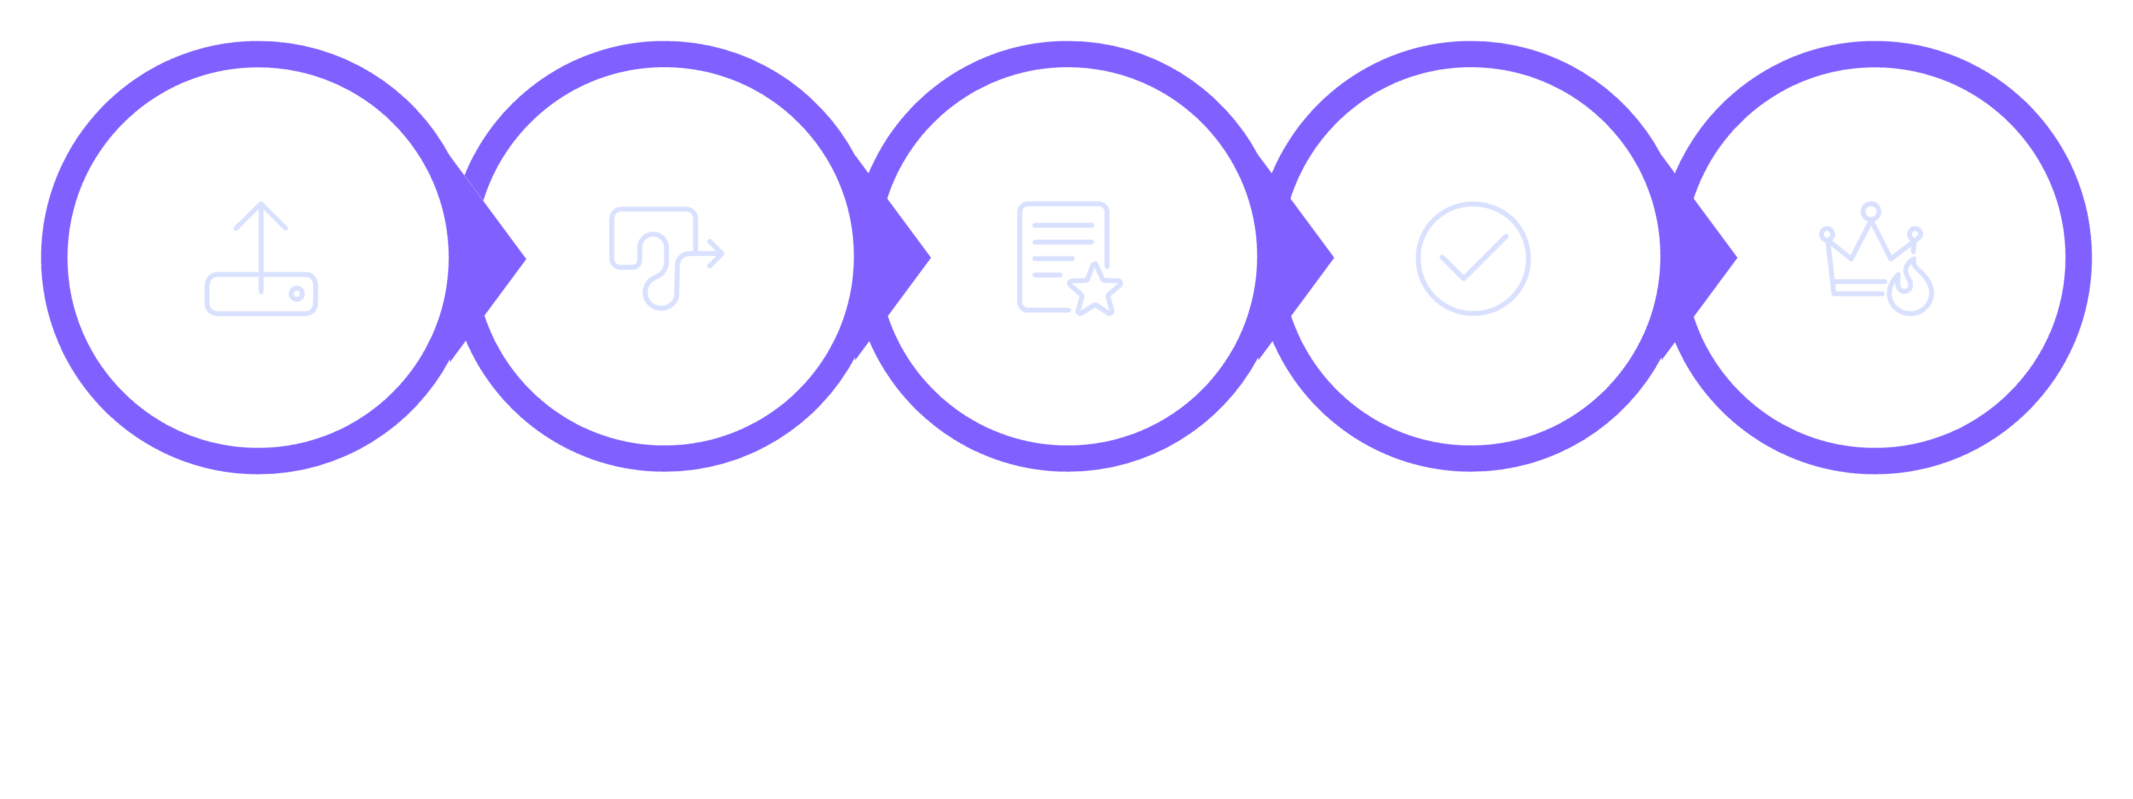
Policy Lifecycle
How a Policy Moves Through the System
A policy progresses through five key stages: Submission, Auto Assignment, Review, Approval, and Activation.
Auto Assignment
Submission
Review
Approval
Activation

Slide 5
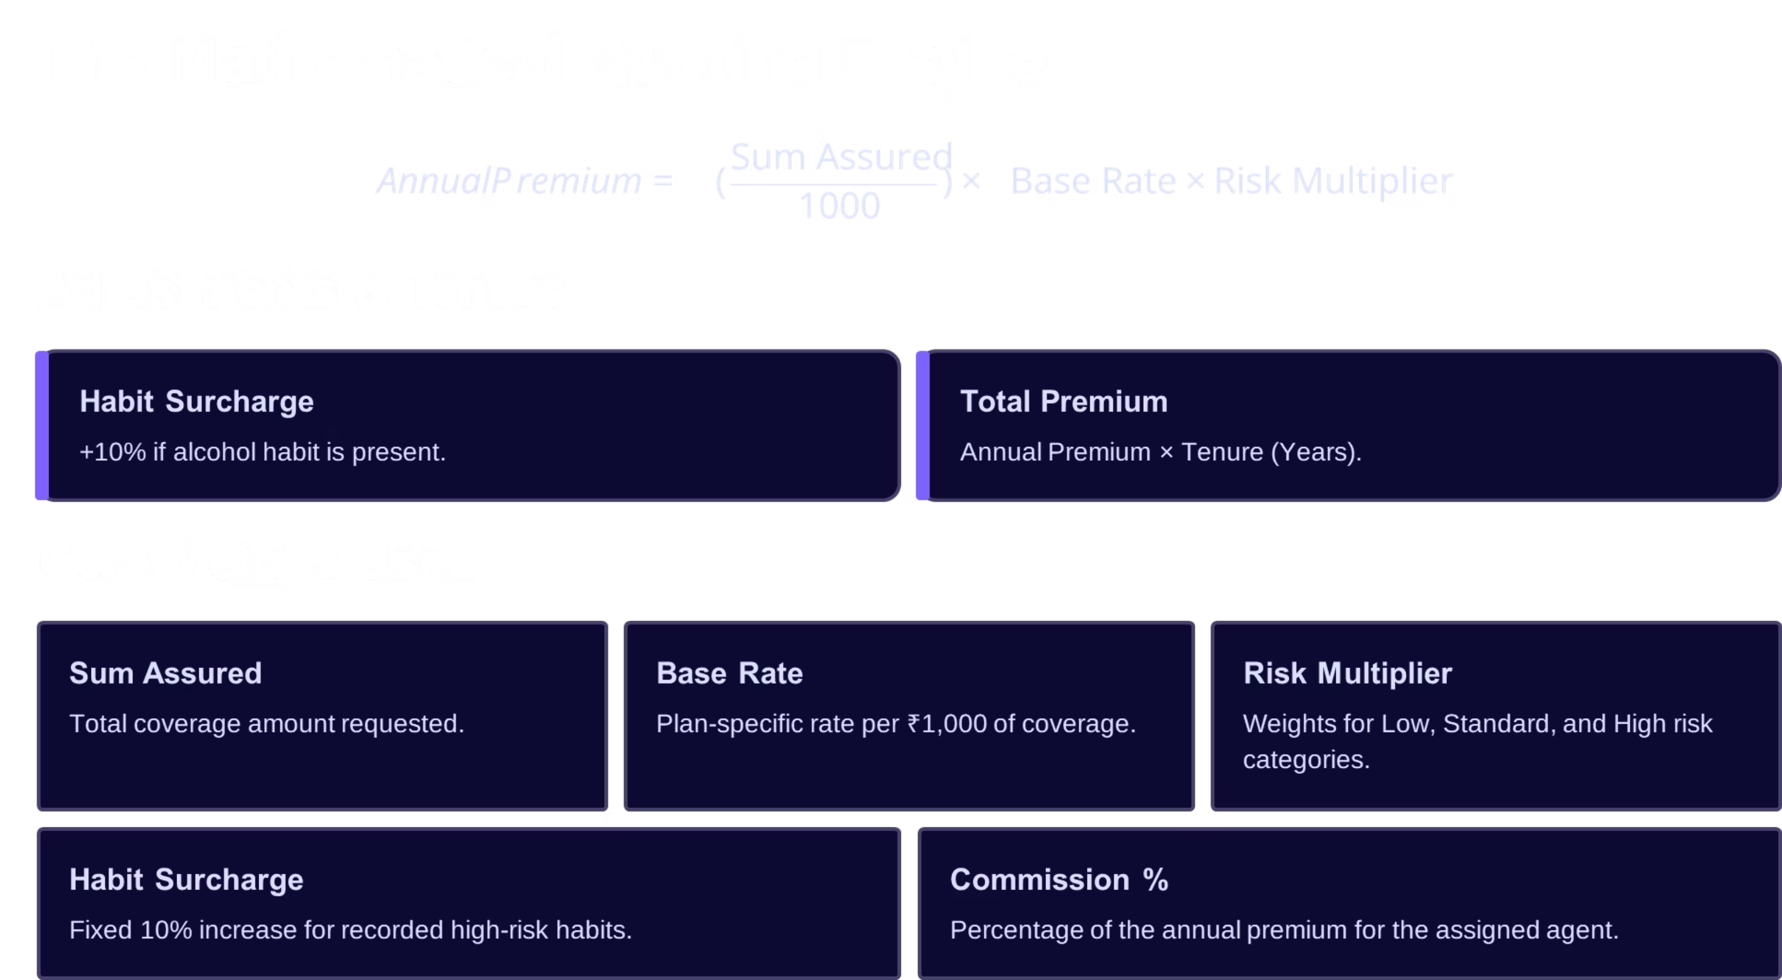

Slide 6

Claim Lifecycle
From Claim Request to Settlement
Approval & Payment
Document Verification
Auto-Assignment
Claim Initiated
This streamlined process ensures quick, secure, and transparent claims processing.

Slide 7
Key Enhancements
Modern tools that improve service, streamline operations, and increase transparency across the policy lifecycle.
① AI Chatbot
② Policy Endorsements
24/7 support with instant answers to common policyholder questions.
Fast updates for beneficiary changes and coverage adjustments.
③ Commission Tracking
④ Invoice Generation
Automated calculation and transparent reporting for agent commissions.
Automatically create and send premium invoices with payment links.

Slide 8




Document Verification Technology
How ID Validation Works
The system extracts and validates data directly from uploaded documents using advanced techniques.
Aadhaar Detection
Duplicate Prevention
Cross-Verification
Uses regex patterns to identify and validate Aadhaar card documents
Applies cryptographic hashing to prevent duplicate document submissions
Matches user-provided data with document information for accuracy
Strengthens identity validation and reduces fraud risk.

Slide 9

AI Integration with Gemini 2.5
Smart Assistance That Improves Accuracy
Policy Summaries
Data Mismatch Detection
Generates clear, concise summaries of complex policy terms and conditions
Identifies inconsistencies between application data and supporting documents
Claim Analysis
Reviews claim documents and highlights key details for officer review
Role-Based Insights
Provides tailored recommendations based on user role and context
The AI skips output when no issues exist, reducing noise and focusing attention where it matters most.

Slide 10
Transforming Insurance with Technology
NexaLife enhances efficiency, accuracy, and user experience through intelligent automation and AI-powered insights.
★ OCR for Documents
★ Mobile Application
★ Predictive Analytics
Extract text from any image-based documents automatically
Complete platform access on iOS and Android devices
ML models that forecast risk and optimize pricing strategies
Thank You
Thank you for your time and attention. We will now proceed to a live demonstration of NexaLife to showcase its features in action.
Let's explore how NexaLife works in real time.

