Slide 1





SQL ANALYTICS PROJECT
SOCIAL MEDIA
ANALYTICS
User Engagement · Content · Hashtags · Follower Analysis
MySQL | SQL Data Analysis

Slide 2




META
  Meta – Founded by Mark Zuckerberg in 2004 as Facebook, rebranded in 2021 to focus on the Metaverse, a virtual space for social interaction and collaboration.
  Products: Facebook, Instagram, WhatsApp, Threads Oculus – aiming to connect virtual and physical worlds.

Slide 3


AGENDA
AGENDA
  Problem Statement
  Data Description
  Objective Key Metrics and Visualizations
  Subjective Question for Insights

Slide 4

PROBLEM
PROBLEM STATEMENT
PROBLEM
Marketing teams wants to leverage Instagram's user data to develop targeted marketing strategies that will increase user engagement, retention, and acquisition. Provide insights and recommendations to address the following objectives

Slide 5

DATA DISCRIPTION
  comments_id : unique identifier for each comment
  comment_text : text content of a given comment
  user_id : unique identifier for each user
  photo_id : unique identifier for each photo
  created_at : date of interaction in the form like, photos, tags
  follower_id : user_id of the follower for a certain user
  followee_id : user_id of followee for a certain user
  tag_id : unique identifier for each tag
  image_url : link to the image posted on the platform
  username : username chosen by the user
DATA LINK LINK

Slide 6
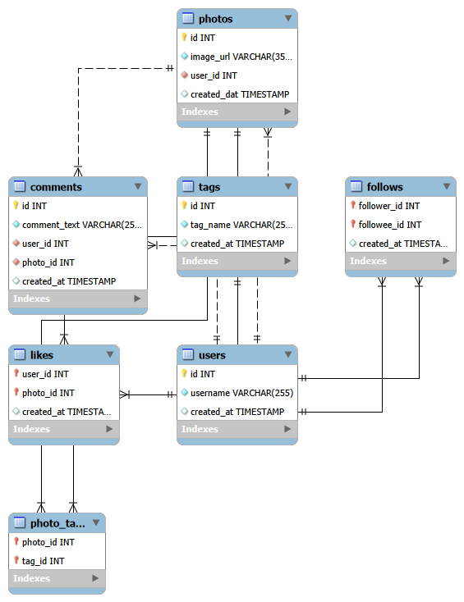
DATABASE SCHEMA
DATABASE
SCHEMA

Slide 7

APPROACH
Understanding Problem Statement
  Define key questions, set analysis goals, and identify available data.
Data Cleaning and Validation
  Checked and removed duplicates in the data sets also treated null values.
Analysis
  Used SQL functions (CTE, aggregates, subqueries, GROUP BY, RANK, etc.) for analysis.
Data Visualization
  Visualised metrics (posts, likes, comments) to rank users by engagement and highlight top hashtags.
Strategy Making
  Prepared plans and strategies for increasing user retention and increasing engagement activity.
Implementation
  Implementation of the plans and strategies is also discussed for optimised and better results.

Slide 8
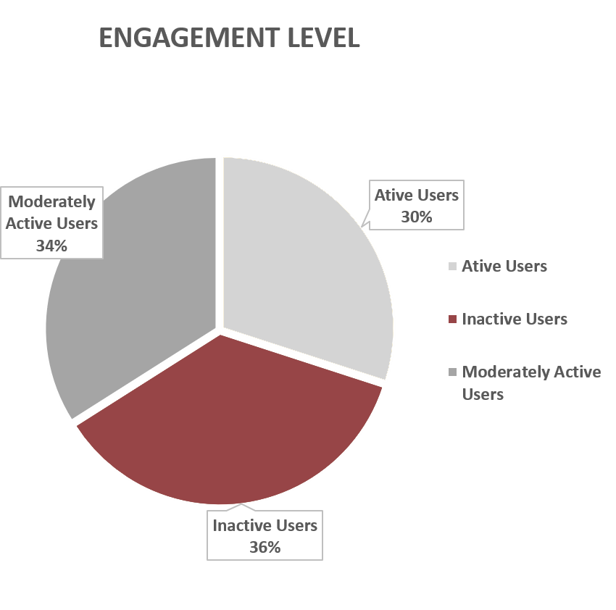
USER CLASSIFICATION
  Out of 100 users there are only 30% of Active Users.
  34 % of users are Moderate Active Users.
  Inactive Users are the those users who have very low engagement rate and they are 34 %.

Slide 9
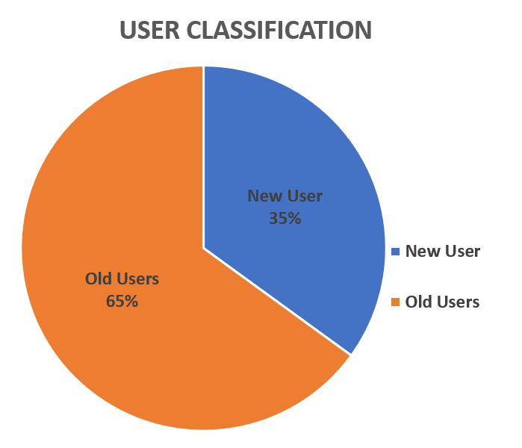
USER CLASSIFICATION
  There are total 100 users.
  There users who created their account before 2017 are considered as Old Users else New Users.
  65% of users are Old Users and 35 % of users are New Users.

Slide 10
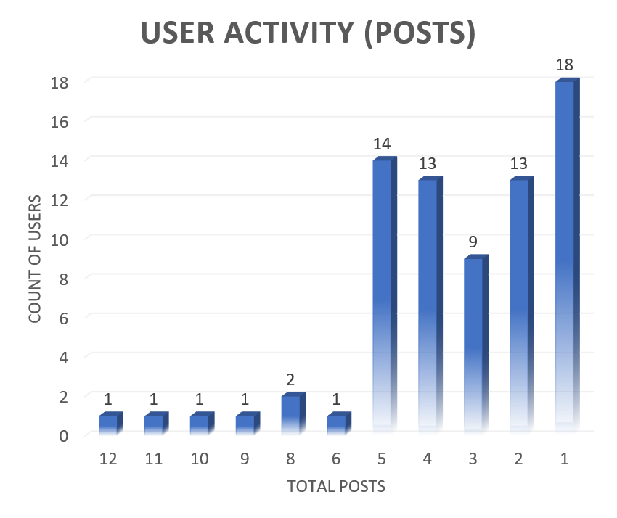
USER ACTIVITY ON PHOTOS
  Out of 100 users, only 74 users have posted photos.
  The majority (18 users) have created only 1 post.
  Only 7 users have posted more than 5 photos.
  As the number of posts increases, the number of users decreases significantly.
  The chart shows the total number of posts made by users.
  The hashtags with the highest engagement rates are
  Beauty; Delicious; Foodie; Dreamy; Food; Photography; Smile; Stunning; Sunset; Beach

Slide 11
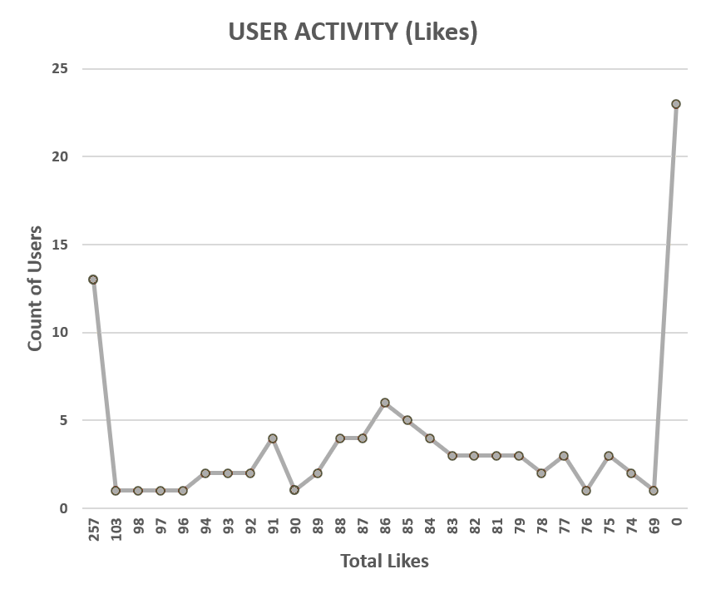
USER ACTIVITY ON LIKES
  The chart shows the number of likes received by each user.
  13 users received 257 likes, which is the highest number of likes among all users.
  The majority of users received fewer than 100 likes.
  23 out of 100 users have received no likes.

Slide 12
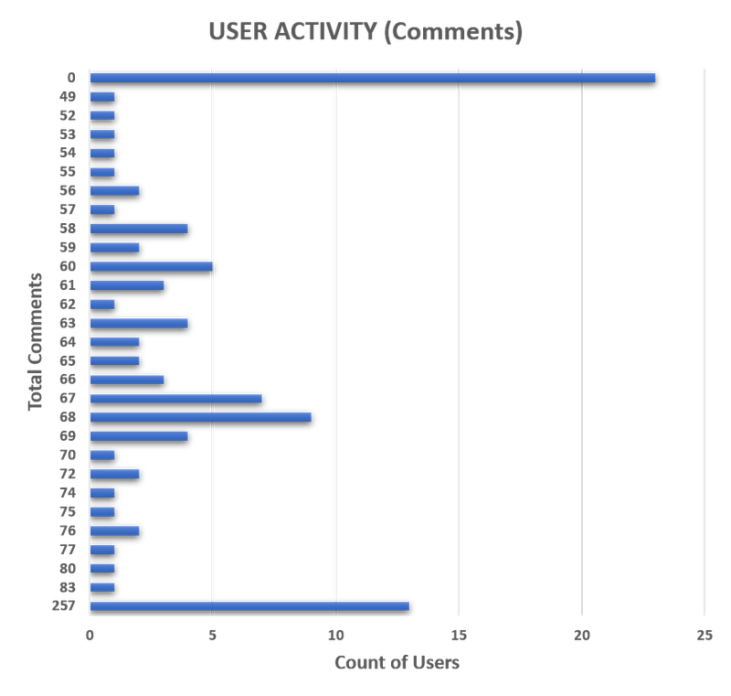
USER ACTIVITY ON COMMENTS
  The chart shows the number of comments made by each user.
  13 users have made 257 comments, which is the highest number of comments made by any user.
  The majority of users have made fewer than 90 comments.
  23 out of 100 users have made no comments.
  These numbers can have a significant impact on the overall engagement rate.

Slide 13
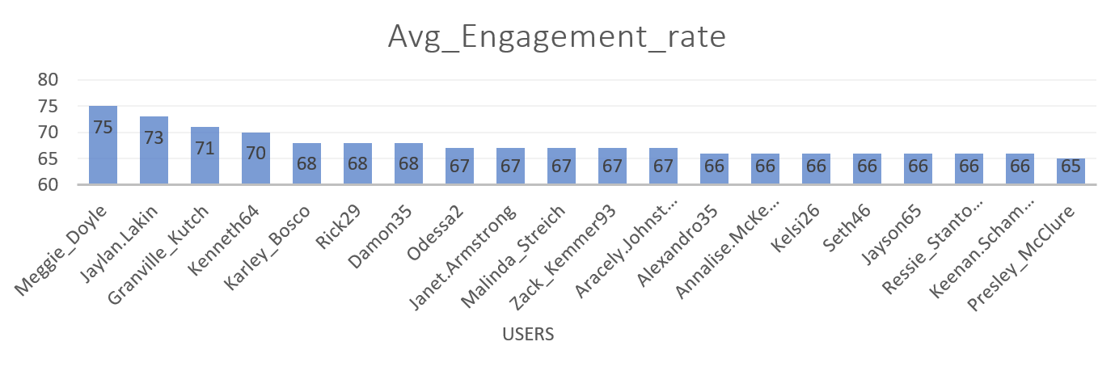
ENGAGEMENT RATE
  The engagement rate is calculated as the sum of the number of likes and comments for each user.
  Improving the user experience can help increase the average engagement rate.
  The chart shows the top 20 most engaged users out of the total 100 users.
  The majority of users have an average engagement rate of less than 70.

Slide 14
RECOMMENDATIONS
Content Strategy
  Focus on food, lifestyle, and nature themes.
  Use high-performing hashtags, such as #foodie and #photography, to improve reach and engagement.
Timing Strategy
  Peak engagement: Around 10 AM. Schedule posts and campaigns accordingly.
  Influencer Strategy
  Collaborate with micro-influencers, such as Florence99 and Eveline95, to create authentic, high-engagement campaigns.
User Segmentation
  Creators: Provide visibility tools and performance analytics.
  Passive Users: Recommend relevant and personalized content to encourage interaction.
  Engagers: Encourage continued interaction through recognition and rewards.
  Dormant Users: Run re-engagement campaigns and personalized outreach.

Slide 15
CONCLUSION
  SQL analysis transformed raw data into actionable insights.
  The analysis identified top influencers, peak engagement times, and trending content.
  These insights can help transform Data → Insights → Strategy → Better Campaigns → Growth.
  Data-driven decision-making can help improve user engagement and support marketing success.
  Promote Reels creation among users and encourage influencers to create Reels around trending hashtags.
  Optimise ads and marketing campaigns based on emerging trends and user engagement patterns.
  Use targeted notifications and email campaigns, supported by A/B testing, to improve campaign effectiveness.

Slide 16

Thanneeu Pranay
THANKYOU
PRESENT BY
THANNEERU PRANAY

