Slide 1
Curdle
By Jeremy, Leon, Harshith, and Andrew

Slide 2
Ever got bored of Wordle?

Slide 3
Introducing
CURDLE

Slide 4
What is Curdle?
Curdle is our project about how we can outsource cheese curd labor and then get a maximum profit on our return tbh

Slide 5
What is Curdle?
Just kidding
We made Wordle
But better

Slide 6
What is Curdle?
Curdle builds upon the original Wordle concept with
Infinite words per day
Global Leaderboards
Bigger words, up to seven letters!
Saved statistics
User login system
Send custom wordles for other people to guess

Slide 7
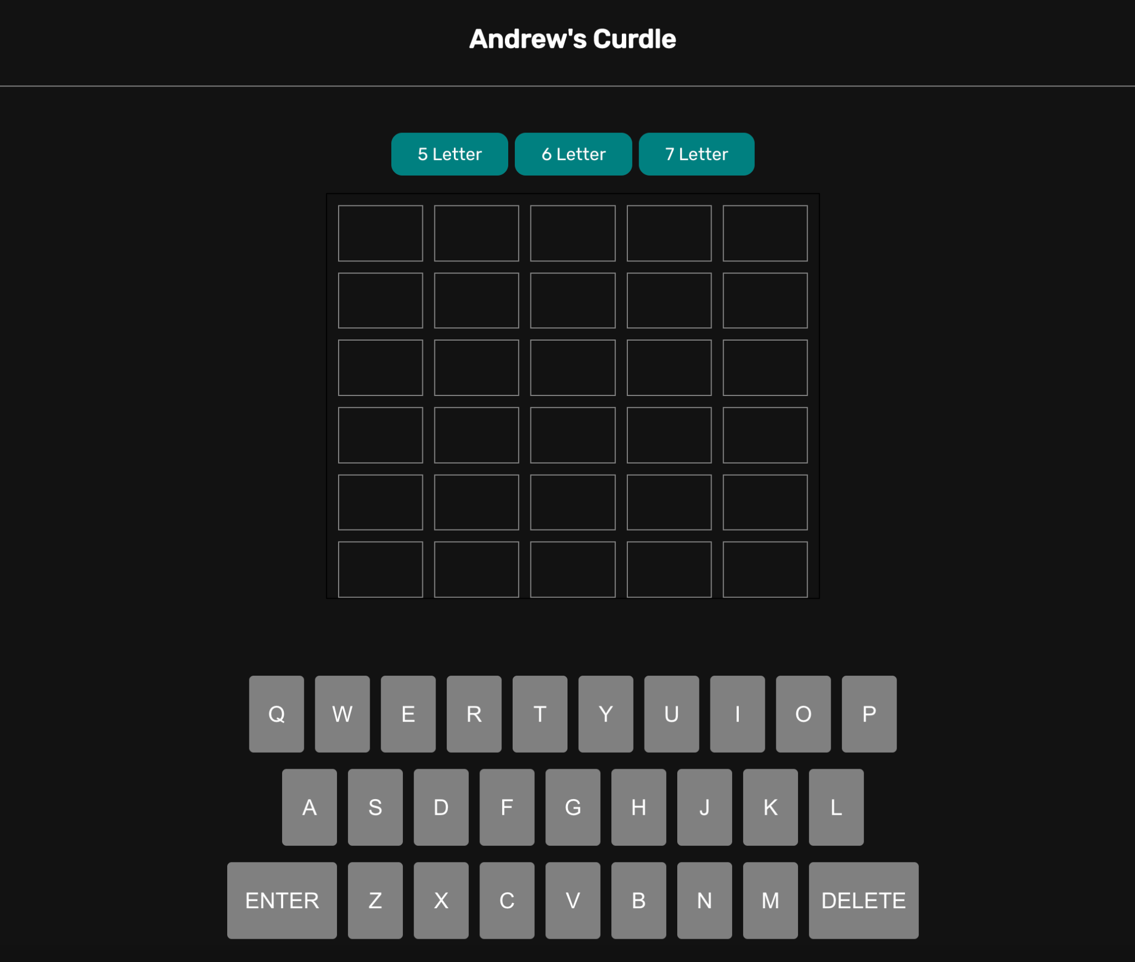

Slide 8
Why do Wordle? Isn’t this really unoriginal?

Slide 9
Why do Wordle?
We all were familiar with the game, it’s popular
We had a ton of ideas for improvements
Simple games like Wordle are fun to build upon

Slide 10
Our Tech

Slide 11
Our Tech Stack
Cheese
Caffeine
2 hours of sleep
React
Node
Firebase

Slide 12
Our Tech Stack
We were able to build the basic Wordle game through ReactJS
Hooked together components to put together a logic system for the game
Based our work off what we learned from the Chorus Lapilli assignment

Slide 13
Our Tech Stack
We looked at the styling and look of the game online, and styled it through CSS
Matched the minimalist style of Wordle
Replicated the look of the original game
Styled the navigation bar menu

Slide 14
Our Tech Stack
We relied on Firebase to implement:
User-specific Data storage:
User Statistics
Store Custom Wordles
User Login data
Log in with specific user ID’s
Allows user-based dynamic displaying of the website
Stats will change if you change accounts, etc.

Slide 15
Our Process

Slide 16
Our Process
We brainstormed ideas
Decided between Wordle and a Medical app
Chose Wordle
Started building

Slide 17
Our Process
We built the basic framework around the game
Developed features around what we could accomplish with Firestore
Split tasks up in terms of
Front-end development
Game and process logic
Server development

Slide 18
How did we meet requirements?

Slide 19
Three Custom Features
Custom board sizes
Global Leaderboard
Hash codes to enter in made by other players
Guess words made by friends, in a sense multiplayer Wordles

Slide 20
We had Three features that satisfy all requirements
Login system
Sending Custom words
Individual Stats

Slide 21
Display Dynamic Data
Real-time updated personal player statistics
Display different boards based on a hash code entered by the user

Slide 22
Uploading data to the back-end
Uploading custom words to Firestore for other people to guess
Stores custom words with a hash code
Whenever the user wins or loses, that data is sent to the back-end
Personal account/user data is uploaded and associated with a user

Slide 23
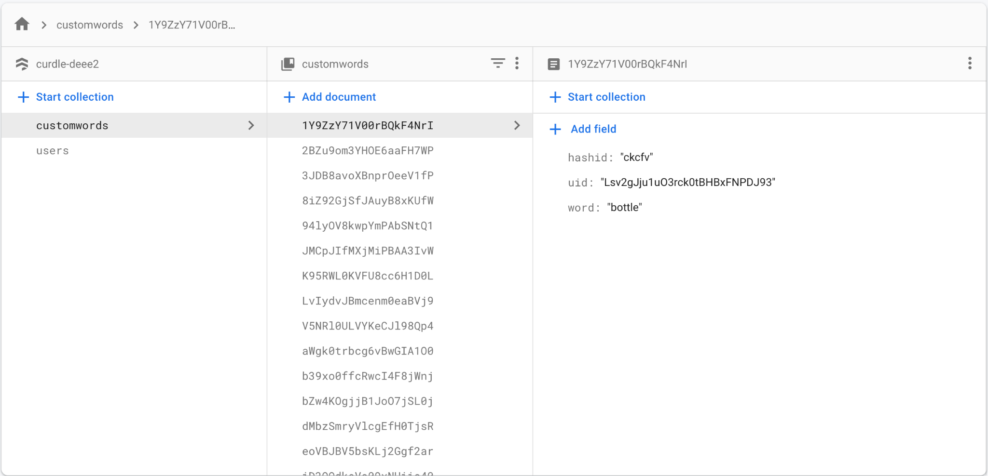

Slide 24
Meaningfully Search Through Server-Side Data
Enter in a hash code
Search through Firestore which sets up a board based on the word associated with the hash code entered
Validating accounts and passwords

Slide 25
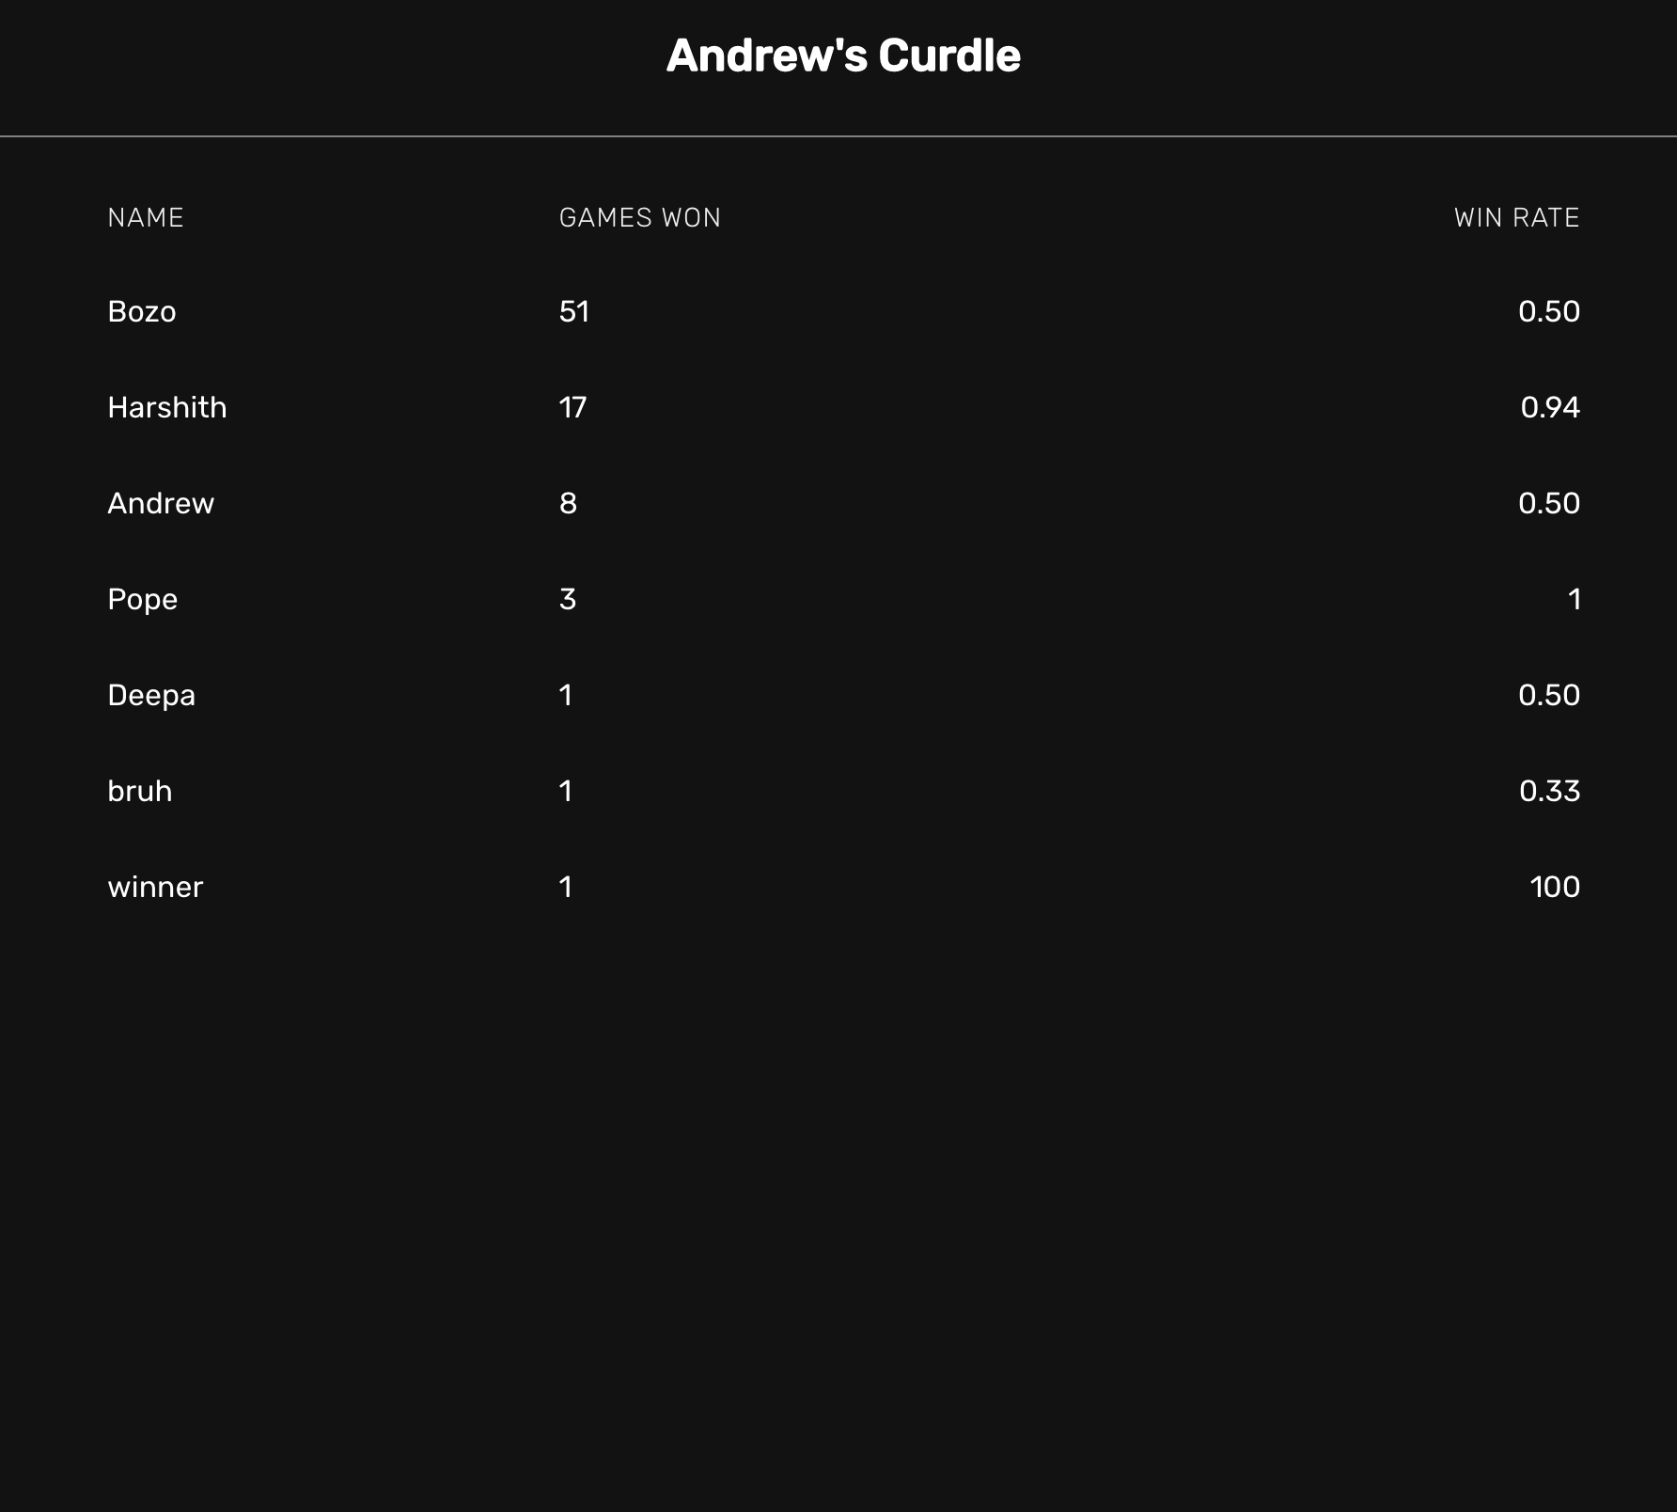

Slide 26
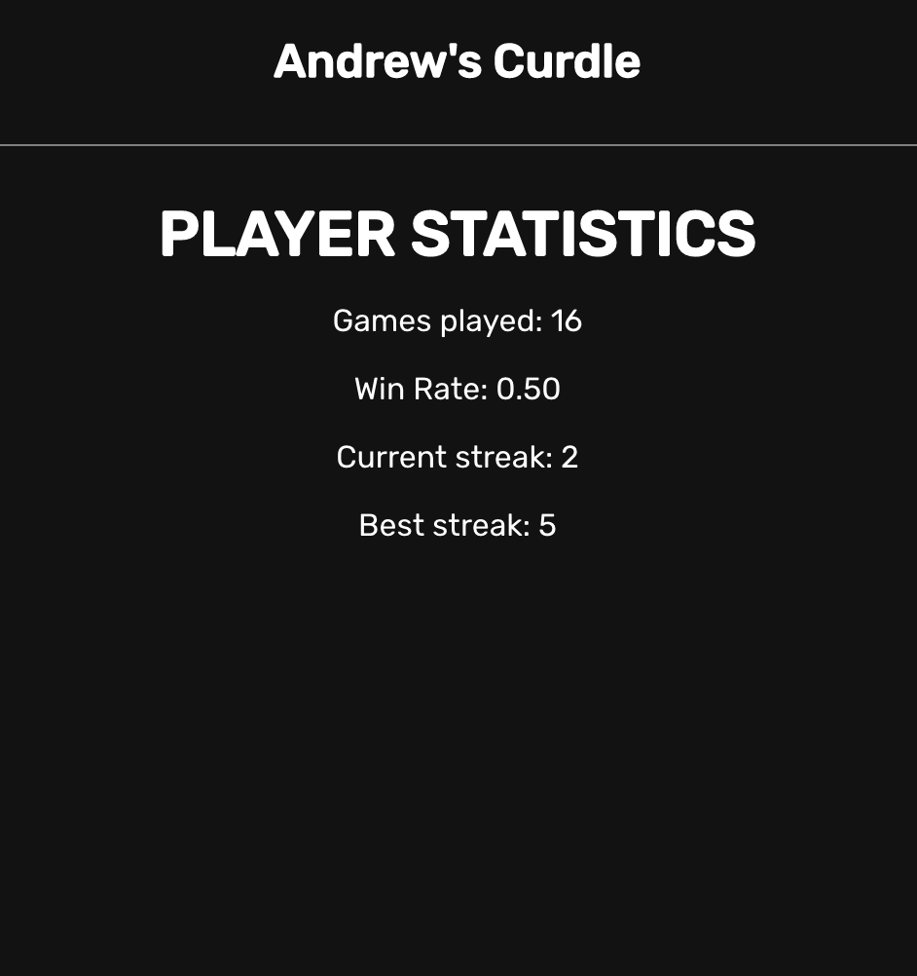

Slide 27
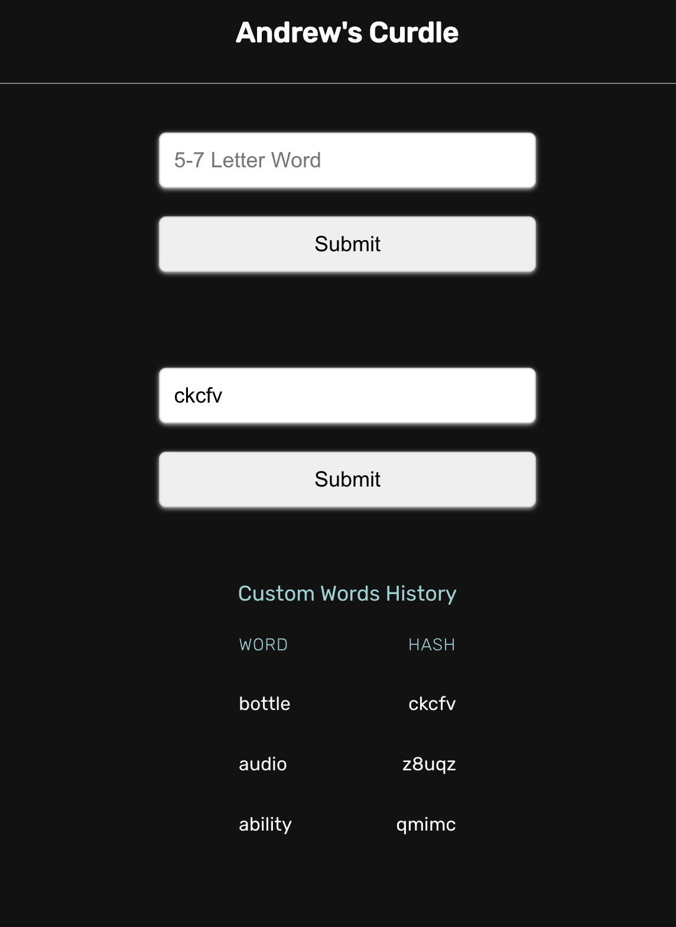

Slide 28
Now - a demo!

