Slide 1
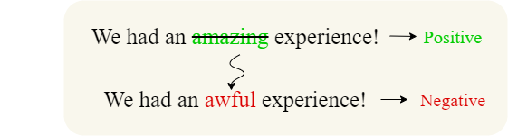
Exploring Text Counterfactual Explanations:
A Multi-Metric Evaluation Approach for
Counterfactual Editors
Diploma Thesis
Karavangelis Athanasios

Slide 2






Table of contents
01.
Introduction
04.
Implementation
02.
Theoretical background
05.
Experiments
06.
Conclusion & Future work
03.
Overview

Slide 3
01.
Introduction

Slide 4

Introduction
Our Objective
The evaluation of counterfactual editors

Slide 5

Introduction
Our Approach
Explore multiple counterfactual generation methods and evaluate them based on various metrics

Slide 6

Introduction
Our Motivation
Counterfactuals of counterfactuals
Filandrianos et al. May 2023

Slide 7

Introduction
Examined NLP Tasks
Text generation, Part-of-speech tagging, Sentiment analysis, Topic classification

Slide 8
Introduction
Our
Objective
The evaluation of counterfactual editors
Explore multiple counterfactual generation methods and evaluate them using novel metrics
Our
Approach
Our
Motivation
Counterfactuals of counterfactuals
Text generation, Part-of-speech tagging, Sentiment analysis, Topic classification
Examined
NLP Tasks

Slide 9
02.
Theoretical background

Slide 10
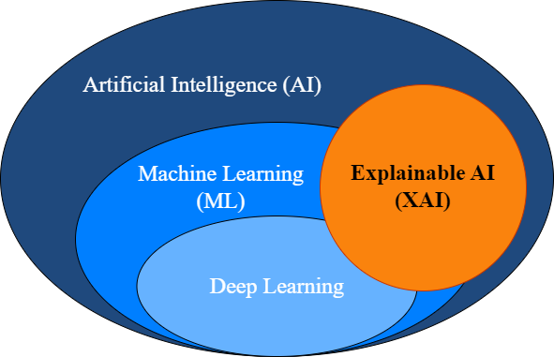
Theoretical background
Explainable AI
Provides explanations of how models make decisions
{
Increases
}
Transparency
Interpretability
Trust
of ML models

Slide 11
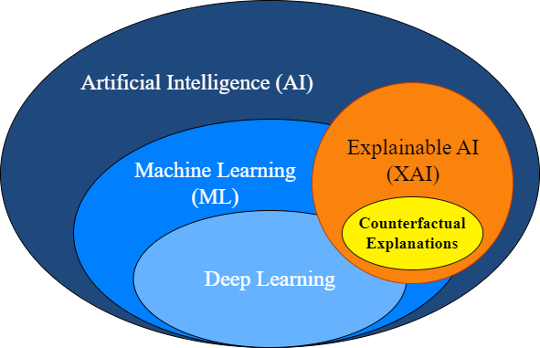
Theoretical background
Counterfactual Explanations

Slide 12

Theoretical background
Counterfactual Explanations
>
Definition
Counterfactual Explanation
Definition: A feature-based explanation that identifies the minimal changes in input variables required to produce a different model prediction.
Life
Explainable AI
ML model
cause
event
input
prediction
a slightly modified cause can result in a different event
minimal changes to the input’s feature values can lead to a different prediction

Slide 13
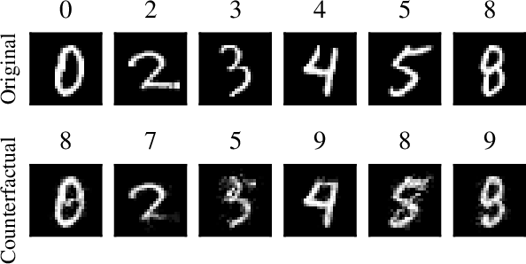
Theoretical background
Counterfactual Explanations
>
Examples
Examples
Image counterfactuals
Example on the Image Classification task with handwritten digits

Slide 14
Theoretical background
Counterfactual Explanations
>
Examples
Examples
Examples
Text counterfactuals
We had an amazing experience!
Positive
Example on the
Sentiment Analysis task
We had an awful experience!
Negative
I think it's a Canon, but it's hardwired. Can it be used?
Miscellaneous
Example on the
Topic Classification task
I think it's a Mac, but it's hardwired. Can it be used?
Computers

Slide 15
Theoretical background
Counterfactual Explanations
>
Counterfactual Editors
Examples
Counterfactual Editor
Definition: A framework that aims to edit a given text instance order to change the prediction of a classifier.
Editor
Search Method
Language model
Input
Masker
Output

Slide 16
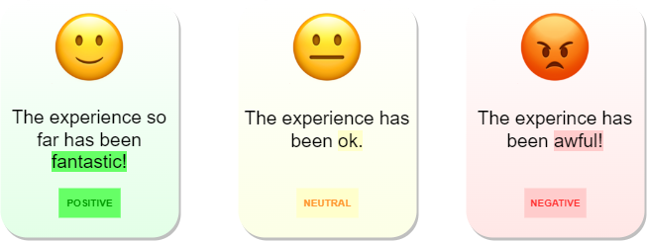
Theoretical background
Examined NLP Tasks
Sentiment Analysis
Topic Classification
Assigns predefined labels to text documents based on their content in order to classify them into distinct topics
Uses computational methods to categorize the sentiment expressed in a piece of text
I have to get my laptop fixed ASAP.
computers
NASA scientists have published some very promising findings.
science

Slide 17


Theoretical background
Examined NLP Tasks
Part-of-speech (POS) tagging
Text Generation
Assigns grammatical tags to individual words in a given text that indicate their part-of-speech
Generates text that resembles human written text using various approaches like language models
We took <mask> for a walk in the <mask>. We had a <mask>.
The short film did not leave up to the high expectations.
Language model
We took the dog for a walk in the park. We had a fun time.

Slide 18
03.
Overview

Slide 19
Overview
Our motivation
Academic paper
Counterfactuals of counterfactuals
Filandrianos et al. May 2023
1
2
Counterfactuals of counterfactuals A new evaluation method for counterfactual editors.
Inconsistency A novel evaluation metric for counterfactual edits.

Slide 20
Overview
Our work
Our motivation
Experiments based on multiple editors combined with various generation methods
We introduce a new constraint on counterfactual generation based on part-of-speech tags
Our evaluation helps explain various aspects of the models’ decisions

Slide 21

Overview
Our motivation
Counterfactual Generation and Evaluation System
Datasets
Editors
Part of speech based constraint
Our System
Metrics
Counterfactuals of counterfactuals

Slide 22
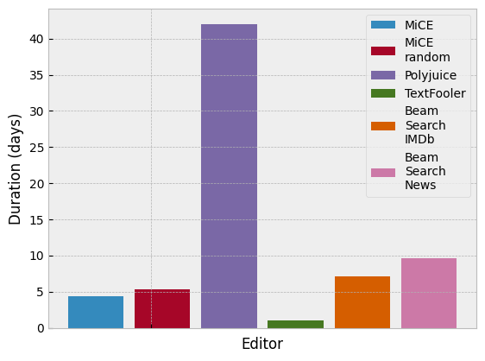
Overview
Our motivation
Experiments and Results
Datasets
Editors
Conduct
Experiments
Extract valuable comparative results and explanations
Part of speech based constraint
Our System
Metrics
Counterfactuals of counterfactuals

Slide 23
04.
Implementation

Slide 24
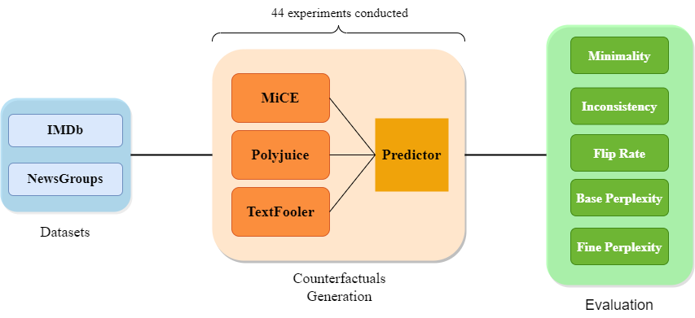
Implementation
An overview

Slide 25


Implementation
Datasets
IMDb
NewsGroups
50.000 movie reviews
20.000 documents
labels: 0 negative 1 positive
7 labels for 7 different topics
we use a subset of 1.000 documents
we use a subset of 500 reviews
mean of 200 words per sentence
mean of 60 words per sentence

Slide 26
Implementation
Counterfactual Generation

Slide 27
Implementation
Our Counterfactual Editing System
The movie was awful.
prediction: 0
The movie was terrible.
prediction: 0
Editor
The game was ok.
prediction: 1
Predictor
Selection of most minimal edit
Masking Method
Language Model
Input
Output
The movie was fantastic.
The movie was <mask>.
The movie was awful.
The movie was terrible.
original prediction: 1
target prediction: 0
The <mask> was <mask>.
The movie was terrible.
new prediction: 0
The game was ok.
POS tag constraint method

Slide 28
Implementation
Counterfactual Editors
MiCE
Polyjuice
Polyjuice
Polyjuice
TextFooler
fine-tuned T5 Transformer
fine-tuned GPT2 model
generates adversarial edits
selects edits based on minimality
generates edits based on specific control codes e.g. negation, surprise
uses word embeddings to find synonyms
employs several deterministic rules e.g. on POS tags
uses gradient masking and random masking
uses random masking
uses word importance ranking for masking

Slide 29
Implementation
Masking methods
Random masking
Gradient masking
Word importance ranking
Polyjuice
Polyjuice
Randomly selects the tokens that will be masked
Uses the predictor’s self-attention to retrieve the most influential words
Calculates the prediction change before and after deleting each word. Then based on this difference, ranks the words from most to less important
MiCE
Polyjuice
MiCE
TextFooler

Slide 30
Implementation
Predictors
Editor
Predictor
Selection of most minimal edit
Masking Method
Language Model
Input
Output
POS tag constraint method

Slide 31
Implementation
Predictors
Example on IMDb
Two pre-trained predictors fine-tuned on IMDb and NewsGroups
Read the book, forget the movie!
Built on RoBERTa Large
Predictor
Calculate the probability of the labels in the range of 0 to 1.
[0.9972, 0.0028]
(0) (1)

Slide 32
Implementation
Our POS tag constraint
Editor
Predictor
Selection of most minimal edit
Masking Method
Language Model
Input
Output
POS tag constraint method

Slide 33
Implementation
Our Part-of-speech (POS) tag constraint

Slide 34
Implementation
Our Part-of-speech (POS) tag constraint
What we do
If you like good thrillers, this amazing film is just what you need!
We use part-of-speech tagging to constrain the words that can be edited
ADJ (adjectives)
Aim to minimize the needed modifications
If you like good thrillers, this amazing film is just what you need!
NOUN (nouns)
Intervene in the masking stage of the editors to enforce the constraint
If you like good thrillers, this amazing film is just what you need!
VERB (verbs)

Slide 35
Implementation
Our Part-of-speech tag constraint
If you like good thrillers, this amazing film is just what you need!
Tokenization
[‘If’, ‘you’, ‘like’, … , ‘what’, ‘you’, ‘need’, ’!’]
adjective
Part-of-speech filter
[‘good’, ‘amazing’]
Predictor
Selection of most minimal edit
Masker
Language Model
If you like <mask> thrillers, this <mask> film is just what you need!
Output

Slide 36
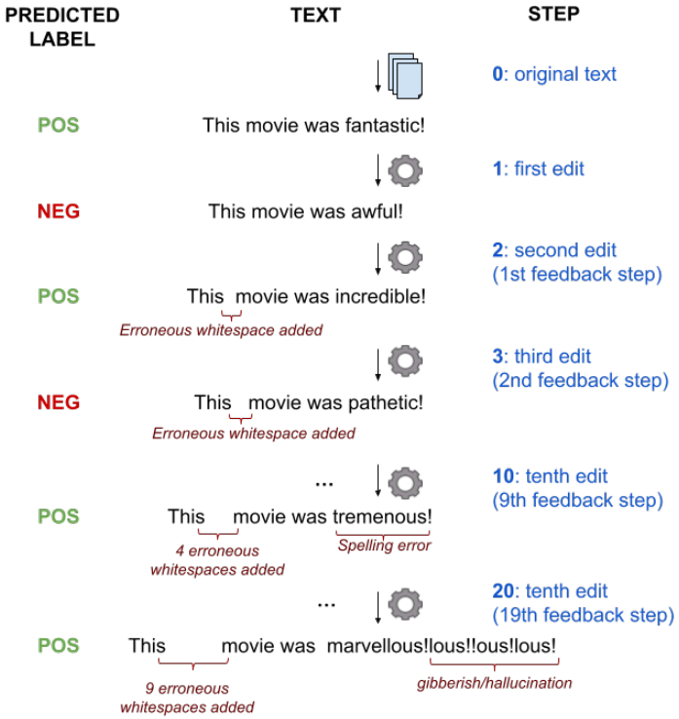
Implementation
Counterfactuals of counterfactuals

Slide 37
Implementation
Counterfactuals of counterfactuals
An iterative feedback process
STEP TEXT
0
The movie was fantastic.
The movie was terrible.
Predictor
1
The movie was terrible.
The movie was fantastic.
Selection of most minimal edit
The movie was amazing.
Input
Editor
Output
2
The movie was amazing.
.
3
The movie was bad.
.
.

Slide 38
Implementation
Combining the methods
Editor
Predictor
Selection of most minimal edit
Masking Method
Language Model
Input
Output
POS tag constraint method
Counterfactuals of counterfactuals

Slide 39
Implementation
Evaluation

Slide 40
Implementation
Evaluation
Minimality
Calculates the word-level Levenshtein edit distance
The movie was a great exhibition of classic cinema.
Shows how many words were changed in the sentence after the edit
minimality: 3
The play was a valid exhibition of bad cinema.
Intuitively: Low values of the metric indicate more minimal changes by the editor

Slide 41

Implementation
Evaluation
Inconsistency (of minimality)
Novel metric introduced by Filandrianos et al.
Measures how “consistent” an editor is with respect to a metric (e.g. minimality)
Step 0:
The movie was a great exhibition of classic cinema.
Values of 0 mean that the editor generates the most minimal edit possible
minimality: 2
Step 1:
The play was a valid exhibition of bad cinema.
Intuitively: Small positive values indicate almost optimal series of edits
minimality: 3
Step 2:
The film was a good exhibition of good cinema.
inc@2 = 3 - 2 / 2 = 0.5

Slide 42

Implementation
Evaluation
Flip Rate
Used with many counterfactual editors (MiCE, TextFooler etc)
Shows how often the output of the predictor is flipped
Also called: attack success rate
Intuitively: The higher the flip rate of an editor, the more edits it succeeds flipping
Accomplished flip!

Slide 43
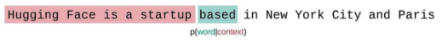
Implementation
Evaluation
Base perplexity
Fine perplexity
A proxy for evaluating fluency
Same as base perplexity but the language model used is fine-tuned on a dataset.
Calculates the likelihood of the next token conditioned on the preceding tokens. based on some language model, e.g. we use GPT2
Intuitively: Lower values mean that the edits converge to the dataset’s distribution. Assesses how the model has adapted to the specific dataset.
Intuitively: Lower values mean more predictable edits. Higher values mean more diverse - surprising edits.
Source: https://huggingface.co/docs/transformers/perplexity

Slide 44







Implementation
Technologies used
Python
GPU accelerated environments
Various ML and NLP libraries
Our experiments needed 1670 GPU hours (!) , this translates to 70 days for one GPU.
Access to pretrained models
Text Generation
ARIS HPC
GPU acceleration
Supercomputer operated by GRNET
Part-of-speech tagging

Slide 45

05.
Experiments

Slide 46

Experiments
Overview
Editors without making any modifications in their code
Experiments on the generation algorithm of MiCE
10 steps of edits
 |  |  |  |  | -
 |  |  |  |  | -
 |  |  |  |  | -
Experiment Types
4 editors
Out-of-the-box
ADJ
NOUN
VERB
Beam-Search
MiCE
MiCERandom
Polyjuice
TextFooler

Slide 47
Experiments
Interpreting the qualitative results

Slide 48
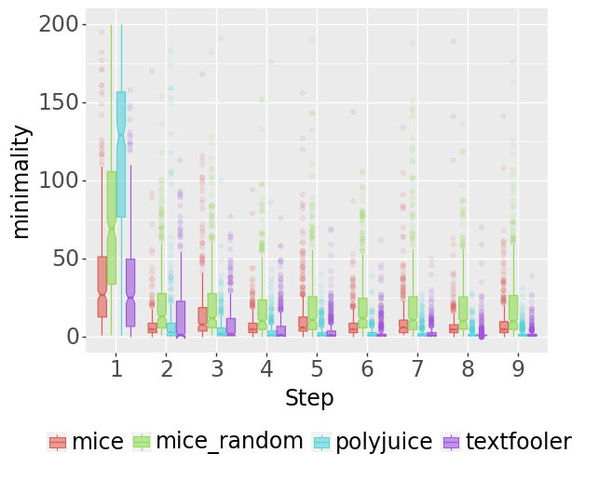
Experiments
Interpreting the qualitative results
Minimality
Intuitively: Low values of the metric indicate more minimal changes by the editor
Out-of-the-box
TextFooler produces the most minimal edits. Deterministic approach with many constraints.
MiCE and Polyjuice edits that use language models are less minimal
Editors with random masking are less minimal than those that use attention masking

Slide 49
Experiments
Interpreting the qualitative results
Minimality
Intuitively: Low values of the metric indicate more minimal changes by the editor
Out-of-the-box
MiCE
0: You may like Tim Burton's fantasies, but not in a commercial-like show off lasting 8 minutes. It demonstrates good technical points without real creativity or some established narrative pace.
1: You may like Cary Grant's play, but not in a full- length 8 minutes. It contains good plot points without real surprises or some established frantic pace.
2: You may like Cary Grant's play, but not in a mere 8 minutes. It contains good plot points without real interest or some established stable pace.

Slide 50
Experiments
Interpreting the qualitative results
Minimality
Intuitively: Low values of the metric indicate more minimal changes by the editor
Out-of-the-box
TextFooler
0: You may like Tim Burton's fantasies, but not in a commercial-like show off lasting 8 minutes. It demonstrates good technical points without real creativity or some established narrative pace.
1: You may such Tim Burton's fantasies, but not in a commercial-like show off lasting 8 mn. It demonstrates good technical points without real groundbreaking or some established narrative pace.
2: You may such Tim Burton's fantasies, but not in a commercial-like show off longstanding 8 mn. It demonstrates good technical points without real groundbreaking or some established narrative pace.

Slide 51
Experiments
Interpreting the qualitative results
Minimality
Intuitively: Low values of the metric indicate more minimal changes by the editor
POS tag constraint
Constraining the editors to a specific POS tag reduces the candidate words for modification
MiCE ADJ
0: You may like Tim Burton's fantasies, but not in a commercial-like show off lasting 8 minutes. It demonstrates good technical points without real creativity or some established narrative pace.
More minimal edits generated
1: You may like Tim Burton's fantasies, but not in a light- hearted show off lasting 8 minutes. It demonstrates good plot points without real creativity or some established predictable pace.
Most efficient POS:
2: You may like Tim Burton's fantasies, but not in a boring show off lasting 8 minutes. It demonstrates basic plot points without real creativity or some established predictable pace.
IMDb
NewsGroups
ADJ
NOUN

Slide 52
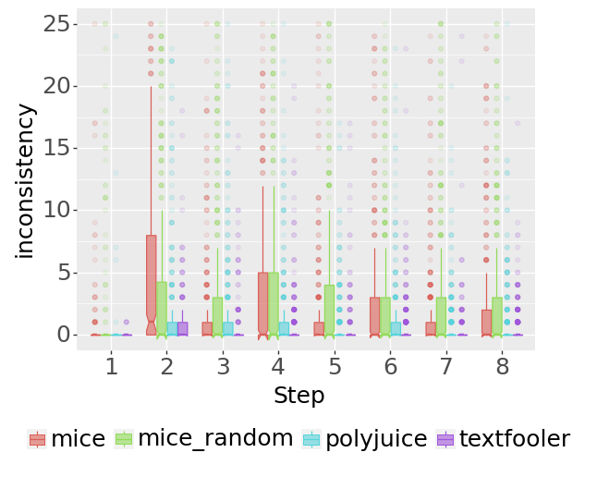
Experiments
Interpreting the qualitative results
Inconsistency
Intuitively: Small positive values indicate almost optimal series of edits
Out-of-the-box
TextFooler produces the most consistent edits.
>Inconsistency values, nearly 0.
Language models are more sensitive to input modifications.
> MiCE and Polyjuice are less consistent.
Editors turn more consistent in later feedback steps.

Slide 53
Experiments
Interpreting the qualitative results
Inconsistency
Intuitively: Small positive values indicate almost optimal series of edits
Out-of-the-box
MiCE editors present higher inconsistency values in even steps
Even steps represent flips from the original prediction to the contrast one
MiCE moves easier back to the original than the contrast one > One cause is text residue from the original sentence

Slide 54
Experiments
Interpreting the qualitative results
Inconsistency
Intuitively: Small positive values indicate almost optimal series of edits
POS tag constraint
Constraining the editors to a specific POS tag makes the editors far more consistent
Most consistent POS:
IMDb & NewsGroups
ADJ
All editors present mean inconsistency values around 0 and 1, hinting at almost optimal edits in terms of minimality

Slide 55
Experiments
Interpreting the qualitative results
Inconsistency
POS tag constraint
IMDb
MiCERandom ADJ
0: The biggest heroes, is one of the greatest movies ever. A good story, great actors and a brilliant ending is what makes this film the jumping start of the director Thomas Vinterberg's great carrier.
1: The great carrier, heroes, is one of the worst horror movies ever. A good story, great actors and a brilliant ending is what makes this film the jumping start of the director Thomas Vinterberg's great carrier.
2: The great carrier, heroes, is one of the best horror movies ever. A good story, great actors and a surprisingly satisfying ending is what makes this film the jumping start of the director Thomas Vinterberg's great carrier.

Slide 56
Experiments
Interpreting the qualitative results
Inconsistency
Out-of-the-box
IMDb
MiCERandom
0: The biggest heroes, is one of the greatest movies ever. A good story, great actors and a brilliant ending is what makes this film the jumping start of the director Thomas Vinterberg's great carrier.
1: The biggest heroes, is not one of the best movies ever. Stupid story, great actors and a brilliant script is what saved the director Wolfgang Vinterberg's great carrier.
2: The original heroes, heroes of slash movies ever created - great actors and actresses ! This is legendary director Üne Vinterberg's great carrier -opera duo.

Slide 57
Experiments
Interpreting the qualitative results
Inconsistency
POS tag constraint
NewsGroups
TextFooler NOUN
0: Wayne: Look for these advertised in sailboat supplies catalogs.
1: Wayne: Look for these advertised in sailboat wares catalogs.
2: Wayne: Look for these advertised in sailboat foodstuffs catalogs.
3: Wayne: Look for these advertised in sailboat wares catalogs.
4: Wayne: Look for these advertised in sailboat foodstuffs catalogs.
5: Wayne: Look for these advertised in sailboat wares catalogs.

Slide 58
Experiments
Interpreting the qualitative results
Inconsistency
Out-of-the-box
NewsGroups
TextFooler
0: Wayne: Look for these advertised in sailboat supplies catalogs.
1: Thomas: Look for these shown in sailboat wares catalogs.
2: Thomas: Look for these shown in sailboat supplies catalogs.
3: Thomas: Look on these shown in spacecraft foodstuff catalogs.
4: Thomas: Look on these shown in boat foodstuffs catalogs.
5: Thomas: Observe on these shown in spacecraft foodstuffs catalogs.

Slide 59
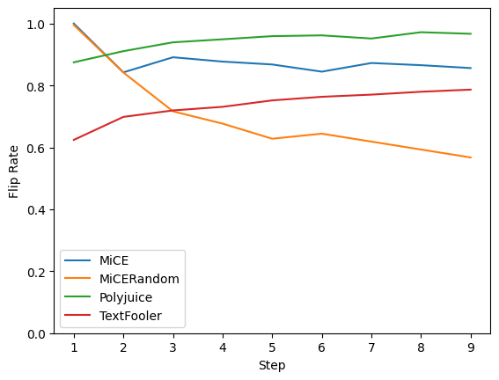
Experiments
Interpreting the qualitative results
Flip Rate
Intuitively: The higher the flip rate of an editor, the more edits it succeeds flipping
Out-of-the-box
Combined with counterfactuals of counterfactuals, it reveals editors imperfections or strengths > e.g. for MiCERandom
At Step 1 MiCE flipped 100% of the input , at Step 9: 85%
Polyjuice and TextFooler become more effective at later steps
Flip rate reveals that the editors present different behavior when they are not dataset-dependent

Slide 60
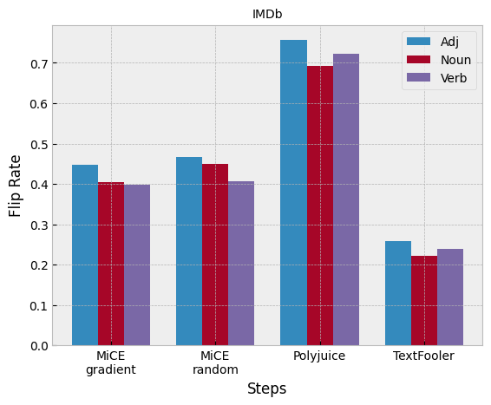
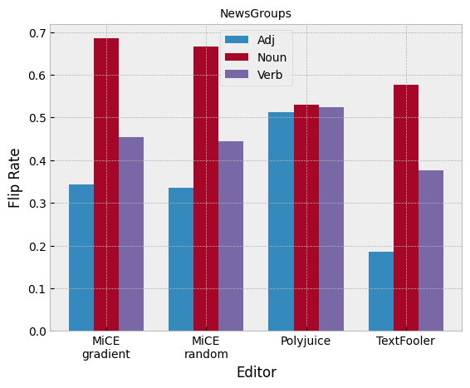
Experiments
Interpreting the qualitative results
Flip Rate
Intuitively: The higher the flip rate of an editor, the more edits it succeeds flipping
POS tag constraint
Generally, much lower flip rates
In IMDb, adjectives perform better
In NewsGroups, nouns perform better

Slide 61
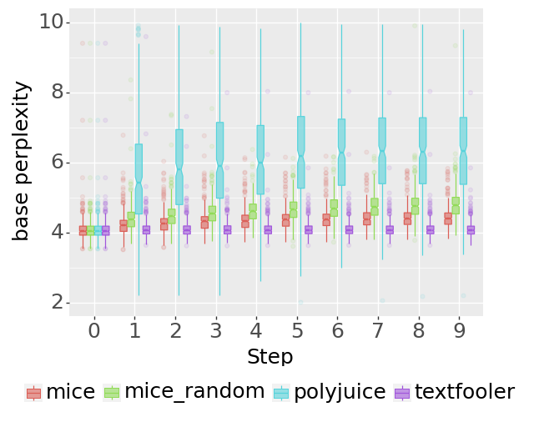
Experiments
Interpreting the qualitative results
Base Perplexity
Intuitively: Lower values mean more predictable edits. Higher values mean more diverse - surprising edits.
Out-of-the-box
IMDb
Polyjuice creates more diverse text->has increasing ppl values >model trained on many datasets
TextFooler’s perplexity does not deteriorate at later steps > maintains sentence’s structure

Slide 62
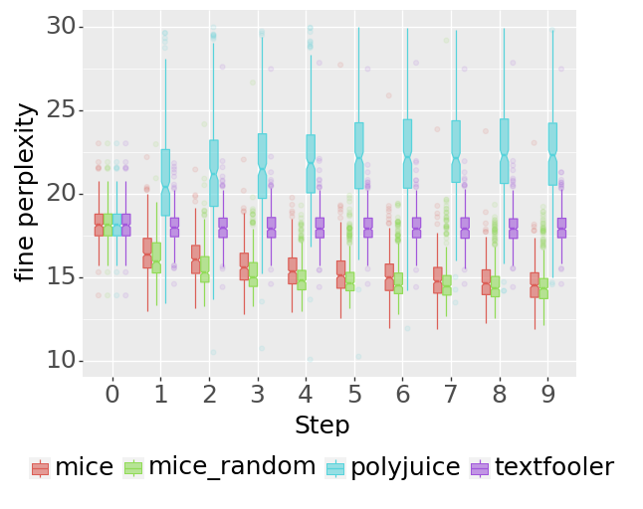
Experiments
Interpreting the qualitative results
Fine Perplexity
Out-of-the-box
Intuitively: Lower values mean that the edits converge to the dataset’s distribution. Assesses how the model has adapted to the specific dataset.
IMDb
MiCE and MiCERandom present decrease in fine-ppl (!) > Overfitting behavior. They are pre-trained on the IMDb dataset , the same dataset the model of fine-ppl is fine-tuned on!
TextFooler is stable, and Polyjuice generates more diverse text

Slide 63
Experiments
Interpreting the qualitative results
Base & Fine Perplexity
POS tag constraint
All editors present lower base perplexity values. > Cause: Editing less tokens favors the maintenance of the sentence’s structure. However, we have less diversity.
The POS constraint helps to limit the overfitting behavior
> the text converges slower to the dataset’s distribution

Slide 64
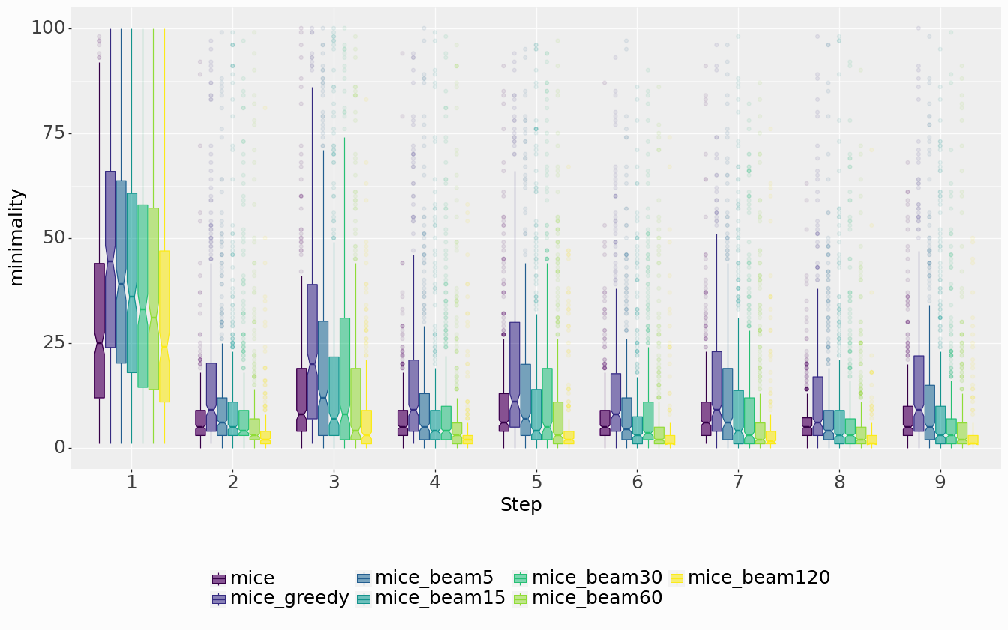
Experiments
Interpreting the qualitative results
Beam-search on MiCE
Beam search with 120 beams outperforms MiCE’s generation method (multinomial sampling) on IMDb in terms of minimality and inconsistency
Minimality on IMDb
Beam search with a high number of beams enables the model to explore more substitutions, increasing the possibility of minimal edits
Slightly more diverse text is generated as beams increase

Slide 65
06.
Conclusion & Future work

Slide 66
Conclusion & Future Work
Conclusion
In this diploma thesis, we:
Introduce a novel method for counterfactuals generation which leverages part-of-speech tagging
Implement a counterfactual generation system
Effectively utilized and expanded methods in the recent bibliography and proved their efficiency
Conduct experiments with multiple counterfactual editors and methods and generate thousands of counterfactuals
Explain the decisions of counterfactual editors and explore potential vulnerabilities

Slide 67
Conclusion & Future Work
Future work
Experiment with more NLP tasks, e.g. Named Entity Recognition
Study the insights inconsistency provides when combined with other metrics too
Different predictors in order to investigate potential bias
Create a dataset with the generated counterfactual explanations for other tasks, e.g. data augmentation
Explore the inverse problem: Develop a new editor from scratch based on this work’s evaluation and explanations, e.g. optimized on inconsistency for more consistent edits

Slide 68

Thank you for your attention!

Slide 69

Questions?

