Slide 1
Internet of Things
Αρχιτεκτονική Συστημάτων IoT

Slide 2
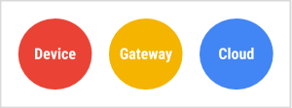
Top-level components
Source: https://cloud.google.com/architecture/iot-overview

Slide 3
Devices
IoT devices are pieces of hardware, such as sensors, actuators, gadgets, appliances, or machines, that are programmed for certain applications and can transmit data over the Ιnternet or other networks. They can be embedded into other mobile devices, industrial equipment, environmental sensors, medical devices, and more.
Source: https://www.arm.com/glossary/iot-devices

Slide 4
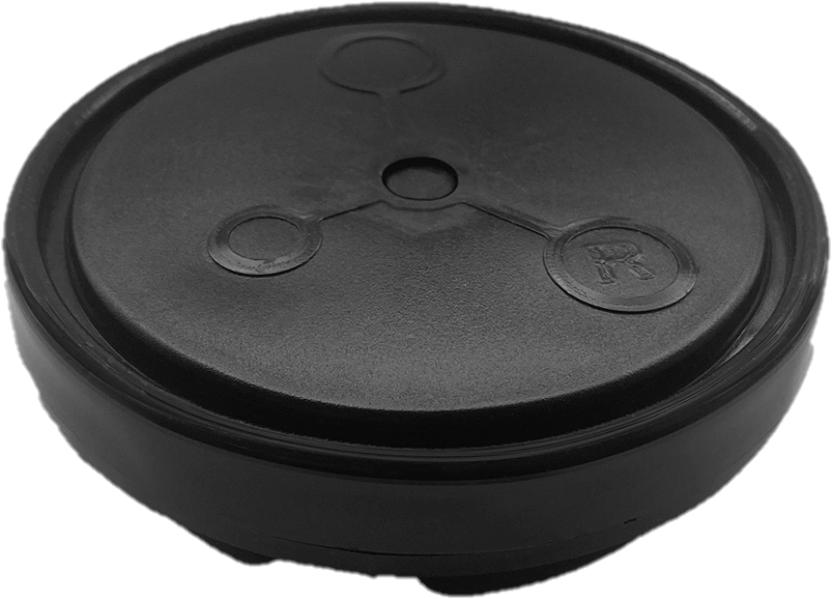
Parking sensor
Source: https://cicicom.gr/pages/lora-wan/lora-parking-sensor/

Slide 5
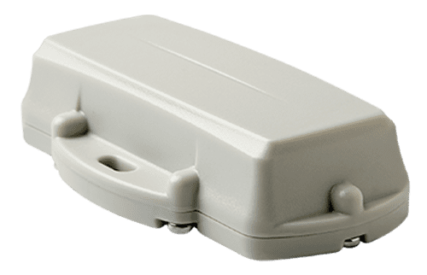
Asset tracker
Source: https://www.digitalmatter.com/devices/guppy-lorawan/

Slide 6
Gateways
An IoT gateway is a physical device or virtual platform that connects sensors, IoT modules, and smart devices to the cloud.
Gateways serve as a wireless access portal to give IoT devices access to the Internet.
All the information moving through an IoT ecosystem – from an IoT device to the cloud, or vice versa – goes through a connected IoT gateway.
Source: https://www.thalesgroup.com/en/markets/digital-identity-and-security/iot/inspired/iot-gateway

Slide 7
Gateways
An IoT Gateway collects massive data from many connected devices and sensors in any given IoT ecosystem.
The gateway pre-processes the data before passing it along to cloud platforms, where the heavy lifting of transforming data into meaningful intelligence is accomplished.
IoT gateways also receive information from the cloud, sent back to devices to allow autonomous management of devices in the field.
Source: https://www.thalesgroup.com/en/markets/digital-identity-and-security/iot/inspired/iot-gateway

Slide 8
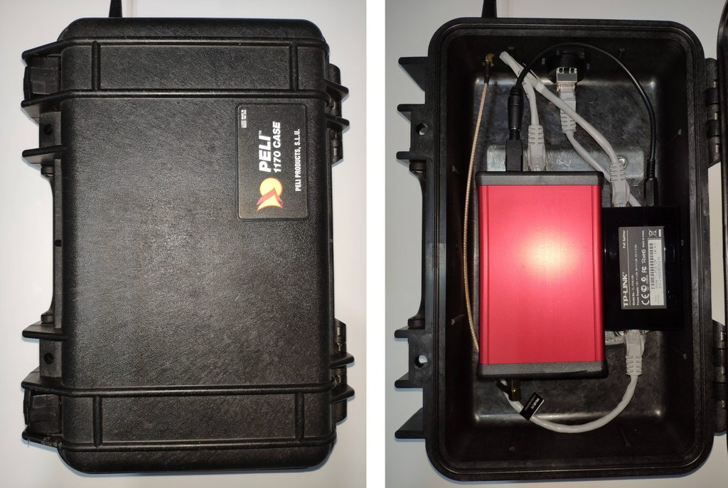
LoRa gateway
Source: https://webshop.ideetron.nl/LARANK-8_PLUS

Slide 9
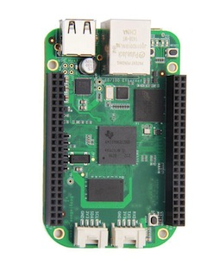
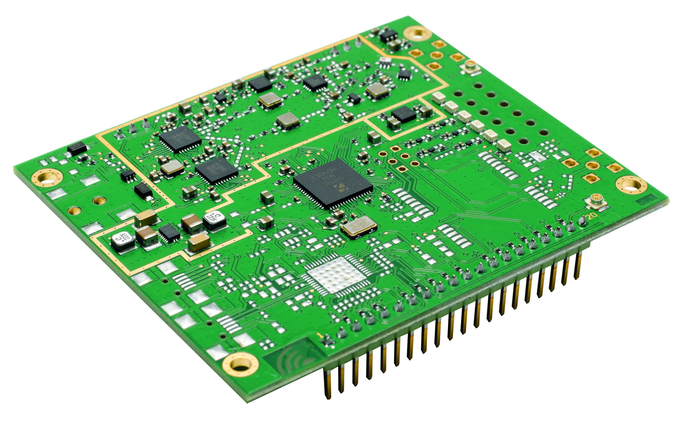
LoRa gateway
Source: https://beagleboard.org/green
Source: https://wireless-solutions.de/products/lora-solutions-by-imst/radio-modules/ic880a-spi/

Slide 10
IoT platform
An IoT platform is typically a third-party vendor provided/hosted SaaS-based tool that is used to support IoT device and endpoint management, connectivity and network management, data management, processing and analysis, application development, cybersecurity, access control, monitoring, event processing, and interfacing/integration.
Source: https://csrc.nist.gov/glossary/term/iot_platform

Slide 11
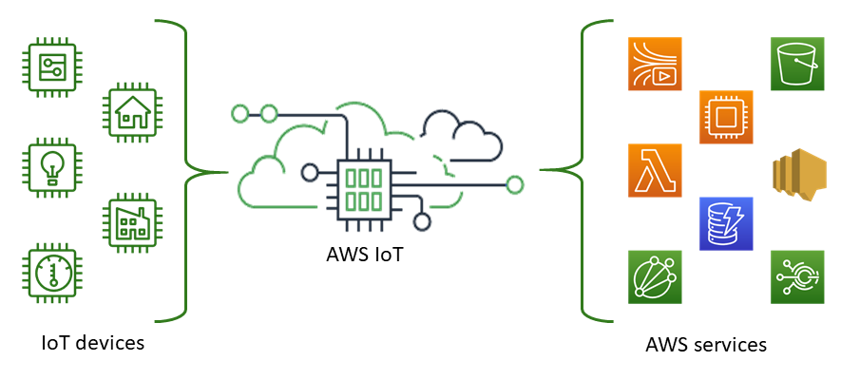
AWS IoT
Source: https://docs.aws.amazon.com/iot/latest/developerguide/what-is-aws-iot.html

Slide 12
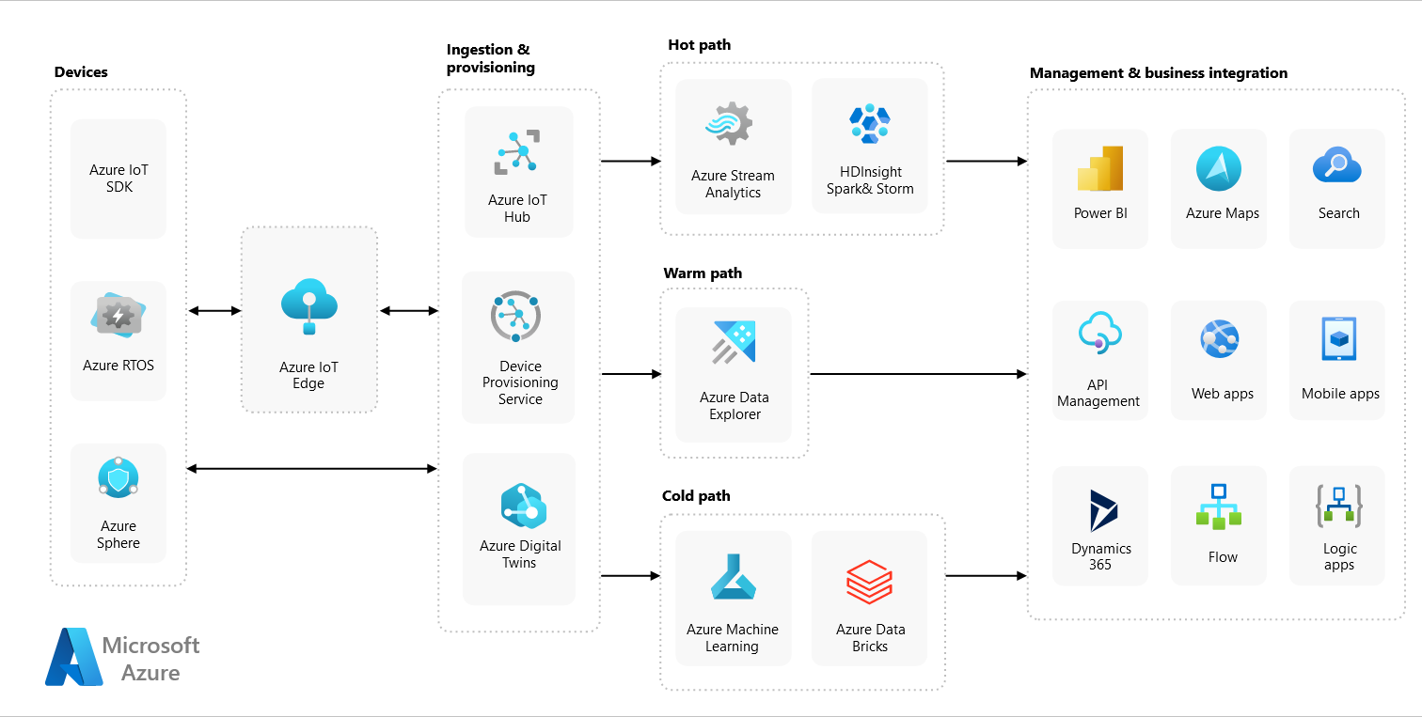
Azure IoT
Source: https://learn.microsoft.com/en-us/azure/architecture/reference-architectures/iot

Slide 13
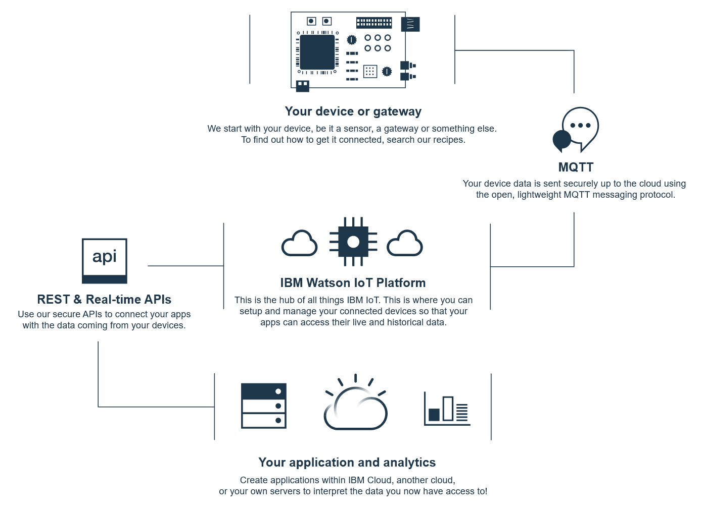
IBM Watson
Source: https://internetofthings.ibmcloud.com/

Slide 14
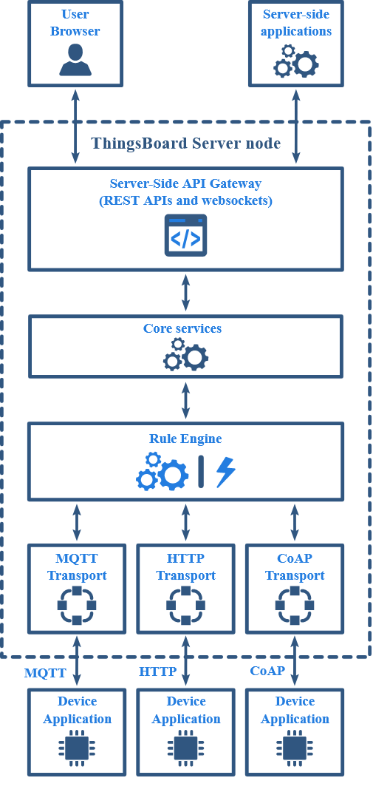
ThingsBoard
Source: https://thingsboard.io/docs/reference/architecture/

Slide 15
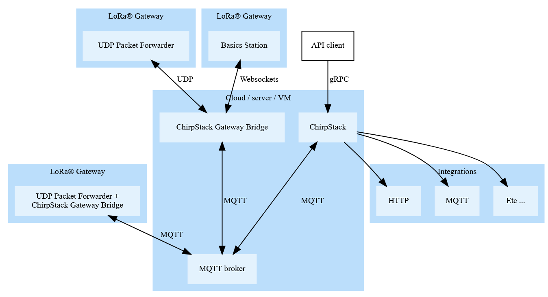
ChirpStack
Source: https://www.chirpstack.io/docs/architecture.html

Slide 16
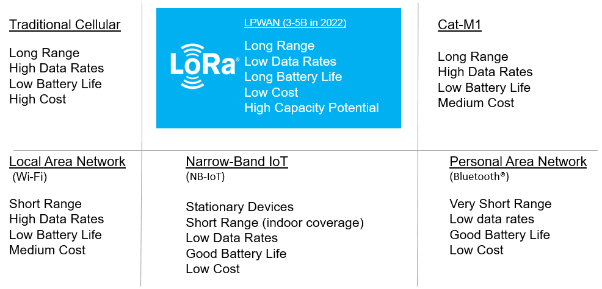
LoRa
Source: https://lora-developers.semtech.com/documentation/tech-papers-and-guides/lora-and-lorawan/

Slide 17
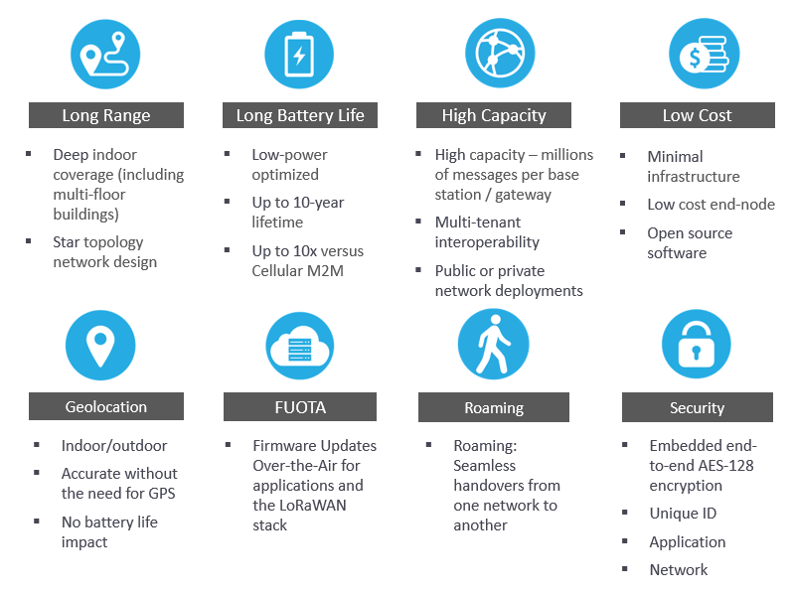
LoRaWAN
Source: https://lora-developers.semtech.com/documentation/tech-papers-and-guides/lora-and-lorawan/

Slide 18
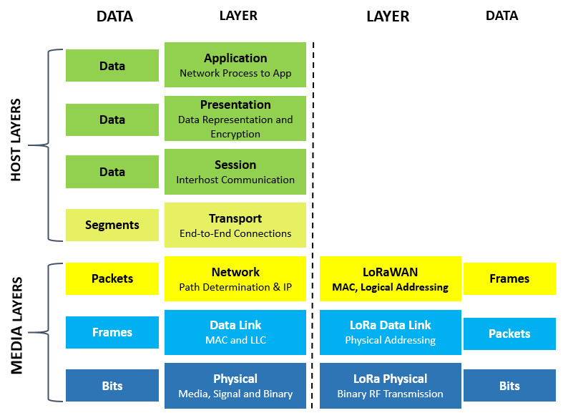
LoRa/LoRaWAN
Source: https://lora-developers.semtech.com/documentation/tech-papers-and-guides/lora-and-lorawan/

Slide 19
Device activation
All end devices that participate in a LoRaWAN network must be activated.
There are two methods of activation:
Over-the-air activation (OTAA)
Activation by personalization (ABP)
Source: https://lora-developers.semtech.com/documentation/tech-papers-and-guides/lorawan-device-activation/device-activation

Slide 20
Device activation
The OTAA and ABP activation methods each result in secret session keys being held by both the end device and the network server, which are used to secure messages being sent and received across the network.
In ABP, these session keys are stored on the end device during the manufacturing process.
In OTAA, the session keys are generated during a series of exchanges with the network server.
OTAA is the more secure option, since the keys can be replaced at any time by rejoining the network.
Source: https://lora-developers.semtech.com/documentation/tech-papers-and-guides/lorawan-device-activation/device-activation

Slide 21
Payload decoding
LoRa devices send their readings as bytes instead of a full JSON object in order to save bandwidth.
Payload decoding refers to the process of converting a simple byte sequence to usable data.
Source: https://docs.datacake.de/lorawan/payload-decoders

Slide 22
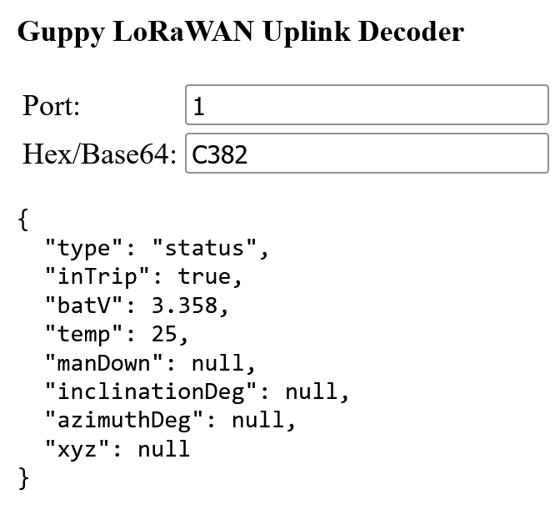
Payload decoding
Source: https://www.oemserver.com/tools/GuppyLoRaWAN/UplinkDecoder.html

