Slide 1

Writing a Compiler in Prolog
Thanos Tintinidis
thanosqr@gmail.com

Slide 2
Why?
Prolog is awesome!
Strong pattern-matching support for lexer
Definite Clause Grammars (DCG) for parser
Built from scratch; no lex/bison

Slide 3
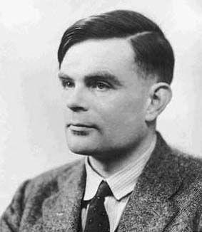
The Alan Language
Simple, pascal-like, imperative language
If-then-else, while, return
Call by value, call by reference
Nested functions
Integers, bytes (chars), arrays

Slide 4
What was asked
Standard compiler structure:
Lexer →
Parser →
Semantic Checks → Symbol Table
Quadruples →
Final Code Library Functions

Slide 5
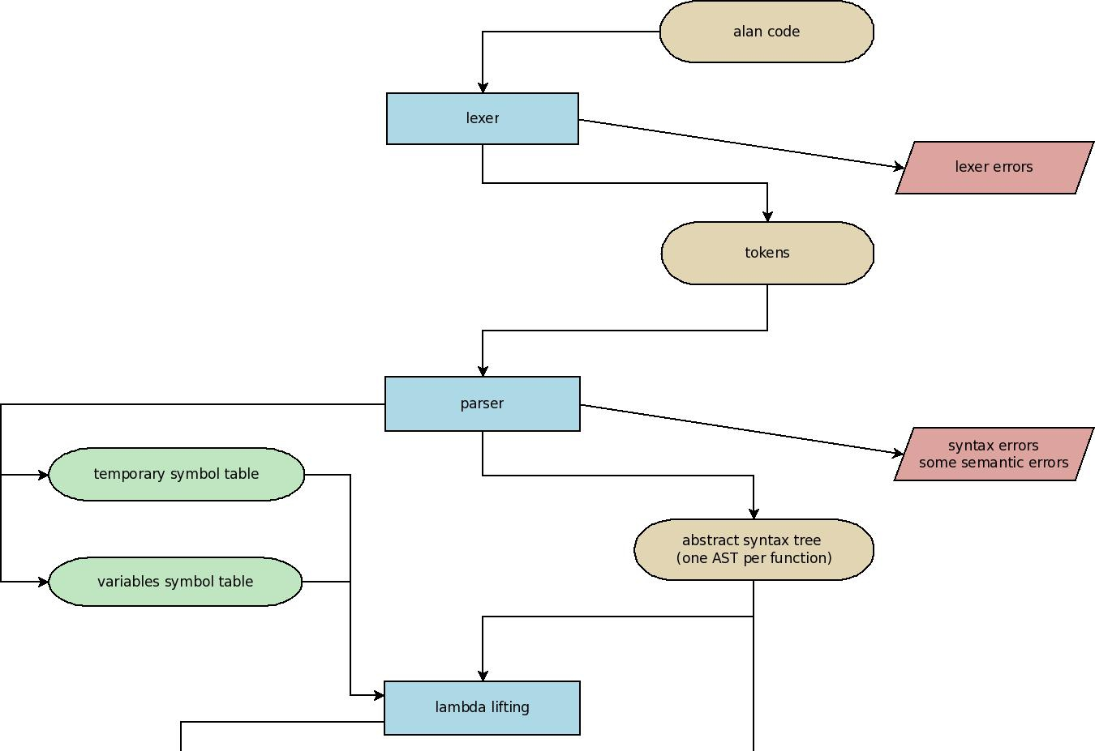
Not exactly what happened...

Slide 6
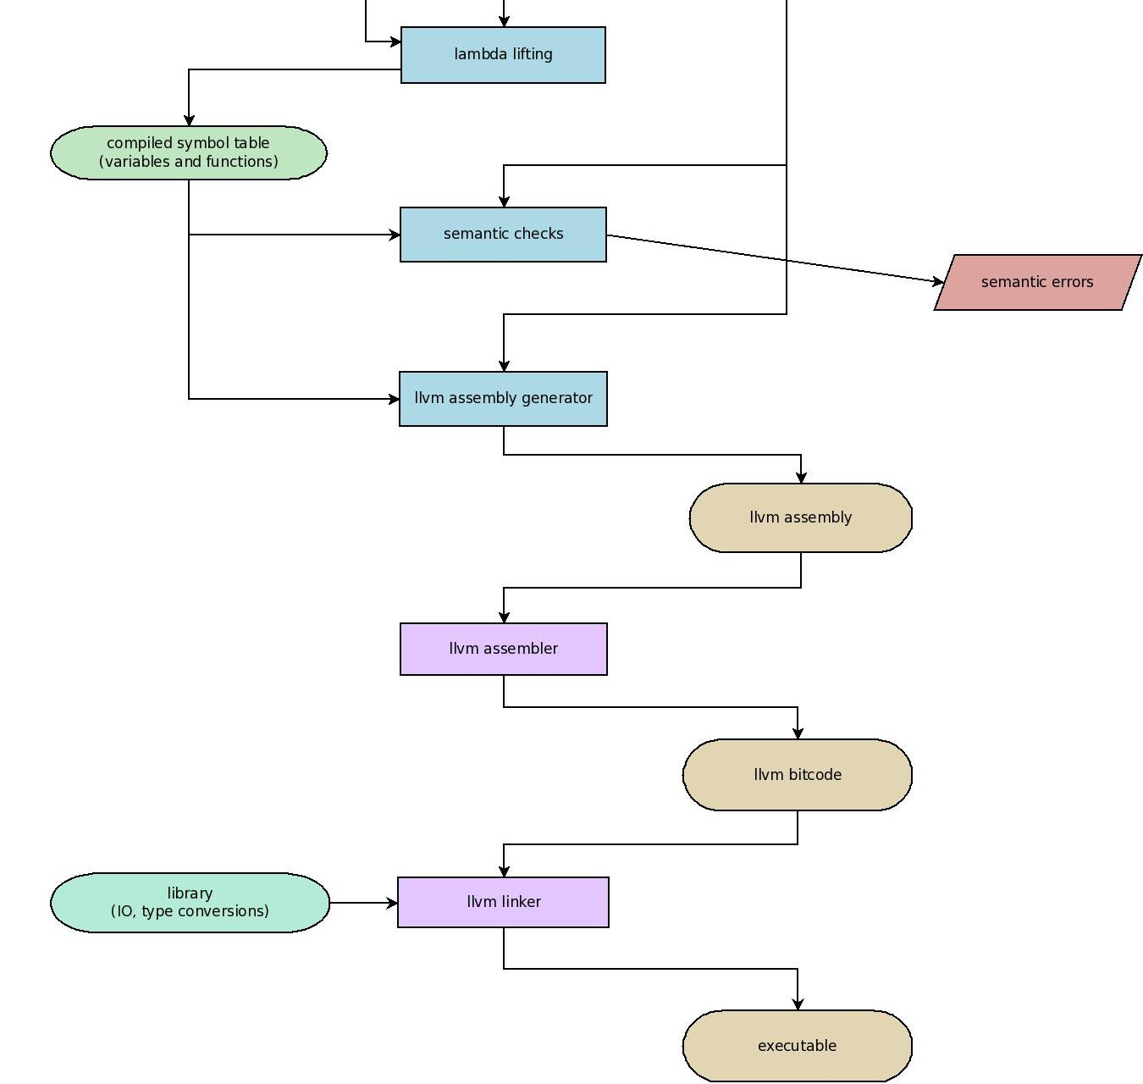

Slide 7
Lexer
Let's recognize tokens of a simple language
Numbers: 1,2,3,...,42,...
Words: start with a low letter, contain letters, numbers, underscores
Names: if, then, true, false
Operators: +,-,*,/,=
Comments (nested): (* comment *)

Slide 8
Strategy: read one char, pattern match
lexer('+',[t_op,'+']).
lexer('-',[t_op,'-']).
lexer('*',[t_op,'*']).
lexer('/',[t_op,'/']).
lexer('=',[t_op,'=']).
                zzzzzzzzzz...

Slide 9
If we meet a number or letter we read the rest
lexer(N,[t_number,Number]):-
  is_number(N),
  read_number(N,Number).
lexer(N,T):-
  is_low_letter(N),
  read_word(N,Word),
  is_name_check(Word,N,T).

Slide 10
Whitespace? Comment? /ignore
lexer('(',T):-
  peek('*'),
  eat_comments,
  read(C),
  lexer(C,T).
  we check the next char to see if it's really a comment
lexer(W,T):-
  whitespace(W),
  read(C),
  lexer(C,T).

Slide 11
No match? false.
Or we can add a clause to print an error and continue checking:
    lexer(_,T):-
      print("error!!!!"),
      read(C),
      lexer(C,T).
  printing line numbers is trivial with mutable global variables (millions of haskell programmers suddenly cried out in terror)

Slide 12
Definite Clause Grammars
Mostly syntactic sugar
DCG clauses usually convert to regular prolog
A simple grammar:
S → aS | b
Equivalent code
s-->
([a],s) ; [b].
(No Bisons hurt!)

Slide 13
The catch
Left-recursive grammars = infinite loop
s-->s,[a].
ERROR: Out of local stack
recursive descent parsers may not be that efficient...

Slide 14
Intermediate Code: an AST
We produce the AST during parsing:
stmt([while,C,S])-->
  t(t_key,while),
  t(t_oparen),
  cond(C),
  t(t_cparen),
  stmt(S).

Slide 15
Expressions
Simply by ordering the clauses we define the operator precedence!!
exprR(E)-->
  t(t_oparen),expr(E),t(t_cparen). % lvl0 precedence
exprR([add,[_,0],E])--> %lvl1 precedence
  t(add),expr(E).
exprR([sub,[_,0],E])-->
  t(sub),expr(E).
expr([O,E1,E2])-->
  exprR(E1), operator(O),expr(E2).
operator(N)-->
  t(mul,N); t(div,N); t(rem,N) % lvl2 precedence
  ;t(add,N); t(sub,N). %lvl3 precedence

Slide 16
Removing Left Recursion
    A → Aa|b
  becomes
    A → bA', A' → ε|aA'

Slide 17
?-parser(Tokens,AST). false.
Not really helpful for debugging
We should print a message (easy) and continue parsing to find more errors (hard)
Actually, the hardest and most buggy part of the compiler

Slide 18
Statement-level parsing
If we are reading a statement and fail
Print a message
Ignore the rest of the statement
Continue parsing, try to read one more statement
But if you find a '}' stop and return; it's the end of the function/compound statement

Slide 19
Still problematic
How about function definitions?
  (printing “syntax error at a function definition” now)
There were lots of bugs related to backtracking, side effects, compound statements.... maybe some are still hidden

Slide 20
Lambda Lifting
Elimination of free variables from local function definitions
More interesting than messing with the stack
May reduce the run-time cost of handling implicit scope

Slide 21
Algorithm
Rename the functions so that each function has a unique name.
Replace each free variable with an additional argument to the enclosing function, and pass that argument to every use of the function.
Replace every local function definition that has no free variables with an identical global function.
Repeat steps 2 and 3 until all free variables and local functions are eliminated.
→ parser
→ λ-lifting
step
→ λ-lifting step
→ λ-lifting step

Slide 22
Idea...
Since we are renaming all functions, lets rename all variables too
And let's construct a basic symbol table
No need to worry about scope at the final symbol table; just ask with the name!
Detect basic semantic errors at parser-time:
undeclared variables, functions...

Slide 23
Beware of side-effects
Since the parser uses backtracking we may recognize a variable when we should have seen a function...
x=foo(42)
var^
...then we will check the ST and probably there won't be an entry, resulting in a false semantic warning!
(then the program will backtrack and realize that it was not a variable and continue without problem)
But we cannot backtrack the IO (maybe with monads? :b)
Solution: careful ordering, store possible errors and print them when you are sure that it's an error

Slide 24
Embarrassingly parallel
Once we finish lambda lifting we can do the semantic checks and produce the final code for each function in parallel
Maybe not great but still a bonus :)

Slide 25
Semantic Checks
Simply traverse the abstract syntax tree (or rather forest) and perform the required checks:
expr_type([Op,E1,E2], T1):-
expr_type(E1,T1),
expr_type(E2,T2),
(T1=T2->true
;error(['in expression ',[Op,E1,E2],
' the first arg has type ',T1,
' while the second ',T2])
).
We can print quite detailed error messages

Slide 26
Symbol Table
asserta/1 is used to dynamically create the symbol table
When the construction is over, the related predicates are compiled and become static in order to have faster access
SWI-prolog uses hash tables (dynamic if the predicate is dynamic) based on the first argument of the predicates by default; therefore, the access to the Symbol Table is done in (practically) constant time

Slide 27
The final part
Instead of producing x86 assembly I decided to use LLVM assembly
Somewhat higher level assembly
No need to manually make optimizations
No need to translate to quadruples
However, most of the code producing quadruples has been written before I decided to use LLVM. It's quite interesting!

Slide 28
Quadruples in prolog: backpatching
Sometimes we don't know where we should jump when we write the jump quadruple so we leave an empty variable and return to fill it later
In prolog, we simply leave the variable uninstantiated, put the tuple in the list exactly like the rest and sometime in the future we instantiate it; the variable in the list will be automatically instantiated

Slide 29
An example
If - then statement:
stmt([if,Cond,Stmt],QC):-
bool(TJ,FJ,Cond,QC1),
peek_label(TJ),
stmt(Stmt,QC2),
peek_label(FJ),
append([QC1,QC2],QC).
peek_label(X) unifies X with the number of the next label that will be used (label numbers are assigned using global variables). Note that we don't traverse the list QC1 which is a list of all the quadruples required for the boolean condition; we just unify TJ with the label number and it's automatically done! Awesome?

Slide 30
Another example: boolean
Let's assume that we have only and, true and false:
boolean(TJ,_FJ,[true],[[N,jump,void,void,TJ]]):-
label(N).
boolean(_TJ,FJ,[false],[[N,jump,void,void,FJ]]):-
label(N).
boolean(TJ,FJ,[and,B1,B2],QC):-
boolean(TJ1,FJ,B1,QC1),
peek_label(TJ1),
boolean(TJ,FJ,B2,QC2),
append([QC1,QC2],QC).
TJ: jump there if true, FJ: jump there if false

Slide 31
append/3
append/3 is not exactly efficient;
however it's used heavily in the current version of the compiler.
To fix it, we can use difference lists that will improve the performance
not done (yet).

Slide 32
Finally! LLVM!
Remember lambda-lifting? We should include all these new parameters in every function call (and we should use call by reference)
Alan supports call by reference anyway so we should implement it
to implement it properly we should pass pointers to the desired l-value, then, before every use of the variable load the value stored there, execute the operation and then store it again....
To avoid it call by copy back was implemented instead: we load the value only one time before the body of the function and store the value at the end of the function

Slide 33
Call by copy-back vs call by reference
void foo(ref int a, ref int b) {
a++;
b++;
}
int main(){
int i=0;
foo(i,i);
return i;
}
Call by copy back: main() returns 1
Call by reference: main() returns 2

Slide 34
there is one more issue
int main(){
int i=0;
void foo(ref int a) {
i++;
a++;
}
foo(i,i);
return i;
}
Since we use lambda-lifting this will be translated to the previous code and therefore we will have the same problem...
So...
It's not a bug, it's a feature!

Slide 35
LLVM type system
In LLVM you should declare the type of the variable/constant/everything any time you want to use it:
%result = add i32 4, %var
Rather troublesome: prolog to the rescue!
Simply leave it uninstantiated, put it with the rest of the code and just write that %var, 4 and %result should have the same type; eventually it will be instantiated (assuming that there were no semantic problems).
(in fact, we are doing a bit of type inference/checking)

Slide 36
A code snippet: short-circuit and/or
bool([op(OP),B1,B2],Result,Code):-
bool(B1,Val1,C1),
typed_make(R1, OP,i1,1,0,C4),
C5=[['store i1', R1, ', i1* %llvmvar'],[br,label,L]],
%make result true OP false and finish:
%if op=and the program will be here if B1 is false
%and the result will be false
%if op=or the program will be here if B1 is true
%and the result will be true
label(L1,C6),
bool(B2,Val2,C7),
typed_make(R2,OP,i1,Val1,Val2,C8),
C9 = [['store i1', R2, ', i1* %llvmvar']],
%for the other cases the program will be here,
%evaluate B2 and perform B1 op B2
label(L,C10),
load('%llvmvar',i1,Result,C11),
append([C1,C2,C3,C4,C5,C6,C7,C8,C9,C10,C11],Code).

Slide 37
Calling LLVM
Finally, we have produced a file containing LLVM assembly.
We call llvm-as to produce a bytecode file and then llvm-ld to link it and produce the final executable code (and keep our fingers crossed!)

Slide 38
Library Functions
The final task was writing a library that could be linked with LLVM; I simply wrote the functions in C and compiled them to LLVM assembly and then LLVM bytecode.
Then they are linked with the original program with llvm-ld (just add the declarations in the program)
One minor issue: we are renaming all functions.... well, a simple change can fix it; if it's an IO function which is not declared in the current scope, don't rename it.

Slide 39
Wrapping all of them together
We use modules for better organization; a module for the lexer, a module for the parser etc.
Simply compile the main file and all the required will be automatically consulted
Or even better: a script to run it from the command line, supporting some flags... just like a normal compiler :)

Slide 40
The bash script
#!/bin/sh
exec swipl -q -f none -g "load_files([interface],[silent(true)])" \
-t interface:get_args -- $*
consult interface, run get_args/0
the args are retrieved by calling:
current_prolog_flag(argv, Arguments)
in get_args/0

Slide 41
Isolating the parts
Imagine this: for some reason the semantic check fails.
Then prolog would backtrack to the parser, possibly print false warnings and then maybe even to the lexer... a mess!
once/1 is used to guarantee that each individual part will run only once.

Slide 42
Questions.
;
;
;
;
;
;
;
thank you :)
github: github.com/thanosqr/Alan-Prolog-Compiler

