Slide 1
Ph.D. position @ HiØ 2nd Interview
Minh Quang Than

Slide 2
Case task
The project involves a smart floor system embedded with phase change materials (PCM) that act as passive thermal storage. A web application is being developed to control the heating system based on real-time data, electricity prices, and weather forecasts.
Imagine you are tasked with designing the logic and user interface for a digital tool that optimizes the heating of the smart floor system. The tool should:
Incorporate real-time temperature data from sensors
Utilize next-day electricity prices and weather forecasts
Minimize energy consumption and cost
Maximize user comfort

Slide 3
Content summary
I. Conceptual Design:
What kind of data would you collect and how would you use it?
What algorithms or logic would you implement to optimize heating?
II. User Interface (UI) Proposal:
Sketch or describe the interface for both the web and mobile applications. Explain how you define frontend and backend database, tools you will use and why.
How would you ensure usability and user engagement?
III. Challenges and Considerations:
What are the main technical and user-related challenges?
How would you address issues like security, data privacy, user preferences, and system reliability?
IV. Your Contribution:
How would your background and skills contribute to solving this challenge?
What additional ideas or improvements would you propose?

Slide 4
I.1. Conceptual design - data
Real-time sensors | Meta/ configuration data | Used
Room air temperature(s) (one per room/zone) | Building envelope parameters (R-values, floor area, ceiling height) | Estimate/simulate thermal states: air temp, floor temp, PCM fraction
Floor surface temperature(s) (near PCM layer) | PCM properties: melting temperature(s), latent heat per m², effective heat capacity curve | Schedule heating plan: for the next 24 hours
PCM temperature(s) (if possible, or inferred from floor temp) | Floor heating actuator limits (max power, min on/off interval, ramp rate) | Control real-time heating
Power consumption of heater(s) (smart meter or per-circuit power sensor) | User comfort preferences (target temp ± tolerance, schedule, “comfort vs cost” slider) | Adaptive learning
Actuator state (valve/opening, pump speed, on/off) | Safety limits (max floor temperature to protect floor/occupants)
External weather feed (API forecasted & sensors) Electricity price feed
(other additional data upon needed)

Slide 5
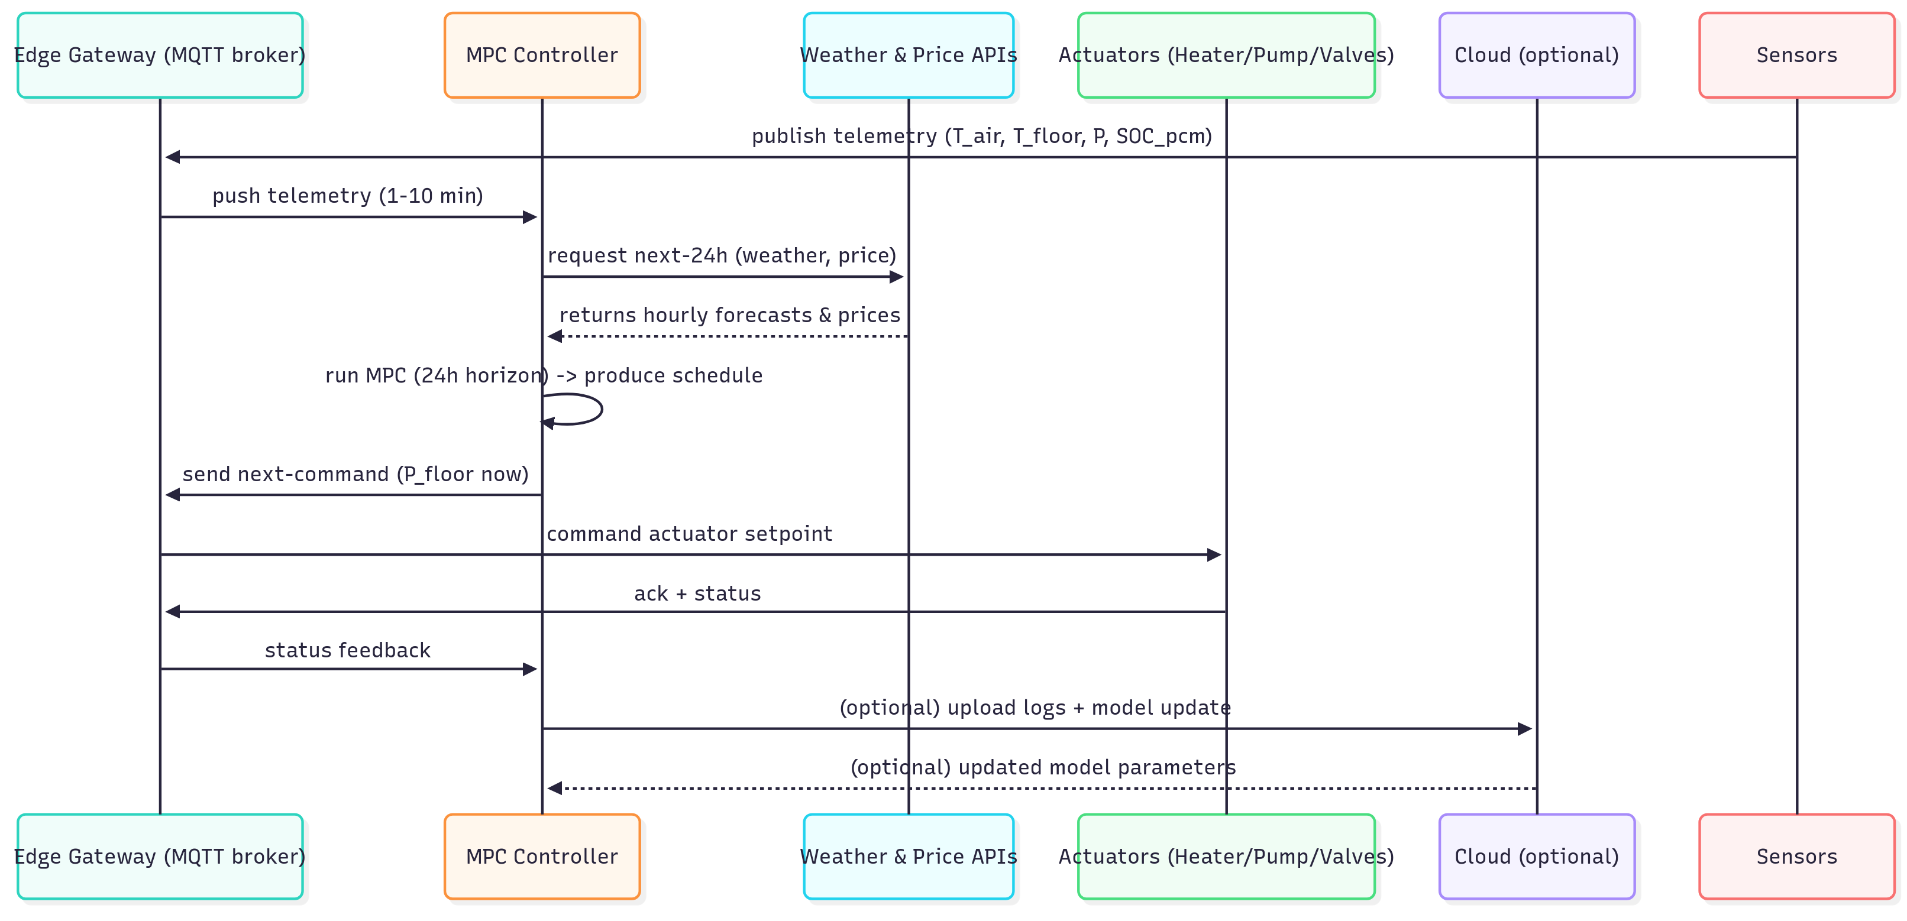
I.1. Conceptual Design - control flow

Slide 6
I.2. Algorithm and logic
Architectural choices
Model Predictive Control (MPC): 24 hours receding horizon, 5–15 min timestep.
Local safety controller: fast PID/relay loop on floor temperature to prevent overheating (executes between MPC updates).
Parameter learning: online system identification (recursive least squares) to update RC thermal model and PCM effective capacity.
Long-term adaption: Reinforcement Learning.
Special logic for PCM pre-charging
When next-day prices include low-price windows (e.g., off-peak), schedule pre-charge: increase floor heating power before peak hours so PCM melts/charges and then releases during high price/peak cold periods.
If forecast predicts sunny midday (solar gains), shift pre-charge to later or reduce it.
If occupancy changes (user home sooner), adapt setpoint and possibly use stored PCM heat to avoid extra energy.
Adaptation & learning
Use recursive least squares or Kalman filter to fit the RC model parameters and PCM capacity from logged temp/power data.
Detect degraded performance or sensor faults via residual monitoring; notify user
Heuristics / Fallback
If price or forecast API fails: run conservative schedule — maintain comfort band with minimal energy and apply simple time-of-day pre-charge based on historical price pattern.
Safety overrides: never exceed floor temp safety threshold.

Slide 7
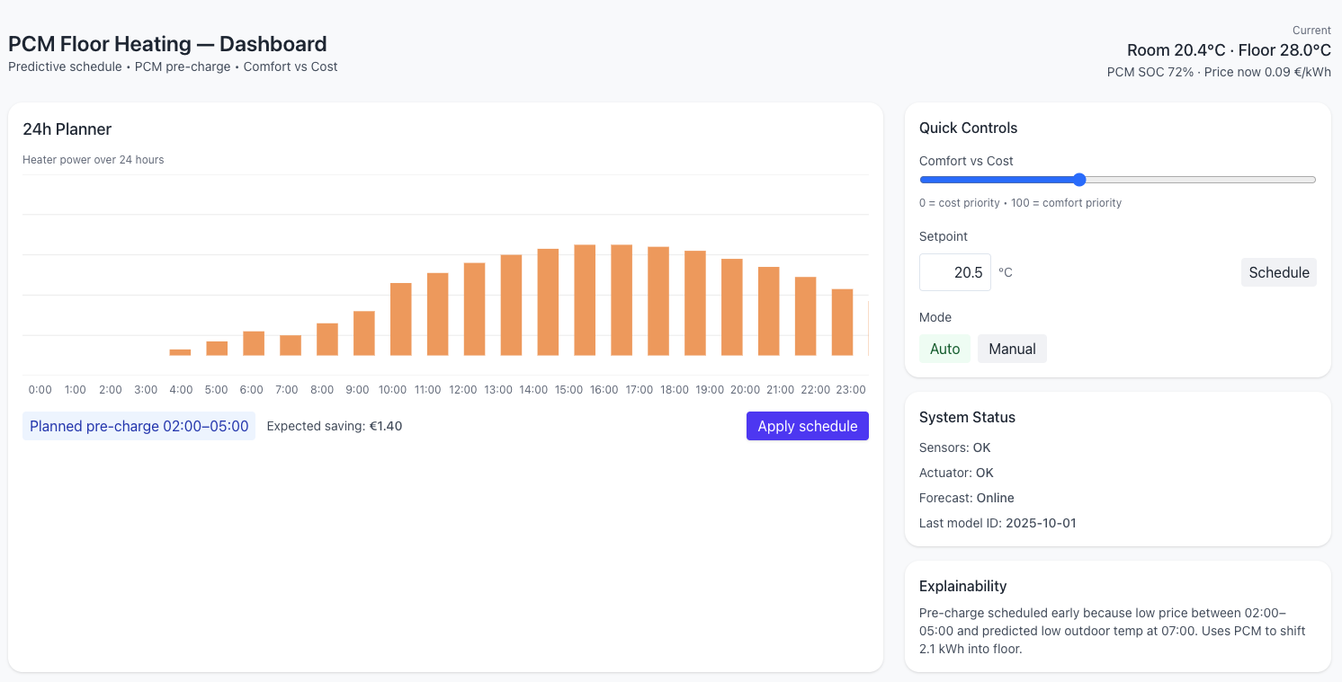
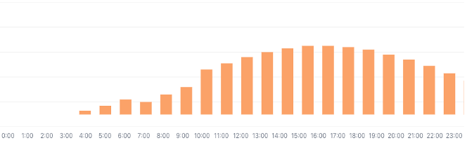



II.1a. UI proposal - main dashboard
Notes:
Top strip (current state): current room temp, floor temp, PCM SOC %, current electricity price, "comfort score" (0–100).
24-hour timeline (centerpiece): stacked view with:
Planned heater power schedule (bar chart under overlay).
Hourly electricity price curve (green).
Predicted room temp (line).
Quick controls:
"Comfort vs Cost" slider (left: cost priority — wider comfort band; right: comfort priority — hold temp tight).
Setpoint temperature (per zone) and schedule.
Toggle "Auto / Manual" and a manual power slider for immediate override.
Explainability box: short plain-language explanation of next actions, e.g.: “Pre-charging floor between 02:00–05:00 because price is low (0.07 €/kWh) and forecasted low of -3°C at 07:00. Expected cost saving today: 1.4 €.”
Energy & Cost preview: estimated energy usage and cost for next 24 h under current plan + comparison vs. "no optimization".

Slide 8
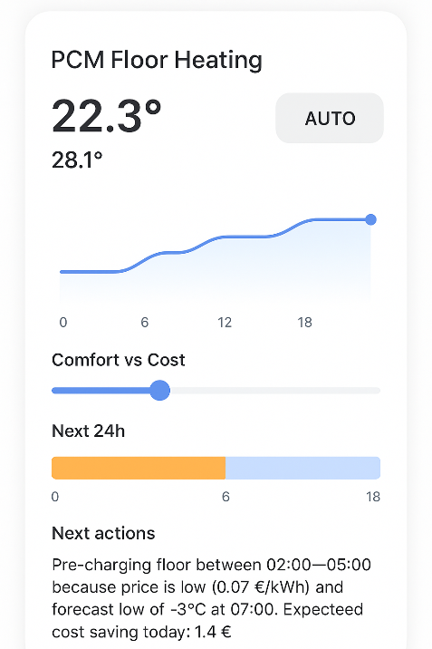
II.1a. UI proposal - mobile UX
Notes:
Condensed dashboard: current temp, next price window, one-tap “force pre-charge” or “eco mode”.
Push notifications for important events (e.g., planned pre-charge started).

Slide 9
II.1a. UI proposal – others
Setup & advanced pages
System configuration wizard: prompts for PCM melting temp, PCM mass/area (or "auto-identify" button).
Sensor map: show where sensors are located; status (online/offline).
Price & weather sources: show API connections, manual override for price schedule.
Advanced tuning: MPC horizon, timestep, α weight, safety limits, system ID toggle.
Notifications & alerts & summary
Alerts for sensor faults, failed actuator commands, or if floor temp limit approached.
Weekly/monthly energy/cost summary and learned thermal parameters.

Slide 10
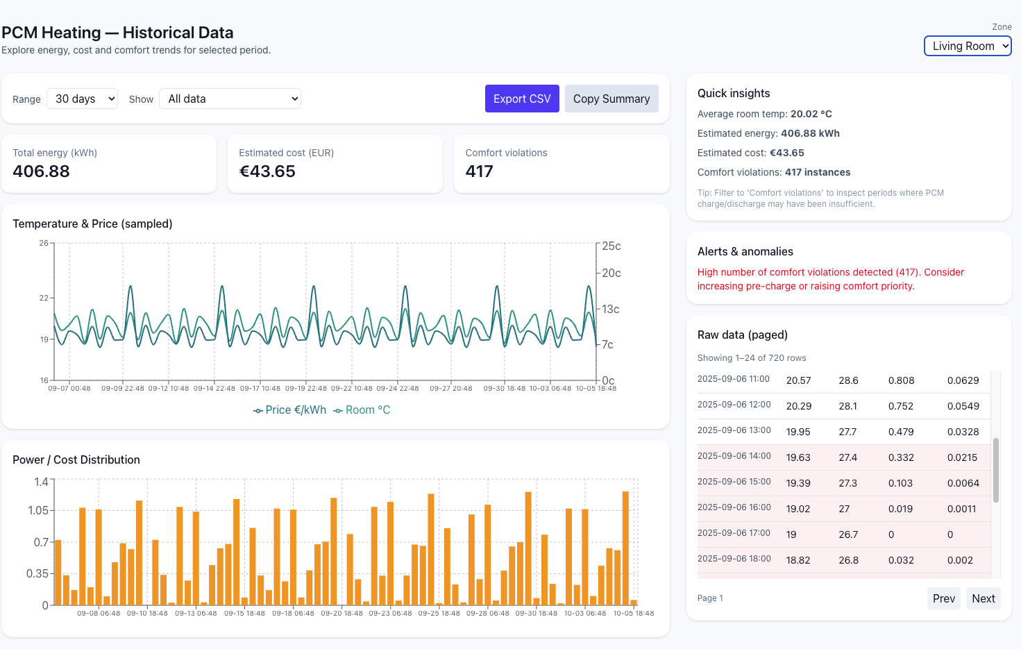
II.1a. UI proposal - summary
Notes:
Top strip (current state): current room temp, floor temp, PCM SOC %, current electricity price, "comfort score" (0–100).
24-hour timeline (centerpiece): stacked view with:
Hourly electricity price curve (line).
Weather forecast (mini bars for outside temp + icons for sun/cloud).
Predicted room temp (line).
Planned heater power schedule (bar chart under overlay).
Shaded band for comfort bounds.
Highlighted pre-charge windows (colored).
Quick controls:
"Comfort vs Cost" slider (left: cost priority — wider comfort band; right: comfort priority — hold temp tight).
Setpoint temperature (per zone) and schedule.
Toggle "Auto / Manual" and a manual power slider for immediate override.
Explainability box: short plain-language explanation of next actions, e.g.: “Pre-charging floor between 02:00–05:00 because price is low (0.07 €/kWh) and forecasted low of -3°C at 07:00. Expected cost saving today: 1.4 €.”
Energy & Cost preview: estimated energy usage and cost for next 24 h under current plan + comparison vs. "no optimization".

Slide 11
II.1b. Frontend and backend database, tools
Layer | Tool / Technology | Purpose
Frontend | React + Tailwind + MQTT client | Real-time, responsive user interface
Backend | FastAPI + Python (MPC/ML models) | Control logic and optimization
Database | PostgreSQL + InfluxDB | Persistent + time-series data
Communication | MQTT + REST API | Real-time & scheduled updates
Deployment | Docker + Kubernetes | Scalability and reliability
Monitoring | Grafana + Prometheus | System health and analytics

Slide 12
II.2. Ensure usability and user management
Category | Tools / Frameworks
UX Research | Figma, Maze, Hotjar
User Analytics | Google Analytics 4, Amplitude
A/B Testing | Optimizely or custom backend logic
Feedback Collection | In-app micro-surveys (Typeform / custom)
Notification System | Firebase Cloud Messaging, Twilio
Personalization Engine | Python ML service integrated with user behavior data

Slide 13
III.1. Challenges & considerations
Main technical and user-related challenges
Challenge Type | Example Issue | Recommended Strategy
Thermal Modeling | Nonlinear PCM dynamics | Physics-informed hybrid models
Real-time Data Integration | Asynchronous feeds | MQTT buffering + timestamp sync
Optimization Load | Slow MPC response | Edge + cloud hybrid processing
Forecast Uncertainty | Weather/price errors | Stochastic or ensemble optimization
User Trust | Reluctance to automate | Transparent decisions, manual override
Usability | Data overload | Simple, progressive UI
Engagement | Notification fatigue | Reports and feedback loops

Slide 14
III.2. Challenges & considerations
Security, data privacy, user preferences, system reliability
Domain | Core Strategy | Implementation Example
Security | Multi-layer protection | TLS, RBAC, signed OTA updates
Privacy | Data minimization & consent | Edge computation, GDPR tools
User Preferences | Adaptive AI with manual control | Personalized comfort profiles
Reliability | Redundant & autonomous systems | Edge fallback, predictive maintenance

Slide 15
IV.1. Contributions - Background and skills
Area | Role | Example Contribution
Architecture | System design | Create modular, scalable backend
Data Integration | API & sensor fusion | Merge weather, price, and IoT data
Optimization Logic | Algorithm engineering | Implement MPC / ML control models
Frontend/UI | Dashboard development | Real-time visualization and control
DevOps | Reliability engineering | CI/CD, monitoring, error recovery
Security | Privacy & compliance | Secure data pipelines and access
Domain knowledge | Project oversight | Align cross-functional teams

Slide 16
IV.2. Contributions
Additional ideas & improvements
Improvement Area | Proposal | Expected Benefit
Control Algorithms | Hybrid MPC + RL | More adaptive and efficient optimization
Comfort Modeling | Adaptive comfort standards | Energy saving without comfort loss
Renewable Integration | PV + demand response | Lower costs and emissions
Analytics | Digital twin + predictive maintenance | Better insights and reliability
User Experience | Smart notifications, profiles | Higher engagement and transparency
Edge & Security | Local AI + OTA updates | Resilience and trust
Scalability | Multi-building optimization | Larger-scale energy efficiency

Slide 17
Thank you
for your attention

