Slide 1
Object-Oriented Programming with Java
Than Quang Minh
thanqminh.com
Course URL: /courses/oopjava

Slide 2
Course’s Content
Java basic
JVM, JDK, version, package & classpath, entry point
Primitive data type and built-in classes.
Testing with Junit
Build tools
Coding convention
GUI (Swing, JavaFX)
OOP
Basic OOP: Inheritance, Polymorphism, Encapsulation, Composition
Design principles
Design Pattern introduction

Slide 3
Evaluation
Be present at the course is only 10 % of the learning path
The remaining 90 % consists in studying at home, doing assignments, final project result and presentations.
2 assignments account for 40% of total score, final project accounts for 50% of total score.

Slide 4
References
Topic | Reference
Java & Coding & Test | Java: A Beginner's Guide, Sixth Edition Clean Code: A Handbook of Agile Software Craftsmanship http://programmingbydoing.com/ JUnit Recipes - Practical Methods for Programmer Testing
OOP | Object-Oriented Analysis and Design with Applications - 3rd Edition http://www.oodesign.com/
Design Patterns | https://sourcemaking.com/design_patterns Head first Design Patterns Design Patterns: Elements of Reusable Object-Oriented Software
OOP Slides | http://thanqminh.com/courses/oopjava/tkhdt.pdf

Slide 5
Today’s topic: Java Overview
Language, JVM, JDK
Package
Classpath
Compiler and Runner
Build tools
IDE

Slide 6
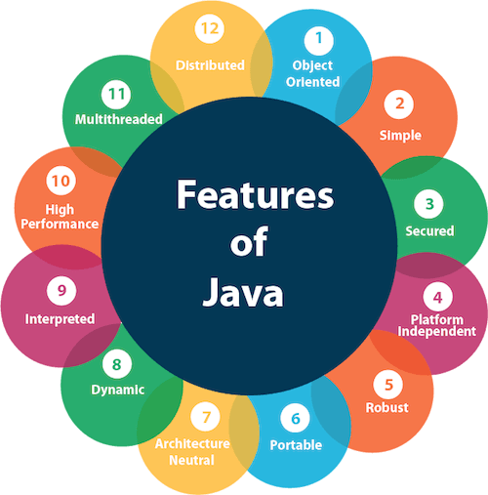
Language features
Originally developed by Sun Microsystems which was initiated by James Gosling and released in 1995.
Latest LTS version: Java 11.
Object Oriented − In Java, everything is an Object. Java can be easily extended since it is based on the Object model.
Simple − Java is designed to be easy to learn. If you understand the basic concept of OOP Java, it would be easy to master.
Platform Independent.
Multithreaded
Interpreted
And more

Slide 7
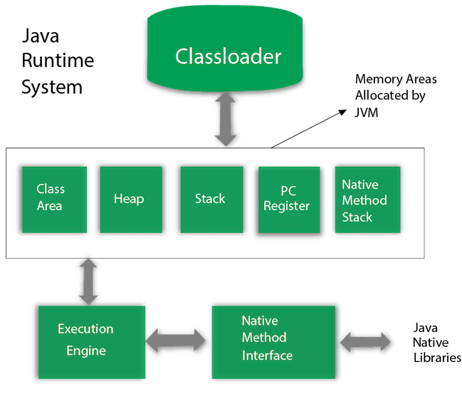
JVM – Java Virtual Machine
A specification where working of Java Virtual Machine is specified. But implementation provider is independent to choose the algorithm. Its implementation has been provided by Oracle and other companies.
An implementation Its implementation is known as JRE (Java Runtime Environment).
Runtime Instance Whenever you write java command on the command prompt to run the java class, an instance of JVM is created.

Slide 8
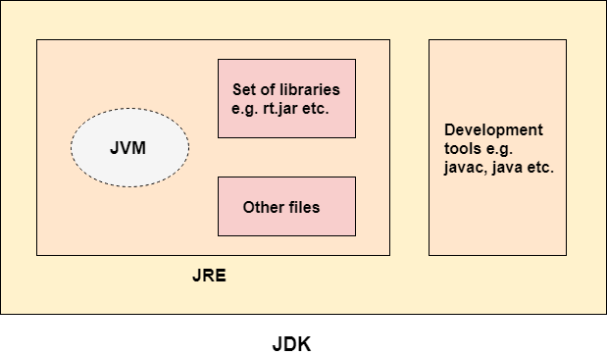
JDK vs JRE vs JVM
https://youtu.be/7tndaxgk1E8

Slide 9
Get started
Installation
Set PATH
Hello World
Keyboard Input / Printing
Entry point

Slide 10
Installation
Download and install Java 11 (JDK)
Use Java 11 as default (set in PATH)
echo %PATH%
Check by running (in command line):
java –version
javac –version
javac: c = compiler, compile java source code (.java) to bytecode (.class).
java: run java program (start JVM) with classes.

Slide 11
Hello World
public class HelloWorld {
public static void main(String[] args) {
System.out.println("Hello World!");
}
}
save as HelloWorld.java (In a folder outside of Users/Program Files/Windows, such as D:\Java), then change current directory to it (cd), compile and run:
javac HelloWorld.java
java HelloWorld

Slide 12
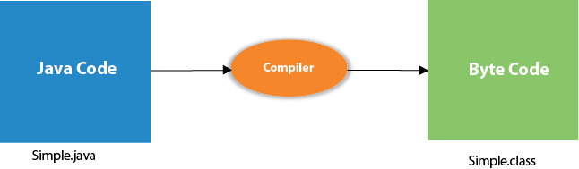
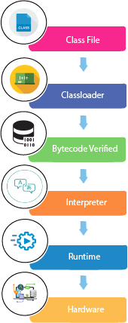
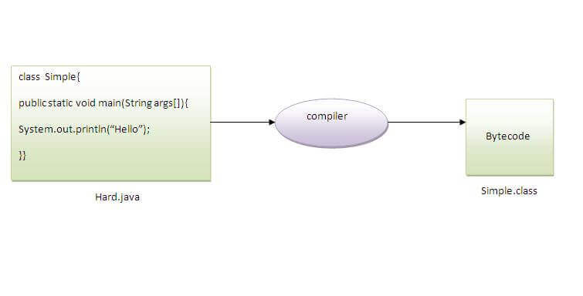
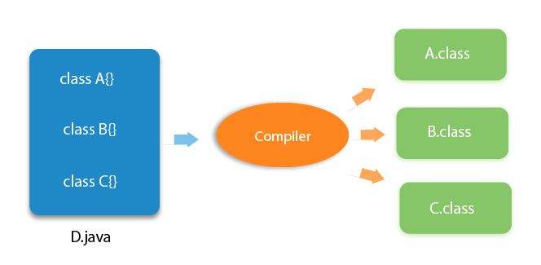
Internal detail of Hello program
Compile time
Run time
compile: javac Hard.java
execute: java Simple
javac D.java

Slide 13
Keyboard Input / Printing
Get a string input from user, put it to name.
Print "Hello <name>"
import java.util.Scanner;
Scanner scanner = new Scanner(System.in); System.out.print("Enter a name:\t");
String name= scanner.nextLine();
System.out.println("Hello " + name);

Slide 14
Entry Point
public class EntryPoint {
public static void foo(String s) { System.out.println(s);}
public static void main(String[] args) {
foo("a test String");
System.out.println("Hello World!");
foo("another String");
foo("one more");
}
}

Slide 15
Entry Point (cont.)
public class FooEntry {
public static void bar(String s) { System.out.println(s);}
public static void main(String[] args) {
bar(args[0]);
System.out.println("Hello World!");
bar(args[1]); bar(args[2]);
}
}
java FooEntry "a test string" "another string" "one more"

Slide 16
Entry Point (cont.)
public class BazEntry {
public static String foo (String s) {
return new StringBuilder(s).reverse().toString();}
public static void main(String[] args) {
System.out.println("Calling BazEntry");
FooEntry.bar(args[0]); FooEntry.bar(args[1]);
FooEntry.main(args);
System.out.println("Calling me - BazEntry");
System.out.println(foo(args[0])); System.out.println(foo(args[1]));
}
}

Slide 17
Entry Point (cont.)
public class FooEntry {
public static void bar(String s) { System.out.println(s);}
public static void main(String[] args) {
System.out.println("Calling FooEntry");
System.out.println(BazEntry.foo(args[0]));
System.out.println(BazEntry.foo(args[1]));
//BazEntry.main(args);
System.out.println("Calling me - FooEntry");
System.out.println(args[0]); System.out.println(args[1]);
bar(args[0]); bar(args[1]);
}
}
java FooEntry string0 string1
java BarEntry string0 string1

Slide 18
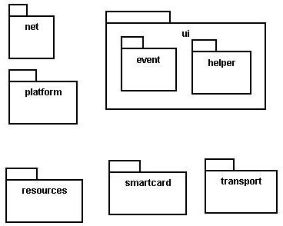
Java packages
package: A collection of related classes.
Can also "contain" sub-packages.
Sub-packages can have similar names, but are not actually contained inside.
java.awt does not contain java.awt.event
Uses of Java packages:
group related classes together
as a namespace to avoid name collisions
provide a layer of access / protection
keep pieces of a project down to a manageable size

Slide 19

Packages and directories
package ←→ directory (folder)
class ←→ file
A class named D in package a.b.c should reside in this file:
a/b/c/D.class
(relative to the root of your project)
The "root" directory of the package hierarchy is determined by your class path or the directory from which java was run.

Slide 20
Classpath
class path: The location(s) in which Java looks for class files.
Can include:
the current "working directory" from which you ran javac / java
other folders
JAR archives
URLs
...
Can set class path manually when running java at command line:
java -cp /home/stepp/libs:/foo/bar/jbl MyClass

Slide 21
A package declaration
package name;
public class name { ...
Example:
package pacman.model;
public class Ghost extends Sprite {
...
}
File Sprite.java should go in folder pacman/model .

Slide 22
Importing a package
import packageName.*; // all classes
Example:
package pacman.gui;
import pacman.model.*;
public class PacManGui {
...
Ghost blinky = new Ghost();
}
PacManGui must import the model package in order to use it.

Slide 23
Importing a class
import packageName.className; // one class
Example:
package pacman.gui;
import pacman.model.Sprite;
public class PacManGui {
Ghost blinky = new Ghost();
}
Importing single classes has high precedence:
if you import .*, a same-named class in the current dir will override
if you import .className, it will not

Slide 24
Static import
import static packageName.className.*;
Example:
import static java.lang.Math.*;
...
double angle = sin(PI / 2) + ln(E * E);
Static import allows you to refer to the members of another class without writing that class's name.
Should be used rarely and only with classes whose contents are entirely static "utility" code.

Slide 25
Referring to packages
packageName.className
Example:
java.util.Scanner console =
new java.util.Scanner(java.lang.System.in);
You can use a type from any package without importing it if you write its full name.
Sometimes this is useful to disambiguate similar names.
Example: java.awt.List and java.util.List
Or, explicitly import one of the classes.

Slide 26
The default package
Compilation units (files) that do not declare a package are put into a default, unnamed, package.
Classes in the default package:
Cannot be imported
Cannot be used by classes in other packages
Many editors discourage the use of the default package.
Package java.lang is implicitly imported in all programs by default.
import java.lang.*;

Slide 27
Setup Development Environment
Install JDK 11 (for example https://www.oracle.com/java/technologies/javase-jdk11-downloads.html )
Install Visual Studio Code
Install Java Extension Pack for VS Code Set JAVA_HOME environment variable
Setup path environment variable (so javac and java command are available)

Slide 28
Homework
Java book: chapter 1-5
Install JDK, VS Code
http://programmingbydoing.com/ 1-75 (except 63)
https://www.ntu.edu.sg/home/ehchua/programming/java/J3f_OOPExercises.html

