Slide 1
Object-Oriented Programming with Java
Mr. Than Quang Minh
thanqminh.com
Course URL: /courses/oopjava

Slide 2
Today’s topic: Remaining design patterns
Adapter
Facade
Template method
Proxy
State
Iterator
Composite

Slide 3
Adapter Pattern
If it walks like a duck and quacks like a duck, then it must might be a duck turkey wrapped with a duck adapter...
public interface Duck {
public void quack();
public void fly();
}
public class MallardDuck implements Duck {
public void quack(z) {
System.out.println(“Quack”);
}
public void fly() {
System.out.println(“I’m flying”);
}
}

Slide 4
Example
public class WildTurkey implements Turkey {
public void gobble() {
System.out.println(“Gobble gobble”);
}
public void fly() {
System.out.println(“I’m flying a short distance”);
}
}
public interface Turkey {
public void gobble();
public void fly();
}
public class TurkeyAdapter implements Duck {
Turkey turkey;
public TurkeyAdapter(Turkey turkey) { this.turkey = turkey; }
public void quack() { turkey.gobble(); }
public void fly() { for(int i=0; i < 5; i++) { turkey.fly(); } } }

Slide 5
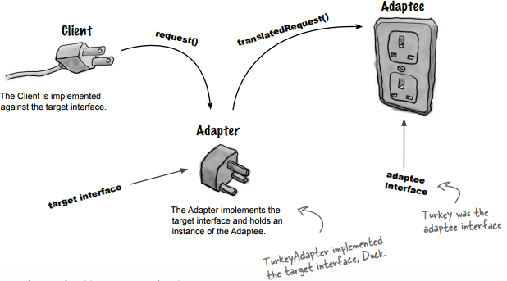
The Adapter Pattern explained

Slide 6
The Adapter Pattern explained
The client makes a request to the adapter by calling a method on it using the target interface.
The adapter translates the request into one or more calls on the adaptee using the adaptee interface.
The client receives the results of the call and never knows there is an adapter doing the translation.
Note that the Client and Adaptee are decoupled – neither knows about the other.

Slide 7
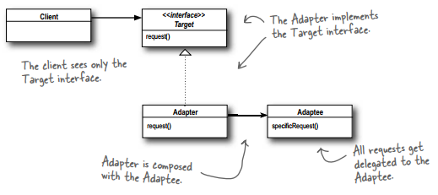
The Adapter Pattern defined
The Adapter Pattern converts the interface of a class into another interface the clients expect. Adapter lets classes work together that couldn’t otherwise because of incompatible interfaces.

Slide 8
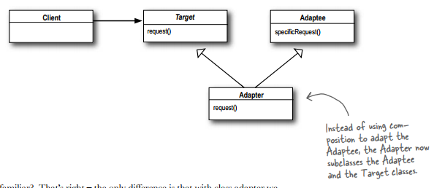
Class Adapter

Slide 9
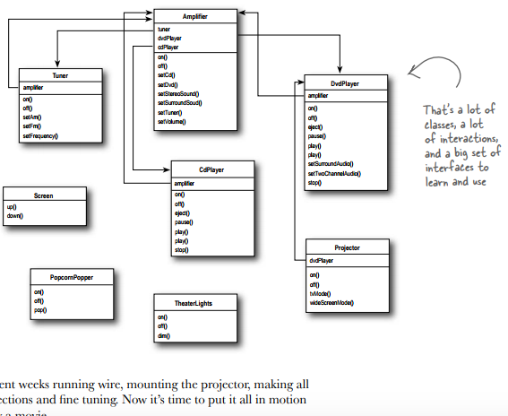
Home Sweet Home Theater

Slide 10
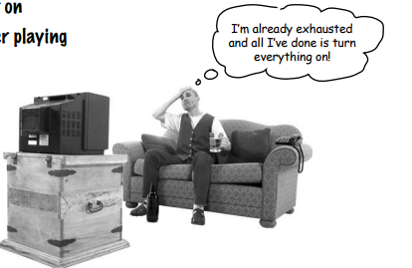
Watching a movie (the hard way)
Turn on the popcorn popper
Start the popper popping
Dim the lights
Put the screen down
Turn the projector on
Set the projector input to DVD
Put the projector on wide-screen mode
Turn the sound amplifier on
Set the amplifier to DVD input
Set the amplifier to surround sound
Set the amplifier volume to medium
Turn the DVD Player on
Start the DVD Player playing

Slide 11
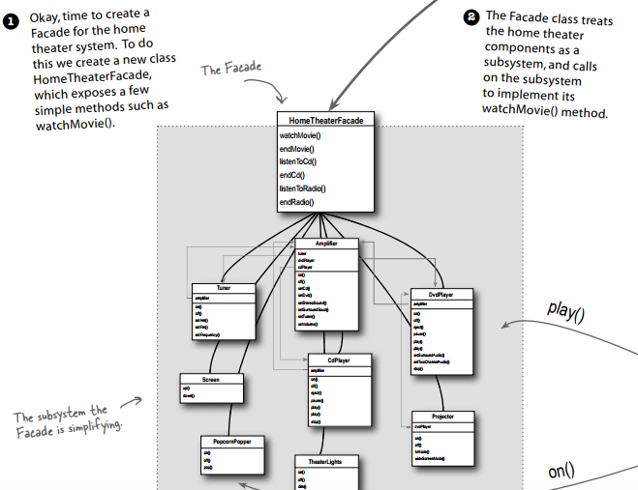

Slide 12
Implementing the simplified interface
public void watchMovie (String movie) {
System.out.println(“Get ready to watch a movie...”);
popper.on();
popper.pop();
lights.dim(10);
screen.down();
projector.on(); projector.wideScreenMode(); amp.on();
amp.setDvd(dvd);
amp.setSurroundSound();
amp.setVolume(5);
dvd.on(); dvd.play(movie);
}
public void endMovie() {
System.out.println(“Shutting movie theater down...”);
popper.off(); lights.on();
screen.up(); projector.off();
amp.off(); dvd.stop();
dvd.eject(); dvd.off(); }
}

Slide 13
Constructing your home theater facade
public class HomeTheaterFacade
{
Amplifier amp;
Tuner tuner;
DvdPlayer dvd;
CdPlayer cd;
Projector projector;
TheaterLights lights;
Screen screen;
PopcornPopper popper;
public HomeTheaterFacade (Amplifier amp, Tuner tuner, DvdPlayer dvd, CdPlayer cd, Projector projector, Screen screen, TheaterLights lights, PopcornPopper popper) {
this.amp = amp; this.tuner = tuner;
this.dvd = dvd; this.cd = cd;
this.projector = projector;
this.screen = screen;
this.lights = lights;
this.popper = popper; }
}

Slide 14
Facade Pattern defined
The Facade Pattern provides a unifi ed interface to a set of interfaces in a subsytem. Facade defi nes a higherlevel interface that makes the subsystem easier to use.
This defi nition tells us loud and clear that the purpose of the facade it to make a subsystem easier to use through a simplified interface.

Slide 15
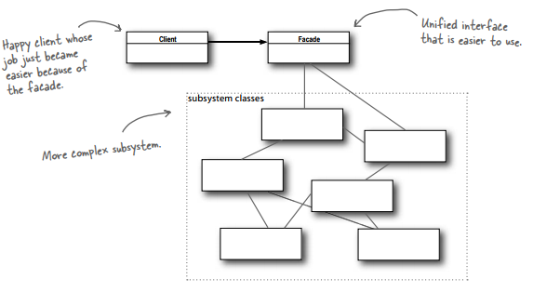
Facade Pattern defined

Slide 16
The Principle of Least Knowledge
The Principle of Least Knowledge guides us to reduce the interactions between objects to just a few close “friends.”
Principle of Least Knowledge - talk only to your immediate friends.
This principle prevents us from creating designs that have a large number of classes coupled together so that changes in one part of the system cascade to other parts. When you build a lot of dependencies between many classes, you are building a fragile system that will be costly to maintain and complex for others to understand.

Slide 17
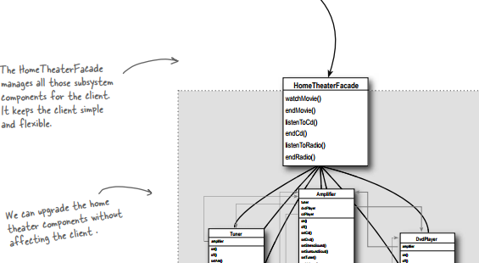
The Facade and the Principle of Least Knowledge

Slide 18
Template Method Pattern
Chapter 8, Page 274.
The Template Method Pattern defi nes the skeleton of an algorithm in a method, deferring some steps to subclasses. Template Method lets subclasses redefi ne certain steps of an algorithm without changing the algorithm’s structure.

Slide 19
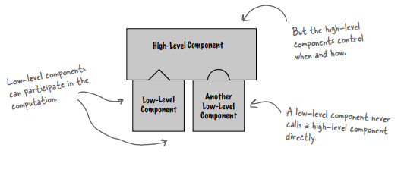
The Hollywood Principle
The Hollywood Principle: Don’t call us, we’ll call you.

Slide 20
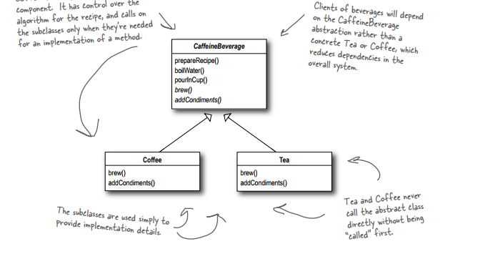
The Hollywood Principle and Template Method

Slide 21
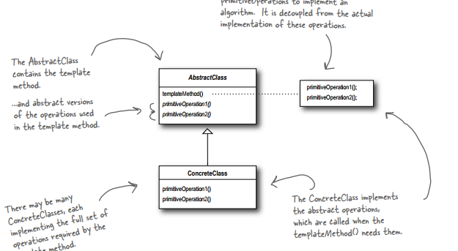
Iterator Class Diagram

Slide 22
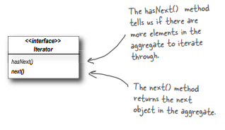
Iterator Pattern

Slide 23
Iterator Pattern defined
The Iterator Pattern provides a way to access the elements of an aggregate object sequentially without exposing its underlying representation.
The Iterator Pattern allows traversal of the elements of an aggregate without exposing the underlying implementation.
It also places the task of traversal on the iterator object, not on the aggregate, which simplifies the aggregate interface and implementation, and places the responsibility where it should be.

Slide 24
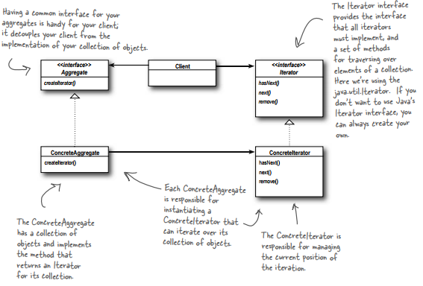

Slide 25
Single Responsibility
A class should have only one reason to change.
Every responsibility of a class is an area of potential change. More than one responsibility means more than one area of change. This principle guides us to keep each class to a single responsibility.
What if we allowed our aggregates to implement their internal collections and related operations AND the iteration methods?
Well, we already know that would expand the number of methods in the aggregate, but so what? Why is that so bad?
When we allow a class to not only take care of its own business (managing some kind of aggregate) but also take on more responsibilities (like iteration) then we’ve given the class two reasons to change. Two? Yup, two: it can change if the collection changes in some way, and it can change if the way we iterate changes. So once again our friend CHANGE is at the center of another design principle

Slide 26
Iterators and Collections in Java 5
ArrayList items = new ArrayList();
items.add(new MenuItem(“Pancakes”, “delicious pancakes”, true, 1.59);
items.add(new MenuItem(“Waffles”, “yummy waffles”, true, 1.99);
items.add(new MenuItem(“Toast”, “perfect toast”, true, 0.59);
for (MenuItem item: items) {
System.out.println(“Breakfast item: “ + item);
}

Slide 27
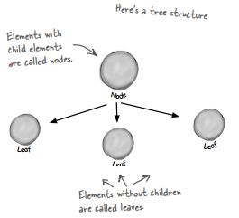
The Composite Pattern defined
The Composite Pattern allows you to compose objects into tree structures to represent part-whole hierarchies. Composite lets clients treat individual objects and compositions of objects uniformly.

Slide 28
Composite Pattern
The Composite Pattern allows us to build structures of objects in the form of trees that contain both compositions of objects and individual objects as nodes.
Using a composite structure, we can apply the same operations over both composites and individual objects. In other words, in most cases we can ignore the differences between compositions of objects and individual objects.

Slide 29
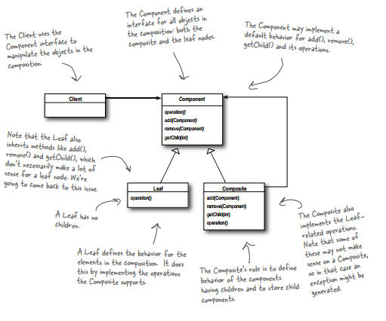

Slide 30
The State Pattern
The State Pattern allows an object to alter its behavior when its internal state changes. The object will appear to change its class.
State pattern encapsulates state-based behavior and delegate behavior to the current state.
Strategy pattern encapsulates interchangeable behaviors and use delegation to decide which behavior to use
In Template method pattern: subclasses decide how to implement steps in an algorithm

Slide 31
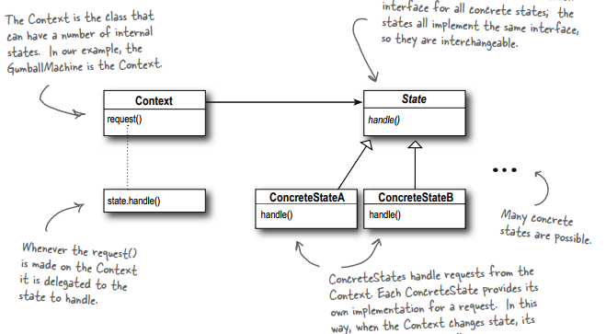
State Pattern class diagram

Slide 32
Strategy & State
In general, think of the Strategy Pattern as a flexible alternative to subclassing; if you use inheritance to define the behavior of a class, then you’re stuck with that behavior even if you need to change it. With Strategy you can change the behavior by composing with a different object.
Think of the State Pattern as an alternative to putting lots of conditionals in your context; by encapsulating the behaviors within state objects, you can simply change the state object in context to change its behavior.

Slide 33
The Proxy Pattern defined
The Proxy Pattern provides a surrogate or placeholder for another object to control access to it
Use the Proxy Pattern to create a representative object that controls access to another object, which may be remote, expensive to create or in need of securing.

Slide 34
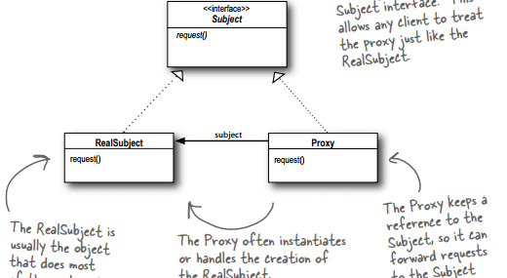
Proxy Class diagram

Slide 35
Pattern
Decorator: Wraps another object and provides additional behavior for it
Façade: Wraps a bunch of objects to simplify their interface
Proxy: Wraps another object to control access to it
Adapter: Wraps another object and provides a different interface to it

Slide 36
Design Pattern defined
A Pattern is a solution to a problem in a context.
The context is the situation in which the pattern applies. This should be a recurring situation.
The problem refers to the goal you are trying to achieve in this context, but it also refers to any constraints that occur in the context.
The solution is what you’re after: a general design that anyone can apply which resolves the goal and set of constraints.
“If you find yourself in a context with a problem that has a goal that is affected by a set of constraints, then you can apply a design that resolves the goal and constraints and leads to a solution.”

Slide 37
Homework
Read compound patterns and other patterns in Head First Book.
Assignment 2 will be given at the end of this week.

