Slide 1
Object-Oriented Programming with Java
Mr. Than Quang Minh
thanqminh.com
Course URL: /courses/oopjava

Slide 2
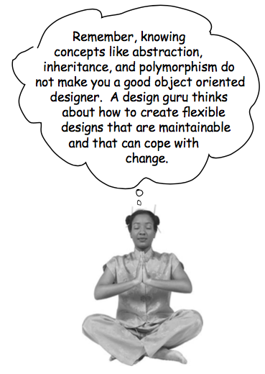

Today’s topic: Design principles with patterns & examples

Slide 3
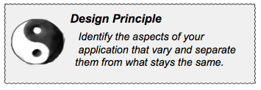
#1: isolate changes
Separating what changes from what stays the same
take the parts that vary and encapsulate them, so that later you can alter or extend the parts that vary without affecting those that don’t.
As simple as this concept is, it forms the basis for almost every design pattern. All patterns provide a way to let some part of a system vary independently of all other parts.

Slide 4
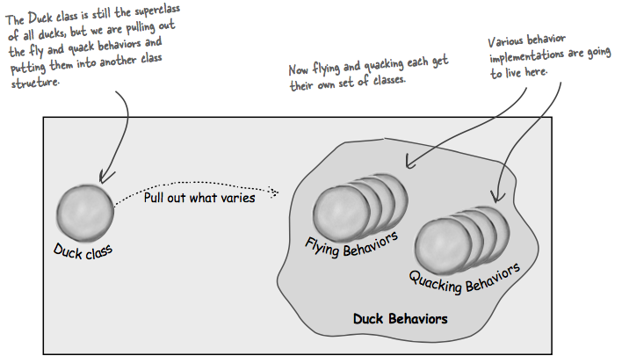
#1 example: Strategy pattern with Duck
We know that fly() and quack() are the parts of the Duck class that vary across ducks.
To separate these behaviors from the Duck class, we’ll pull both methods out of the Duck class and create a new set of classes to represent each behavior.

Slide 5
#2: Program to an interface, not an implementation.
“Program to an interface” really means “Program to a supertype.”
The word interface is overloaded here. There’s the concept of interface, but there’s also the Java construct interface. You can program to an interface, without having to actually use a Java interface.
The point is to exploit polymorphism by programming to a supertype so that the actual runtime object isn’t locked into the code.
the declared type of the variables should be a supertype, usually an abstract class or interface, so that the objects assigned to those variables can be of any concrete implementation of the supertype, which means the class declaring them doesn’t have to know about the actual object types!

Slide 6
#2 examples:
Programming to an implementation would be:
Dog d = new Dog();
d.bark();
But programming to an interface/supertype would be:
Animal animal = new Dog();
animal.makeSound();
Even better, rather than hard-coding the instantiation of the subtype (like new Dog()) into the code, assign the concrete implementation object at runtime:
a = getAnimal();
a.makeSound();

Slide 7
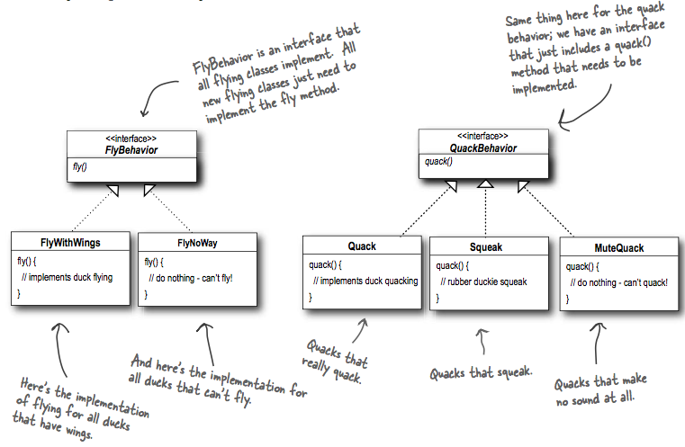
#2 examples: Duck behaviors
With this design, other types of objects can reuse our fly and quack behaviors because these behaviors are no longer hidden away in our Duck classes!
And we can add new behaviors without modifying any of our existing behavior classes or touching any of the Duck classes that use flying behaviors.

Slide 8
#2 examples: Duck behaviors
With this design, other types of objects can reuse our fly and quack behaviors because these behaviors are no longer hidden away in our Duck classes!
And we can add new behaviors without modifying any of our existing behavior classes or touching any of the Duck classes that use flying behaviors.
So we get the benefit of REUSE without all the baggage that comes along with inheritance.

Slide 9
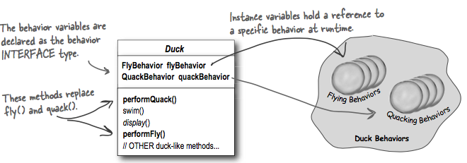
#2 example: integrate behaviors

Slide 10
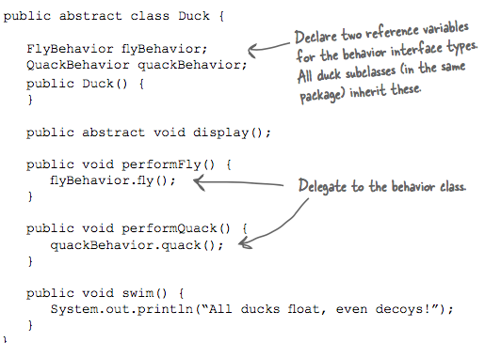
#2: Duck implementation

Slide 11
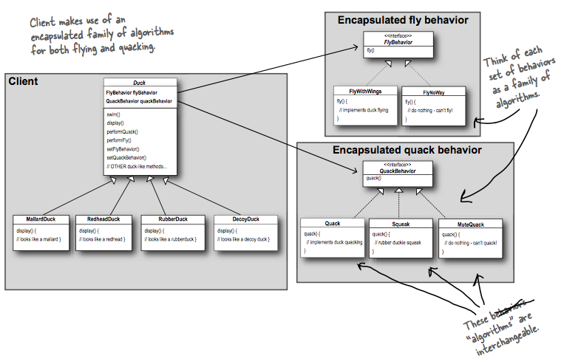
Big picture of strategy pattern example

Slide 12
#3: Favor composition over inheritance.
HAS-A can be better than IS-A.
The HAS-A relationship is an interesting one: each duck has a FlyBehavior and a QuackBehavior to which it delegates flying and quacking.
When you put two classes together like this you’re using composition. Instead of inheriting their behavior, the ducks get their behavior by being composed with the right behavior object.
As you’ve seen, creating systems using composition gives you a lot more flexibility. Not only does it let you encapsulate a family of algorithms into their own set of classes, but it also lets you change behavior at runtime as long as
the object you’re composing with implements the correct behavior interface.
Composition is used in many design patterns and you’ll see a lot more about its advantages and disadvantages when using it

Slide 13
Observer Pattern
You know how newspaper or magazine subscriptions work:
A newspaper publisher goes into business and begins publishing newspapers.
You subscribe to a particular publisher, and every time there’s a new edition it gets delivered to you. As long as you remain a subscriber, you get new newspapers.
You unsubscribe when you don’t want papers anymore, and they stop being delivered.
While the publisher remains in business, people, hotels, airlines and other businesses constantly subscribe and unsubscribe to the newspaper.

Slide 14
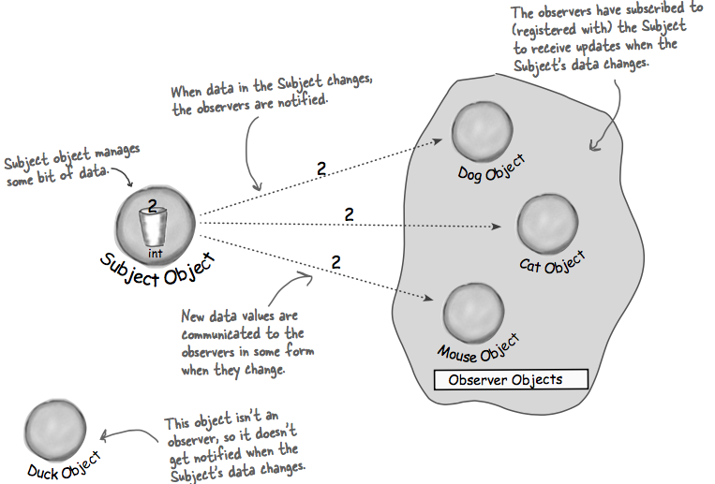
Publishers + Subscribers = Observer Pattern

Slide 15
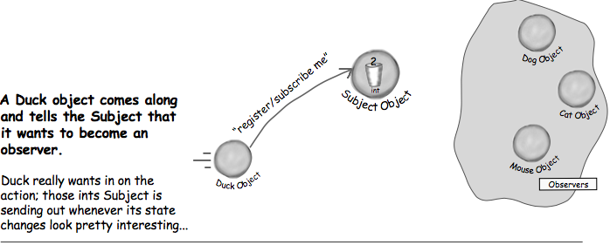
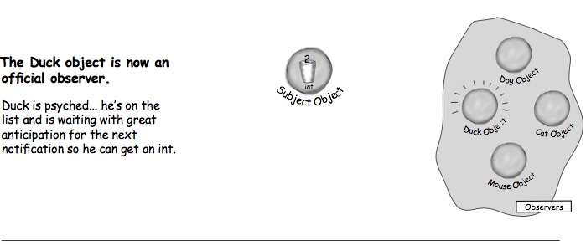
A day in the life of the Observer Pattern

Slide 16
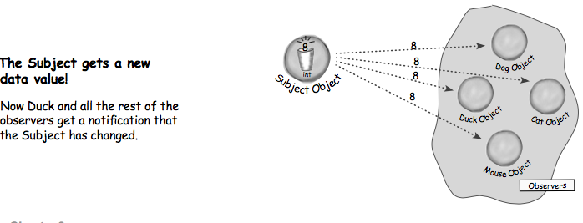
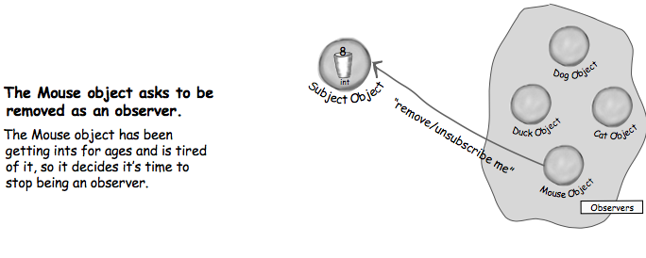
A day in the life of the Observer Pattern

Slide 17
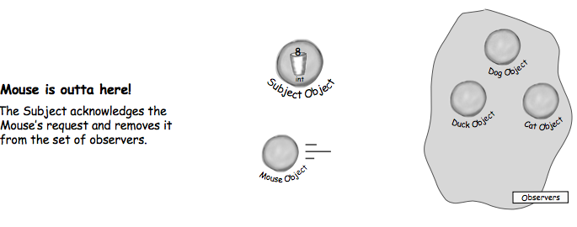
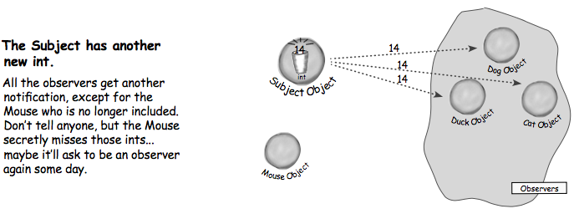
A day in the life of the Observer Pattern

Slide 18
The Observer Pattern defined
When you’re trying to picture the Observer Pattern, a newspaper subscription service with its publisher and subscribers is a good way to visualize the pattern.
The Observer Pattern defines a one-to-many dependency between objects
so that when one object changes state, all of its dependents are notified and updated automatically.

Slide 19
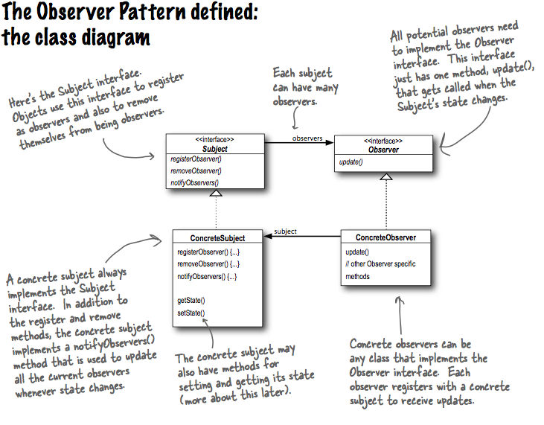

Slide 20
#4: Loose Coupling
Strive for loosely coupled designs between objects that interact.
When two objects are loosely coupled, they can interact, but have very little knowledge of each other.
The Observer Pattern provides an object design where subjects and observers are loosely coupled.
Why?

Slide 21
Answer: Loose coupling support changes
The only thing the subject knows about an observer is that it implements a certain interface:
(the Observer interface). It doesn’t need to know the concrete class of the observer, what it does, or anything else about it.
We never need to modify the subject to add new types of observers.
We can reuse subjects or observers independently of each other.
Changes to either the subject or an observer will not affect the other.
Loosely coupled designs allow us to build flexible OO systems that can handle change because they minimize the interdependency between objects.

Slide 22
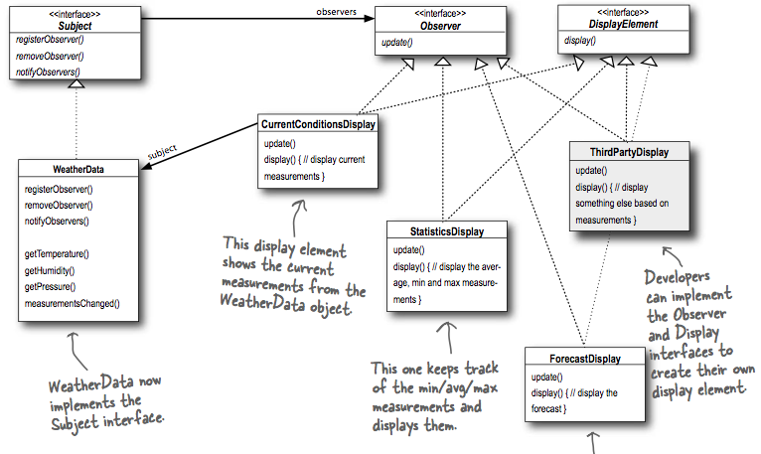
Designing the Weather Station

Slide 23
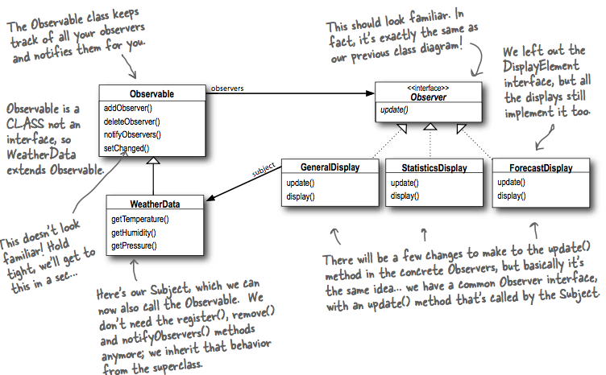
Java Built-in Observer Pattern

Slide 24
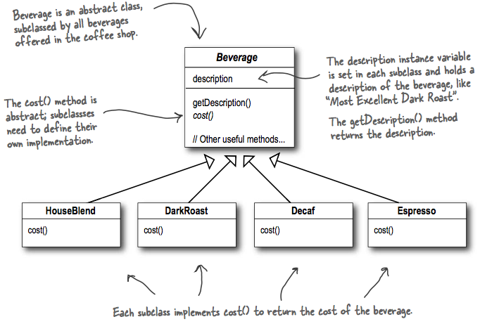
Decorator pattern: Starbuzz Coffee Example

Slide 25
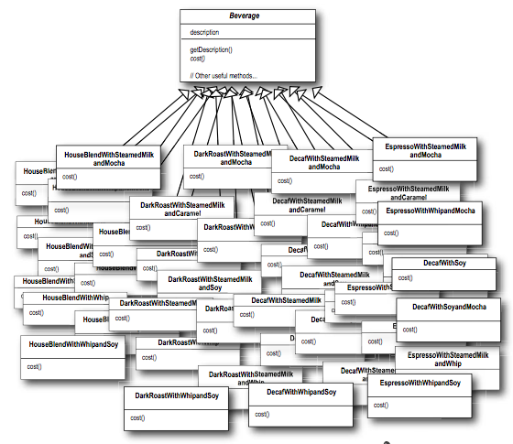
With more beverages & Toppings

Slide 26
The Open-Closed Principle
Classes should be open for extension, but closed for modification.
Come on in; we’re open. Feel free to extend our classes with any new behavior you like. If your needs or requirements change (and we know they will), just go ahead and make your own extensions.
Sorry, we’re closed. That’s right, we spent a lot of time getting this code correct and bug free, so we can’t let you alter the existing code. It must remain closed to modification. If you don’t like it, you can speak to the manager.
Our goal is to allow classes to be easily extended to incorporate new behavior without modifying existing code.
What do we get if we accomplish this? Designs that are resilient to change and flexible enough to take on new functionality to meet changing requirements.

Slide 27

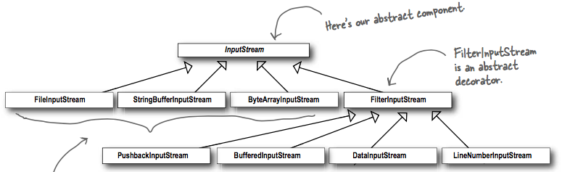
The Decorator Pattern defined
Decorator Pattern attaches additional responsibilities to an object dynamically. Decorators provide a flexible alternative to subclassing for extending functionality.
Real World Decorators: Java I/O
BufferedInputStream and LineNumberInputStream both extend FileInputStream, which acts as the abstract decorator class.

Slide 28
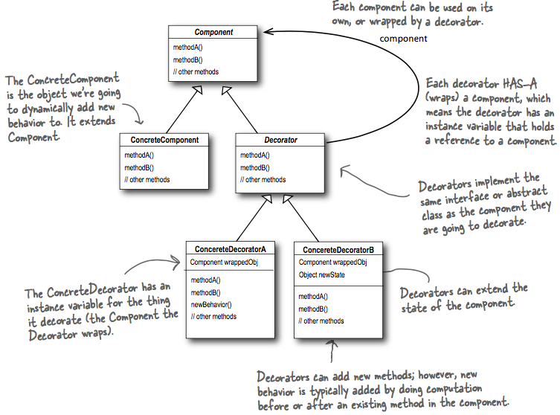
Class diagram

Slide 29
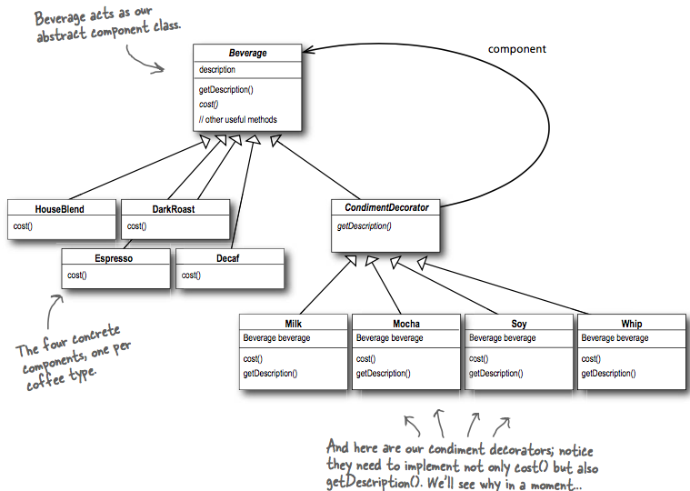
Starbuzz example

Slide 30
Homework
Continue reading Head First Design Pattern Book.
Download code from publisher’s website and play with the implementations.
Continue doing assignment 1

