Slide 1
Advanced Web Design
Than Quang Minh
thanqminh.com
Course URL: /courses/avd

Slide 2
Course summary & assessment
Attendance: 10%
Usability: web flow and mockup (20%)
UI framework: web layout (20%)
Simple web app: final project (50%)

Slide 3
References:
Don't Make Me Think, Revisited: A Common Sense Approach to Web Usability (3rd Edition) – Steve Krug
https://www.w3schools.com/
https://www.coursera.org/learn/html-css-javascript-for-web-developers
https://learnlayout.com/
https://getbootstrap.com/docs/4.5/getting-started/introduction/
https://www.w3schools.com/xml/ajax_intro.asp
https://git-scm.com/docs

Slide 4
Today’s topics
Introduction to Usability
Git & Github page

Slide 5
Usability Introduction
In the last few years, making things more usable has become almost everybody’s responsibility.
Visual designers and developers now often find themselves doing things like:
interaction design (deciding what happens next when the user clicks, taps, or swipes) and
information architecture (figuring out how everything should be organized).
If something is usable: A person of average (or even below average) ability and experience can figure out how to use the thing to accomplish something without it being more trouble than it’s worth.

Slide 6
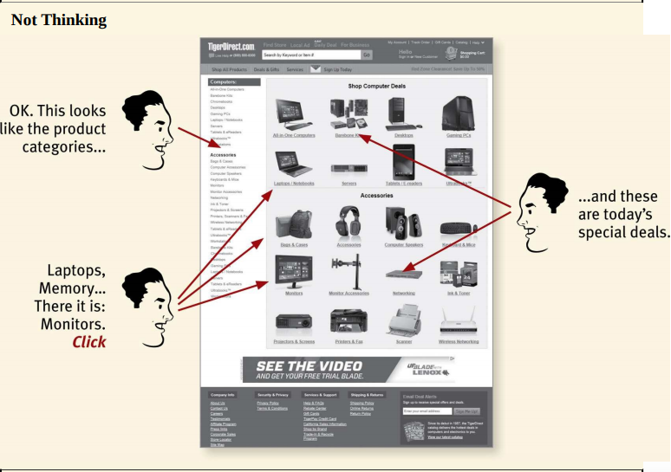
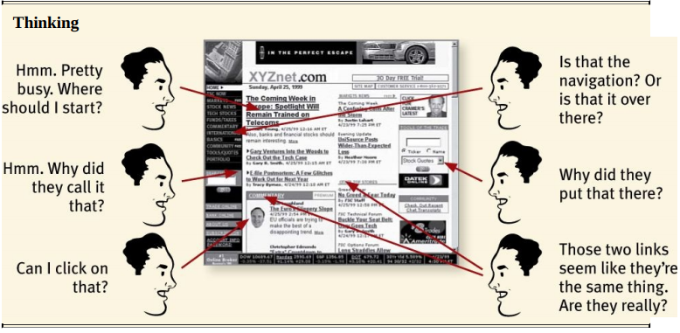
First law of Usability
Don’t make me think!

Slide 7
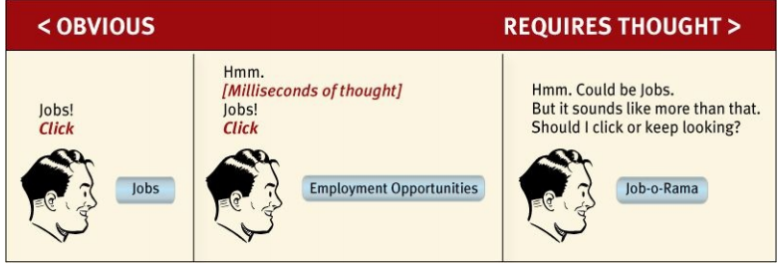
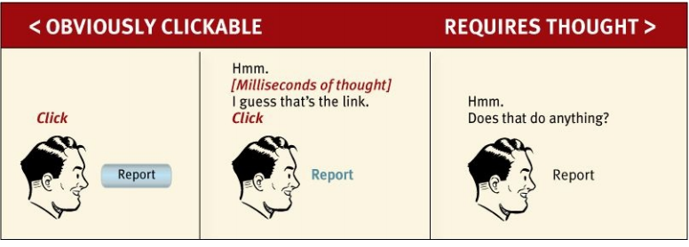
Things that make us think

Slide 8
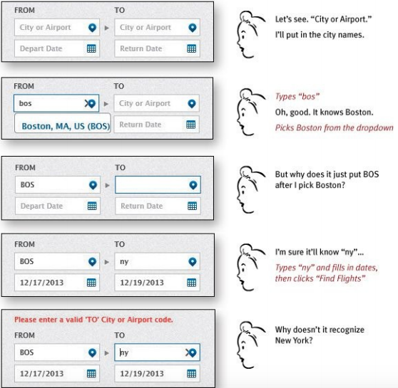

Slide 9
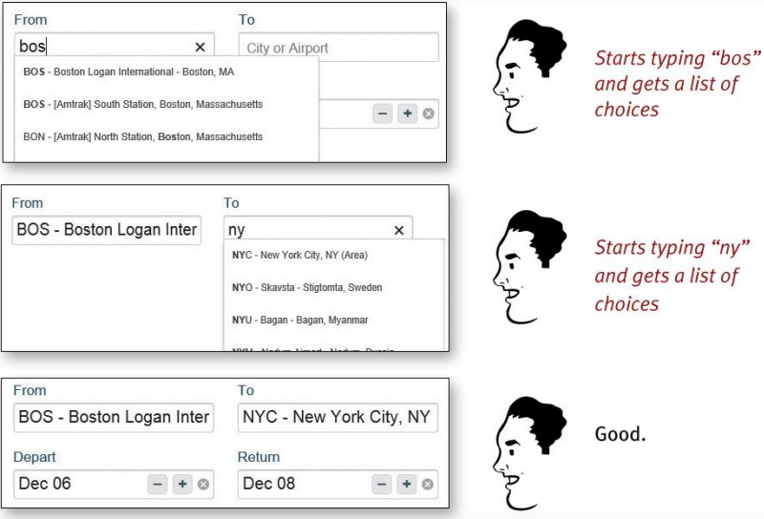

Slide 10
Think = Question mark
Where am I?
Where should I begin?
Where did they put _____?
What are the most important things on this page?
Why did they call it that?
Is that an ad or part of the site?

Slide 11
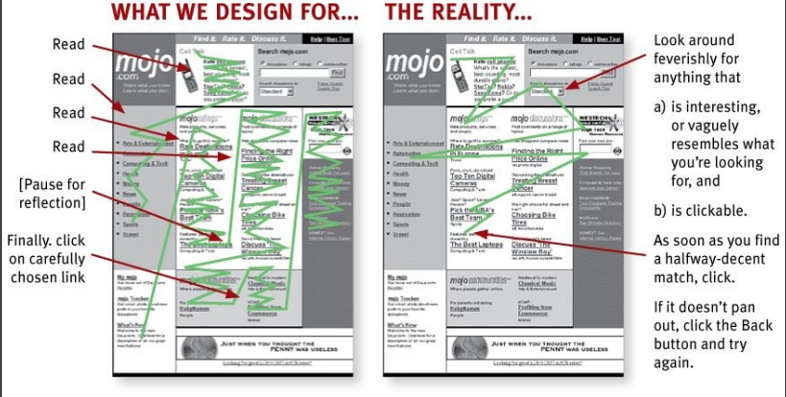
How we really use the web

Slide 12
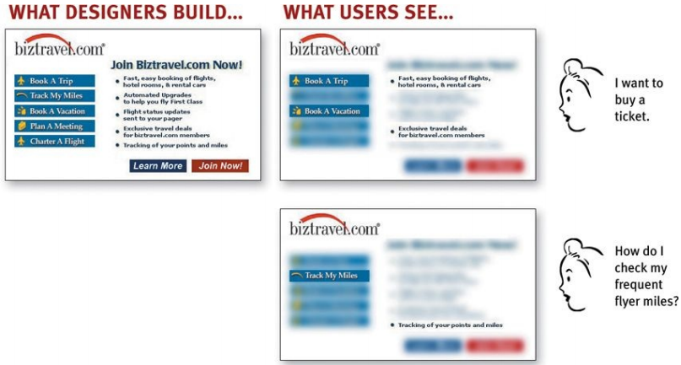
3 Facts: 1
FACT OF LIFE #1: We don’t read pages. We scan them.
We’re usually on a mission
We know we don’t need to read everything.
We’re good at it.

Slide 13
3 Facts: 2
FACT OF LIFE #2: We don’t make optimal choices. We satisfice.
We’re usually in a hurry
There’s not much of a penalty for guessing wrong.
Weighing options may not improve our chances.
Guessing is more fun.

Slide 14
3 Facts: 3
FACT OF LIFE #3: We don’t figure out how things work. We muddle through.
It’s not important to us
If we find something that works, we stick to it.
Try it yourself: ask some family members what a Web browser is.

Slide 15
DESIGNING FOR SCANNING, NOT READING
Take advantage of conventions:
Where things will be located on a page
How things work
How things look
Create effective visual hierarchies
Break pages up into clearly defined areas
Make it obvious what’s clickable: Break up pages into clearly defined areas
Eliminate distractions: shouting, Disorganization, Clutter
Format content to support scanning

Slide 16
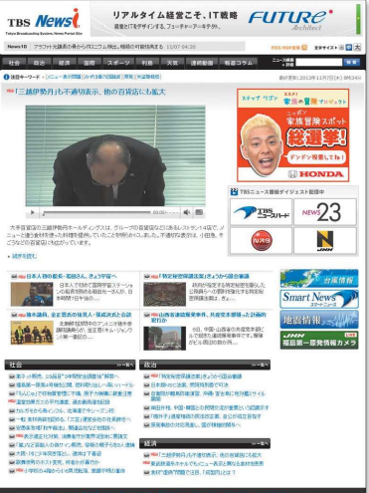

Slide 17
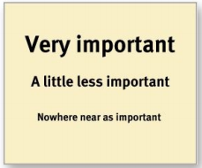
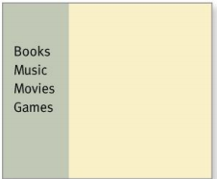
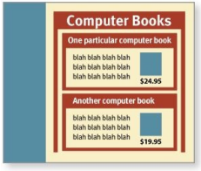
Create effective visual hierarchies
The more important something is, the more prominent it is: larger, bolder, in a distinctive color, set off by more white space, or nearer the top of the page—or some combination of the above
Things that are related logically are related visually
Things are “nested” visually to show what’s part of what

Slide 18
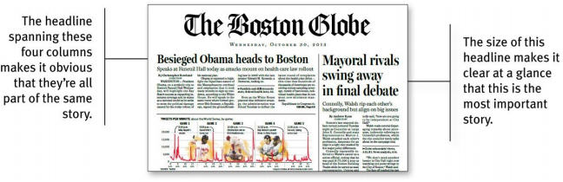
There’s nothing new about visual hierarchies.

Slide 19
Keep the noise down to a dull roar
Shouting: overwhelming of effects.
Disorganization: use grids to align elements.
Clutter: too much stuff
Start with the assumption that everything is visual noise.

Slide 20
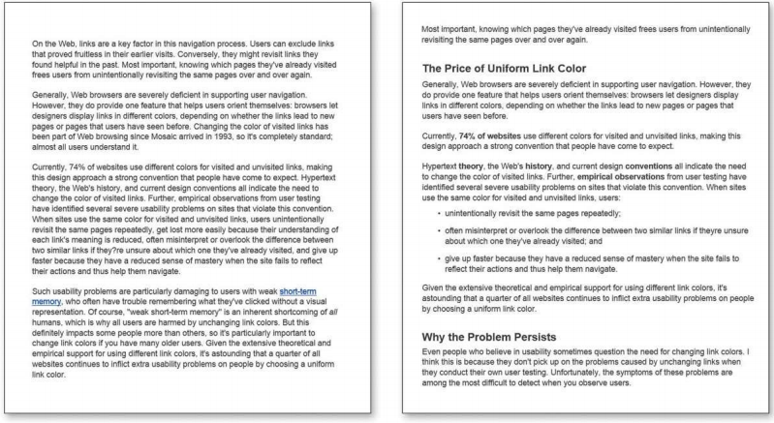
Format text to support scanning

Slide 21
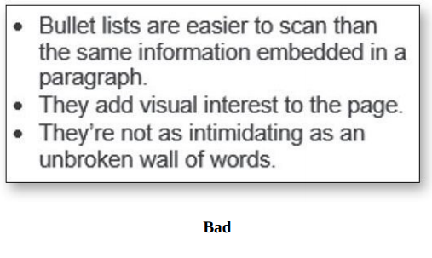
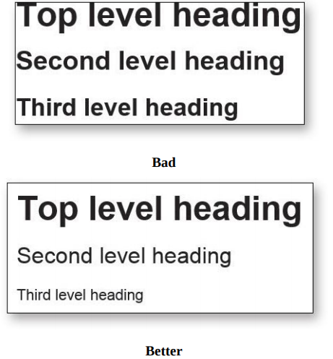
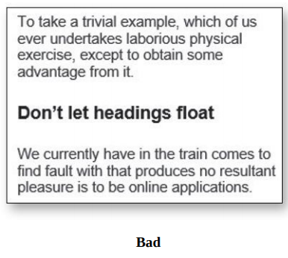
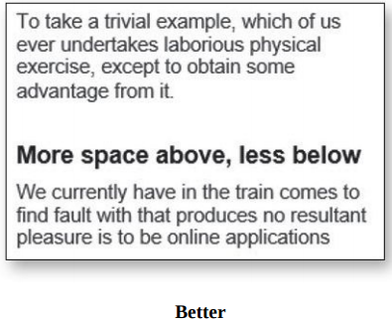
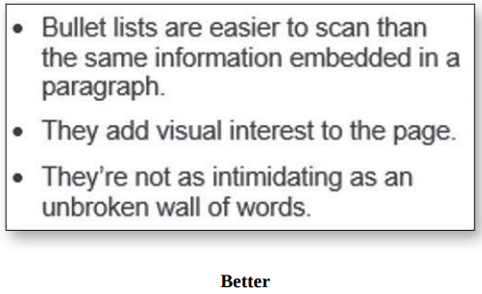
Format text to support scanning
Use plenty of headings.
Keep paragraphs short.
Use bulleted lists.
Highlight key terms.

Slide 22
Git & Github page
Basic concepts:
https://dzone.com/articles/git-basic-terminologies-explained
More git tutorials:
https://dev.to/unseenwizzard/learn-git-concepts-not-commands-4gjc
Github page demo:

Slide 23
Homework & Prepare for practice
Install nodejs
Install git
Install Visual Studio Code
Install Photoshop
Install Postman/Insomnia
Create Github account
Install SSH & create key pairs & add public key to Github
https://www.w3schools.com/html/exercise.asp
https://github.com/jhu-ep-coursera/fullstack-course4 (2)

