Slide 1
Object-Oriented Programming with Java
Than Quang Minh
thanqminh.com
Course URL: /courses/oopjava

Slide 2
Course’s Content
Java basic
JVM, JDK, version, package & classpath, entry point
Primitive data type and built-in classes.
Testing with Junit
Build tools
Coding convention
GUI (Swing, JavaFX)
OOP
Basic OOP: Inheritance, Polymorphism, Encapsulation, Composition
Design principles
Design Pattern introduction

Slide 3
Evaluation
Be present at the course is only 10 % of the learning path
The remaining 90 % consists in studying at home, doing assignments, final project result and presentations.
2 assignments account for 40% of total score, final project accounts for 50% of total score.

Slide 4
References
Topic | Reference
Java & Coding & Test | Java: A Beginner's Guide, Sixth Edition Clean Code: A Handbook of Agile Software Craftsmanship http://programmingbydoing.com/ JUnit Recipes - Practical Methods for Programmer Testing
OOP | Object-Oriented Analysis and Design with Applications - 3rd Edition http://www.oodesign.com/
Design Patterns | https://sourcemaking.com/design_patterns Head first Design Patterns Design Patterns: Elements of Reusable Object-Oriented Software

Slide 5
Before we start
Prerequisites: Basic programming skills.
Survey: /courses/oopjava
Current background: knowledge & skills.
Communication channels
Notifications
Quick questions:
Java
Programming experience
OOP Experience

Slide 6
Today’s topic: Java Overview
Language, JVM, JDK
Package
Classpath
Compiler and Runner
Build tools
IDE

Slide 7
Language
Originally developed by Sun Microsystems which was initiated by James Gosling and released in 1995.
Latest stable version: Java 10.
Object Oriented − In Java, everything is an Object. Java can be easily extended since it is based on the Object model.
Simple − Java is designed to be easy to learn. If you understand the basic concept of OOP Java, it would be easy to master.
Platform Independent.
Multithreaded
Interpreted
And more

Slide 8
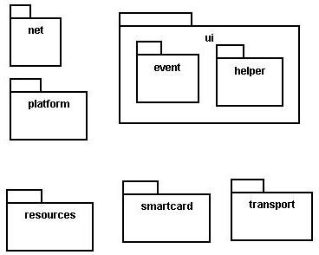
Java packages
package: A collection of related classes.
Can also "contain" sub-packages.
Sub-packages can have similar names, but are not actually contained inside.
java.awt does not contain java.awt.event
Uses of Java packages:
group related classes together
as a namespace to avoid name collisions
provide a layer of access / protection
keep pieces of a project down to a manageable size

Slide 9

Packages and directories
package ←→ directory (folder)
class ←→ file
A class named D in package a.b.c should reside in this file:
a/b/c/D.class
(relative to the root of your project)
The "root" directory of the package hierarchy is determined by your class path or the directory from which java was run.

Slide 10
Classpath
class path: The location(s) in which Java looks for class files.
Can include:
the current "working directory" from which you ran javac / java
other folders
JAR archives
URLs
...
Can set class path manually when running java at command line:
java -cp /home/stepp/libs:/foo/bar/jbl MyClass

Slide 11
A package declaration
package name;
public class name { ...
Example:
package pacman.model;
public class Ghost extends Sprite {
...
}
File Sprite.java should go in folder pacman/model .

Slide 12
Importing a package
import packageName.*; // all classes
Example:
package pacman.gui;
import pacman.model.*;
public class PacManGui {
...
Ghost blinky = new Ghost();
}
PacManGui must import the model package in order to use it.

Slide 13
Importing a class
import packageName.className; // one class
Example:
package pacman.gui;
import pacman.model.Sprite;
public class PacManGui {
Ghost blinky = new Ghost();
}
Importing single classes has high precedence:
if you import .*, a same-named class in the current dir will override
if you import .className, it will not

Slide 14
Static import
import static packageName.className.*;
Example:
import static java.lang.Math.*;
...
double angle = sin(PI / 2) + ln(E * E);
Static import allows you to refer to the members of another class without writing that class's name.
Should be used rarely and only with classes whose contents are entirely static "utility" code.

Slide 15
Referring to packages
packageName.className
Example:
java.util.Scanner console =
new java.util.Scanner(java.lang.System.in);
You can use a type from any package without importing it if you write its full name.
Sometimes this is useful to disambiguate similar names.
Example: java.awt.List and java.util.List
Or, explicitly import one of the classes.

Slide 16
The default package
Compilation units (files) that do not declare a package are put into a default, unnamed, package.
Classes in the default package:
Cannot be imported
Cannot be used by classes in other packages
Many editors discourage the use of the default package.
Package java.lang is implicitly imported in all programs by default.
import java.lang.*;

Slide 17
Package access
Java provides the following access modifiers:
public : Visible to all other classes.
private : Visible only to the current class (and any nested types).
protected : Visible to the current class, any of its subclasses, and any other types within the same package.
default (package): Visible to the current class and any other types within the same package.
To give a member default scope, do not write a modifier:
package pacman.model;
public class Sprite {
int points; // visible to pacman.model.*
String name; // visible to pacman.model.*

Slide 18
Package exercise
Add packages to the Rock-Paper-Scissors game.
Create a package for core "model" data.
Create a package for graphical "view" classes.
Any general utility code can go into a default package or into another named utility (util) package.
Add appropriate package and import statements so that the types can use each other properly.

Slide 19
JAR Files
JAR: Java ARchive. A group of Java classes and supporting files combined into a single file compressed with ZIP format, and given .JAR extension.
Advantages of JAR files:
compressed; quicker download
just one file; less mess
can be executable
The closest you can get to having a .exe file for your Java application.

Slide 20
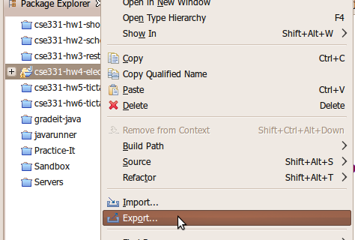
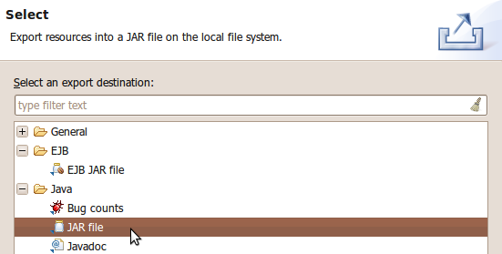
Creating a JAR archive
from the command line:
jar -cvf filename.jar files
Example:
jar -cvf MyProgram.jar *.class *.gif *.jpg
some IDEs (e.g. Eclipse) can create JARs automatically
File → Export... → JAR file

Slide 21
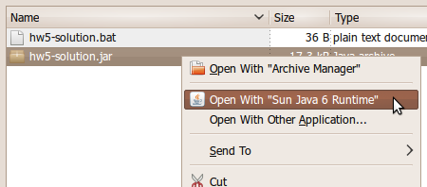
Running a JAR
Running a JAR from the command line:
java -jar filename.jar
Most OSes can run JARs directly by double-clicking them:

Slide 22
Making a runnable JAR
manifest file: Used to create a JAR runnable as a program.
jar -cvmf manifestFile MyAppletJar.jar mypackage/*.class *.gif
Contents of MANIFEST file:
Main-Class: MainClassName
Eclipse will automatically generate and insert a proper manifest file into your JAR if you specify the main-class to use.

Slide 23
Resources inside a JAR
You can embed external resources inside your JAR:
images (GIF, JPG, PNG, etc.)
audio files (WAV, MP3)
input data files (TXT, DAT, etc.)
...
But code for opening files will look outside your JAR, not inside it.
Scanner in = new Scanner(new File("data.txt")); // fail
ImageIcon icon = new ImageIcon("pony.png"); // fail
Toolkit.getDefaultToolkit().getImage("cat.jpg"); // fail

Slide 24
Accessing JAR resources
Every class has an associated .class object with these methods:
public URL getResource(String filename)
public InputStream getResourceAsStream(String name)
If a class named Example wants to load resources from within a JAR, its code to do so should be the following:
Scanner in = new Scanner( Example.class.getResourceAsStream("/data.txt"));
ImageIcon icon = new ImageIcon( Example.class.getResource("/pony.png"));
Toolkit.getDefaultToolkit().getImage( Example.class.getResource("/images/cat.jpg"));
(Some classes like Scanner read from streams; some like Toolkit read from URLs.)
NOTE the very important leading / character; without it, you will get a null result

Slide 25
Homework
Java book: chapter 1-5
Install Java, JDK, IDE
http://programmingbydoing.com/ 1-74

