Slide 1
Software Engineering and Human Computer Interaction
Than Quang Minh
thanqminh.com
Course URL: /courses/sehci

Slide 2
Today’s topics: Usability testing
Avoid arguments about usability
How to conduct usability testing
Assignment 2

Slide 3
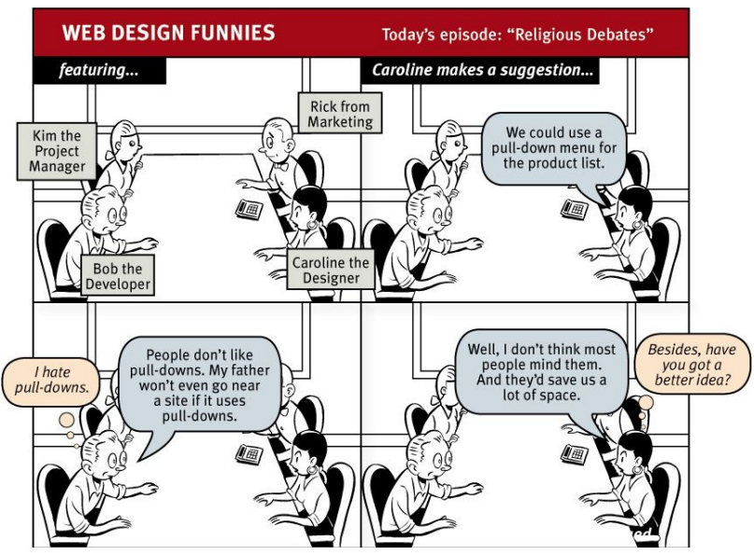

Slide 4
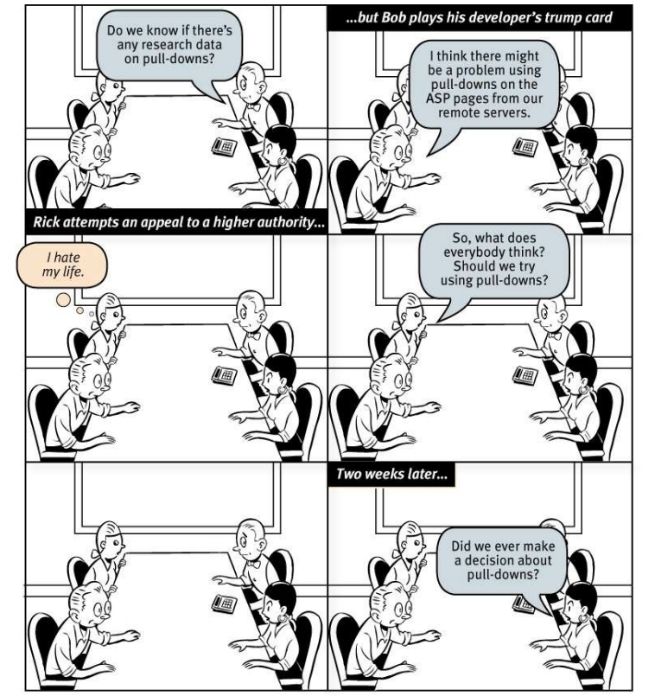

Slide 5
Web design: endless discussions - religious debates
Web teams aren’t notoriously successful at making decisions about usability questions
personal beliefs about things that can’t be proven.
rarely result in anyone involved changing his or her point of view
wasting time
create tension and erode respect among team members
prevent the team from making critical decisions

Slide 6
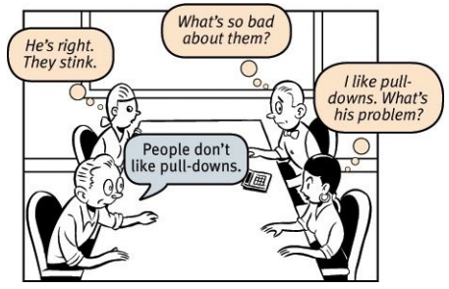

Forces & Antidote
Everybody likes ….
Different perspectives:
Professional passion.
Farmers love fences, cowmen love the open range.
Oh, that. It came to our CEO in a dream, so we had to add it

Slide 7
The myth of the Average User
All web users are unique and all web use is basically idiosyncratic
There are no simple “right” answers for most Web design questions (at least not for the important ones)
What works is good, integrated design that fills a need—carefully thought out, well executed, and tested.
“Does this pull-down, with these items and this wording in this context on this page create a good experience for most people who are likely to use this site?”
The answer is testing: build some version of the thing, watch some people carefully as they try to figure out what it is and how to use it

Slide 8
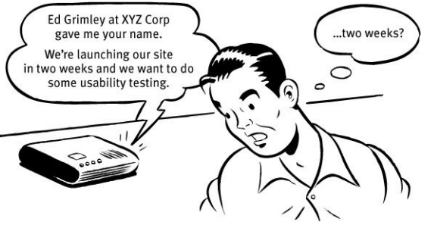
Usability Testing: why didn’t we do this sooner?

Slide 9
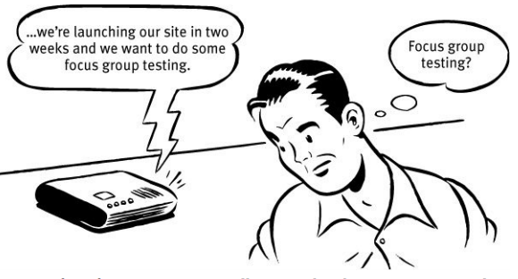
Usability Testing: why didn’t we do this sooner?

Slide 10
Focus groups are not usability tests
Usability tests are about watching one person at a time try to use something (whether it’s a Web site, a prototype, or some sketches of a new design) to do typical tasks so you can detect and fix the things that confuse or frustrate them.
Focus groups are about having people talk about things, like their opinions about our products, their past experiences with them, or their reactions to new ideas that we show them.
Focus groups are good for quickly getting a sampling of users’ feelings and opinions about things.
So the main difference is that in usability tests, you watch people actually use things, instead of just talk about them.”
Focus groups are not good for learning about whether your site works and how to improve it

Slide 11
True things about usability testing
If you want a great site, you’ve got to test.
Testing one user is 100 percent better than testing none.
Testing one user early in the project is better than testing 50 near the end

Slide 12
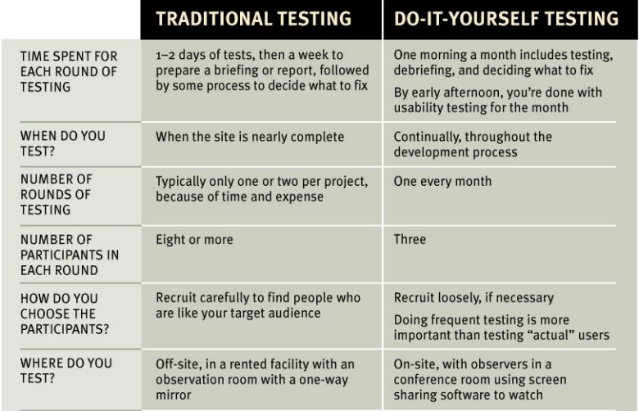
Do-it-yourself usability testing
Web teams aren’t notoriously successful at making decisions about usability questions
personal beliefs about things that can’t be proven.
rarely result in anyone involved changing his or her point of view
wasting time
create tension and erode respect among team members
prevent the team from making critical decisions

Slide 13
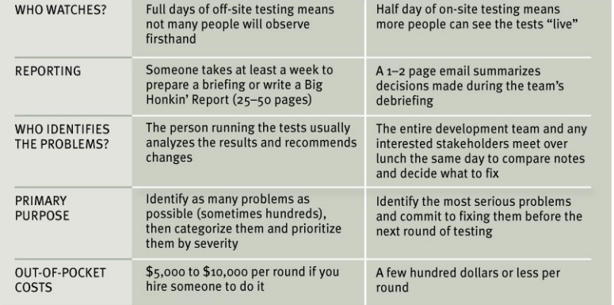
Do-it-yourself usability testing

Slide 14
Do-it-yourself usability testing
Web teams aren’t notoriously successful at making decisions about usability questions
personal beliefs about things that can’t be proven.
rarely result in anyone involved changing his or her point of view
wasting time
create tension and erode respect among team members
prevent the team from making critical decisions

Slide 15
How often should you test? a morning/month
It keeps it simple so you’ll keep doing it.
It gives you what you need.
It frees you from deciding when to test.
It makes it more likely that people will attend.

Slide 16
How many users do you need?
Ideal number of participants for each round of do-it-yourself testing is three
The purpose of this kind of testing isn’t to prove anything: purpose is to improve what you’re building by identifying and fixing usability problems. The process isn’t rigorous at all: You give them tasks to do, you observe, and you learn. The result is actionable insights, not proof.
You don’t need to find all of the problems: You can find more problems in half a day than you can fix in a month.

Slide 17
How do you choose the participants?
Recruit loosely and grade on a curve - When somebody has a problem: would our users have that problem, or was it only a problem because they didn’t know what our users know?
It’s usually not a good idea to design a site so that only your target audience can use it.
We’re all beginners under the skin.
Experts are rarely insulted by something that is clear enough for beginners.

Slide 18
How do you find participants?
User groups, trade shows, Craigslist, Facebook, Twitter, customer forums, a pop-up on your site, or even asking friends and neighbors.
Checkout NNM report: Ho to Recruit Participants for Usability Studies.
Where do you test?

Slide 19
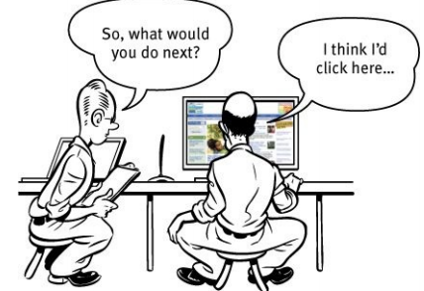
Where do you test?
Quite space, 1 desk, 1 chairs, PC with internet, microphone.
Screen sharing software to allow observing the tests.
Screen recording software.

Slide 20
Who should do the testing?
Facilitator. Almost anyone can facilitate a usability test.
patient, calm, empathetic, and a good listener
keeping the participants comfortable and focused on doing the tasks
encourage participants to think out loud as much as possible.
The combination of watching what the participants do and hearing what they’re thinking while they do it is what enables the observers to see the site through someone else’s eyes and understand why some things that are obvious to them are confusing or frustrating to users.

Slide 21
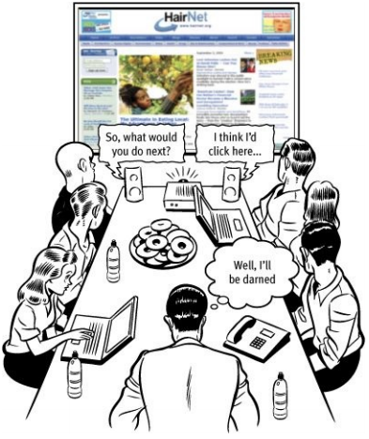
Who should observe?
As many people as possible!
For many people, it’s a transformative experience that dramatically changes the way they think about users: They suddenly “get it” that users aren’t all like them.
team members, stakeholders, managers, and even executives
buy the best snacks you can to lure people in

Slide 22
What do you test, and when do you test it?
It’s important to start testing as early as possible and to keep testing through the entire development process.
Even before you begin designing your site, for instance, it’s a good idea to do a test of competitive sites.
Bring in three participants and watch them try to do some typical tasks on one or two competitive sites.
If you’re redesigning an existing site, you’ll know what’s not working (and needs to be changed) and what is working (so you don’t break it).
beginning with your first rough sketches and continuing on with wireframes, page comps, prototypes, and finally actual pages.

Slide 23
How do you choose the tasks to test?
For each round of testing, you need to come up with tasks: the things the participants will try to do.
If you have more than a sketch to show them, though, start by making a list of the tasks people need to be able to do with whatever you’re testing.
word each task carefully, so the participants will understand exactly what you want them to do, Include any information that they’ll need but won’t have.
Task should increase their emotional investment and allows them to use more of their personal knowledge of the content.

Slide 24
What happens during the test?
See script & demo test video at http://rocketsurgerymadeeasy.com/
One-hour test:
Welcome (4 mins)
The questions (2 mins)
The Home page tour (3 mins)
The tasks (35 mins)
Probing (5 mins)
Wrapping up (5 mins)

Slide 25
Typical problems
Users are unclear on the concept.
The words they’re looking for aren’t there.
There’s too much going on.

Slide 26
The debriefing: Deciding what to fix
Focus ruthlessly on fixing the most serious problems first
Make a collective list + 3 most serious problem/ participant
Choose the ten most serious problems.
Rate them. Number them from 1 to 10, 1 being the worst on top.
Create an ordered list. Starting at the top.
Deciding what to fix:
Keep a separate list of low-hanging fruit: not serious but easy.
Resist the impulse to add things.
Take “new feature” requests with a grain of salt.
Ignore “kayak” problems.
Alternative lifestyles:
Remote testing.
Unmoderated remote testing.

Slide 27
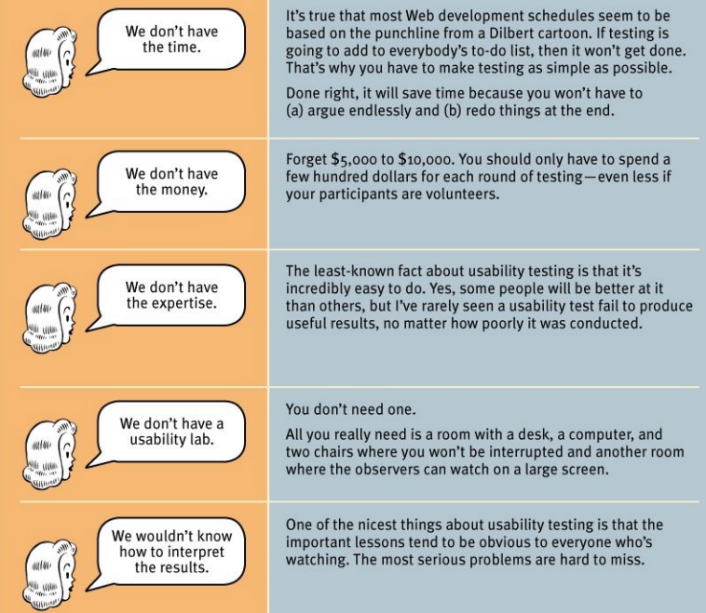
The Top Five Plausible Reasons for not Testing Web Sites

Slide 28
Assignment 2
Find (or create) a website or similar websites and conduct a usability testing.
Things to submit:
Tasks for each test
Scripts
Recorded videos.
Ordered problem lists.
Working progress should be reported daily.
Evaluation:
Qualities of submitted documents: 1.4
Timely reported & steady progress: 0.6
Submission deadline: 1st November, 2017.

