Slide 1
Software Engineering and Human Computer Interaction
Than Quang Minh
thanqminh.com
Course URL: /courses/sehci

Slide 2
Today’s topics:
Mobile Usability
Usability as common courtesy
Accessibility
Make it happen
Final project

Slide 3
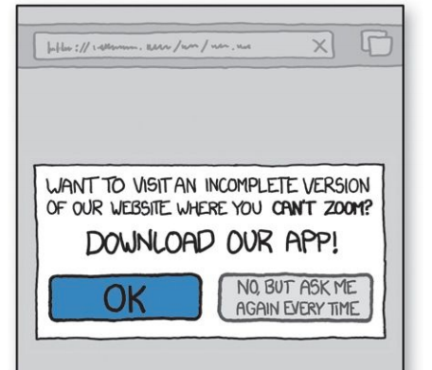
Example

Slide 4
Constraints & Tradeoffs
It’s all about tradeoffs. One way to look at design—any kind of design—is that it’s essentially about:
constraints (things you have to do and things you can’t do) and
tradeoffs (the less-than-ideal choices you make to live within the constraints).
the best you can do is please some of the people some of the time
You can fool some of the people all of the time, and all of the people some of the time, but you cannot fool all of the people all of the time
Whenever you’re designing, you’re dealing with constraints. And where there are constraints, there are tradeoffs to be made.
Many—if not most—serious usability problems are the result of a poor decision about a tradeoff.

Slide 5
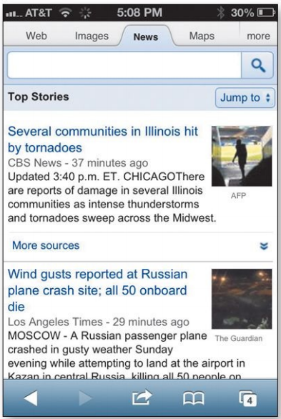
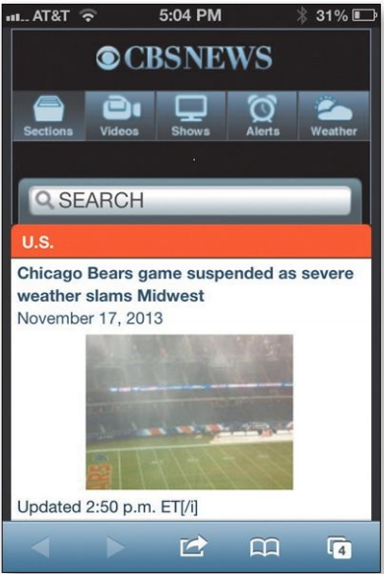
Example

Slide 6
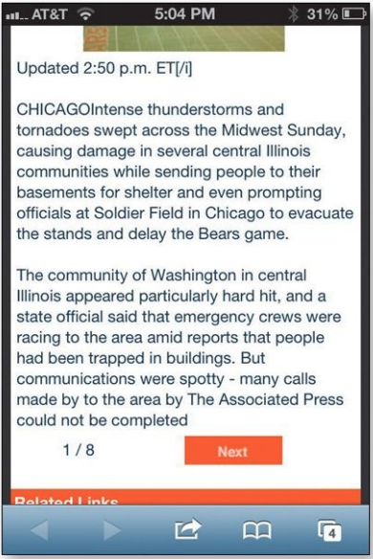
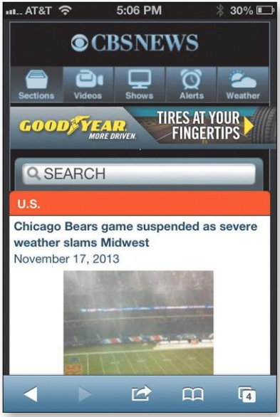
Repeat 8 times to read the whole story.

Slide 7
Limitted space
if you thought Home page real estate was precious before, try accomplishing the same things on a mobile site.
One way to deal with a smaller living space is to leave things out: Create a mobile site that is a subset of the full site. Which, of course, raises a tricky question: Which parts do you leave out?
One approach was Mobile First. Instead of designing a full-featured (and perhaps bloated) version of your Web site first and then paring it down to create the mobile version, you design the mobile version first based on the features and content that are most important to your users. Then you add on more features and content to create the desktop/full version.
But some people interpreted it to mean that you should choose what to include based on what people want to do when they’re mobile. This assumed that when people accessed the mobile version they were “on the move,” not sitting at their desk, so they’d only need the kinds of features you’d use on the move.

Slide 8
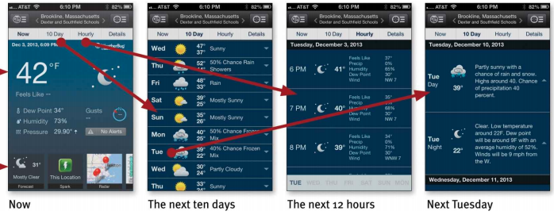
Deeper navigation system.
People want to include everything
Things I want to use in a hurry or frequently should be close at hand. Everything else can be a few taps away, but there should be an obvious path to get to them.

Slide 9
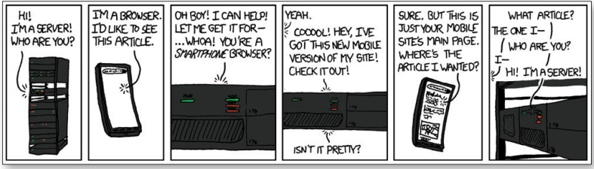
MANAGING REAL ESTATE CHALLENGES SHOULDN’T BE DONE AT THE COST OF USABILITY
It tends to be a lot of work.
It’s very hard to do it well.
Allow zooming
Don’t leave me standing at the front door
Always provide a link to the “full” Web site.

Slide 10


Don’t hide your affordances under a bushel
Don’t hide your affordances under a bushel
No cursor = no hover = no clue

Slide 11
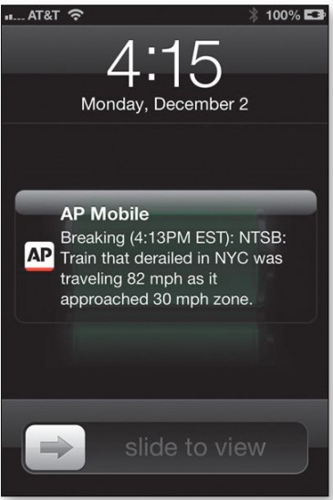

You actually can be too rich or too thin
but computers can never be too fast. Particularly on mobile devices, speed just makes everything feel better. Slow performance equals frustration for users and loss of goodwill for publishers.

Slide 12
Mobile apps, usability attributes of
attributes that some people include in their definitions of usability: useful, learnable, memorable, effective, efficient, desirable, and delightful. Well, that time has arrived.
A person of average (or even below average) ability and experience can figure out how to use the thing [i.e., it’s learnable] to accomplish something [effective] without it being more trouble than it’s worth [efficient].
Making your app delightful is a fine objective. Just don’t focus so much attention on it that you forget to make it usable, too.

Slide 13
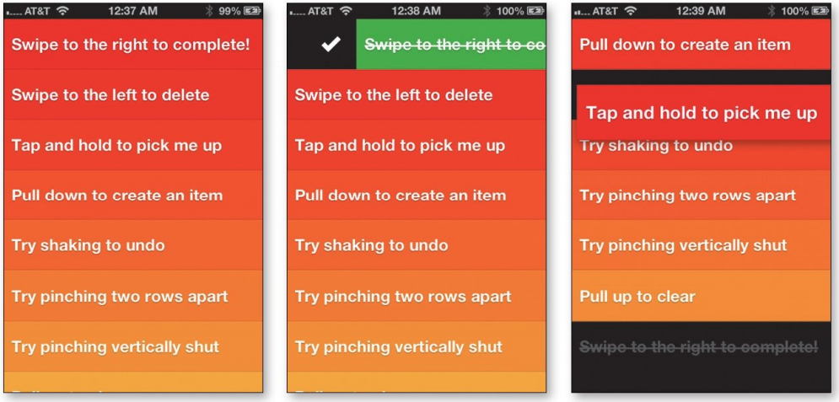
Apps need to be learnable
Apps need to be memorable, too

Slide 14
Usability testing on mobile devices
Almost everything that’s different when you’re doing mobile testing isn’t about the process; it’s about logistics.
Do you need to let the participants use their own devices?
Do they need to hold the device naturally, or can it be sitting on a table or propped up on a stand?
What do the observers need to see (e.g., just the screen, or both the screen and the participant’s fingers so they can see their gestures)?
And how do you display it in the observation room?
How do you create a recording?
some of the tools we rely on for desktop testing don’t exist yet for mobile devices.

Slide 15
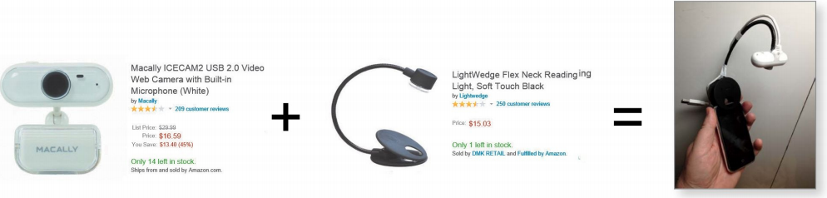
Recommendations
Use a camera pointed at the screen instead of mirroring.
Attach the camera to the device so the user can hold it naturally.
Attach the camera to the device so the user can hold it naturally.
Don’t bother with a camera pointed at the participant.

Slide 16
The rest of the setup is very straightforward
Connect the Brundlefly to the facilitator’s laptop via USB.
Open something like AmCap (on a PC) or QuickTime Player (on a Mac) to display the view from the Brundlefly. The facilitator will watch this view.
Share the laptop screen with the observers using screen sharing (GoToMeeting, WebEx, etc.)
Run a screen recorder (e.g., Camtasia) on the computer in the observation room. This reduces the burden on the facilitator’s laptop.

Slide 17


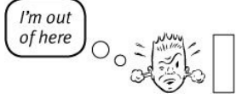
Usability as common courtesy
doing the right thing—being considerate of the user.
Besides “Is my site clear?” you also need to be asking, “Does my site behave like a mensch?”
The reservoir of goodwill
It’s idiosyncratic.
It’s situational.
You can refill it
Sometimes a single mistake can empty it.

Slide 18
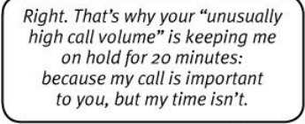
Things that diminish goodwill
Hiding information that I want: customer support phone numbers, shipping rates, and prices.
Punishing me for not doing things your way.
Asking me for information you don’t really need.
Shucking and jiving me.
Putting sizzle in my way.
Your site looks amateurish.

Slide 19
Things that increase goodwill
Know the main things that people want to do on your site and make them obvious and easy
Tell me what I want to know.
Save me steps wherever you can.
Put effort into it.
Know what questions I’m likely to have, and answer them.
Provide me with creature comforts like printer-friendly pages.
Make it easy to recover from errors.
When in doubt, apologize.

Slide 20
Accessibility and you
What designers and developers fear
More work.
Compromised design.
The four things you can do right now:
#1. Fix the usability problems that confuse everyone
#2. Read an article
Screen-reader users scan with their ears.
#3. Read a book
A Web for Everyone: Designing Accessible User Experiences
Web Accessibility: Web Standards and Regulatory Compliance
#4. Go for the low-hanging fruit

Slide 21
#4. Go for the low-hanging fruit
Add appropriate alt text to every image
Use headings correctly
Make your forms work with screen readers.: <label> element to associate the fields with their text labels
Put a “Skip to Main Content” link at the beginning of each page.
Make all content accessible by keyboard.
Create significant contrast between your text and background.
Use an accessible template.

Slide 22
MAKING USABILITY HAPPEN WHERE YOU LIVE
Ya gotta know the territory
Convincing management to support (and fund) usability work:
Demonstrate ROI
Speak their language: pain points, touch points, KPIs, and CSI, or whatever
Get your boss (and her boss) to watch a usability test.
Do the first one on your own time.
Do a test of the competition.
Empathize with management.
Know your place in the grand scheme of things.

Slide 23
A few definitive answers
Don’t use small, low-contrast type.
Don’t put labels inside form fields.
Preserve the distinction between visited and unvisited text links.
Don’t float headings between paragraphs.

Slide 24
Homework
Read the remaining chapters.
Prepare for final project

