Slide 1
Advanced Web Design
Than Quang Minh
thanqminh.com
Course URL: /courses/avd

Slide 2
Today’s topics: REST Api
Web service APIs that adhere to the REST architectural constraints are called RESTful APIs.^{[14]} HTTP-based RESTful APIs are defined with the following aspects:^{[15]}
a base URI, such as http://api.example.com/collection/;
standard HTTP methods (e.g., GET, POST, PUT, PATCH and DELETE);

Slide 3
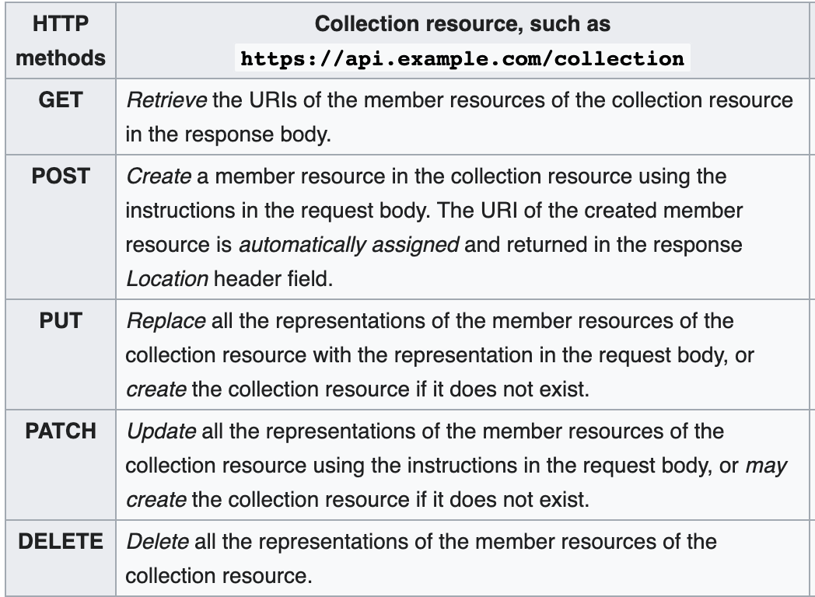
CRUD – HTTP Methods
https://stoplight.io/blog/crud-api-design/

Slide 4
Hands-on: Google Drive Api
Read documentation about Google Drive Api: https://developers.google.com/drive/api/v3/reference
Then use Google Oauth Playground to obtain token: https://developers.google.com/oauthplayground/
Then use a HTTP client tool such as PostMan or Insomnia to perform CRUD on Google Drive
Get list of file, Create a file, update its name, update its content, delete.

