Slide 1
Basic Object-Oriented Concepts

Slide 2
Why OOP?
Software is complex
  Complexity of problem domain
  Difficulty of managing development process
Complex system often has hierarchic structure
Dealing with complexity: Divide and rule
  Algorithmic decomposition
  Object-Oriented decomposition
The algorithmic view highlights the ordering of events, and the object-oriented view emphasizes the agents that either cause action or are the subjects on which these operations act.

Slide 3
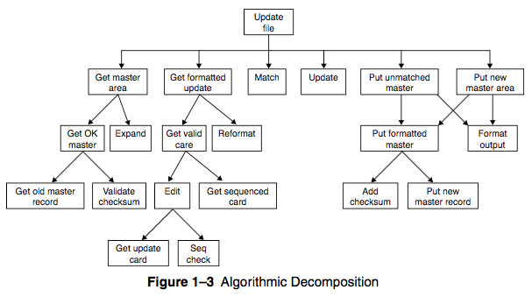
Algorithmic Decomposition

Slide 4
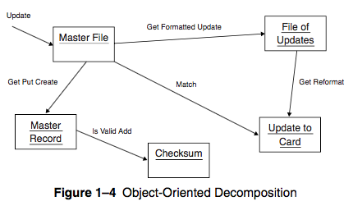
Object-Oriented Decomposition

Slide 5
OOP & OOD & OOA
OOP is a method of implementation in which programs are organized as cooperative collections of objects, each of which represents an instance of some class, and whose classes are all members of a hierarchy of classes united via inheritance relationships
Object-oriented design is a method of design encompassing the process of object- oriented decomposition and a notation for depicting both logical and physical as well as static and dynamic models of the system under design.
OOA is a method of analysis that examines requirements from the perspective of the classes and objects found in the vocabulary of the problem domain.

Slide 6
OOP language
A language is object-oriented if and only if it satisfies the following requirements:
  It supports objects that are data abstractions with an interface of named operations and a hidden local state.
  Objects have an associated type [class].
  Types [classes] may inherit attributes from supertypes [superclasses].

Slide 7
Programming style
Programming style: a way of organizing programs on the basis of some conceptual model of programming and an appropriate language to make programs written in the style clear”
5 main programming styles & its abstraction:
  Procedure-oriented: Algorithms
  Object-oriented: Classes and objects
  Logic-oriented: Goals, often expressed in a predicate calculus
  Rule-oriented: If–then rules
  Constraint-oriented: Invariant relationships

Slide 8
Object model
4 major elements:
  1. Abstraction
  2. Encapsulation
  3. Modularity
  4. Hierarchy
3 minor elements:
  1. Typing
  2. Concurrency
  3. Persistence

Slide 9
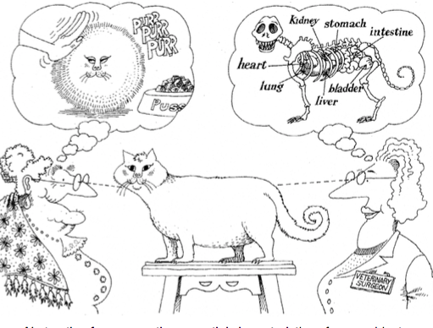
The mean of abstraction
An abstraction denotes the essential characteristics of an object that distinguish it from all other kinds of objects and thus provide crisply defined conceptual boundaries, relative to the perspective of the viewer.

Slide 10
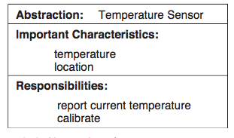
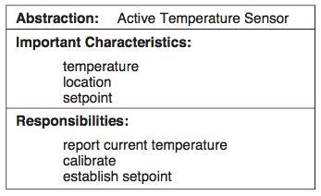
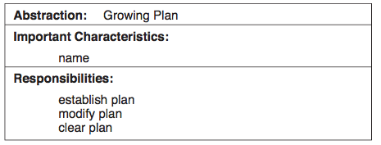
Abstraction Example

Slide 11
Encapsulation
Abstraction and encapsulation are complementary concepts:
  Abstraction focuses on the observable behavior of an object
  whereas encapsulation focuses on the implementation that gives rise to this behavior.
Encapsulation: is most often achieved through information hiding (not just data hiding): hide object secrets not contribute to its essential characteristics: structure & implementation of its methods.
Whereas abstraction “helps people to think about what they are doing,” encapsulation “allows program changes to be reliably made with limited effort”.
No part of a complex system should depend on the internal details of any other part.

Slide 12
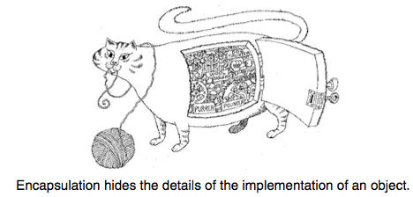
Encapsulation
Encapsulation is the process of compartmentalizing the elements of an abstraction that constitute its structure and behavior; encapsulation serves to separate the contractual interface of an abstraction and its implementation.

Slide 13
Hierarchy & Inheritance
Hierarchy is a ranking or ordering of abstractions.
Inheritance defines a relationship among classes:
  one class shares the structure or behavior defined in one (single inheritance) or more classes (multiple inheritance).
  Typically, a subclass augments or redefines the existing structure and behavior of its superclasses.
Inheritance thus represents a hierarchy of abstractions, in which a subclass inherits from one or more superclasses.

Slide 14
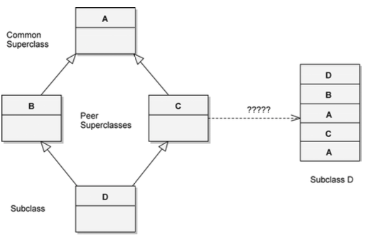
Repeated & Multiple Inheritance Problem

Slide 15
Typing
Typing is the enforcement of the class of an object, such that objects of different types may not be interchanged, or at the most, they may be interchanged only in very restricted way
Strongly typed: type conformance is strictly enforced: Operations cannot be called on an object unless the exact signature of that operation is defined in the object’s class or superclasses.
Static vs Dynamic Typing:
  (early/static) binding: compilation time.
  late binding: run time

Slide 16
Benefit of strongly typed languages
Without type checking, a program in most languages can ‘crash’ in mysterious ways at runtime.
In most systems, the edit-compile-debug cycle is so tedious that early error detection is indispensable.
Type declarations help to document programs.
Most compilers can generate more efficient object code if types are declared.

Slide 17
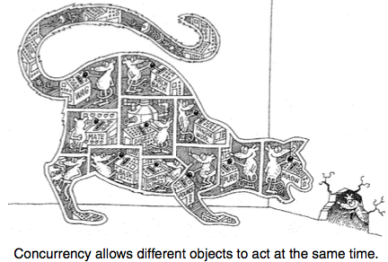
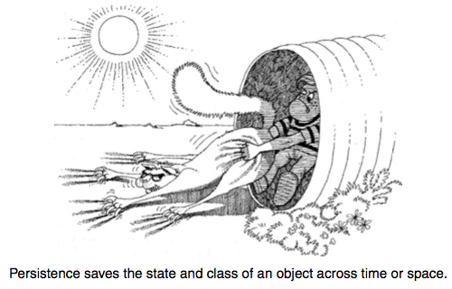
Concurrency & Persistence
Concurrency allows different objects to act at the same time.
Persistence saves the state and class of an object across time or space

Slide 18
Benefits of Object model
Exploit the expressive power of object-based and object-oriented programming languages: taking advantage of class hierarchies in the design process
Encourages the reuse not only of software but of entire designs, leading to the creation of reusable application frameworks: less code to write and maintain, better cost and schedule benefits
Produces systems that are built on stable inter- mediate forms, which are more resilient to change: allowed to evolve over time, rather than be abandoned or com- pletely redesigned in response to the first major change in requirements.

Slide 19
Objects
An object is an entity that has state, behavior, and identity. The structure and behavior of similar objects are defined in their common class. The terms instance and object are interchangeable.
The state of an object encompasses all of the (usually static) properties of the object plus the current (usually dynamic) values of each of these properties.
Behavior is how an object acts and reacts, in terms of its state changes and message passing.
The state of an object represents the cumulative results of its behavior.

Slide 20
Operations
Modifier: an operation that alters the state of an object
Selector: an operation that accesses the state of an object but does not alter the state
Iterator: an operation that permits all parts of an object to be accessed in some well-defined order
Constructor: an operation that creates an object and/or initializes its state
Destructor: an operation that frees the state of an object and/or destroys the object itself

Slide 21
Roles & Responsibilities
“Responsibilities are meant to convey a sense of the purpose of an object and its place in the system. The responsibilities of an object are all the services it pro- vides for all of the contracts it supports” [9].
In other words, we may say that the state and behavior of an object collectively define the roles that an object may play in the world, which in turn fulfill the abstraction’s responsibilities.

Slide 22
Class, Interface & Implementation
A class is a set of objects that share a common structure, common behavior, and common semantics.
A single object is simply an instance of a class.
Interface: outside view, emphasizes the abstraction while hiding its structure and the secrets of its behavior & inside view. Consist of Declarations of:
  all the operations applicable to instances of this class,
  other classes, constants, variables, and exceptions as needed to complete the abstraction.
Implementation: inside view, which encompasses the secrets of its behavior: consists of the implementation of all of the operations defined in the interface of the class.

Slide 23
Inheritance
Inheritance: one class shares the structure and/or behavior defined in one (single inheritance) or more (multiple inheritance) other classes.
The class from which another class inherits its superclass. A class that inherits from one or more classes a subclass;
Classes with no instances are called abstract classes: written with the expectation that its subclasses will add to its structure and behavior, usually by completing the implementation of its (typically) incomplete methods.
A subclass typically augments or restricts the existing structure and behavior of its superclasses.

Slide 24
Polymorphism
Polymorphism is a concept in type theory wherein a name may denote instances of many different classes as long as they are related by some common superclass.
Any object denoted by this name is thus able to respond to some common set of operations in different ways.
With polymorphism, an operation can be implemented differently by the classes in the hierarchy.
Overloading & Overriding
Polymorphism and late binding go hand in hand. In the presence of polymorphism, the binding of a method to a name is not determined until execution

Slide 25
Relationships among classes
Inheritance
Association
Aggregation
Dependency

Slide 26
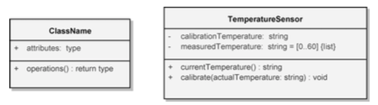
Class Notation
The class icon consists of three compartments:
  class name,
  attributes,
  operations.
Attribute format: visibility attributeName : Type [multiplicity] = DefaultValue
Operation format: visibility operationName (parameterName : Type) : ReturnType

Slide 27
Concept: An object has behaviors
In old style programming, you had:
  data, which was completely passive
  functions, which could manipulate any data
An object contains both data and methods that manipulate that data
  An object is active, not passive; it does things
  An object is responsible for its own data
    But: it can expose that data to other objects

Slide 28
Concept: An object has state
An object contains both data and methods that manipulate that data
  The data represent the state of the object
  Data can also describe the relationships between this object and other objects
Example: A CheckingAccount might have
  A balance (the internal state of the account)
  An owner (some object representing a person)

Slide 29

Example: A “Rabbit” object
You could (in a game, for example) create an object representing a rabbit
It would have data:
  How hungry it is
  How frightened it is
  Where it is
And methods:
  eat, hide, run, dig

Slide 30
Concept: Classes describe objects
Every object belongs to (is an instance of) a class
An object may have fields, or variables
  The class describes those fields
An object may have methods
  The class describes those methods
A class is like a template, or cookie cutter
  You use the class’s constructor to make objects

Slide 31
Concept: Classes are like Abstract Data Types
An Abstract Data Type (ADT) bundles together:
  some data, representing an object or "thing"
  the operations on that data
The operations defined by the ADT are the only operations permitted on its data
Example: a CheckingAccount, with operations deposit, withdraw, getBalance, etc.
Classes enforce this bundling together
  If all data values are private, a class can also enforce the rule that its defined operations are the only ones permitted on the data

Slide 32
Example of a class
class Employee {
// Fields
private String name; //Can get but not change
private double salary; // Cannot get or set
// Constructor
Employee(String n, double s) {
name = n; salary = s;
}
// Methods
void pay () {
System.out.println("Pay to the order of " +
name + " $" + salary);
}
public String getName() { return name; } // getter
}

Slide 33
Approximate Terminology
instance = object
fields = instance variables = attributes = properties
method = function = operations = behaviors
sending a message to an object =
calling a function
These are all approximately true

Slide 34
Concept: Classes form a hierarchy
Classes are arranged in a treelike structure called a hierarchy
The class at the root is named Object
Every class, except Object, has a superclass
A class may have several ancestors, up to Object
When you define a class, you specify its superclass
  If you don’t specify a superclass, Object is assumed
Every class may have one or more subclasses

Slide 35
Example of (part of) a hierarchy
Container
Panel
ScrollPane
Window
Dialog
Frame
FileDialog
A FileDialog is a Dialog is a Window is a Container

Slide 36
C++ is different
In C++ there may be more than one root
  but not in Java!
In C++ an object may have more than one parent (immediate superclass)
  but not in Java!
Java has a single, strict hierarchy

Slide 37
Concept: Objects inherit from superclasses
A class describes fields and methods
Objects of that class have those fields and methods
But an object also inherits:
  the fields described in the class's superclasses
  the methods described in the class's superclasses
A class is not a complete description of its objects!

Slide 38
Example of inheritance
class Person {
String name;
int age;
void birthday () {
age = age + 1;
}
}
class Employee
extends Person {
double salary;
void pay () { ...}
}
Every Employee has name and age fields and birthday method as well as a salary field and a pay method.

Slide 39
Concept: Objects must be created
int n; does two things:
  It declares that n is an integer variable
  It allocates space to hold a value for n
  For a primitive, this is all that is needed
Employee secretary; also does two things
  It declares that secretary is type Employee
  It allocates space to hold a reference to an Employee
  For an object, this is not all that is needed
secretary = new Employee ( );
  This allocate space to hold a value for the Employee
  Until you do this, the Employee is null

Slide 40
Notation: How to declare and create objects
Employee secretary; // declares secretary
secretary = new Employee (); // allocates space
Employee secretary = new Employee(); // does both
But the secretary is still "blank" (null)
secretary.name = "Adele"; // dot notation
secretary.birthday (); // sends a message

Slide 41
Notation: How to reference a field or method
Inside a class, no dots are necessary
  class Person { ... age = age + 1; ...}
Outside a class, you need to say which object you are talking to
  if (john.age < 75) john.birthday ();
If you don't have an object, you cannot use its fields or methods!

Slide 42
Concept: this object
Inside a class, no dots are necessary, because
  you are working on this object
If you wish, you can make it explicit:
  class Person { ... this.age = this.age + 1; ...}
this is like an extra parameter to the method
You usually don't need to use this

Slide 43
Concept: A variable can hold subclass objects
Suppose B is a subclass of A
  A objects can be assigned to A variables
  B objects can be assigned to B variables
  B objects can be assigned to A variables, but
  A objects can not be assigned to B variables
    Every B is also an A but not every A is a B
You can cast: bVariable = (B) aObject;
  In this case, Java does a runtime check

Slide 44
Example: Assignment of subclasses
class Dog { ... }
class Poodle extends Dog { ... }
Dog myDog;
Dog rover = new Dog ();
Poodle yourPoodle;
Poodle fifi = new Poodle ();
myDog = rover; // ok
yourPoodle = fifi; // ok
myDog = fifi; //ok
yourPoodle = rover; // illegal
yourPoodle = (Poodle) rover; //runtime check

Slide 45
Concept: Methods can be overridden
class Bird extends Animal {
void fly (String destination) {
location = destination;
}
}
class Penguin extends Bird {
void fly (String whatever) { }
}
So birds can fly. Except penguins.

Slide 46
Concept: Don't call functions, send messages
Bird someBird = pingu;
someBird.fly ("South America");
Did pingu actually go anywhere?
  You sent the message fly(...) to pingu
  If pingu is a penguin, he ignored it
  Otherwise he used the method defined in Bird
You did not directly call any method
  You cannot tell, without studying the program, which method actually gets used
  The same statement may result in different methods being used at different times

Slide 47
Sneaky trick: How to use overridden methods
class FamilyMember extends Person {
void birthday () { // override birthday() in Person
super.birthday (); // call overridden method
givePresent (); // and add your new stuff
}
}

Slide 48
Concept: Constructors make objects
Every class has a constructor to make its objects
Use the keyword new to call a constructor
  secretary = new Employee ( );
You can write your own constructors; but if you don’t,
Java provides a default constructor with no arguments
  It sets all the fields of the new object to zero
  If this is good enough, you don’t need to write your own
The syntax for writing constructors is almost like that for writing methods

Slide 49
Syntax for constructors
Do not use a return type and a name; use only the class name
You can supply arguments
Employee (String theName, double theSalary) {
name = theName;
salary = theSalary;
}

Slide 50
Trick: Give field and parameter the same name
A parameter overrides a field with the same name
But you can use this.name to refer to the field
class Person {
String name;
int age;
Person (String name, int age) {
this.name = name;
this.age = age;
}
}
Using the same name is a common and useful convention

Slide 51
Internal workings: Constructor chaining
If an Employee is a Person, and a Person is an Object, then when you say new Employee ()
  The Employee constructor calls the Person constructor
  The Person constructor calls the Object constructor
  The Object constructor creates a new Object
  The Person constructor adds its own stuff to the Object
  The Employee constructor adds its own stuff to the Person

Slide 52
The case of the vanishing constructor
If you don't write a constructor for a class, Java provides one (the default constructor)
  The one Java provides has no arguments
If you write any constructor for a class, Java does not provide a default constructor
Adding a perfectly good constructor can break a constructor chain
You may need to fix the chain

Slide 53
Example: Broken constructor chain
class Person {
String name;
Person (String name) {
this.name = name;
}
}
class Employee extends Person {
double salary;
Employee ( ) {
salary = 12.50;
}
}
Java tries to execute an implicit super() at this point
super();
cannot resolve symbol – constructor Person()

Slide 54
Fixing a broken constructor chain
Special syntax: super(...) calls the superclass constructor
When one constructor calls another, that call must be first
  class Employee {
  double salary;
  Employee (String name) {
  super(name); // must be first
  salary = 12.50;
  }
  }
Now you can only create Employees with names
This is fair, because you can only create Persons with names

Slide 55
Trick: one constructor calling another
this(...) calls another constructor for this same class
class Something {
Something (int x, int y, int z) {
// do a lot of work here
}
Something ( ) { this (0, 0, 0); }
}
It is poor style to have the same code more than once
If you call this(...), that call must be the first thing in your constructor

Slide 56
Concept: You can control access
class Person {
public String name;
private String age;
protected double salary;
public void birthday { age++; }
}
Each object is responsible for its own data
Access control lets an object protect its data and its methods

Slide 57
Concept: Classes can have fields and methods
Usually a class describes fields (variables) and methods for its objects (instances)
  These are called instance variables and instance methods
A class can have its own fields and methods
  These are called class variables and class methods
There is exactly one copy of a class variable, not one per object
Use the special keyword static to say that a field or method belongs to the class instead of to objects

Slide 58
Example of a class variable
class Person {
String name;
int age;
static int population;
Person (String name) {
this.name = name;
this.age = 0;
population++;
}
}

Slide 59
Advice: Restrict access
Always, always strive for a narrow interface
Follow the principle of information hiding:
  the caller should know as little as possible about how the method does its job
  the method should know little or nothing about where or why it is being called
Make as much as possible private
Your class is responsible for it’s own data; don’t allow other classes to screw it up!

Slide 60
Advice: Use setters and getters
class Employee extends Person {
private double salary;
private boolean male;
public void setSalary (double newSalary) {
salary = newSalary;
}
public double getSalary () { return salary; }
public boolean isMale() { return male; }
}
This way the object maintains control
Setters and getters have conventional names: setDataName, getDataName, isDataName (booleans only)

Slide 61
Kinds of access
Java provides four levels of access:
  public: available everywhere
  protected: available within the package (in the same subdirectory) and to all subclasses
  [default]: available within the package
  private: only available within the class itself
The default is called package visibility
In small programs this isn't important...right?

Slide 62
Homework
OOP Book: chapter 1, 2, 3.
Java Book: chapter 6-9
OOP Exercises

