Slide 1
Design Pattern Introduction

Slide 2
Big questions
What is a design pattern?
What is the advantage of knowing/using
design patterns?
Which patterns are named in the reading?
What are the key ideas of those patterns?

Slide 3
Design challenges
Designing software for reuse is hard. One must find:
  a good problem decomposition, and the right software
  a design with flexibility, modularity and elegance
designs often emerge from trial and error
successful designs do exist
  two designs they are almost never identical
  they exhibit some recurring characteristics
Can designs be described, codified or standardized?
  this would short circuit the trial and error phase
  produce "better" software faster

Slide 4
Design patterns
design pattern:
a solution to a common software problem in a context
  describes a recurring software structure
  is abstract from programming language
  identifies classes and their roles in the solution to a problem
  patterns are not code or designs; must be instantiated/applied
example: Iterator pattern
  The Iterator pattern defines an interface that declares methods for sequentially accessing the objects in a collection.

Slide 5
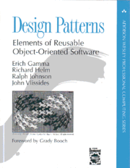
History of patterns
the concept of a "pattern" was first expressed
in Christopher Alexander's work A Pattern
Language in 1977 (2543 patterns)
in 1990 a group called the Gang of Four or "GoF"
(Gamma, Helm, Johnson, Vlissides) compile a
catalog of design patterns
1995 book Design Patterns:
Elements of Reusable Object-Oriented
Software is a classic of the field

Slide 6
Benefits of using patterns
patterns are a common design vocabulary
  allows engineers to abstract a problem and talk about that abstraction in isolation from its implementation
  embodies a culture; domain-specific patterns increase design speed
patterns capture design expertise and allow that expertise to be communicated
  promotes design reuse and avoid mistakes
improve documentation (less is needed) and understandability (patterns are described well once)

Slide 7
Gang of Four (GoF) patterns
Creational Patterns
(abstracting the object-instantiation process)
  Factory Method Abstract Factory Singleton
  Builder Prototype
Structural Patterns
(how objects/classes can be combined to form larger structures)
  Adapter Bridge Composite
  Decorator Facade Flyweight
  Proxy
Behavioral Patterns
(communication between objects)
  Command Interpreter Iterator
  Mediator Observer State
  Strategy Chain of Responsibility Visitor
  Template Method

Slide 8
Design Principles
Identify the aspects of your application that vary and separate them from what stays the same.
Program to an interface, not an implementation.
Favor composition over inheritance.
Strive for loosely coupled designs between objects that interact
Classes should be open for extension, but closed for modification. (Open-Closed)
Depend upon abstractions. Do not depend upon concrete classes. (Dependency Inversion)

Slide 9
Design Principles
Principle of Least Knowledge: talk only to your immediate friends.
The Hollywood Principle: Don’t call us, we’ll call you.
Single Responsibility: A class should have only one reason to change.

Slide 10
Programming Principles
Demeter
Wirth
Brook
Conway
least astonishment
Boy Scout
YAGNI
DRY
KISS
SOLID
GRASP

Slide 11
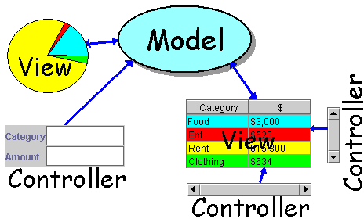
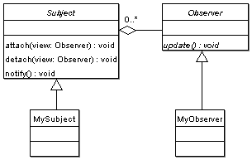
Pattern: Observer
objects whose state can be watched

Slide 12
Recall: model and view
model: classes in your system that are related to the internal representation of the state of the system
  often part of the model is connected to file(s) or database(s)
  examples (card game): Card, Deck, Player
  examples (bank system): Account, User, UserList
view: classes in your system that display the state of the model to the user
  generally, this is your GUI (could also be a text UI)
  should not contain crucial application data
  Different views can represent the same data in different ways
    Example: Bar chart vs. pie chart
  examples: PokerPanel, BankApplet

Slide 13
Model-view-controller
model-view-controller (MVC): common design paradigm for graphical systems
controller: classes that connect model and view
  defines how user interface reacts to user input (events)
  receives messages from view (where events come from)
  sends messages to model (tells what data to display)
  sometimes part of view (see left)
data for rendering
Model
View
View
Component
Model
updates
events
Controller
Controller

Slide 14
Observer pattern
observer: an object that "watches" the state of another object and takes action when the state changes in some way
  examples in Java: event listeners; java.util.Observer
observable object: an object that allows observers to examine it (often the observable object notifies the observers when it changes)
  permits customizable, extensible event-based behavior for data modeling and graphics

Slide 15
Benefits of observer
abstract coupling between subject and observer; each can be extended and reused individually
dynamic relationship between subject and observer; can be established at run time (can "hot-swap" views, etc) gives a lot more programming flexibility
broadcast communication: notification is broadcast automatically to all interested objects that subscribed to it
Observer can be used to implement model-view separation in Java more easily

Slide 16
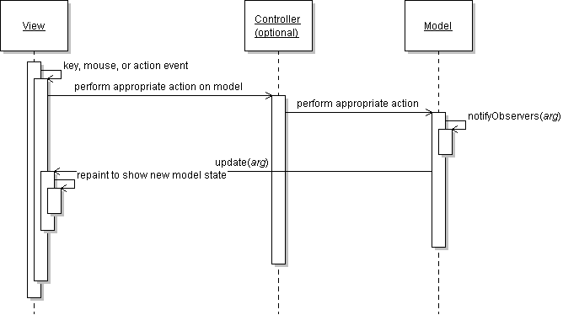
Observer sequence diagram

Slide 17
Observer interface
package java.util;
public interface Observer {
public void update(Observable o, Object arg);
}
Idea: The update method will be called when the observable model changes, so put the appropriate code to handle the change inside update

Slide 18
Observable class
public void addObserver(Observer o)
public void deleteObserver(Observer o)
Adds/removes o to/from the list of objects that will be notified (via their update method) when notifyObservers is called.
public void notifyObservers()
public void notifyObservers(Object arg)
Inform all observers listening to this Observable object of an event that has occurred. An optional object argument may be passed to provide more information about the event.
public void setChanged()
Flags the observable object as having changed since the last event; must be called each time before calling notifyObservers.

Slide 19
Common usage of Observer
1. write a model class that extends Observable
  have the model notify its observers when anything significant happens
2. make all views of that model (e.g. GUI panels that draw the model on screen) into observers
  have the panels take action when the model notifies them of events (e.g. repaint, play sound, show option dialog, etc.)

Slide 20
Using multiple views
make an Observable model
write a View interface or abstract class
  make View an observer
extend/implement View for all actual views
  give each its own unique inner components and code to draw the model's state in its own way
provide mechanism in GUI to set view (perhaps through menus)
  to set view, attach it to observe the model

Slide 21
Example: changing views
// in the frame's action listener:
// hide old view; show new one
model.deleteObserver(view1);
model.addObserver(view2);
view1.setVisible(false);
view2.setVisible(true);

Slide 22
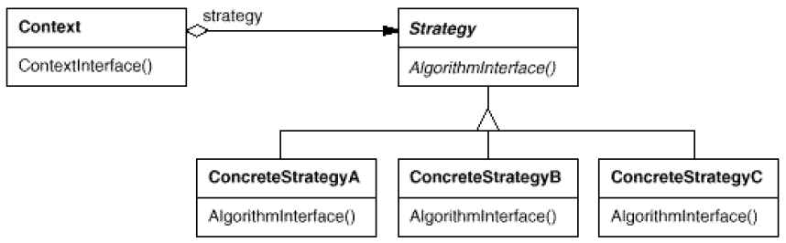
Pattern: Strategy
objects that hold alternate algorithms to solve a problem

Slide 23
Strategy pattern
strategy: an algorithm separated from the object that uses it, and encapsulated as its own object
  each strategy implements one behavior, one implementation of how to solve the same problem
  separates algorithm for behavior from object that wants to act
  allows changing an object's behavior dynamically without extending / changing the object itself
examples:
  file saving/compression
  layout managers on GUI containers
  AI algorithms for computer game players
Notes:
difference from Command pattern:
command objects each solve different problems
strategy objects all solve the same problem in different ways

Slide 24
Strategy example: Card player
// Strategy hierarchy parent
// (an interface or abstract class)
public interface Strategy {
public Card getMove();
}
// setting a strategy
player1.setStrategy(new SmartStrategy());
// using a strategy
Card p1move = player1.move(); // uses strategy

Slide 25
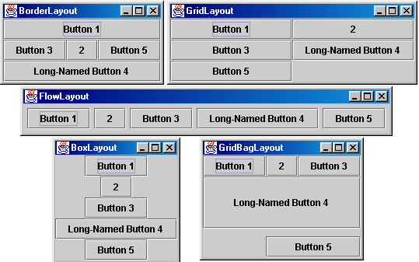
Containers with layout
The idea: Place many components into a special component called a container, then add the container to the window frame

Slide 26
Container
container: an object that holds components; it also governs their positions, sizes, and resize behavior
public void add(Component comp)
public void add(Component comp, Object info)
Adds a component to the container, possibly giving extra information about where to place it.
public void remove(Component comp)
Removes the given component from the container.
public void setLayout(LayoutManager mgr)
Uses the given layout manager to position the components in the container.
public void validate()
You should call this if you change the contents of a container that is already on the screen, to make it re-do its layout.

Slide 27
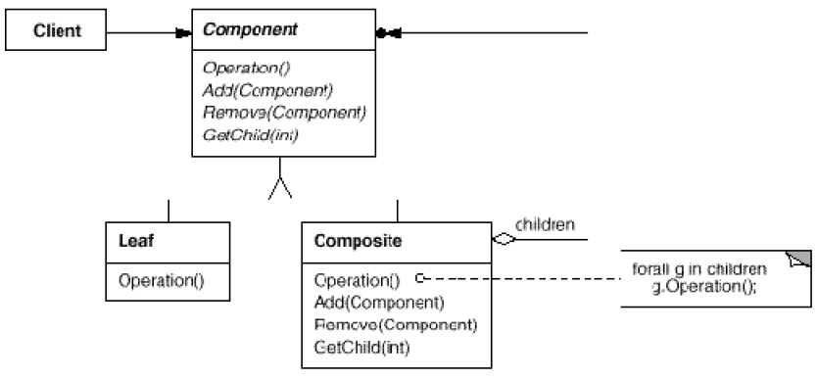
Pattern: Composite
objects that can serve as containers, and can hold other objects like themselves

Slide 28
Composite pattern
composite: an object that is either an individual item or a collection of many items
  composite objects can be composed of individual items or of other composites
  recursive definition: objects that can hold themselves
  often leads to a tree structure of leaves and nodes:
    <node> ::= <leafnode> | <compositenode>
    <compositenode> ::= <node>*
examples in Java:
  collections (a List of Lists)
  GUI layout (panels containing panels containing buttons, etc.)

Slide 29
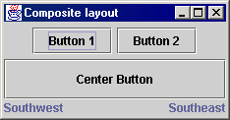
Composite example: panels
Container north = new JPanel(new FlowLayout());
north.add(new JButton("Button 1"));
north.add(new JButton("Button 2"));
Container south = new JPanel(new BorderLayout());
south.add(new JLabel("Southwest"), BorderLayout.WEST);
south.add(new JLabel("Southeast"), BorderLayout.EAST);
// overall panel contains the smaller panels (composite)
JPanel overall = new JPanel(new BorderLayout());
overall.add(north, BorderLayout.NORTH);
overall.add(new JButton("Center Button"), BorderLayout.CENTER);
overall.add(south, BorderLayout.SOUTH);
frame.add(overall);

Slide 30
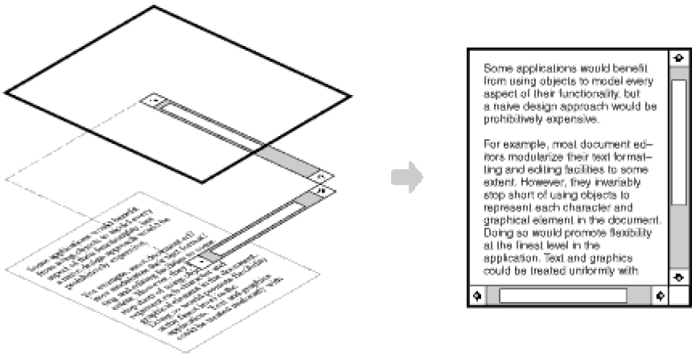
Pattern: Decorator
objects that wrap around other objects to add useful features

Slide 31
Decorator pattern
decorator: an object that modifies behavior of, or adds features to, another object
  decorator must maintain the common interface of the object it wraps up
  used so that we can add features to an existing simple object without needing to disrupt the interface that client code expects when using the simple object
  the object being "decorated" usually does not explicitly know about the decorator
examples in Java:
  multilayered input streams adding useful I/O methods
  adding scroll bars to GUI controls

Slide 32
Decorator example: I/O
normal InputStream class has only public int read() method to read one letter at a time
decorators such as BufferedReader or Scanner add additional functionality to read the stream more easily
// InputStreamReader/BufferedReader decorate InputStream
InputStream in = new FileInputStream("hardcode.txt");
InputStreamReader isr = new InputStreamReader(in);
BufferedReader br = new BufferedReader(isr);
// because of decorator streams, I can read an
// entire line from the file in one call
// (InputStream only provides public int read() )
String wholeLine = br.readLine();

Slide 33
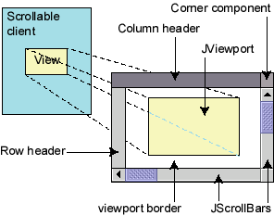
Decorator example: GUI
normal GUI components don't have scroll bars
JScrollPane is a container with scroll bars to which you can add any component to make it scrollable
// JScrollPane decorates GUI components
JTextArea area = new JTextArea(20, 30);
JScrollPane scrollPane = new JScrollPane(area);
contentPane.add(scrollPane);
  JComponents also have a setBorder method to add a "decorative" border. Is this another example of the Decorator pattern? Why or why not?

Slide 34
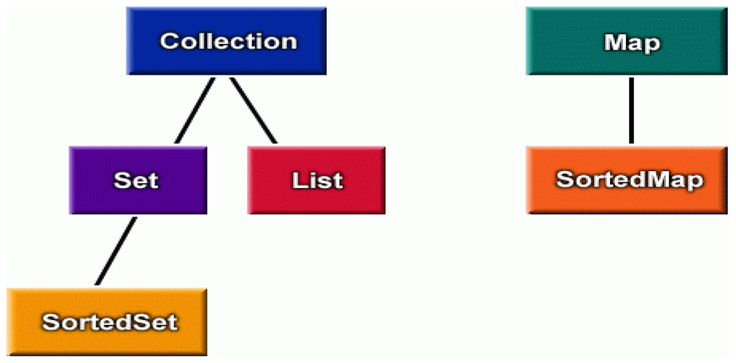
Pattern: Iterator
objects that traverse collections

Slide 35
Iterator pattern
iterator: an object that provides a standard way to examine all elements of any collection
  uniform interface for traversing many different data structures
  supports concurrent iteration and element removal
for (Iterator<Account> itr = list.iterator(); itr.hasNext(); ) {
Account a = itr.next();
System.out.println(a);
}
set.iterator()
map.keySet().iterator()
map.values().iterator()

Slide 36
Homework
Head First Design Pattern Book
Finish Beginner Exercises
Finish OOP Exercises

