Slide 1
Java Swing
Walter Milner

Slide 2
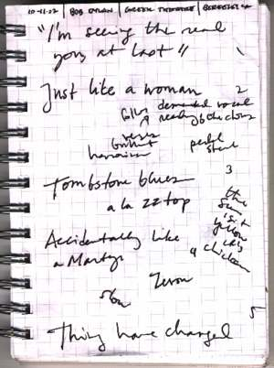
Note - this presentation..
often needs to refer to source code which is too big to put on a slide
So the source code is in a separate Word document
And is also given in within this presentation in the notes

Slide 3
What is Swing?
A group of 14 packages to do with the UI
451 classes as at 1.4 (!)
Part of JFC Java Foundation Classes (compare now defunct MFC)
Notes:
JFC is Swing, AWT, Accessibility, 2D graphics and Drag and Drop
The Swing pacakges are accessibility, swing, swing.border, swing.colorchooser, swing.event, swing.filechooser, swing.plaf, swing.table, swing.text, swing.text.html. swing.text.html.parser, swing.text.rtf, swing.tree and swing.undo
MFC was Microsoft Foundation Classes, the set of C++ classes representing GUI components.

Slide 4
Swing and the AWT
AWT = abstract windows toolkit (cross platform)
AWT = earliest version of Java GUI
eg Frame AWT not JFrame Swing
Most Swing components are 'lightweight'
Do not mix AWT and Swing
Use Swing
Notes:
The AWT components are 'heavyweight', in the sense that the correspond to an underlying OS element. For example a Frame in MS Windows is a Window as far as the OS is concerned.
Most Swing components are 'lightweight', in the sense that they are coded in Java and do not correspond to OS things. They therefore do not have all the data linked to an OS GUI object (much of which is not needed) so is faster with less memory.

Slide 5
Swing and threads
A thread is a lightweight process
Most Swing components are not thread-safe
Solution is to make sure all code that creates and modifies Swing components executes in the same 'event-dispatching' thread
Start a Swing application using the following code..
Notes:
Threads run at the same time. Problems arise if one thread alters things in another thread, without them being synchronised.
In this situation a typical issue is when code in one thread alters a component attribute (say the colour of a button) while another thread is drawing the component - the result is unpredictable, depending on the exact timing (called a race condition).
The (pretty obscure) solution used in these examples follows what is suggested by Sun in their Swing tutorial.

Slide 6
Swing and Threads - starting up
public static void main(String[] args) {
SwingUtilities.invokeLater(new Runnable()
{
public void run()
{
createAndShowGUI(); // << method to start it
}
});
}
Notes:
All teh code to set up and start the GUI is placed in the static method createAndShowGUI

Slide 7

createAndShowGUI
private static void createAndShowGUI()
{
//Create and set up the window.
JFrame frame = new JFrame("Hi..");
frame.setDefaultCloseOperation(JFrame.EXIT_ON_CLOSE);
//Add a label.
JLabel label = new JLabel("Hello World");
frame.getContentPane().add(label);
//Display the window.
frame.pack();
frame.setVisible(true);
}
Try this out
Notes:
First we construct a JFrame (a GUI window) with a title.
The .setDefaultCloseOperation sets what will happen when the frame is closed - the application exits.
Then we construct a label.
.getContentpane() gets hold of the 'front drawing part' of the frame. The label is added to this.
frame.pack() adjusts the size of the frame to fit what is inside it.
A frame is by default not visible, and setVisible(true) makes it visible.

Slide 8
Layout Managers
Most Swing UIs utilise a LayoutManager to control positioning of items
There is a choice of these which work in different ways
Initially we do without one, and position items ourselves:
frame.setLayout(null);

Slide 9
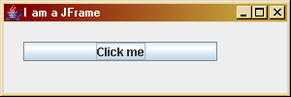
Absolute positioning
JFrame frame = new JFrame("I am a JFrame");
frame.setDefaultCloseOperation(JFrame.EXIT_ON_CLOSE);
frame.setBounds(20,30,300,100);
frame.setLayout(null);
JButton butt=new JButton("Click me");
frame.getContentPane().add(butt);
butt.setBounds(20, 20, 200,20);
frame.setVisible(true);
Try this out
- start with last example and put this in CreateandShowGUI()
Notes:
frame.setLayout(null); means that we will detrmine the size and position of components.
frame.setBounds gives the screen co-ordinates of the top left corner (20,30) and the width (300) and height(100) of the frame.
Then we make a button, add it, then setBounds fixes its position and size.

Slide 10
Responding to user actions
Based on an event-handling model
New component eg a button should have a Listener specified
The Listener object is programmed to respond to Event objects coming from the component
The Listener object needs to implement the appropriate interface
Notes:
When a button is clicked, an Event object is constructed (actually a subclass of Event).
The Event is passed to an object which has been designated as the Listener of the button.
The Event is received as a parameter by a method of the listener. In the case of a button, the method is called actionPerformed
Different components produce different events, which must be handled by different methds. The set of methods is the appropriate interface. A JButton, for example, produces ActionEvents, which are handled by teh method in the ActionListener interface.

Slide 11
Event-handling
Event object
interface eg ActionListener
the listener eg JFrame
when clicked
component eg button
during initialisation, component selects another object eg a JFrame, to be the listener
executes appropriate interface method ie actionPerformed

Slide 12
Interfaces
An interface is a set of methods
eg the ActionListener interface has just one method -
public void actionPerformed(ActionEvent e)
A class can declare that it implements it eg
public class Main implements ActionListener
Then it must actually define the methods in that interface
Or the compiler will complain
Classes can implement multiple interfaces

Slide 13
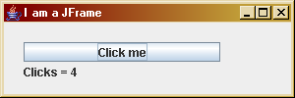
Button click demo
See source code in Word
JButton and JLabel
clickCounts remembers the number of clicks
Class implements ActionListener
Make JFrame, JButton and JLabel
Instantiate application object
Set to be the listener of the button
Notes:
We need an object to listen to the button. We also need to remember the number of clicks. We do this by instantiating an application object ( Main app = new Main(); ). We set this as the object which listens to the button is
butt.addActionListener(app);
This means that Main must implement the ActionListener interface.
The label is an application object field - that way the actionPerformed method can refer to it. In a static context (in createAndShowGUI) qwe must refer to it as app.label
Source code is:
import javax.swing.*;
import java.awt.event.*;
public class Main implements ActionListener {
private static void createAndShowGUI() {
// make frame..
JFrame frame = new JFrame("I am a JFrame");
frame.setDefaultCloseOperation(JFrame.EXIT_ON_CLOSE);
frame.setBounds(20,30,300,100);
frame.getContentPane().setLayout(null);
// make a button
JButton butt=new JButton("Click me");
frame.getContentPane().add(butt);
butt.setBounds(20, 20, 200,20);
// instantiate an application object
Main app = new Main();
// make the label
app.label = new JLabel("0 clicks");
app.label.setBounds(20,40, 200,20);
frame.getContentPane().add(app.label);
// set the application object to be the thing which
// listens to the button
butt.addActionListener(app);
frame.setVisible(true);
}
public void actionPerformed(ActionEvent e)
{
// this executes when button is clicked
clickCount++;
label.setText("Clicks = "+clickCount);
}
public static void main(String[] args) {
// start off..
SwingUtilities.invokeLater(new Runnable() {
public void run() {
createAndShowGUI();
}
});
}
// application object fields
int clickCount=0;
JLabel label;
}

Slide 14
Which button?
If have several buttons, all must link to actionPerformed
How to know which button was clicked?
Use the .getSource method of the ActionEvent object

Slide 15
Example which button
butt1=new JButton("Button 1");
..
butt2 = new JButton("Button 2");
..
public void actionPerformed(ActionEvent e)
{
if (e.getSource()==butt1)
label.setText("Butt1 clicked");
else
label.setText("Butt2 clicked");
}
Try this out
Notes:
Change the last example to hav e2 buttons. The 2 buttons must be application object fields, not local to the static method createAndShowGUI

Slide 16
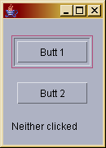
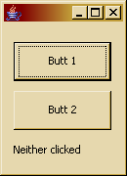
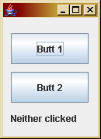
Look and feels
CDE/Motif
Windows
Metal
Available look and feels depend on implementation
Notes:
plaf = pluggable look and feels display windows and components with differing appearance.

Slide 17
Setting a laf
try {
UIManager.setLookAndFeel(
"com.sun.java.swing.plaf.motif.MotifLookAndFeel" );
}
catch (Exception e)
{
System.out.println("Cant get laf");
}
..
JFrame frame = new JFrame();
This in main() - set laf as first step
try .. catch.. because could fail
UIManager is in java.lang
Notes:
See next slide for how to determine choices of a laf

Slide 18
Finding installed lafs
Object a[]= UIManager.getInstalledLookAndFeels();
for (int i=0; i<a.length; i++)
System.out.println(a[i]);

Slide 19
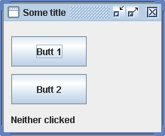
Decorated
JFrame.setDefaultLookAndFeelDecorated(true);
.. call JFrame constructor
Notes:
Results in the fancy border and title area as shown. Call this before the JFrame is constructed.

Slide 20
Swing has a lot of classes
controls
User I/O widgets
eg JButton
containers
things that hold other things
eg JFRame
Notes:
Well I think 451 is a lot.

Slide 21
Containers
top level containers - JFrame JApplet JDialog
general purpose containers -
panel
scroll pane
split pane
tabbed pane
tool bar
Notes:
The top level containers are not contained in anything else (although normally an applet is inside a browser window).
The others can be nested. So you can have a panel in a frame, and in turn a panel in a panel.

Slide 22
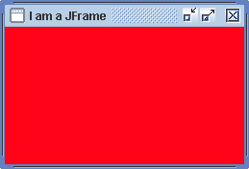
JPanel ( in createAndShowGUI)
JFrame.setDefaultLookAndFeelDecorated(true);
JFrame frame = new JFrame("I am a JFrame");
frame.setDefaultCloseOperation(JFrame.EXIT_ON_CLOSE);
frame.setBounds(20,30,300,100);
frame.setLayout(null);
//Create a panel
JPanel myPanel = new JPanel();
myPanel.setBackground(new Color(255,3,25));
myPanel.setOpaque(true);
//Make it the content pane.
frame.setContentPane(myPanel);
frame.setVisible(true);
Notes:
A frame has a default rootpane o which you can display things - get this by making the thing, then saying
frame.getContentPane.add(thing);
In this example we are making our red panel to be the 'front' of the window by using setContentPane

Slide 23
JPanel
Is a subclass of JComponent
So are all the other Swing components except the top-level containers
You can add a border
And a tool-tip
Notes:
In other words all the JComponents can have a border and a tooltip - and lots other things. See the API spec of JComponent

Slide 24
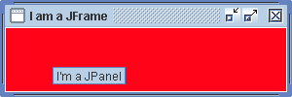
Tooltip and border
..
myPanel.setOpaque(true);
myPanel.setToolTipText("I'm a JPanel");
myPanel.setBorder(BorderFactory.createLineBorder(Color.white));
frame.setContentPane(myPanel);
..
Notes:
The tooltip appears on the mouse cursor when held over it for a second or 2. Useful to tell users what a button will do before they click it.

Slide 25
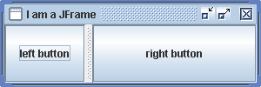
JSplitPane
..
setLayout(null);
//Create a split pane
JSplitPane myPane = new JSplitPane();
myPane.setOpaque(true);
frame.setContentPane(myPane);
frame.setVisible(true);

Slide 26
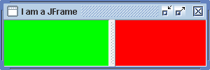
JSplitPane with JPanels
//Create a split pane
JSplitPane myPane = new JSplitPane();
myPane.setOpaque(true);
myPane.setDividerLocation(150);
// make two panels
JPanel right = new JPanel();
right.setBackground(new Color(255,0,0));
JPanel left = new JPanel();
left.setBackground(new Color(0,255,0));
// set as left and right in split
myPane.setRightComponent(right);
myPane.setLeftComponent(left);
Notes:
Putting panels in teh left and right part of a splitpane

Slide 27
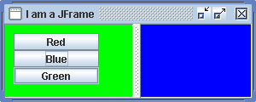
Exercise
Program this
The buttons set the colour of the left hand pane
Notes:
Start with last example.
The right panel must be an application object field, so you can refer to them in actionPerformed
Add 3 buttons to the left panel (they also must be application object fields)
In actionPerformed you must find out which button was pressed, and change the panel colour accordingly.

Slide 28
JTextField
For single-line text input
Methods getText, setText
Can use ActionListener, triggered when Enter pressed

Slide 29
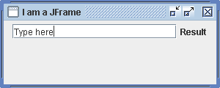
Example of JTextField
See source in Word doc
Check Main object fields for label and textfield
Make a panel, set as content pane
Make and add text field
Add actionlistener
Make and add a label
Program actionPerformed
Notes:
An ActionPerformed event is produced when the user hits Enter on the text field.
Source code:
import javax.swing.*;
import java.awt.event.*;
import java.awt.*;
public class Main implements ActionListener {
private static void createAndShowGUI() {
Main app=new Main();
// make frame..
JFrame.setDefaultLookAndFeelDecorated(true);
JFrame frame = new JFrame("I am a JFrame");
frame.setDefaultCloseOperation(JFrame.EXIT_ON_CLOSE);
frame.setBounds(20,30,300,120);
frame.setLayout(null);
// make a panel
JPanel myPanel = new JPanel();
// make a text field
app.textField = new JTextField("Type here",20);
myPanel.add(app.textField);
// set up action listener
app.textField.addActionListener(app);
// make and add label
app.label = new JLabel("Result");
myPanel.add(app.label);
frame.setContentPane(myPanel);
frame.setVisible(true);
}
public void actionPerformed(ActionEvent e)
{
// this happens when Enter hit on the text field
label.setText(textField.getText());
}
public static void main(String[] args) {
// start off..
try {
UIManager.setLookAndFeel(
"javax.swing.plaf.metal.MetalLookAndFeel" );
}
catch (Exception e)
{
System.out.println("Cant get laf");
}
SwingUtilities.invokeLater(new Runnable() {
public void run() {
createAndShowGUI();
}
});
}
// application object fields
JLabel label;
JTextField textField;
}

Slide 30
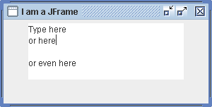
JTextArea
JPanel myPanel = new JPanel();
app.textArea = new JTextArea("Type here",5, 20);
myPanel.add(app.textArea);
TextArea expands rows and columns as needed

Slide 31
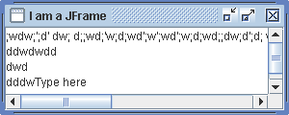
JScrollPane
JTextArea textArea = new JTextArea("Type here",5, 20);
JScrollPane scrollPane = new JScrollPane(textArea);
frame.setContentPane(scrollPane);
Notes:
In the AWT some components could have scroll bars. In Swing a ScrollPane can be created as a 'viewport' onto any component, so in effect anything can have scrollbars.
You tell the scroll pane what to 'look at' by supplying it as an argument to the constructor.
By default, scroll bars appear when they are needed.

Slide 32
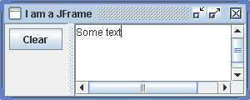
Exercise
Program this
Use the selectAll and cut methods of JTextComponent, which JTextArea inherits
Notes:
The textarea will need to be an application oject field

Slide 33
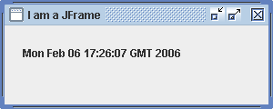
Timer
..
Timer t = new Timer(1000, app);
t.start();
app.label = new JLabel("Time");
app.label.setBounds(20,20,200,20);
frame.getContentPane().add(app.label);
..
public void actionPerformed(ActionEvent e)
{
String now = (new java.util.Date()).toString();
label.setText(now);
}
Notes:
There are 3 Timer classes in J2SE - this is javax.swing.Timer
A timer object fires an ActionPerformed event at regular intervals once started. The constructor is given the object to listen to these events, together with the delay in milliseconds.

Slide 34
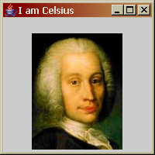
Images
JFrame frame = new JFrame("I am Celsius");
frame.setDefaultCloseOperation(JFrame.EXIT_ON_CLOSE);
frame.setBounds(20,30,200,200);
frame.getContentPane().setLayout(null);
ImageIcon icon = new ImageIcon("c:/celsius.jpg", "Celsius");
JLabel label = new JLabel(icon);
label.setBounds(20,20,150,150);
frame.getContentPane().add(label);
frame.setVisible(true);
Notes:
The second argument to the constructor is an 'alt text' for accessibility software.

Slide 35
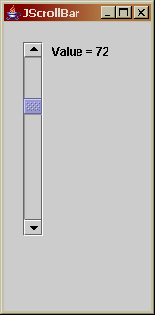
JScrollBar
See source code
JScrollBar and JLabel
Constructor arguments
implements AdjustmentListener
adjustmentValueChanged
e.getValue()
Notes:
A scrollbar has a 'value' which is the setting of teh slider.
The arguments to the JScrollBar constructor are:
whether it is horizontal or vertical
the initial value
the step change
minimum value
maximum value
When the user moves a scrollbar, an AdjustmentEvent is contructed, which goes through the AdjustmentListener interface, with just one method as show.
import javax.swing.*;
import java.awt.event.*;
public class Main implements AdjustmentListener {
private static void createAndShowGUI() {
// make frame..
JFrame frame = new JFrame("JScrollBar");
frame.setDefaultCloseOperation(JFrame.EXIT_ON_CLOSE);
frame.setBounds(20,30,200,200);
frame.getContentPane().setLayout(null);
Main app = new Main();
app.sbar = new JScrollBar(java.awt.Adjustable.VERTICAL, 127, 1,0,255);
app.sbar.setBounds(20,20, 20, 200);
app.sbar.addAdjustmentListener(app);
frame.getContentPane().add(app.sbar);
app.label = new JLabel();
app.label.setBounds(50,20,100,20);
frame.getContentPane().add(app.label);
frame.setVisible(true);
}
public void adjustmentValueChanged(AdjustmentEvent e)
{
label.setText("Value = "+e.getValue());
}
public static void main(String[] args) {
// start off..
SwingUtilities.invokeLater(new Runnable() {
public void run() {
createAndShowGUI();
}
});
}
// application object fields
JScrollBar sbar;
JLabel label;
}

Slide 36
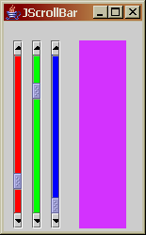
Exercise
Program this
The scroll bars determine the red, green and blue components of the background of the panel
Notes:
Start with the last example. Just do the red slider first, then add the other two.
Use the setBackground() methdo to change the colour of the scrollbar.

Slide 37
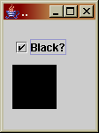
JCheckBox
See source code
implements ActionListener
isSelected()
Notes:
The isSelected method tells you whether it is checked or not.
Source code:
import javax.swing.*;
import java.awt.event.*;
import java.awt.*;
public class Main implements ActionListener {
private static void createAndShowGUI() {
// make frame..
JFrame frame = new JFrame("..");
frame.setDefaultCloseOperation(JFrame.EXIT_ON_CLOSE);
frame.setBounds(20,30,70,150);
frame.getContentPane().setLayout(null);
Main app = new Main();
app.checkBox = new JCheckBox("Black?");
app.checkBox.setBounds(10,20,100,20);
frame.getContentPane().add(app.checkBox);
app.checkBox.addActionListener(app);
app.panel = new JPanel();
app.panel.setBounds(10,50,50,50);
app.panel.setBackground(new Color(255,255,255));
frame.getContentPane().add(app.panel);
frame.setVisible(true);
}
public void actionPerformed(ActionEvent e)
{
if (checkBox.isSelected())
panel.setBackground(new Color(0,0,0));
else
panel.setBackground(new Color(255,255,255));
}
public static void main(String[] args) {
// start off..
SwingUtilities.invokeLater(new Runnable() {
public void run() {
createAndShowGUI();
}
});
}
// application object fields
JCheckBox checkBox;
JPanel panel;
}

Slide 38
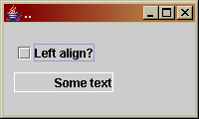
Exercise
Program this
The checkbox determines if the text in the label is left or right aligned

Slide 39
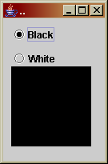
RadioButton
Come in groups – only 1 selected per group
See demo code
Make radiobuttons
Make group
Add radiobuttons to group
ActionListener
Notes:
A ButtonGroup object is not visible. Instead it controls the behaviour of teh radio buttons which have been added to it - so that only one out of that group can be 'on'.
Source code:
import javax.swing.*;
import java.awt.event.*;
import java.awt.*;
public class Main implements ActionListener {
private static void createAndShowGUI() {
// make frame..
JFrame frame = new JFrame("..");
frame.setDefaultCloseOperation(JFrame.EXIT_ON_CLOSE);
frame.setBounds(20,30,70,150);
frame.getContentPane().setLayout(null);
Main app = new Main();
app.panel = new JPanel();
app.panel.setBounds(10, 60, 100,100);
app.panel.setBackground(Color.red);
frame.getContentPane().add(app.panel);
app.choice1 = new JRadioButton("Black");
app.choice2 = new JRadioButton("White");
app.choice1.addActionListener(app);
app.choice2.addActionListener(app);
ButtonGroup group = new ButtonGroup();
group.add(app.choice1);
group.add(app.choice2);
frame.getContentPane().add(app.choice1);
frame.getContentPane().add(app.choice2);
app.choice1.setBounds(10,10,100,20);
app.choice2.setBounds(10,40, 100,20);
frame.setVisible(true);
}
public void actionPerformed(ActionEvent e)
{
if (choice1.isSelected())
panel.setBackground(new Color(0,0,0));
if (choice2.isSelected())
panel.setBackground(new Color(255,255,255));
}
public static void main(String[] args) {
// start off..
SwingUtilities.invokeLater(new Runnable() {
public void run() {
createAndShowGUI();
}
});
}
// application object fields
JRadioButton choice1, choice2;
JPanel panel;
}

Slide 40
RadioButton Exercise
Modify the demo by adding more colour options

Slide 41
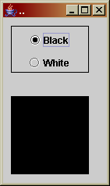
RadioButton group border
..
JPanel groupPanel = new JPanel();
groupPanel.setBounds(10,10,100,60);
groupPanel.setBorder(BorderFactory.createLineBorder(Color.black));
frame.getContentPane().add(groupPanel);
groupPanel.add(app.choice1);
groupPanel.add(app.choice2);
..
Notes:
A ButtonGroup is not visible, so usually a visual clue is needed to show the user which are the alternative choices.
The solution shown here is to have a panel with a border, and add the radio buttons to the panel.

Slide 42
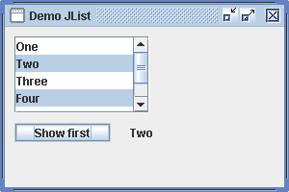
ListBox
See source code
Data held in array
List box shows array
List box inside scroll pane
myList.getModel().getElementAt(..
Notes:
Swing components have a 'model-view-controller' architecture. Usuallu you can ignore this, but for a list box it helps.
The model holds the data in the component - eg the text in a text field
The view controls what it looks like on screen.
The controller controls the behaviour of the compenent eg what happens when you click a radio button.
For a listbox, the model involves storing the listbox data in an array (or a Vector - see next example)
The listbox needs to be put into a scrollpane if you want scroll bars.
.getSelectedIndices returns an array of which items are selected. In the state shown on teh slide, this array would have elements 1,3 since these are the ones selected (starts at 0).
.getModel() gets the array which holds the data, and getElementAt gets an element from that.
Source code
import javax.swing.*;
import java.awt.event.*;
import java.awt.*;
public class Main implements ActionListener {
private static void createAndShowGUI() {
Main app=new Main();
// make frame..
JFrame.setDefaultLookAndFeelDecorated(true);
JFrame frame = new JFrame("Demo JList");
frame.setDefaultCloseOperation(JFrame.EXIT_ON_CLOSE);
frame.setBounds(20,30,300,200);
frame.getContentPane().setLayout(null);
// make array to hold values..
String listContents[] = {"One", "Two", "Three","Four","Five","Six"};
// make a ListBox using this data
app.myList = new JList(listContents);
app.myList.setBounds(0,0,100,100);
// make a scrollpane using this listbow
JScrollPane myScrollPane = new JScrollPane(app.myList);
myScrollPane.setBounds(10,10, 140, 80);
frame.getContentPane().add(myScrollPane);
//add button
JButton myButton= new JButton("Show first");
myButton.setBounds(10, 100, 100,20);
frame.getContentPane().add(myButton);
myButton.addActionListener(app);
// add label
app.myLabel = new JLabel("First shown here");
app.myLabel.setBounds(130,100,100, 20);
frame.getContentPane().add(app.myLabel);
frame.setVisible(true);
}
public void actionPerformed(ActionEvent e)
{
// get array of which items are selected
// get indices, not the actual items
int select[] = myList.getSelectedIndices();
if (select.length>0) // if anything selected
myLabel.setText((String)myList.getModel().getElementAt(select[0]));
else
myLabel.setText("No selection");
}
public static void main(String[] args) {
// start off..
try {
UIManager.setLookAndFeel(
"javax.swing.plaf.metal.MetalLookAndFeel" );
}
catch (Exception e)
{
System.out.println("Cant get laf");
}
SwingUtilities.invokeLater(new Runnable() {
public void run() {
createAndShowGUI();
}
});
}
// application object fields
JLabel myLabel;
JList myList;
}

Slide 43
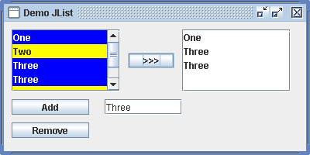
Two JListBoxes
See source code
We want to add items to list
So use a Vector not an array to hold data
Check methods to delete items and copy to other listbox
Notes:
A Vector ( in java.util ) is like an array, except that its size can be altered at run-time. This is convenient here when we want to insert new things into a listbox.
A Vector is declared to hold Object type. So when you get something out of a Vector, you have to typecast it to the actual type (which here is String).
Source code:
import javax.swing.*;
import java.awt.event.*;
import java.awt.*;
import java.util.*;
public class Main implements ActionListener {
private static void createAndShowGUI() {
Main app=new Main();
// make frame..
JFrame.setDefaultLookAndFeelDecorated(true);
JFrame frame = new JFrame("Demo JList");
frame.setDefaultCloseOperation(JFrame.EXIT_ON_CLOSE);
frame.setBounds(20,30,400,200);
frame.getContentPane().setLayout(null);
// make vactors..
app.listContents= new Vector();
app.vector2 = new Vector();
// make a ListBox
app.myList1 = new JList(app.listContents);
app.myList1.setBounds(0,0,100,100);
app.myList1.setBackground(Color.yellow);
app.myList1.setSelectionBackground(Color.blue);
app.myList1.setSelectionForeground(Color.white);
// make a scrollpane using this listbox
JScrollPane myScrollPane = new JScrollPane(app.myList1);
myScrollPane.setBounds(10,10, 140, 80);
frame.getContentPane().add(myScrollPane);
// second listbox
app.myList2 = new JList();
app.myList2.setBounds(0,0,100,100);
// make a scrollpane using this listbow
JScrollPane myScrollPane2 = new JScrollPane(app.myList2);
myScrollPane2.setBounds(230,10, 140, 80);
frame.getContentPane().add(myScrollPane2);
//add button
app.addButton= new JButton("Add");
app.addButton.setBounds(10, 100, 100,20);
frame.getContentPane().add(app.addButton);
app.addButton.addActionListener(app);
// add text field
app.addText = new JTextField("Item to add");
app.addText.setBounds(130,100,100, 20);
frame.getContentPane().add(app.addText);
//delete button
app.delButton= new JButton("Remove");
app.delButton.setBounds(10, 130, 100,20);
frame.getContentPane().add(app.delButton);
app.delButton.addActionListener(app);
//copy button
app.copyButton= new JButton(">>>");
app.copyButton.setBounds(160, 40, 60,20);
frame.getContentPane().add(app.copyButton);
app.copyButton.addActionListener(app);
frame.setVisible(true);
}
public void actionPerformed(ActionEvent e)
{
if (e.getSource()==addButton)
{ //copy text from text field and add to vector
listContents.add(addText.getText());
myList1.setListData(listContents);
}
if (e.getSource()==delButton)
{
// get the indices of selected items
int select[] = myList1.getSelectedIndices();
// copy these into a temporary vector
Vector v = new Vector();
for (int i = 0; i<select.length; i++)
{
v.add((String)(myList1.getModel().getElementAt(select[i])));
}
// remove from original vector
for (int i=0; i<v.size(); i++)
listContents.remove(v.elementAt(i));
// reset vector as list source
myList1.setListData(listContents);
}
if (e.getSource()==copyButton)
{
// get the indices of selected items
int select[] = myList1.getSelectedIndices();
// copy these into other vector
vector2.clear(); // first empty it
for (int i = 0; i<select.length; i++)
{
vector2.add((String)(myList1.getModel().getElementAt(select[i])));
}
// reset data source
myList2.setListData(vector2);
}
}
public static void main(String[] args) {
// start off..
try {
UIManager.setLookAndFeel(
"javax.swing.plaf.metal.MetalLookAndFeel" );
}
catch (Exception e)
{
System.out.println("Cant get laf");
}
SwingUtilities.invokeLater(new Runnable() {
public void run() {
createAndShowGUI();
}
});
}
// application object fields
JList myList1;
JList myList2;
JTextField addText;
Vector listContents;
Vector vector2;
JButton addButton;
JButton delButton;
JButton copyButton;
}

Slide 44
Exercise
Add a button to the last example which deletes selected items in the second list box

Slide 45
Layout Managers
A layout manager controls the positioning of components
Components have a 'preferred size' so can avoid sizing them
.pack() adjusts size of a container to fit components
Notes:
See next slide for examples

Slide 46
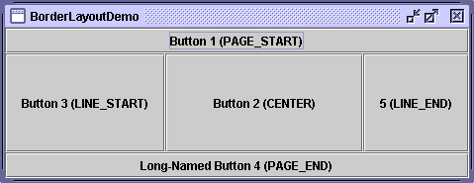
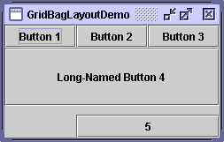
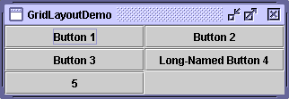

Some LayoutManagers
from Swing tutorial on
java.sun.com
Notes:
There are others - these are some common ones.
Arguments for using layout managers are
1. Less code to write usually
2. Deals with the problem of differing screen resolutions meaning pixels vary in size
3. Deals with user resizing the window (layout manager rearranges things accordingly)
Only problem is that it sometimes takes some ingenuity to get the layout you want.

Slide 47

FlowLayout
JFrame.setDefaultLookAndFeelDecorated(true);
JFrame frame = new JFrame("FlowLayout");
frame.setDefaultCloseOperation(JFrame.EXIT_ON_CLOSE);
frame.getContentPane().setLayout(new FlowLayout());
JButton b1 = new JButton("Hello");
frame.getContentPane().add(b1);
JButton b2 = new JButton("Two");
frame.getContentPane().add(b2);
JTextField t1 = new JTextField("Text here");
frame.getContentPane().add(t1);
frame.pack();
frame.setVisible(true);
Try this
Try re-sizing the frame at runtime
Add more buttons
Add frame.setBounds
Remove pack();
Notes:
Note there is no frame.setBounds to size the frame. Instead frame.pack() calculates the frame size to fit.
FlowLayout just puts things in a row. If it runs out of room, it starts another row.

Slide 48
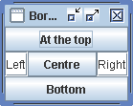
BorderLayout
JFrame.setDefaultLookAndFeelDecorated(true);
JFrame frame = new JFrame("Border");
frame.setDefaultCloseOperation(JFrame.EXIT_ON_CLOSE);
JButton b1 = new JButton("At the top");
frame.getContentPane().add(b1,BorderLayout.PAGE_START );
JButton b2 = new JButton("Bottom");
frame.getContentPane().add(b2,BorderLayout.PAGE_END);
JTextField t1 = new JTextField("Left");
frame.getContentPane().add(t1,BorderLayout.LINE_START);
JTextField t2 = new JTextField("Right");
frame.getContentPane().add(t2,BorderLayout.LINE_END);
JButton b3 = new JButton("Centre");
frame.getContentPane().add(b3,BorderLayout.CENTER );
frame.pack();
frame.setVisible(true);
Try this
Notes:
A BorderLayout divides the container into 5 parts - top bottom left right and center.
Components are added to one of these parts, only one component per part.
Panels default to borderlayout, so there is no .setLayout

Slide 49
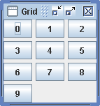
Grid
JFrame.setDefaultLookAndFeelDecorated(true);
JFrame frame = new JFrame("Grid");
frame.setDefaultCloseOperation(JFrame.EXIT_ON_CLOSE);
frame.getContentPane().setLayout(new GridLayout(4,3,5,5));
for (int i=0; i<10; i++)
frame.getContentPane().add(new JButton(""+i));
frame.pack();
frame.setVisible(true);
Notes:
A GridLayout is a rectangular array of locations. Items are added (by default) into top-down left-right order.
In the GridLayout constructor -
1. The third and fourth arguments are gaps between cells. These default to 0
2. The first and second are rows and columns. Usually you supply just one of these (the other is zero). So if you had 0,3 you would get 3 columns, and the number of rows is determined by how many items are added. If you supply both, teh rows takes precedence.

Slide 50
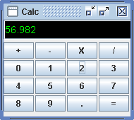
Combination layouts
See source code
Frame is null layout
Frame has an upper and lower panel
Upper panel null layout
Lower panel is grid layout
Note font of display
Notes:
Usually you would need to divide the main frame into several areas with different layoutmanagers. This is an example.
Only the digit buttons do anything - I did not want to obscure using a layoumanager with the logic of writing a claculator.
Font is a class. The constructor has 3 arguments - the font name, the style, and the point size.
Source code
import javax.swing.*;
import java.awt.event.*;
import java.awt.*;
import java.util.*;
public class Main implements ActionListener {
private static void createAndShowGUI() {
Main app = new Main();
JFrame.setDefaultLookAndFeelDecorated(true);
// make frame
JFrame frame = new JFrame("Calc");
frame.setDefaultCloseOperation(JFrame.EXIT_ON_CLOSE);
frame.getContentPane().setLayout(null);
frame.setBounds(50,50,190,170);
// create top panel
JPanel topPanel=new JPanel();
topPanel.setBounds(0,0, 200,28);
topPanel.setLayout(null);
// add display to it
app.display.setBounds(0,0, 200,28);
app.display.setBackground(Color.black);
app.display.setForeground(Color.green);
app.display.setFont(new Font("Palatino",Font.PLAIN,14));
topPanel.add(app.display);
// show top panel
frame.getContentPane().add(topPanel);
// make lower panel
JPanel lowerPanel=new JPanel();
frame.getContentPane().add(lowerPanel);
lowerPanel.setBounds(0,32, 180,100);
lowerPanel.setLayout(new GridLayout(0,4,2,2));
// add buttons to it
app.add = new JButton("+");
lowerPanel.add(app.add);
app.sub = new JButton("-");
lowerPanel.add(app.sub);
app.mul = new JButton("X");
lowerPanel.add(app.mul);
app.div = new JButton("/");
lowerPanel.add(app.div);
for (int i=0; i<10; i++)
{
app.digits[i] = new JButton(""+i);
app.digits[i].addActionListener(app);
lowerPanel.add(app.digits[i]);
}
app.point = new JButton(".");
lowerPanel.add(app.point);
app.point.addActionListener(app);
app.equals = new JButton("=");
lowerPanel.add(app.equals);
frame.setVisible(true);
}
public void actionPerformed(ActionEvent e)
{
for (int i = 0; i<10; i++)
{
if (e.getSource()==digits[i])
current+=""+i;
}
if (e.getSource()==point)
current+=".";
display.setText(current);
}
public static void main(String[] args) {
// start off..
try {
UIManager.setLookAndFeel(
"javax.swing.plaf.metal.MetalLookAndFeel" );
}
catch (Exception e)
{
System.out.println("Cant get laf");
}
SwingUtilities.invokeLater(new Runnable() {
public void run() {
createAndShowGUI();
}
});
}
// application object fields
JButton add,sub, mul, div;
JButton point, equals;
JButton[] digits = new JButton[10];
String current = new String();
JTextField display = new JTextField();
}

Slide 51
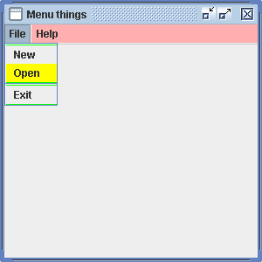
Menus
JMenuBar
JMenu
JMenuItem
Notes:
So you make a menubar
Make a menu (usually several) and add it to the bar
Make menuitems and add them to a menu

Slide 52
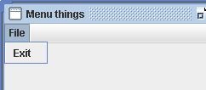
Menu
Main app = new Main();
..
JMenuBar myMenuBar = new JMenuBar();
JMenu menu1 = new JMenu("File");
JMenuItem item = new JMenuItem("Exit");
item.addActionListener(app);
menu1.add(item);
myMenuBar.add(menu1);
frame.setJMenuBar(myMenuBar);
..
public void actionPerformed(ActionEvent e)
{
System.exit(0);
}
Notes:
MenuItems are like buttons and they use the ActionListener

Slide 53
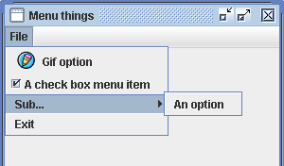
Menu Options
See source code
Exercise
Copy this
Add a second option 'Edit' after 'File'
Put choices Undo, Redo, Cut Copy and Paste in it
Use appropriate icons if possible
Notes:
This shows -
1. Menu item with an icon - in the constructor
2. A checkbox type item
3. A submenu added to a menu
Source code
import javax.swing.*;
import java.awt.event.*;
import java.awt.*;
import java.util.*;
public class Main implements ActionListener {
private static void createAndShowGUI() {
Main app = new Main();
JFrame.setDefaultLookAndFeelDecorated(true);
// make frame
JFrame frame = new JFrame("Menu things");
frame.setDefaultCloseOperation(JFrame.EXIT_ON_CLOSE);
frame.getContentPane().setLayout(null);
frame.setBounds(50,50,300,300);
JMenuBar myMenuBar = new JMenuBar();
JMenu menu1 = new JMenu("File");
// item with an image
JMenuItem itemgif = new JMenuItem("Gif option",new ImageIcon("icon.gif"));
menu1.add(itemgif);
// checkbox
JCheckBoxMenuItem itemCheck = new JCheckBoxMenuItem("A check box menu item");
menu1.add(itemCheck);
// submenu .. first make submenu
JMenu subMenu = new JMenu("Sub...");
// add an item to it
JMenuItem subMenuItem = new JMenuItem("An option");
subMenu.add(subMenuItem);
// add it to main menu
menu1.add(subMenu);
JMenuItem item = new JMenuItem("Exit");
item.addActionListener(app);
menu1.add(item);
myMenuBar.add(menu1);
frame.setJMenuBar(myMenuBar);
frame.setVisible(true);
}
public void actionPerformed(ActionEvent e)
{
System.exit(0);
}
public static void main(String[] args) {
// start off..
try {
UIManager.setLookAndFeel(
"javax.swing.plaf.metal.MetalLookAndFeel" );
}
catch (Exception e)
{
System.out.println("Cant get laf");
}
SwingUtilities.invokeLater(new Runnable() {
public void run() {
createAndShowGUI();
}
});
}
// application object fields
}

Slide 54
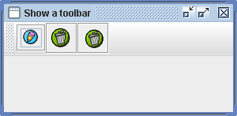
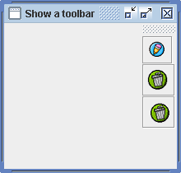
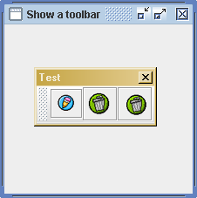
JToolBar
..
.. frame is BorderLayout
..
JToolBar toolBar = new JToolBar("Test");
JButton butt1 = new JButton(new ImageIcon("icon.gif"));
toolBar.add(butt1);
..
frame.add(toolBar, BorderLayout.PAGE_START);
Notes:
A JToolBar holds a set of buttons - here all icons but could be text.
If it is added to a container which is BorderLayout, it can be docked on a side, or left floating.

Slide 55
paint
JComponents have a paint() method
This is called by the system when it needs to display the object
Initially and eg after a re-size
You can over-ride paint() to control the appearance of the component
This implies you sub-class the component
The paint method has a Graphics object as a parameter
This is a context eg color, font etc
You tell the Graphics object to show things

Slide 56
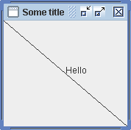
Example
public class MyFrame extends JFrame
{
public MyFrame()
{
super("Some title");
setDefaultCloseOperation(EXIT_ON_CLOSE);
setBounds(20,30,230,180);
myPanel = new MyPanel();
myPanel.setOpaque(true);
setContentPane(myPanel);
setVisible(true);
}
MyPanel myPanel;
}
public class MyPanel extends JPanel
{
public void paint(Graphics g)
{
g.drawLine(0,0,getWidth(),getHeight());
g.drawString("Hello",getWidth()/2,getHeight()/2);
}
}

