Slide 1
RESTAURANT RECOMMENDER SYSTEM IN YANGON IBM DATA SCIENCE CAPSTONE PROJECT

Slide 2
INTRODUCTION
Business Understanding
Data Understanding
Methodology
Conclusion

Slide 3
Business Understanding
Recommender system is one of the best way for everyone can easily check based on its references.
Purpose for this project is not only for the travelers but also everyone who rarely use restaurants would prefer to have the most rated restaurants nearby them and all this could be easily handed by our recommender system.
It is basically everyone who is exploring different places or similar places and they can easily check the restaurant rating around them.

Slide 4
Data Understanding
Before creating restaurant recommender system , we need data that can collect everywhere but we have to know which data is related in our system .
I considered the basic requirements in this scenario:
Firstly , I checked the location where I am so that I have used the google map to find the location so that I have used the data which are longitude and latitude to find out my current location.
Another one is population of the neighborhoods because I would like to know which restaurant is convenient for me, even though I find lots of restaurant near me.

Slide 5
Methodology
Data
Collection
Exploratory
Data
Analysis
Restaurant
Recommender
System
Inferential
Analysis
Machine
Learning

Slide 6
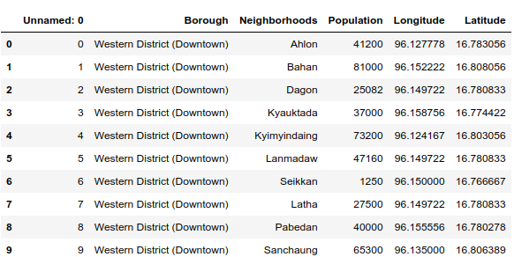
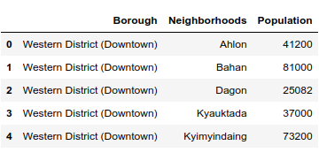
Data Collection
Figure 1.1 : list of neighborhoods in Yangon
Figure 1.2: Population in Yangon

Slide 7
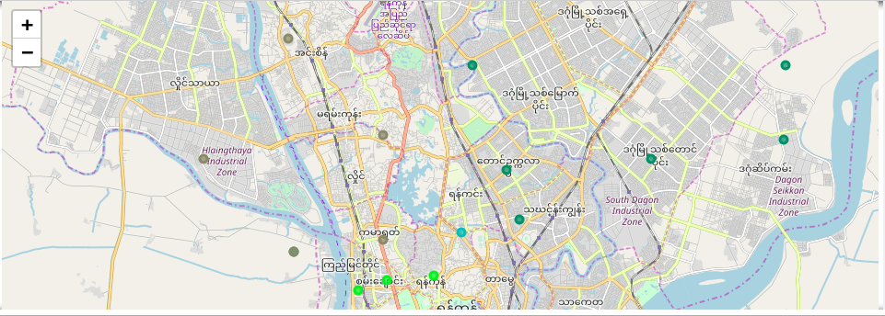
Figure 2: Exploring Yangon Neighborhoods using FourSquare API

Slide 8
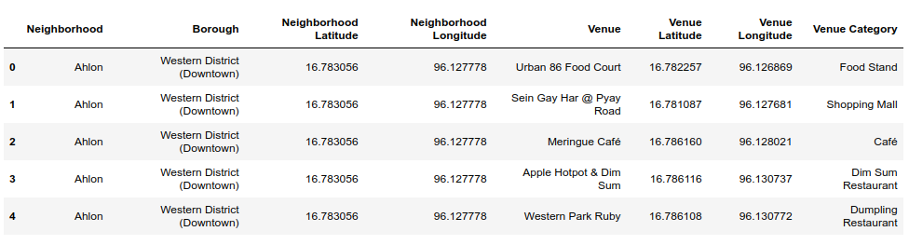
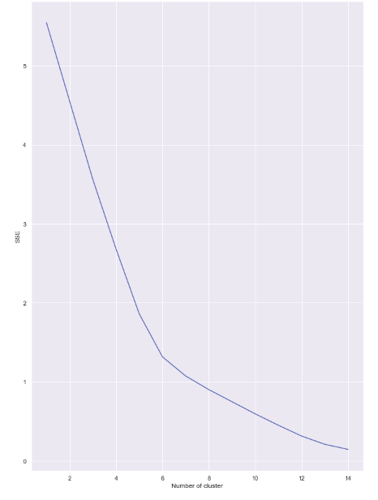
Figure 3.1: Clusters Graph
Figure 3.2 : Number of Venues

Slide 9
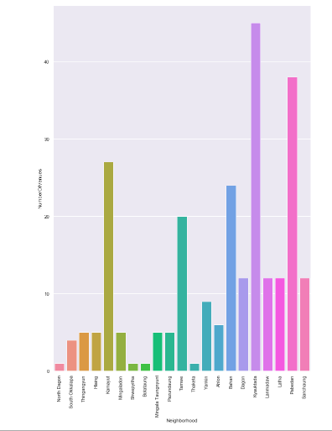
Figure 4 : Number of neighborhoods in Yangon

Slide 10
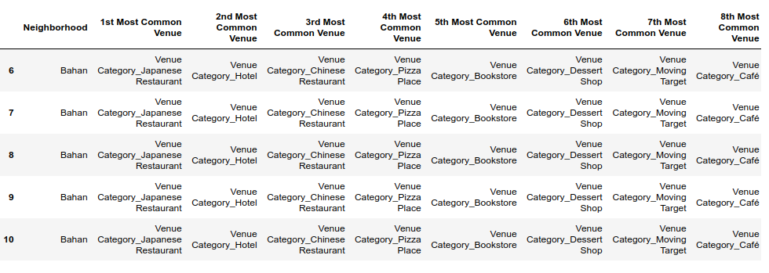
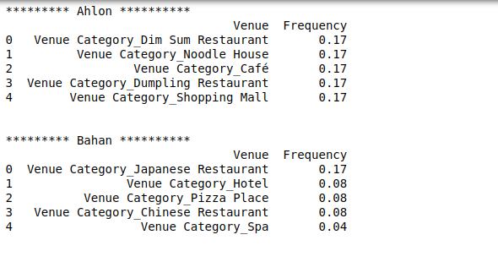
Results And Conclusion
Figure 5.1 : Venues occur each neighborhoods showing the number of frequency
Figure 5.2 : Recommend the neighborhoods cities near Kyauktada city In Yangon

Slide 11

THANK YOU

