Slide 1
Smart Vanding Machine
With
Arduino Project
Play on

Slide 2
Our team
Ma Shoon Lae Wai
3GIT-6
Ma Shar Thet Han
3GIT-8
Ma Aye Nyein Phyo
3GIT-19
Ma Thet Thet Khin
3GIT-17
Mg Kaung Khant Thu
3GIT-22
Ma Thet Mue Naing
3GIT-35

Slide 3
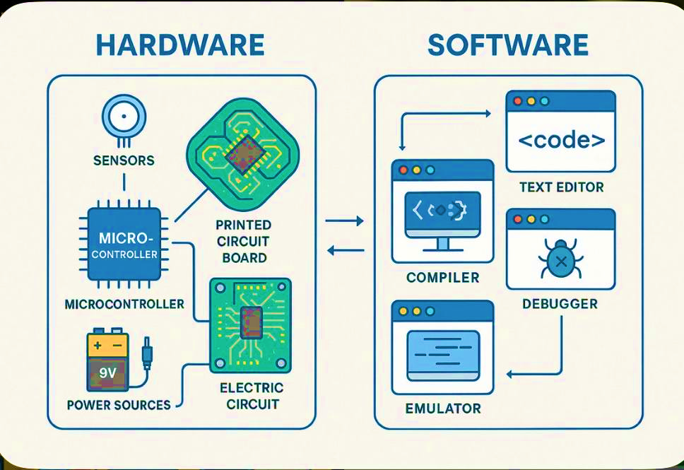
Introduction

Slide 4
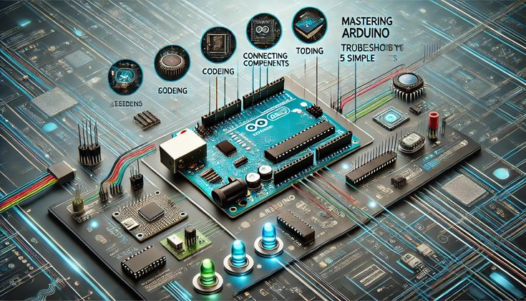
What is Arduino?
Arduino is an open-source electronics platfrom based on easy to use hardware and software.It provides the flexibility to build highly customizable systems.

Slide 5
Project Title Selection

