Slide 1


Slide 2
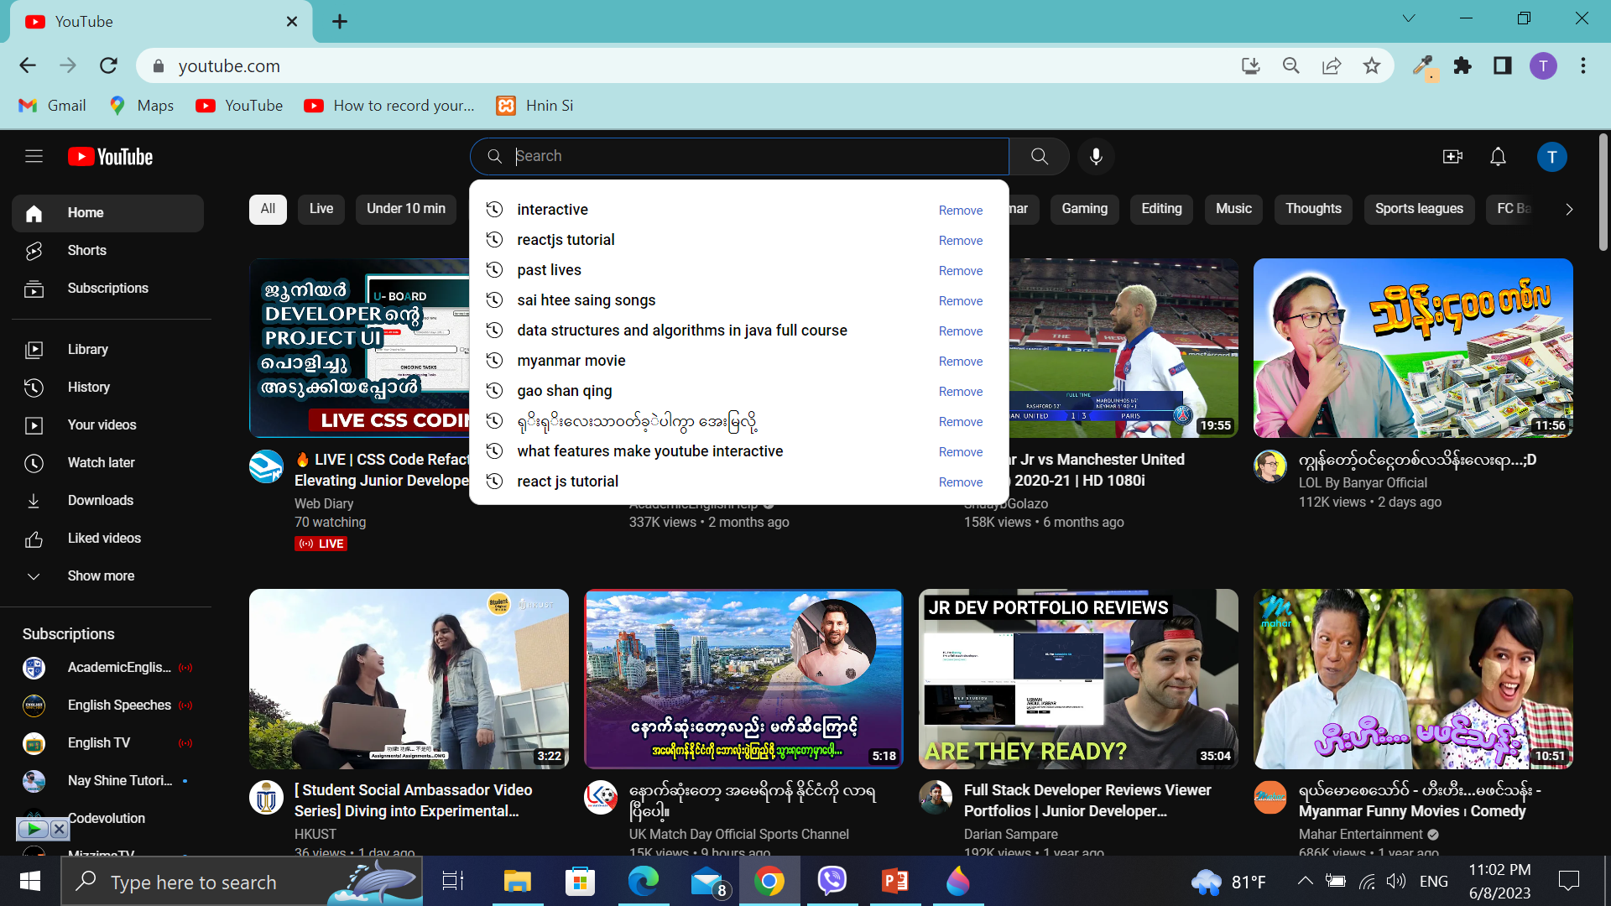
What feactures make youtube more
Efficient and effective to use
Search history and suggestions
Voice search
Notifications
Filter by Category

Slide 3
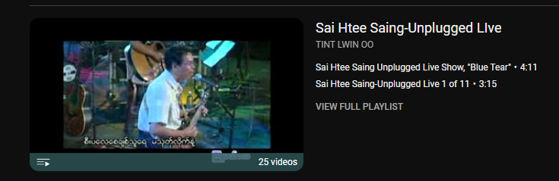
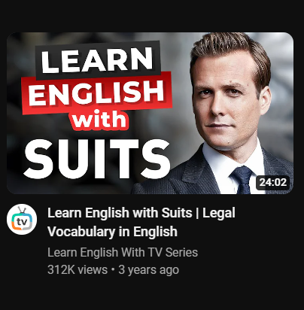
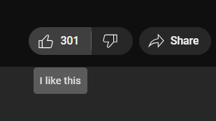
Mix Playlists
View Count can help you that
you should watch or not
Icons’ functions are described with tooltip

Slide 4
The interactive product
User can watch the video by hovering
Miniplayer is available
Video can play a while even there is no internet
Can Download the vedio and watch offline

