Slide 1
Restaurant Development in Atlanta, GA
By: Thanu Avirneni

Slide 2
Introduction
Atlanta, being the capital of Georgia is one of the busiest cities in America. It has a population of around 500,000 and continues to grow. As a college student attending school in Atlanta, I thought it would be interesting to study which neighborhoods in Atlanta would be the best place to open up an Indian restaurant. As this is actually something I have thought about eventually doing in Atlanta. Given that Atlanta already has a ton of restaurants in the area, we could see which places are worth opening restaurants in.
1.2 Problem
We can answer questions such as...
1) Which neighborhoods in Atlanta have the least amount of restaurants?
2) Which neighborhoods have the most?
3) Which neighborhoods have Indian restaurants and don't have Indian restaurants?
4) how far are the neighborhoods from the center of the city
The solutions to these questions will give future restaurant owners an idea on where to open up their restaurant in the city of Atlanta and what type of cuisine would thrive in certain areas.

Slide 3
Data Acquisition
Using the Foursquare API, I can get the list of all the venues in neighborhoods/boroughs in Atlanta.
List of types of cuisines that are popular in each area
I am using the well-known Atlanta Mercedes Benz Stadium as our starting point as well as google maps geocoding api

Slide 4
Data Cleaning
I am importing data from the Atlanta regional website. The Atlanta regional website provided with this information below. They provided an object id, npu, statistica, population in 2010, neighborhood, URL, total population of now, race, global id and the last date this data was edited. The information particularly useful to us is Borough (Statistica), Neighborhood, population. In order to get the longitude and latitude values, I got the place id of every address and looped through the values to get the longitude and latitude results. After geocoding all the addresses, I was able to get the latitude, longitude, accuracy, google place id, and postcode of each address.

Slide 5
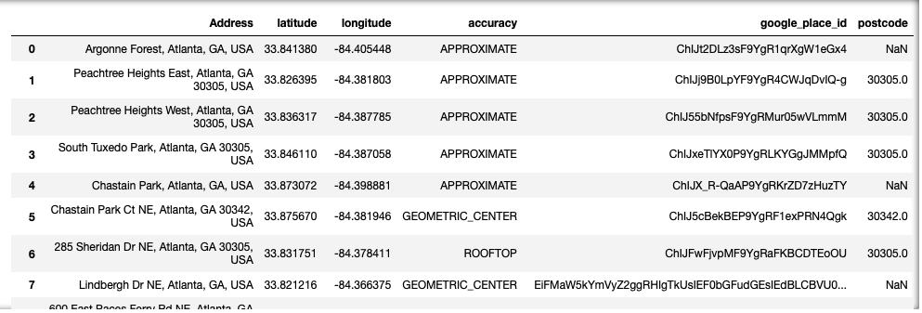

Slide 6
Exploratory Data Analysis
There are a total of 11 Indian restaurants in the area.
The percentage of Indian restaurants is 2.08%.
The average number of restaurants in the neighborhood is 3.37.
The total number of restaurants is 530.

Slide 7
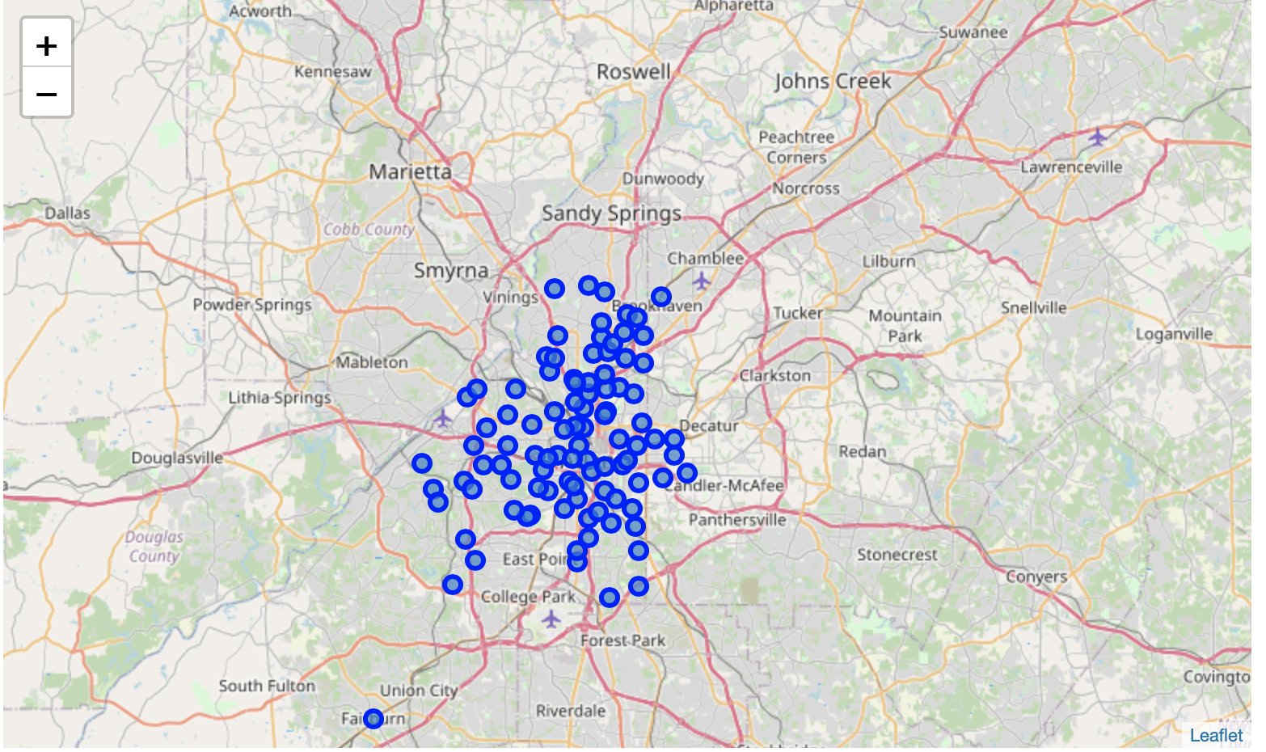
Neighborhoods in Atlanta

Slide 8
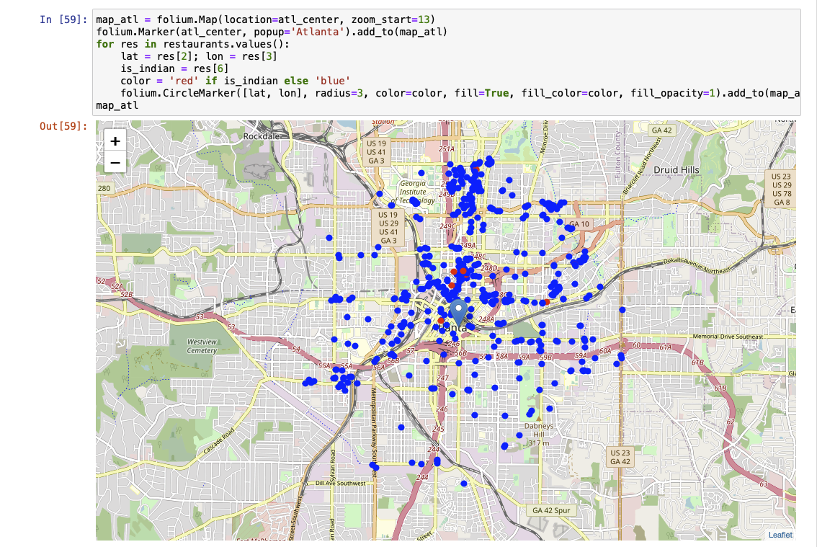
Restaurants in Area The red dots highlight the Indian restaurants in the area.

Slide 9
Conclusion
Purpose of this project was to identify Atlanta areas close to center with low number of restaurants (particularly Indian restaurants) in order to aid stakeholders in narrowing down the search for optimal location for a new Indian restaurant. By calculating restaurant density distribution from Foursquare data we have first identified general boroughs that justify further analysis and then generated extensive collection of locations which satisfy some basic requirements regarding existing nearby restaurants. Clustering of those locations was then performed in order to create major zones of interest (containing greatest number of potential locations) and addresses of those zone centers were created to be used as starting points for final exploration by stakeholders.
Final decision on optimal restaurant location will be made by stakeholders based on specific characteristics of neighborhoods and locations in every recommended zone, taking into consideration additional factors like attractiveness of each location (proximity to park or water), levels of noise / proximity to major roads, real estate availability, prices, social and economic dynamics of every neighborhood etc.

