Slide 1
Course Registration & Timetable Builder
KLEHB-FED-26-10-5
K. Thanuj
Pavan Teja
2620080122
2620040160

Slide 2

Presentation Overview
This presentation will outline our innovative solution for course registration and timetable building, designed to transform the student experience and streamline administrative processes.
Identify current challenges in manual registration.
Present our project objectives and key features.
Detail the system architecture and technology stack.
Highlight the expected benefits for both students and administration.

Slide 3

The Problem: Manual Registration Chaos
Hours Lost to Schedule Conflicts
Students spend hours navigating conflicting course schedules with no automated guidance.
Zero Conflict Detection
No automated system flags clashes between selected courses — errors are discovered too late.
Error-Prone Manual Process
Building timetables by hand is tedious, time-consuming, and highly susceptible to mistakes.

Slide 4


Current Challenges
No Real-Time Availability
Impossible Optimization
No Personalization
Course seat counts are not updated live, leading to last-minute surprises and disappointment.
Finding the best combination of courses across departments is a near-impossible manual puzzle.
The system offers zero tailored recommendations based on a student's history or preferences.

Slide 5



Project Objectives
Automate Conflict Detection
Optimized Timetable Generation
Real-Time Availability
Instantly flag and resolve scheduling conflicts during the registration process.
Provide live seat counts and course availability so students can plan with confidence.
Generate the best possible schedule based on each student's unique preferences and constraints.

Slide 6
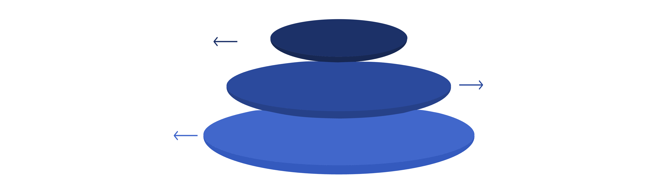
System Architecture Overview
Frontend
User-friendly registration interface
Backend
Course database and scheduling engine
Database
Course catalog and student records
A clean three-tier architecture separates concerns — keeping the UI responsive, the logic powerful, and the data reliable.

Slide 7




Key Features
Intelligent Conflict Detection
Customizable Timetable Builder
Smart algorithm catches scheduling clashes instantly before they become problems.
Students design their schedule around personal preferences and academic goals.
Real-Time Seat Tracking
Calendar Export
Live updates on course seat availability across all departments.
Export finalized timetables directly to popular calendar formats for easy access.

Slide 8
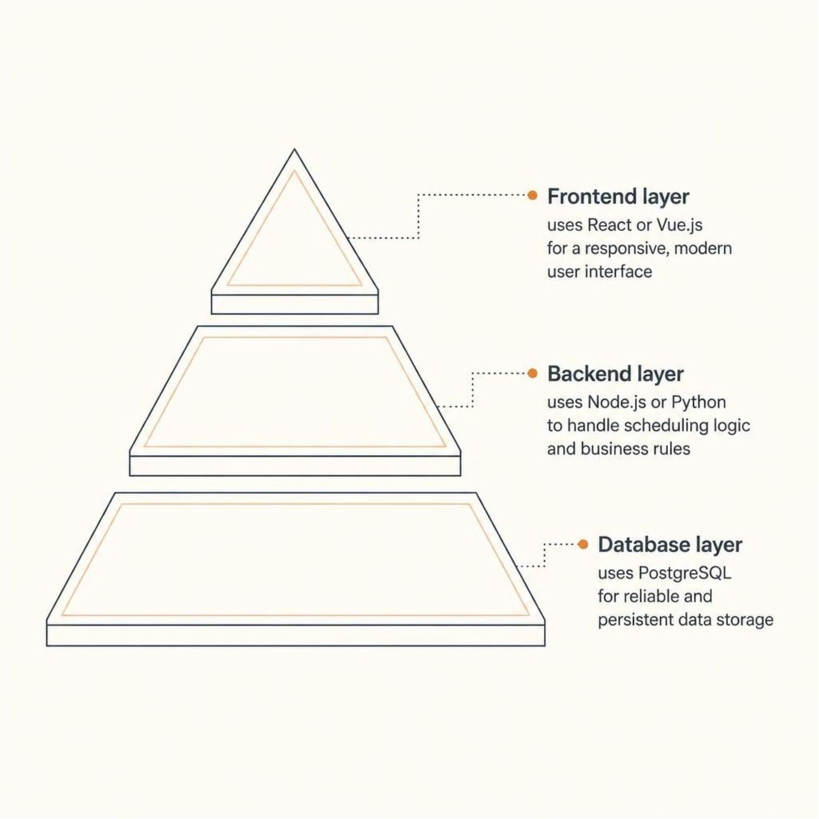
Technology Stack
Frontend
React / Vue.js — A modern, responsive user interface that makes registration intuitive and fast for every student.
Backend
Node.js / Python — Robust server-side logic powers the scheduling engine, conflict detection, and optimization algorithms.
Database
PostgreSQL — A reliable relational database ensures persistent, structured storage of course catalogs, student records, and generated timetables.

Slide 9

Expected Benefits
80%
0
Time Saved
Scheduling Conflicts
Reduction in time spent on course registration and schedule building.
Intelligent detection eliminates timetable clashes entirely.
100%
Student Satisfaction
Improved planning experience and confidence in course selection.

Slide 10

Thank You
Questions & Discussion

