Slide 1

CORNERSTONE PROJECT – REVIEW 2
PROJECT TITLE: LOAN PREDICTION DATA ANALYSIS
COURSE: DATA ANALYSIS ESSENTIALS
Department of Computer Science Engineering
TEAM MEMBERS | ROLL NUMBERS
1. RAMOJU SURYA VENKATA SAI PRAKASH | 25B11CS809
2. SANTHA THANUJA | 25B11CS855
3. SALADI VEERA SAI ANUSHA | 25B11CS839
4. NIMISHA MAITY | 25B11CS677

Slide 2
PROBLEM STATEMENT
Banks receive a large number of loan applications.
Evaluating applications manually can be time-consuming.
Loan approval depends on several factors such as:
  Income
  CIBIL Score
  Loan Amount
  Loan Term
  Assets
Our project analyzes these factors to identify their relationship with loan approval.
The system performs basic loan prediction using the analyzed data.
Why is this Project Important ?
Helps identify important factors associated with loan approval.
Makes large loan datasets easier to analyze.
Supports data-driven decision-making in the banking domain.
Provides a foundation for developing more advanced loan prediction systems.

Slide 3
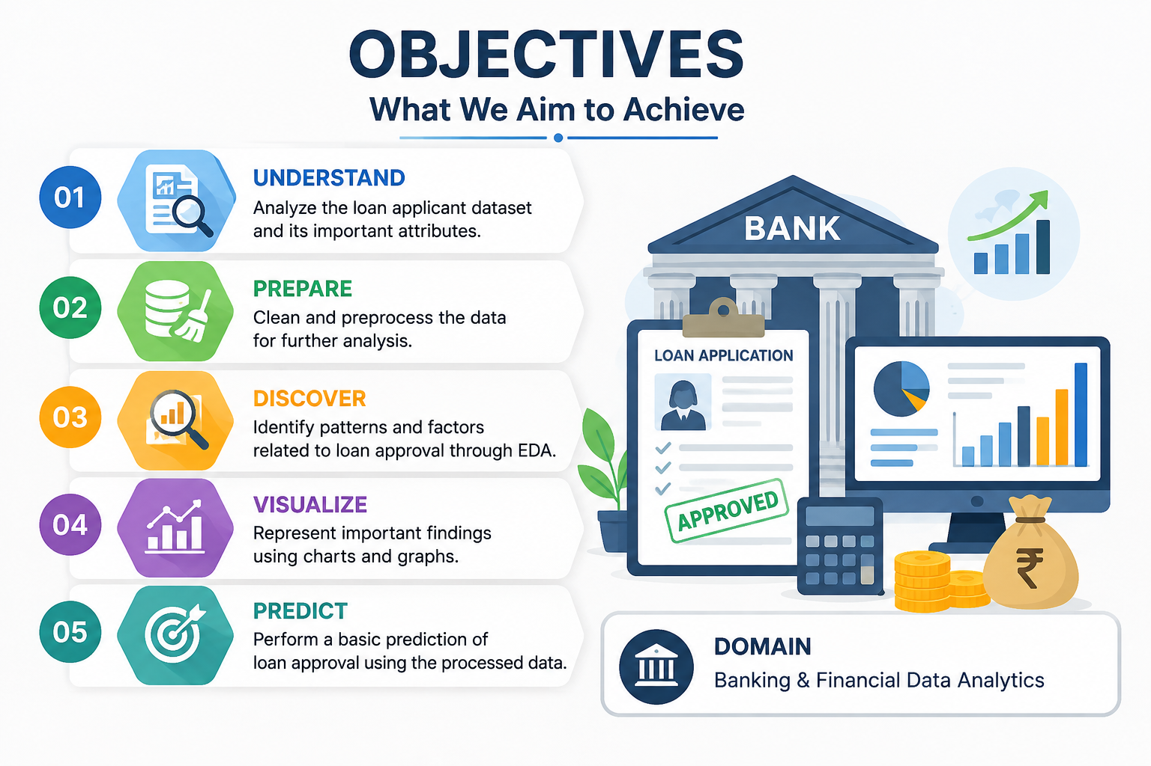
PROBLEM OBJECTIVES
Main Objective
To analyze loan applicant data & identify the key factors influencing loan approval using data analysis techniques.
Specific Objectives
Analyze and understand the loan dataset.
Clean and preprocess the data.
Identify important factors affecting loan approval.
Perform Exploratory Data Analysis (EDA).
Visualize patterns and relationships in the data.
Perform a basic loan approval prediction.
Domain
Banking & Financial Data Analysis

Slide 4
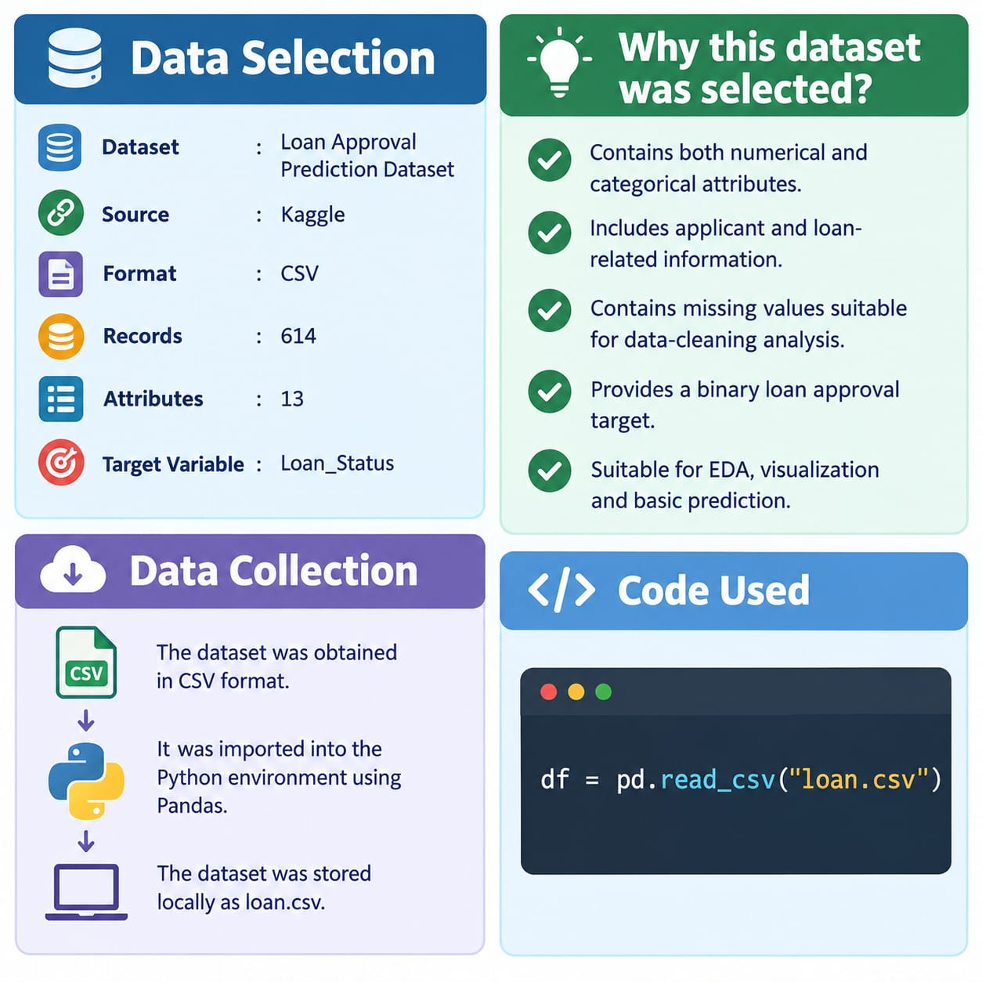
Data Selection & Data Collection
Data Selection
Dataset: Loan Approval Prediction Dataset
Source: Kaggle
Format: CSV
Records: 614
Attributes: 13
Target Variable: Loan_Status
Why this dataset was selected?
Contains both numerical and categorical attributes.
Includes applicant and loan-related information.
Contains missing values suitable for data-cleaning analysis.
Provides a binary loan approval target.
Suitable for EDA, visualization and basic prediction.
Data Collection
The dataset was obtained in CSV format.
It was imported into the Python environment using Pandas.
The dataset was stored locally as loan.csv.
Code used:
df = pd.read_csv("loan.csv")

Slide 5
Dataset Attributes
Attribute | Description
Loan_ID | Unique loan application identifier
Gender | Applicant gender
Married | Marital status
Dependents | Number of dependents
Education | Education status
Self_Employed | Employment status
ApplicantIncome | Applicant income
CoapplicantIncome | Co-applicant income
LoanAmount | Requested loan amount
Loan_Amount_Term | Loan repayment term
Credit_History | Credit history indicator
Property_Area | Property location category
Loan_Status | Loan approval status
Target: Loan_Status

Slide 6
Data Cleaning & Preprocessing
Data Cleaning
The dataset was checked for missing values and duplicate records.
Missing values were handled using:
Categorical variables
-Gender → Mode
-Married → Mode
-Dependents → Mode
-Self_Employed → Mode
Numerical variables
-LoanAmount → Median
-Loan_Amount_Term → Median
-Credit_History → Median
.
Other Cleaning Steps
-Duplicate records were checked.
-3+ in Dependents was converted into numerical form.
-Remaining missing values were verified after cleaning.
-Data types were examined before further processing.
Result: The dataset was cleaned and prepared for analysis

Slide 7
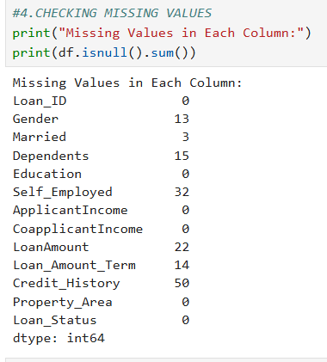
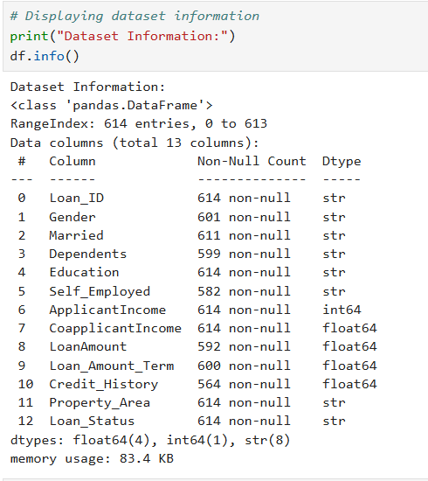
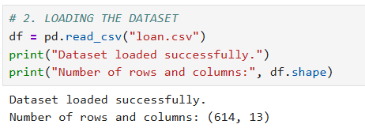
PROCESSING THE DATA
IMPORT DATASET
MISSING DATA
DUM DATA

Slide 8
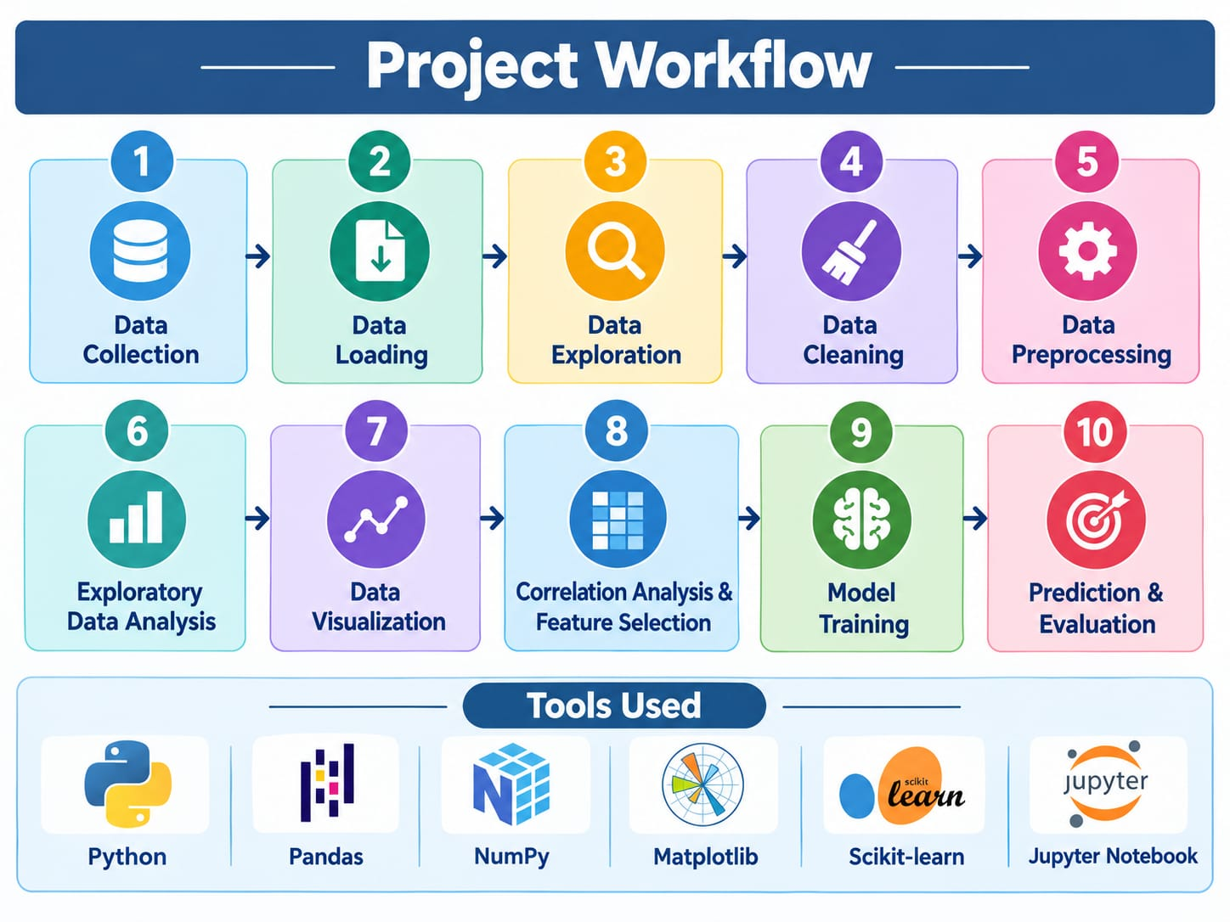
Project Workflow

Slide 9
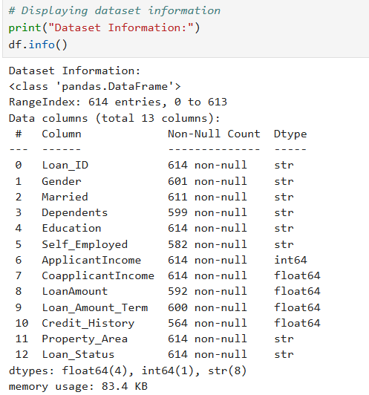
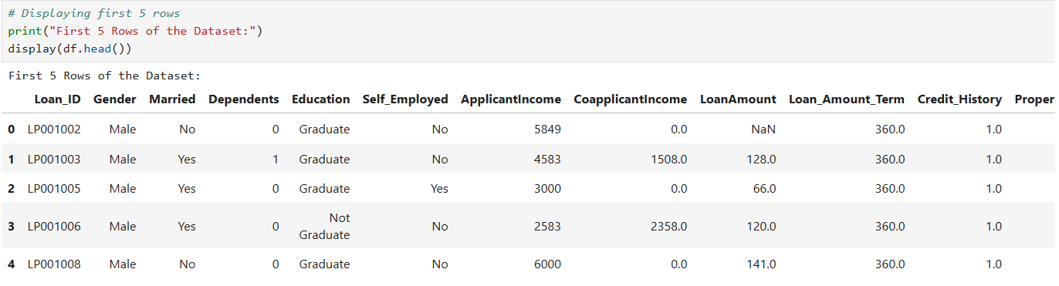
Dataset exploration
Dataset Information:
Initial Dataset Understanding
The dataset was initially explored to understand its structure and contents.
Exploration Methods
df.head() → View the first records
df.shape → Identify number of rows and columns
df.columns → View attribute names
df.info() → Examine data types and non-null values
df.describe() → Obtain statistical summary
Dataset Overview
614 records
13 attributes
Numerical and categorical variables
Loan_Status used as the target variable
Displaying first five rows:

Slide 10
Missing Value Analysis
Missing values were identified before performing further analysis.
Missing Values Found In
-Gender
-Married
-Dependents
-Self_Employed
-LoanAmount
-Loan_Amount_Term
-Credit_History
Duplicate Check
Duplicate records were checked using duplicated().
No duplicate rows were found.
Handling Strategy:
Variable Type | Method
Categorical | Mode
Numerical | Median

Slide 11
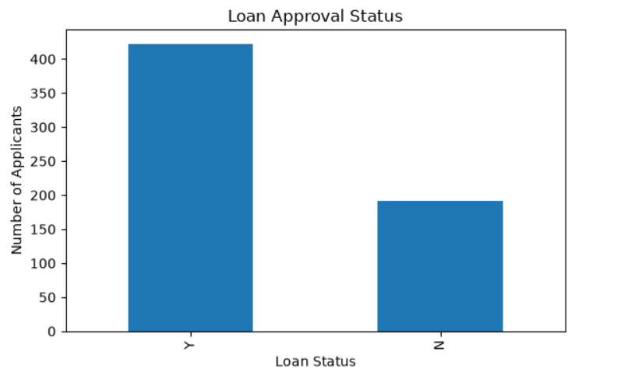
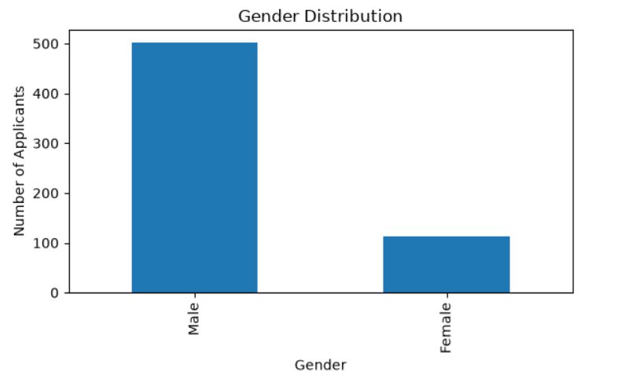
Exploratory Data Analysis
Exploratory Data Analysis
Exploratory Data Analysis was performed to understand the overall characteristics of the loan application dataset. Both categorical and numerical variables were examined before applying machine learning techniques.
The analysis focused on:
-Distribution of loan approval status among applicants.
-Distribution of applicants based on gender and education.
-Distribution of applicants across different property areas.
-Distribution of applicant income and loan amount.
-Relationship between credit history and loan approval.
EDA helped us understand the structure of the data and identify patterns that could be considered during further processing and prediction.

Slide 12
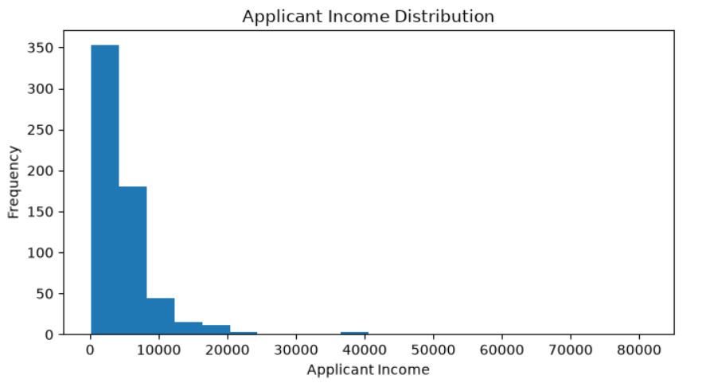
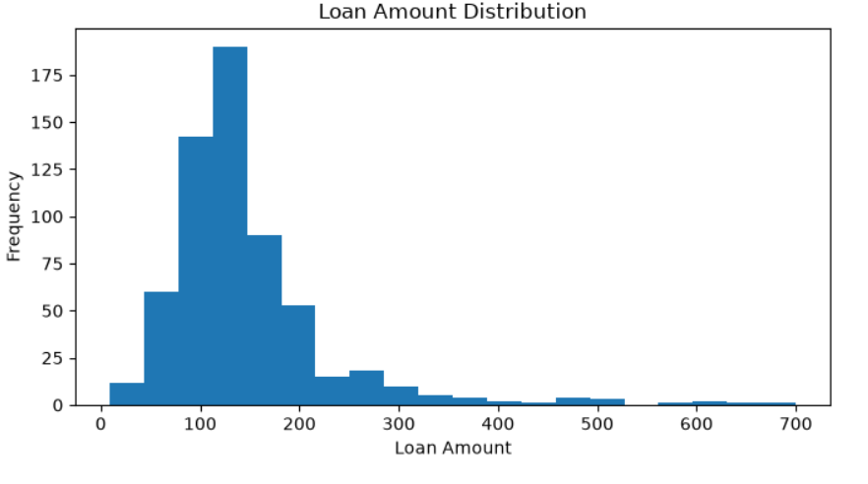
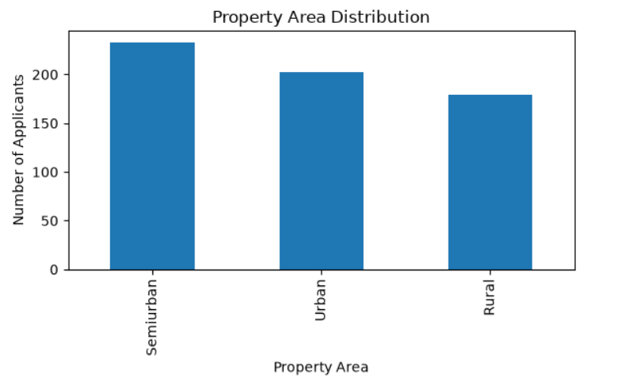
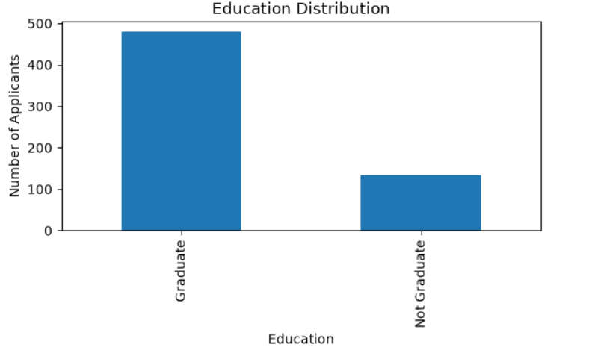
Data Visualization
The project uses Matplotlib to visualize numerical variables and relationships.
EDA was performed to understand the distribution of applicant characteristics and loan approval outcomes in the dataset.

Slide 13
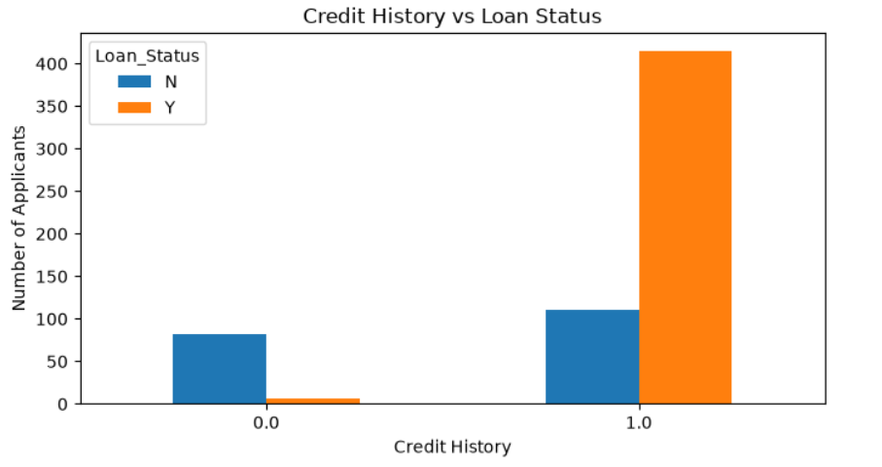
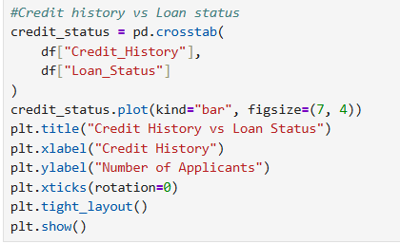
Categorical analysis
Analysis of Categorical Variables
Categorical variables were analyzed to understand how applicant characteristics were associated with loan approval status.
Credit History vs Loan Status
Credit history was compared with loan approval status to observe approval patterns.
Education vs Loan Status
Loan approval status was compared across education categories.
Property Area vs Loan Status
Loan approval status was analyzed across rural, semiurban and urban property areas.
These comparisons provide an understanding of how different applicant characteristics are distributed with respect to loan approval.

Slide 14
Data Transformation and Preprocessing
Data Transformation
Before applying the prediction model, categorical variables were converted into numerical form.
Label Encoding was applied to:
-Gender
-Married
-Education
-Self_Employed
-Loan_Status
Label Encoding converts categorical values into numerical labels so that they can be processed by the machine learning model.
One-Hot Encoding was applied to:
-Property_Area
This creates separate binary columns for the property-area categories while avoiding unnecessary duplication using drop_first=True.
Additional Processing
Loan_ID was removed because it is an identifier and does not provide useful predictive information.
Boolean values generated during encoding were converted into integers.
Dependents was converted into numerical form.

Slide 15
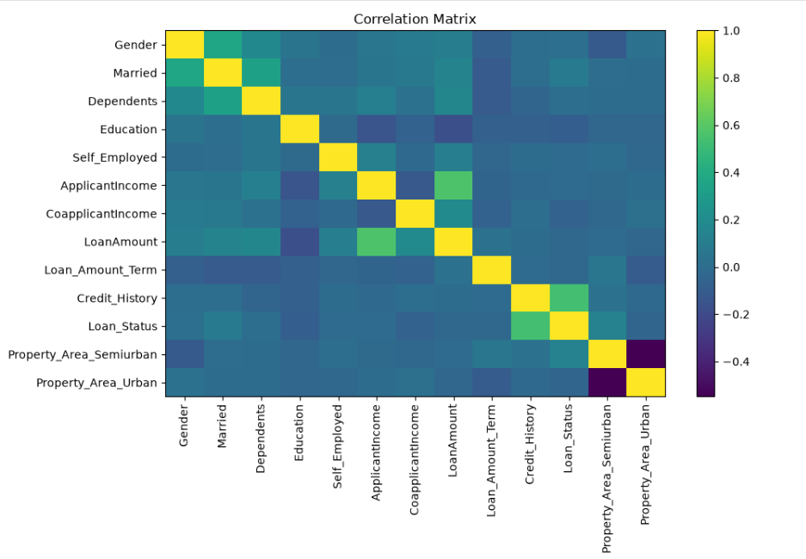
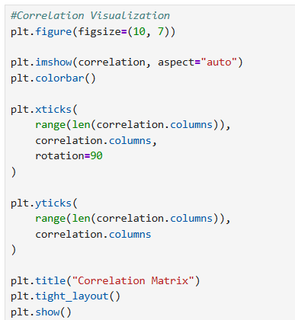
Feature Scaling, Standardization and Correlation
Numerical Data Processing
Numerical variables have different ranges. Therefore, scaling and standardization techniques were applied.
Min-Max Scaling
Applied to:
ApplicantIncome
CoapplicantIncome
LoanAmount
Loan_Amount_Term
Min-Max Scaling transforms values into a common range.
Standardization
StandardScaler was applied to the same numerical variables to transform them based on their mean and standard deviation.
Correlation Analysis
A correlation matrix was generated to examine relationships between the processed variables.
Correlation analysis helps understand how variables are related and supports further feature analysis before modelling.

Slide 16
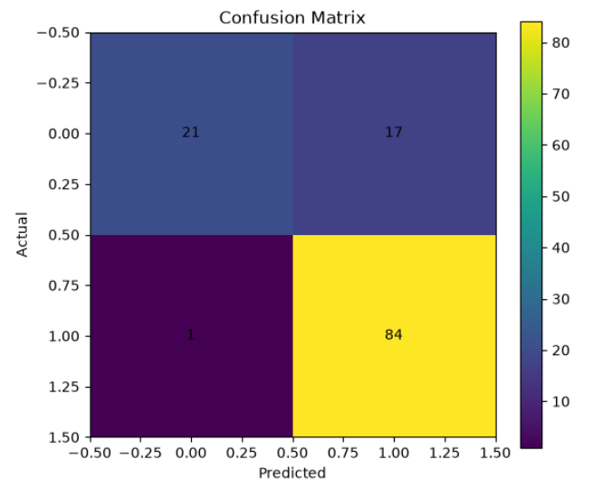
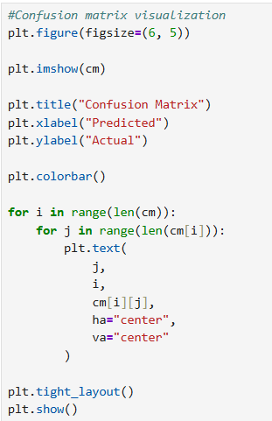
Loan Approval Prediction
After preprocessing and feature selection, Logistic Regression was used to perform basic loan approval prediction.
The dataset was divided into:
80% Training Data
20% Testing Data
The trained model was then used to predict loan approval status for the test data.
Model Evaluation
The model was evaluated using:
-Accuracy
-Classification Report
-Confusion Matrix
-Logistic Regression Feature Coefficients
The confusion matrix provides a comparison between the actual and predicted loan approval classes.

Slide 17
CONCLUSION
-Successfully loaded and explored the loan dataset using Pandas.
-Identified and handled missing values and duplicate records.
-Applied Label Encoding and One-Hot Encoding to categorical data.
-Applied Feature Scaling and Standardization to numerical features.
-Performed EDA and visualization to identify important patterns.
-Used correlation analysis and feature selection to prepare the data.
-Applied Logistic Regression for basic loan approval prediction.
-Evaluated the model using accuracy, classification report, and confusion matrix.
FUTURE ENHANCEMENTS
-Compare multiple machine learning models.
-Apply advanced feature selection and hyperparameter tuning.
-Add more model evaluation metrics.
-Develop an interactive loan prediction interface.
-Deploy the system as a web-based application.

Slide 18
THANK YOU

