Slide 1
ANALYSIS OF PEDESTRIANTRAFFIC DATA DURING COVID-19 IN AUCKLAND

Slide 2
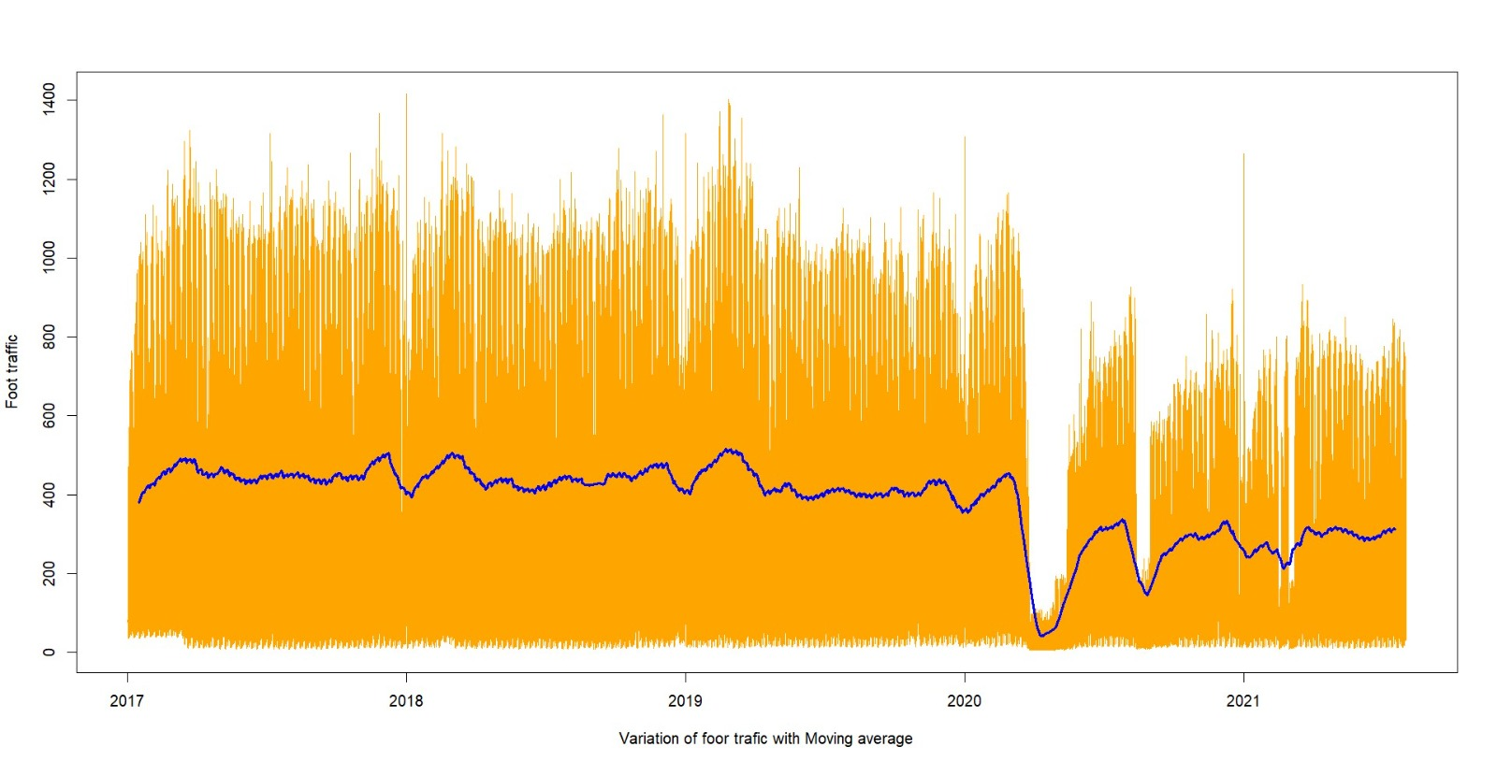
Overall behavior of pedestrian traffic before and during the pandemic
Yellow lines - actual data set
Blue line – Moving average values of the data set
Mean and variance of the series not stable with the time.
There is a sudden change in the series at some point.

Slide 3
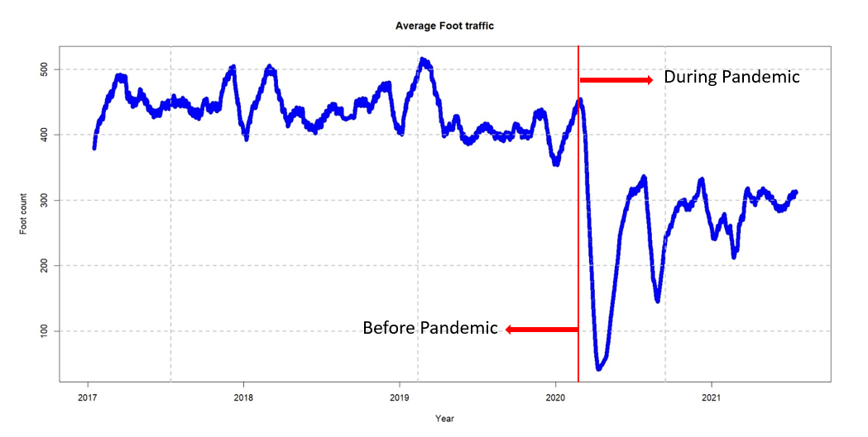
Time series seems not stationary and it is decreasing.
Before pandemic period the data series vary around pedestrian count 438.
During pandemic period there is a significantly decrease in mean of the series.
The variance of the data series has increased during pandemic period.
Peaks during January to March before pandemic.
Cannot exactly observe the same pattern during the pandemic period.

Slide 4
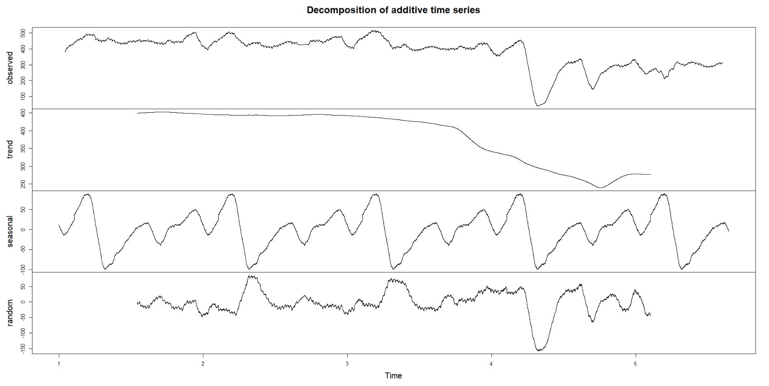
Decomposition of the time series
Trend- Indicate long-term movement in the data
Seasonal – reflects recurring patterns that repeat at regular intervals
Random - represents the random fluctuations and noise that are not explained by the trend and seasonality.
Trend component shows a slightly steady line before pandemic period and dramatic fall during the pandemic period. That means there is a significant volume decrease in the pedestrian foot count during the pandemic period
The seasonal component indicates that the pedestrian traffic spikes and drops, due to seasonality factors such as weather seasons, holidays and festivals.
No significant difference in monthly cyclic patterns in before and during pandemic periods.
The random plot shows there is the high deviation of the data at some point during the pandemic time.

Slide 5
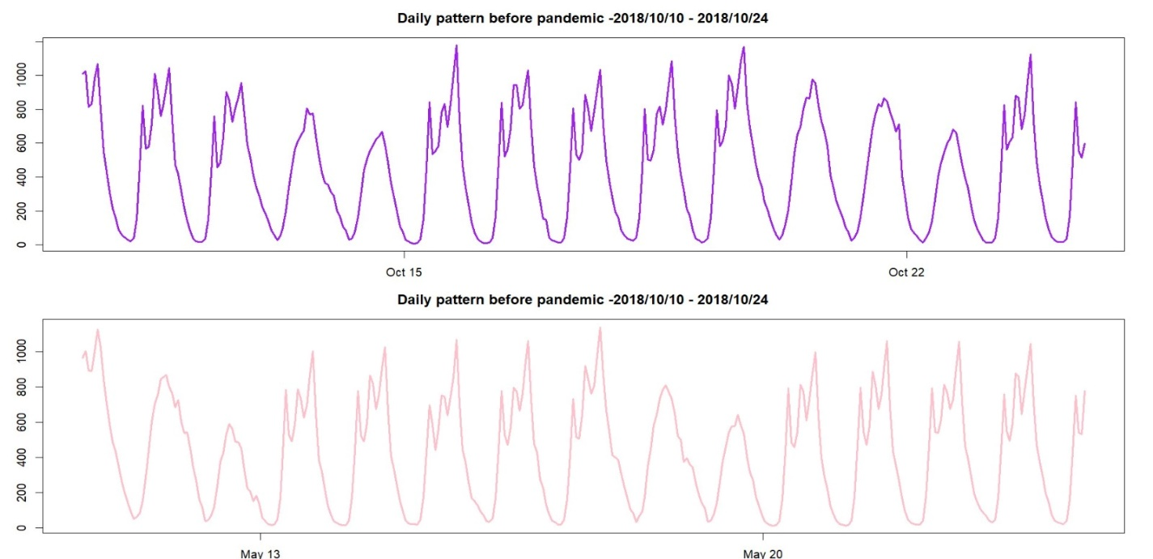
Pedestrian Traffic Patterns according to in different covid- 19 alert levels
Before Covid-19
consistent patterns emerge on weekdays and weekends.
These patterns vary significantly in shape and magnitude.

Slide 6
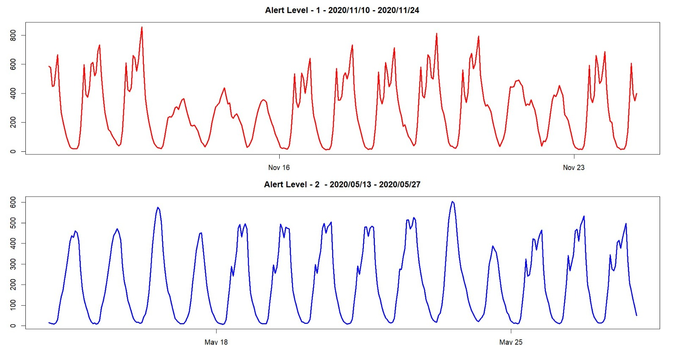
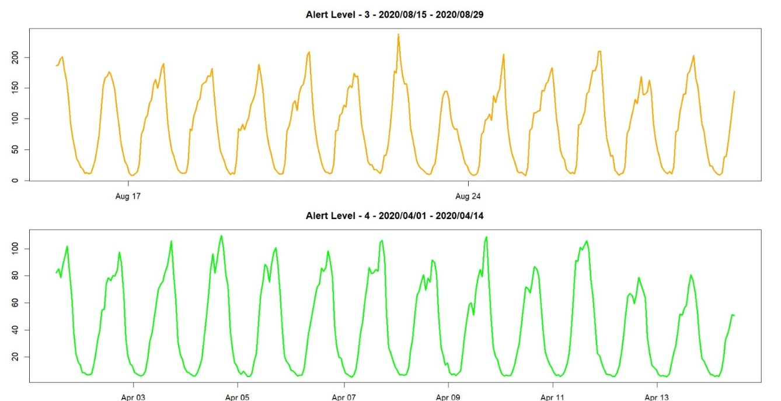
During Pandemic
Nearly uniform pattern observed throughout the week, excluding instances of alert level 1.
During Alert Level 1, the daily patterns are quite similar to the pattern in non-pandemic period.
Overall, there is a significant change in daily and weekly pedestrian patterns between before and during pandemic.

Slide 7
Conclusion
Based on the analysis, it is evident that the volume of pedestrian traffic has decreased during pandemic phase.
There is a notable difference in daily and weekly patterns between before and during pandemic period.
Finally, we can justify the business owners claim.

