Slide 1
Weather or Time? Understanding What Drives Capital Bikeshare Usage
DATA 601 FALL 2025
Author: Thanusha Balasubramanian

Slide 2


About THE COMPANY
Quick Facts
Launch Year | 2010
Initial Fleet | ~400 bikes
Current Fleet | 6,000+ bikes
Stations | 700+
Membership Types | Casual (Single Ride or Day Pass), Registered (Annual)
Coverage Area | Washington, D.C., Maryland, Virginia

Slide 3
What is the relationship between weather and the number of bike share users in an hour?

Slide 4
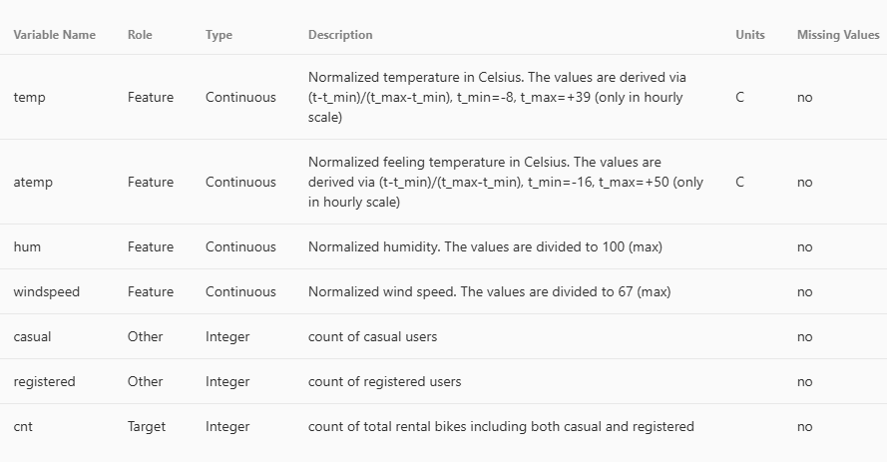
Dataset & Workflow
Pre-Cleaned Data
Transform Back to Raw
Exploratory Visualizations
Modeling

Slide 5
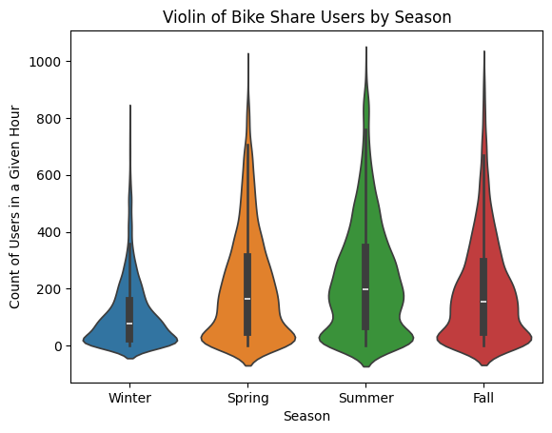
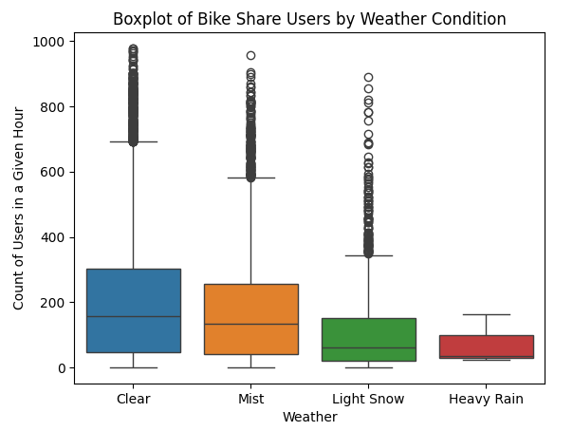
WEATHER

Slide 6
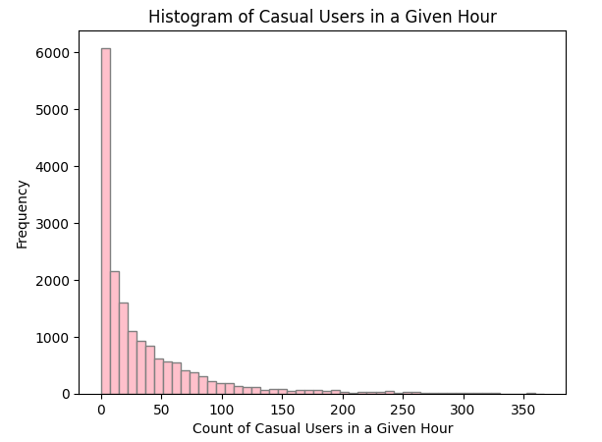
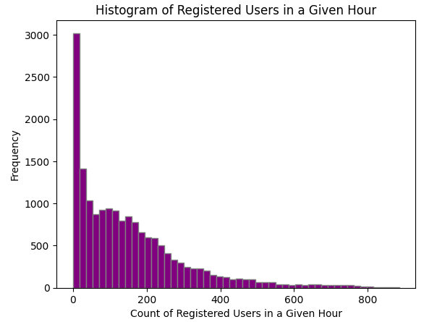
USER TYPE

Slide 7
What if we look at the hour?

Slide 8
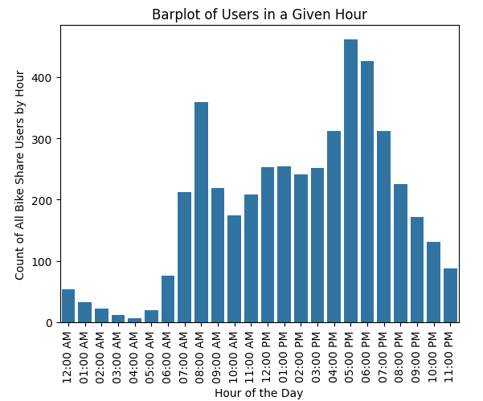

Commutes?

Slide 9
Analysis: Modeling Approach and Results
Notes:
Model 1 – Linear Regression, Model 2 – Random Forest Classification

Slide 10
Model 1 – Linear Regression
Feature | Coefficient
Hour | 53.50
Feel Temperature | 44.53
Year | 40.71
Humidity | 37.60
Season | 21.89
Temperature | 11.76
RMSE = 139.78
Mean of Users = 189.46
Median of Users = 142

Slide 11
Model 2 – Random Forest Classification: Bucketing
User Count Bucket | No. of Users
Low Usage | <40 users ~ Bottom 25%
Medium Usage | 40 – 281 Users ~ Middle 50%
High Usage | >281 Users ~ Top 25%

Slide 12
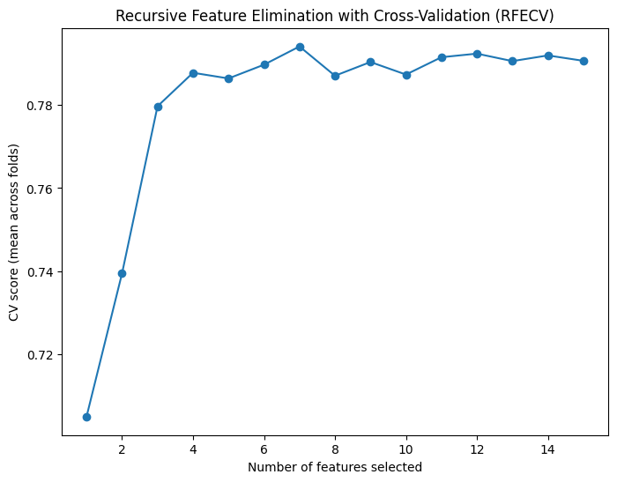
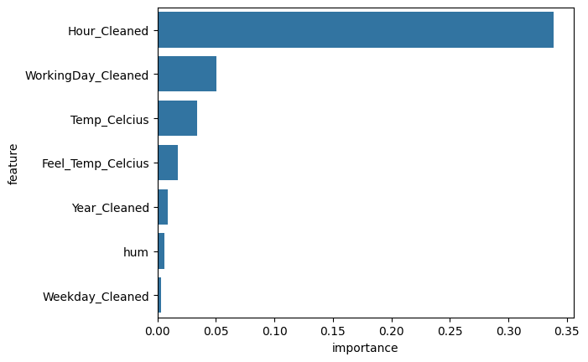
Model 2 – Random Forest Classification: Features

Slide 13
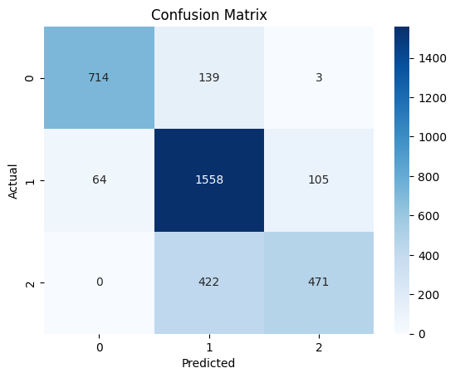
Model 2 – Random Forest Classification: Model Accuracy
Accuracy = 0.7891
Precision = 0.8003
Recall = 0.7891
Notes:
Precision = (TP)/(TP + FP) – proportion of correctly identified positives (Spam recognition)
Recall = (TP)/(TP + FN) – proportion of identified positives which are actually positive (Disease Detection)

Slide 14
Application: Business Recommendations
Notes:
Business Insights & Applications

Slide 15

Business Insights & Applications
Application | Recommendation
Dynamic Pricing | Apply surcharge during peak hours
Operational Efficiency | Charge and redistribute bikes during low-use hours
Marketing Opportunities | Incentivize off-peak rides with discounts or loyalty offers

Slide 16
Sometimes You Find the unexpected

Slide 17
Future Of Project
Improvement on Regression Model
  The regression model was built before our class on regression, so I may proceed to fine tune the model. (ie. Adjust features included, maybe transform the data). Check the conditions of the model (Data 602) to see if the residuals are normally distributed and check for homoscedasticity.
Additional Fine Tuning of Classification Model
  I will change the hyperparameters, beyond number of features (ex: max depth) to improve model. Try a different classification for usage.

