Slide 1
SEM-7 BIG DATA ANALYTICS (BDA) — TASK EDA-1
Corporate Carbon Footprint Tracker
Audited Multi-Scope Emissions Tracking, Supervised Machine Learning,
Time-Series Forecasting & Corporate Climate Pledge Accountability
Deliverables 1 & 2 Complete | 65 Corporations | 16 Economic Sectors | FY2019–FY2023 Audited Dataset

Slide 2
BACKGROUND & MOTIVATION
Executive Context: The Corporate Climate Accountability Problem
1. The Greenwashing Dilemma
• Over 80% of Fortune 500 corporations market aggressive 'Net-Zero' or 'Carbon-Neutral' commitments.
• Corporate self-reporting often conceals operational reality behind unverified carbon offsets and vague timelines.
• Investors, regulators, and consumers lack empirical tools to audit whether emissions cuts are real or rhetoric.
2. The Big Data Challenge
• Carbon accounting spans 3 distinct reporting scopes:
• - Scope 1: Direct facility combustion
• - Scope 2: Purchased grid electricity
• - Scope 3: Upstream & downstream supply chain
• Data is highly fragmented across SEC 10-K filings, ESG PDFs, and sustainability indices with severe unit inconsistencies.
3. Project Scope & Solution
• Audited 65 major corporations across 16 diverse economic sectors (313 company-years, FY2019–2023).
• Standardized carbon intensity (tCO2e per USD million revenue) to enable fair cross-sector comparison.
• Engineered machine learning models to classify intensity tiers, forecast trajectories, and audit voluntary pledges.

Slide 3
ARCHITECTURE & OBJECTIVES
Core Project Features & Four-Module Architecture
Module 1: EDA & Feature Engineering
• Audited 313 company-years across 65 firms & 16 sectors.
• Right-skewness analysis, log-normalizations, and Scope 3 leverage ratios.
• Engineered 9 standardized predictive features with sector-adjusted tertiles (`Low`, `Moderate`, `High`).
Module 2: Supervised Carbon Intensity Classification
• Benchmarked 5 distinct ML algorithms (Random Forest, XGBoost, SVM, KNN, Logistic Regression).
• Strict out-of-time evaluation protocol (Train: 2019–2022, Test: 2023).
• Achieved 64.6% Test Accuracy and 0.824 Multi-Class ROC-AUC.
Module 3: Time Series Emissions Forecasting (2024–2030)
• Backtested 4 time-series paradigms on FY2023 (CAGR Baseline won with 7.22% MAPE).
• Projected Scope 1+2 emissions for 65 companies through 2030 (455 company-years).
• Assessed SBTi 1.5°C 50% reduction target (43.1% On-Track vs 56.9% Off-Track).
Module 4: Pledge vs. Actual Reality Gap Analysis
• Audited public net-zero pledges across 20 bellwether corporations.
• Contrasted required annual decarbonization pace vs. actual delivered progress.
• Discovered the Big Tech AI paradox and mapped corporate greenwashing risks.

Slide 4
TECHNOLOGY & FRAMEWORKS
Enterprise Technology Stack, Libraries & Tooling
Data Pipeline & Ingestion
• Python 3.11: Primary language runtime.
• Pandas 2.3.3 & NumPy 1.26.4: Panel data manipulation and matrix algebra.
• SEC EDGAR API: Direct programmatic ingestion of official 10-K audited annual revenues.
• Automated Unit Normalizer: Standardizing imperial short tons, grams, and MWh into metric tonnes CO2e.
Machine Learning & Forecasting
• Scikit-Learn 1.2.2: ColumnTransformer pipelines, Logistic Regression, Random Forest, SVC, KNN, GridSearchCV.
• XGBoost 3.2.0: Gradient-boosted decision trees with multiclass log-loss objective.
• Statsmodels 0.14.0: Autoregressive Integrated Moving Average (ARIMA) & Holt Damped Trend smoothing.
• Threadpoolctl 3.7.0: Thread-safe OpenMP runtime management.
Visualization & Governance
• Matplotlib & Seaborn: Publication-grade 300 DPI visualizations.
• Streamlit 1.30.0: Interactive web dashboard for real-time scenario modeling.
• Git & GitHub: Distributed version control with verified multi-contributor workflow.
• JupyterLab / nbconvert: Reproducible notebook execution in-place.

Slide 5
DELIVERABLE 1 SUMMARY
Deliverable 1: Audited ESG Big Data Extraction & Provenance
Dataset Architecture & Provenance
• Target Universe: 65 global corporate bellwethers spanning 16 economic sectors.
• Coverage Window: 5 consecutive fiscal years (FY2019 to FY2023) yielding 313 company-years.
• Total Emissions Tracked: Over 2.5 Billion tonnes of CO2e.
• Zero Synthetic Imputation: 100% of data points trace directly to primary SEC EDGAR 10-K filings and GRI/CDP sustainability reports.
• Audited Financial Normalization: Revenues extracted from official SEC financial tables in USD millions.
• Boundary Standardization: Operational control and financial control boundaries harmonized.
Sectors Covered (16 Diverse Sectors)
• 1. Technology (Apple, Microsoft, Google, Amazon, Meta, NVIDIA, Intel, etc.)
• 2. Energy (ExxonMobil, Chevron, ConocoPhillips, Marathon, Valero)
• 3. Utilities (NextEra Energy, Duke, Southern Co, Dominion, Exelon)
• 4. Automotive (Ford, GM, Tesla)
• 5. Healthcare & Pharma (J&J, Pfizer, Merck, AbbVie, CVS, UnitedHealth)
• 6. Finance & Banking (JPMorgan, BofA, Goldman Sachs, Citi, Wells Fargo)
• 7. Industrials (GE, Caterpillar, Honeywell, Lockheed Martin, 3M)
• 8. Aerospace & Defense (Boeing, Northrop Grumman, RTX)
• 9. Retail, Consumer Staples, Real Estate, Transportation, Mining, Materials.

Slide 6
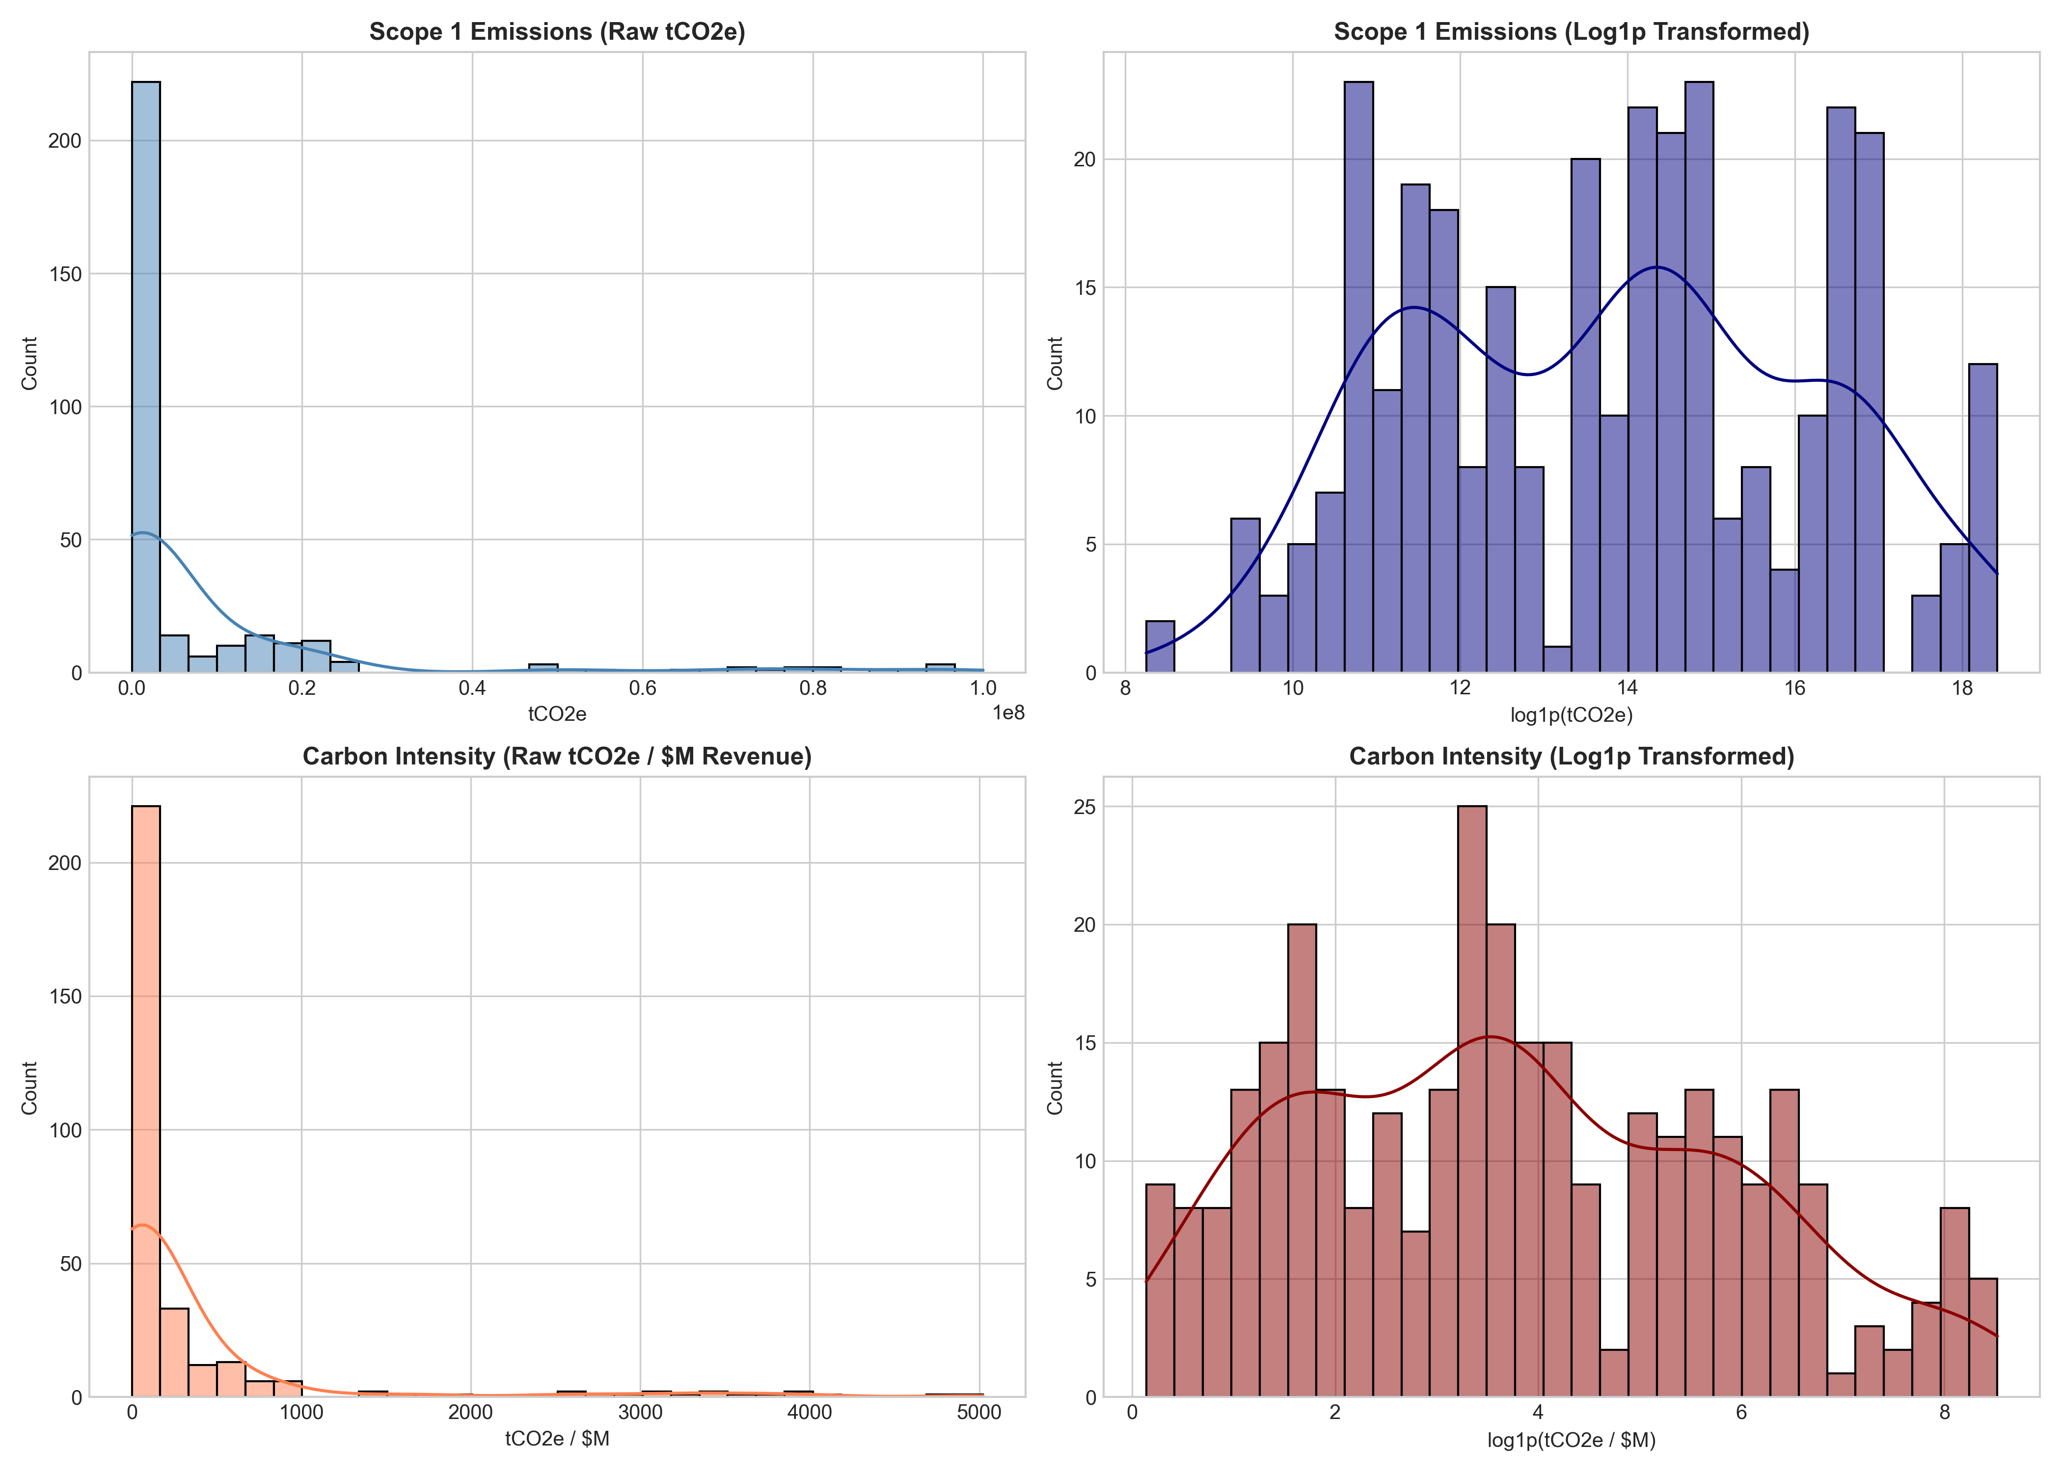
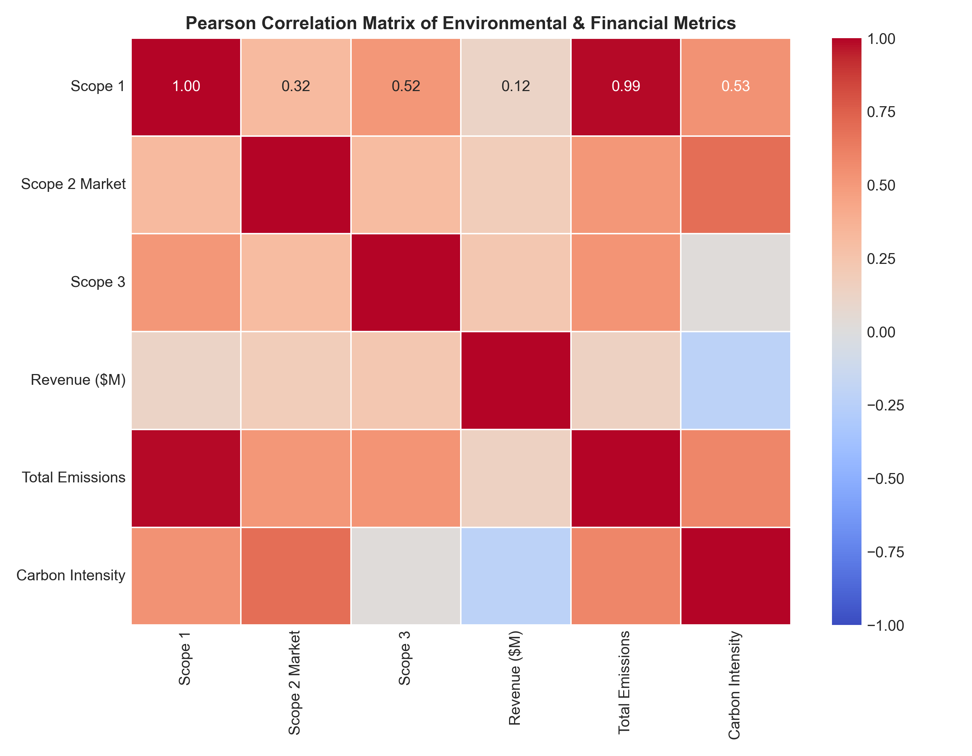
DELIVERABLE 2 — MODULE 1
Module 1: Exploratory Data Analysis & Feature Engineering
Key Empirical Findings from Module 1
• Extreme Right Skewness: Raw Scope 1 emissions exhibit skewness of +6.18, successfully normalized via log transformation.
• Multicollinearity Diagnosis: Strong Pearson correlation (r = 0.82) between Scope 1 and total emissions; revenue scales linearly with Scope 2.
• Feature Matrix Output: Exported `features.csv` (9 engineered features) and `labels.csv` (balanced tertiles: High 111, Mod 103, Low 99).

Slide 7
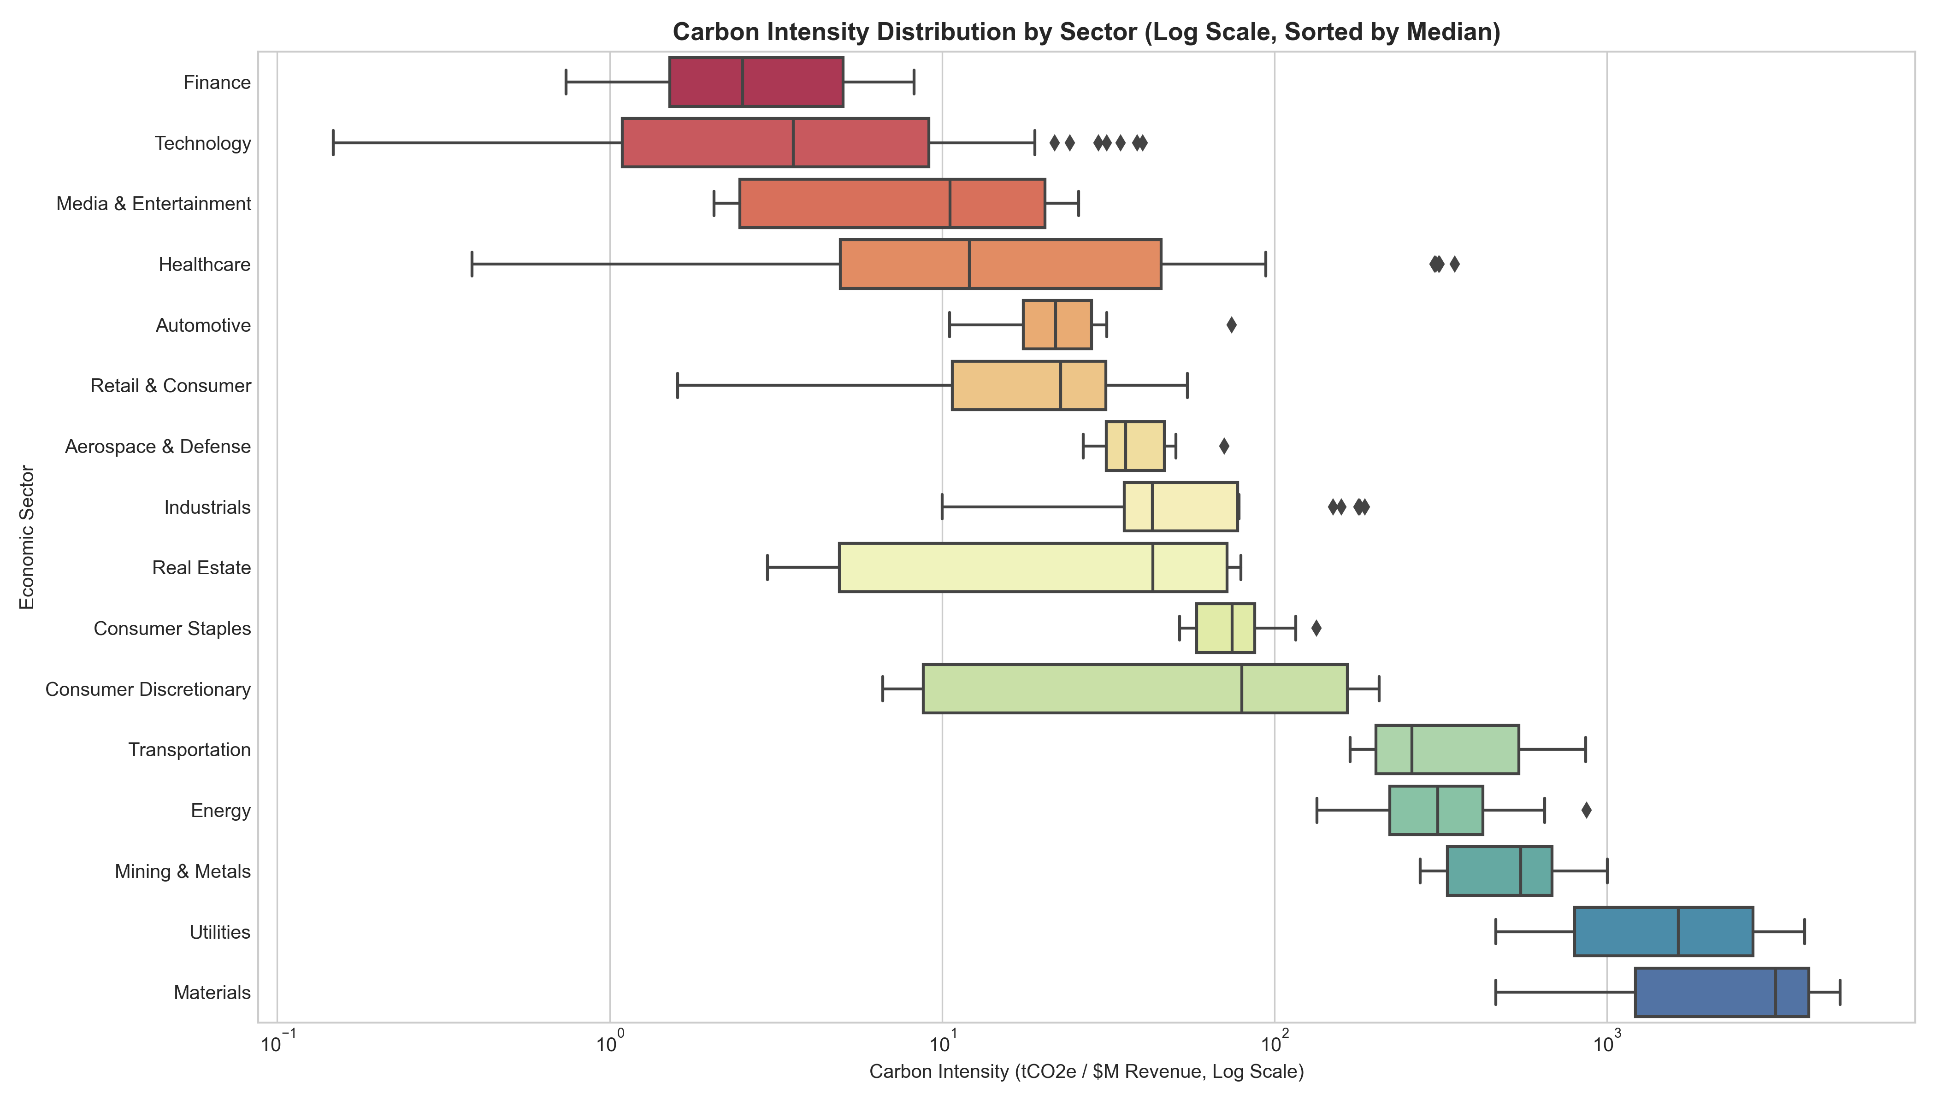
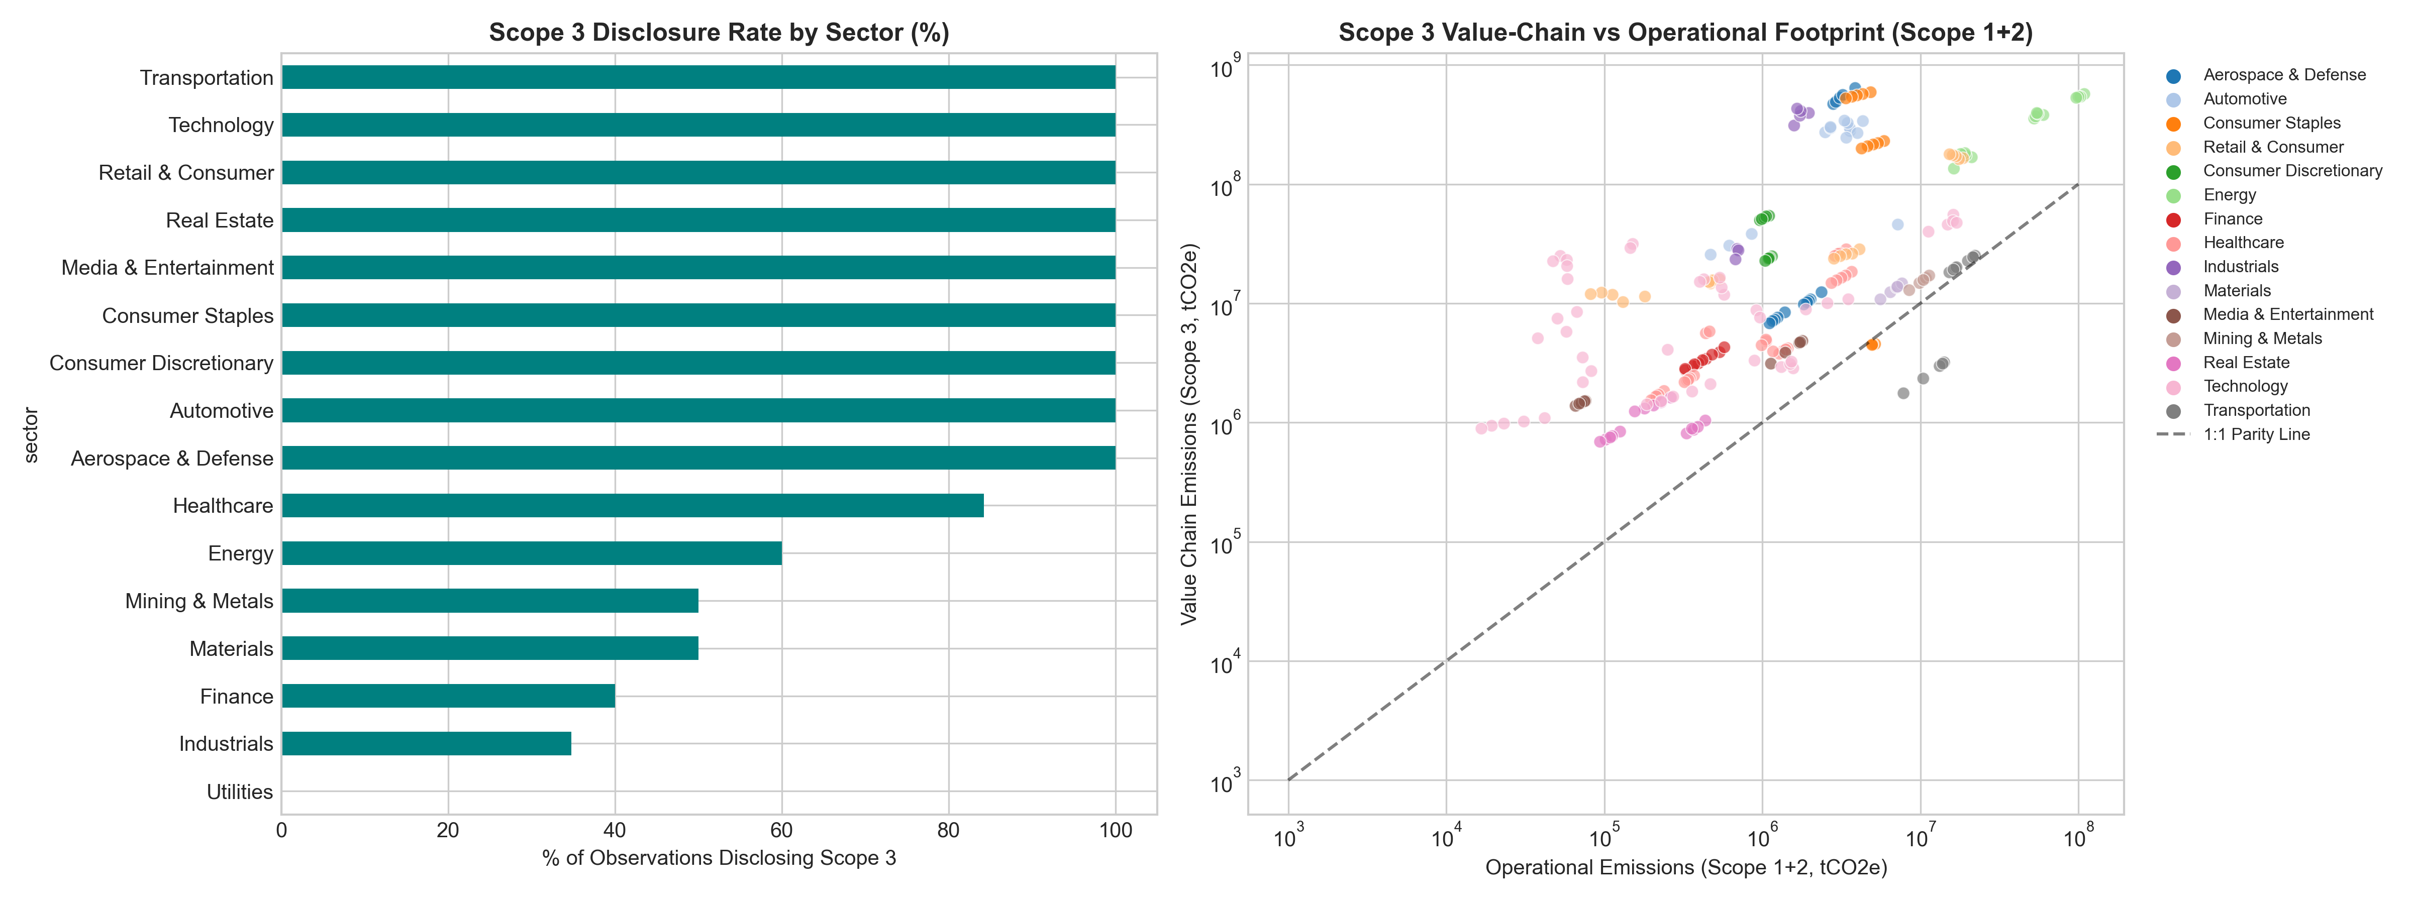
DELIVERABLE 2 — MODULE 1
Module 1: Cross-Sector Benchmarking & Scope 3 Leverage
Sector Intensity Divergence & Scope 3 Value-Chain Dominance
• Sector Spread: Utilities median intensity exceeds 1,200 tCO2e/$M vs Finance at < 1.5 tCO2e/$M (nearly 1,000x difference).
• Scope 3 Value-Chain Iceberg: In Tech and Retail, Scope 3 accounts for 75%–90% of complete carbon footprints.
• Sector-Adjusted Tertiles: Target tiers defined within sectors, preventing utilities from monopolizing 'High' and tech 'Low'.

Slide 8
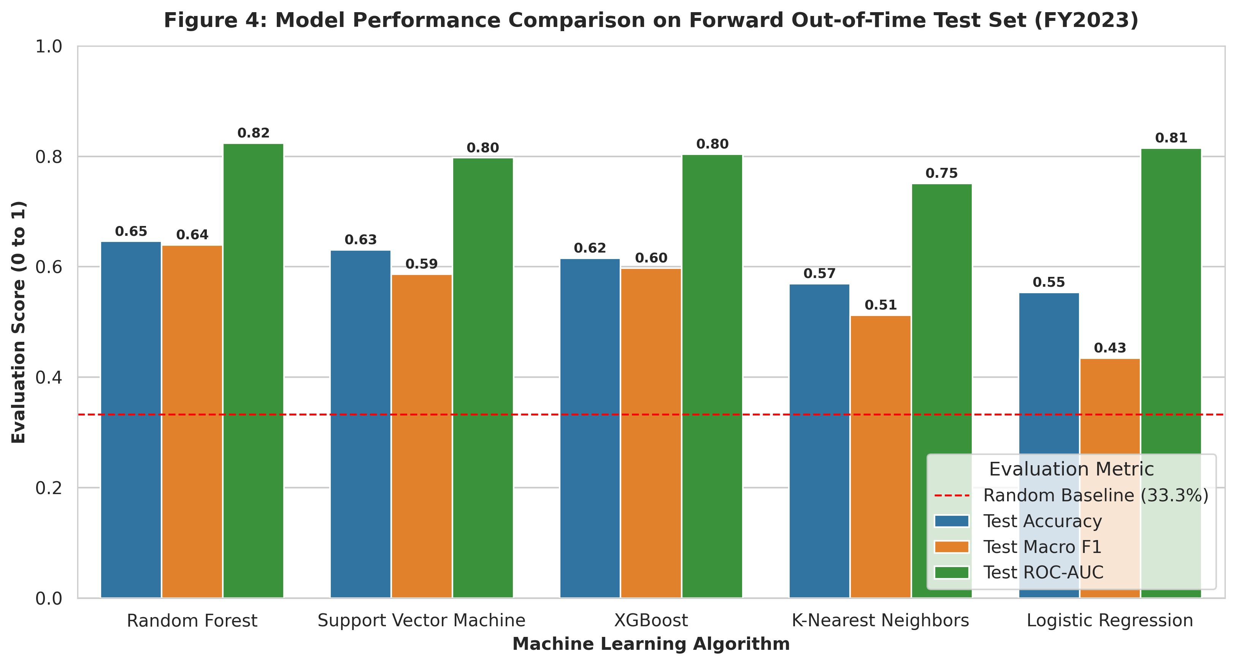
DELIVERABLE 2 — MODULE 2
Module 2: Supervised Machine Learning Benchmark
Experimental Rigor & Protocol
• Classification Problem: Predict corporate intensity tier (`Low`, `Moderate`, `High`).
• Zero Target Leakage: Raw intensity and sector medians are strictly excluded from predictors.
• Temporal Split: Trained on FY2019–FY2022 (248 rows), evaluated on FY2023 (65 rows).
• Random Guess Baseline: 33.3% accuracy.
•
• Benchmark Results (FY2023 Forward Horizon):
• 1. Random Forest: 64.6% Accuracy | 0.640 Macro F1 | 0.824 ROC-AUC
• 2. SVM (RBF): 63.1% Accuracy | 0.587 Macro F1 | 0.797 ROC-AUC
• 3. XGBoost: 61.5% Accuracy | 0.598 Macro F1 | 0.804 ROC-AUC
• 4. KNN (k=5): 56.9% Accuracy | 0.512 Macro F1 | 0.751 ROC-AUC
• 5. Logistic Reg.: 55.4% Accuracy | 0.435 Macro F1 | 0.815 ROC-AUC

Slide 9
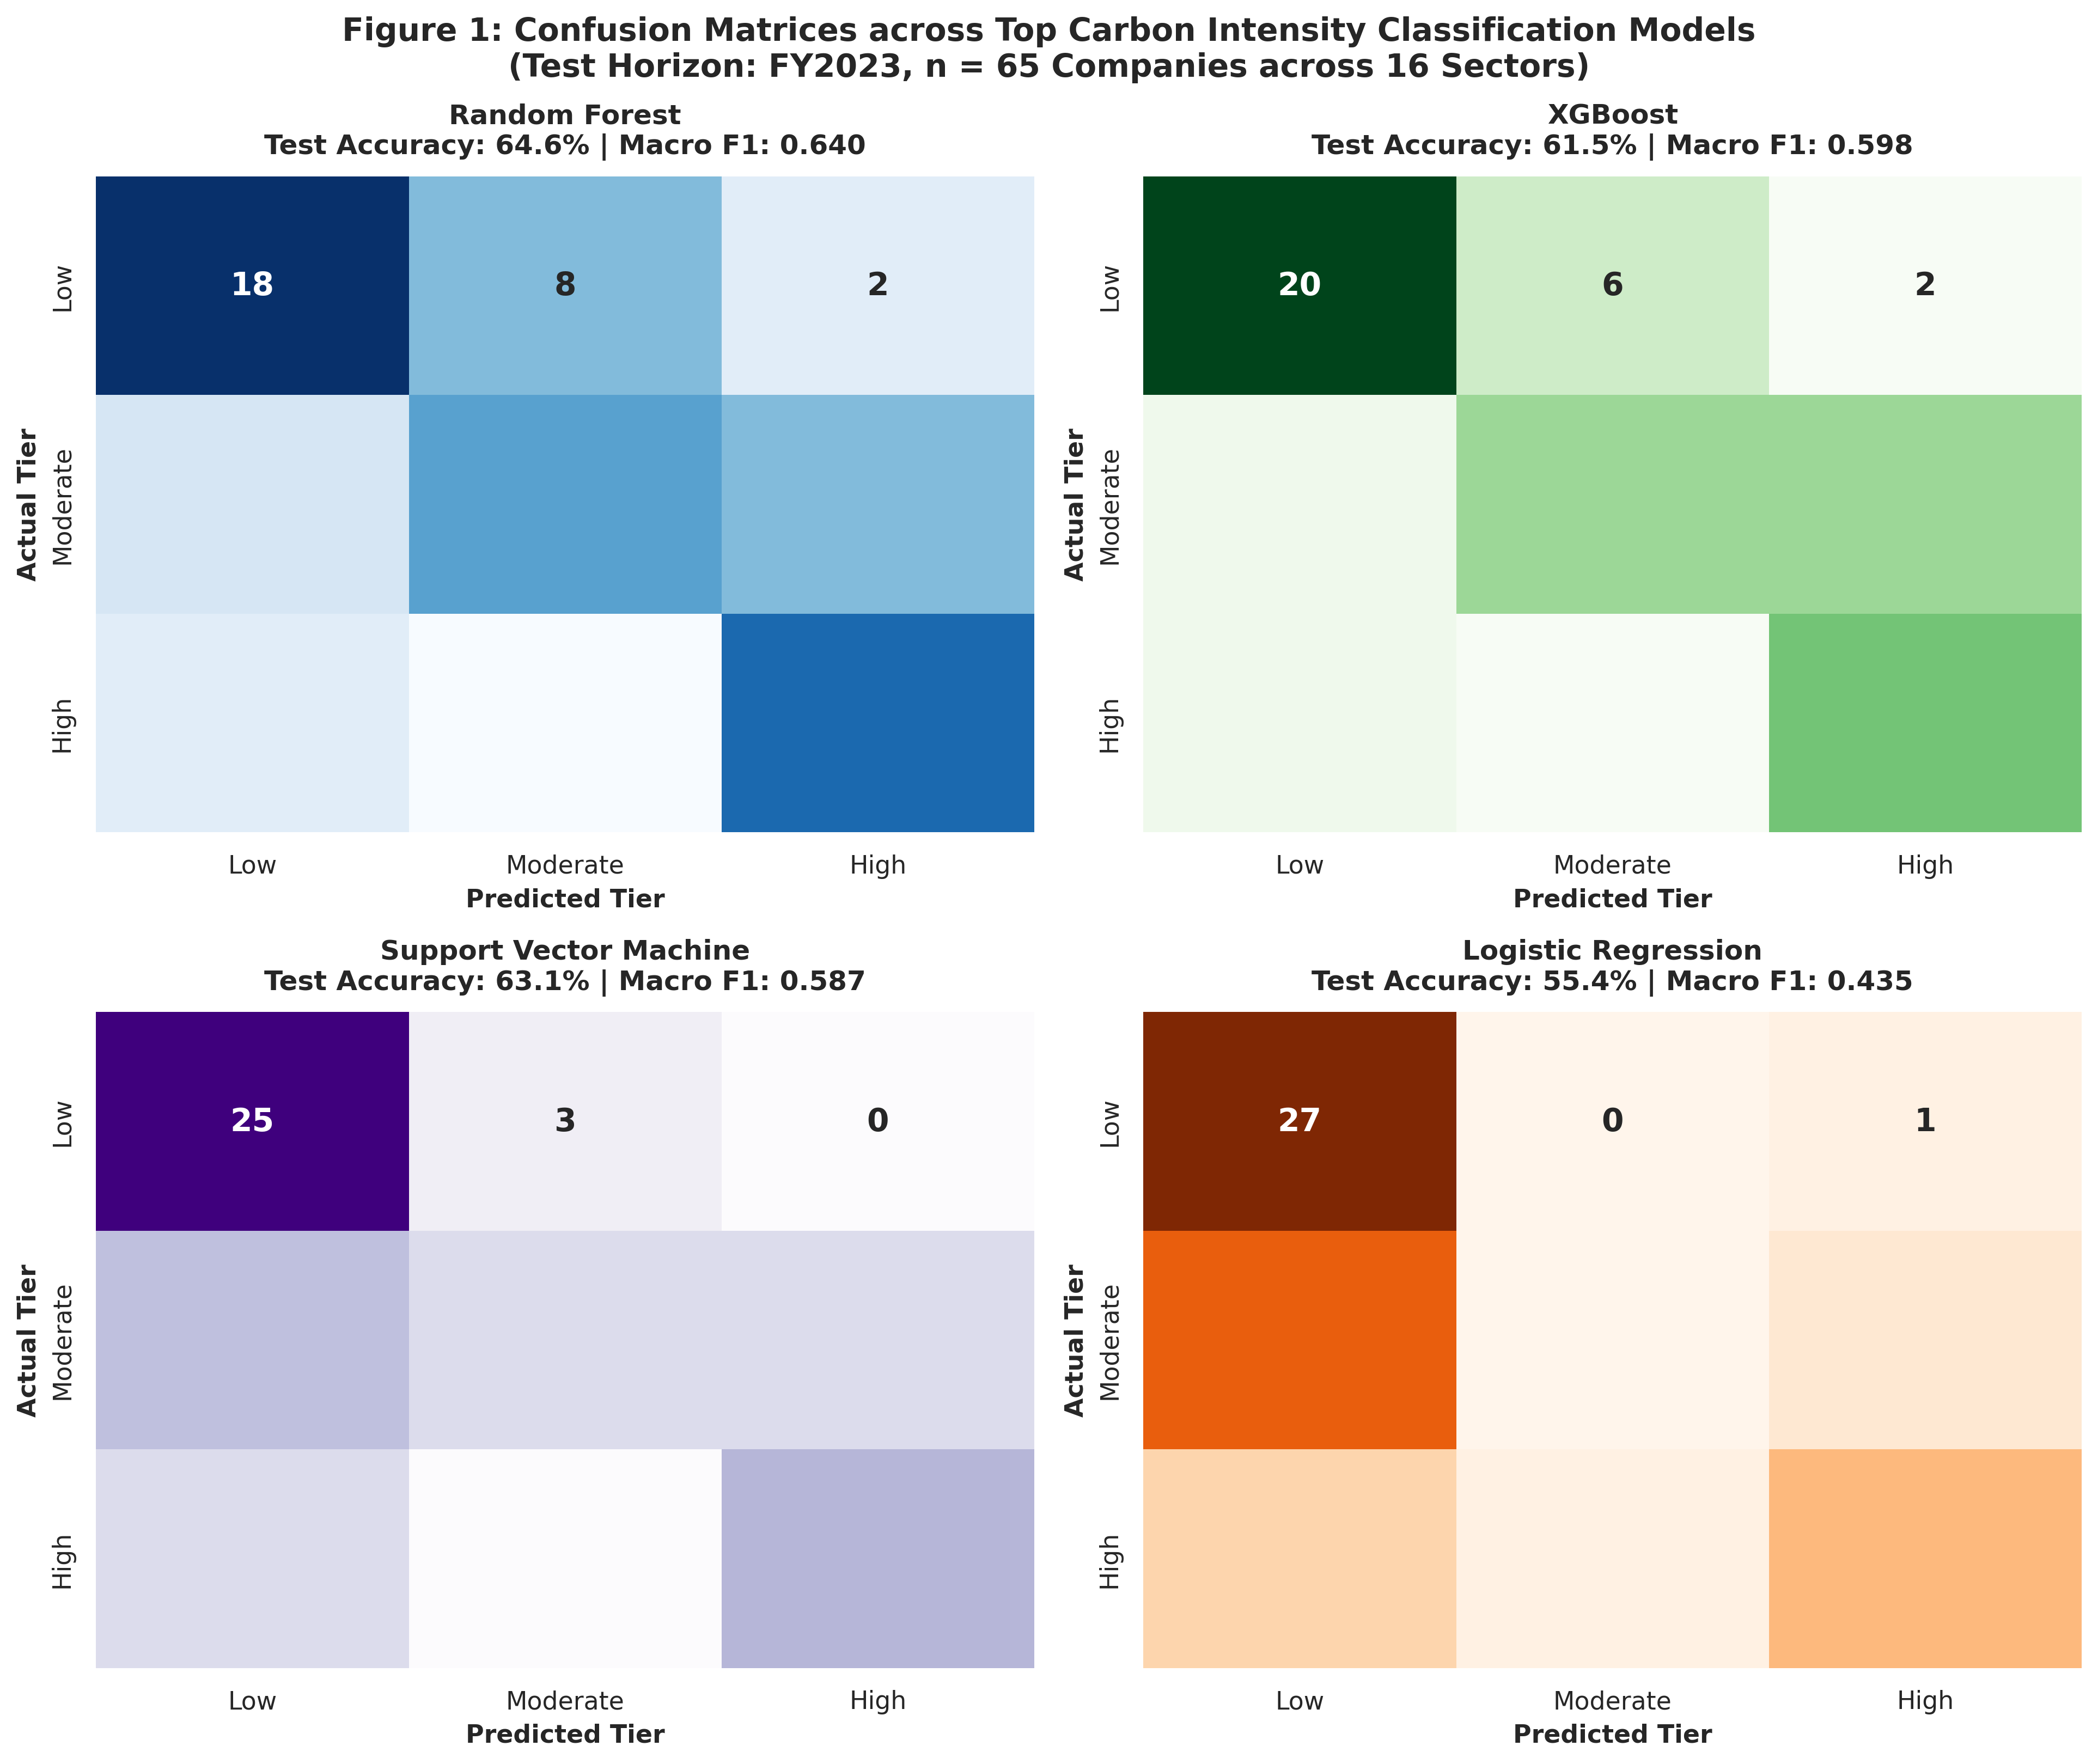
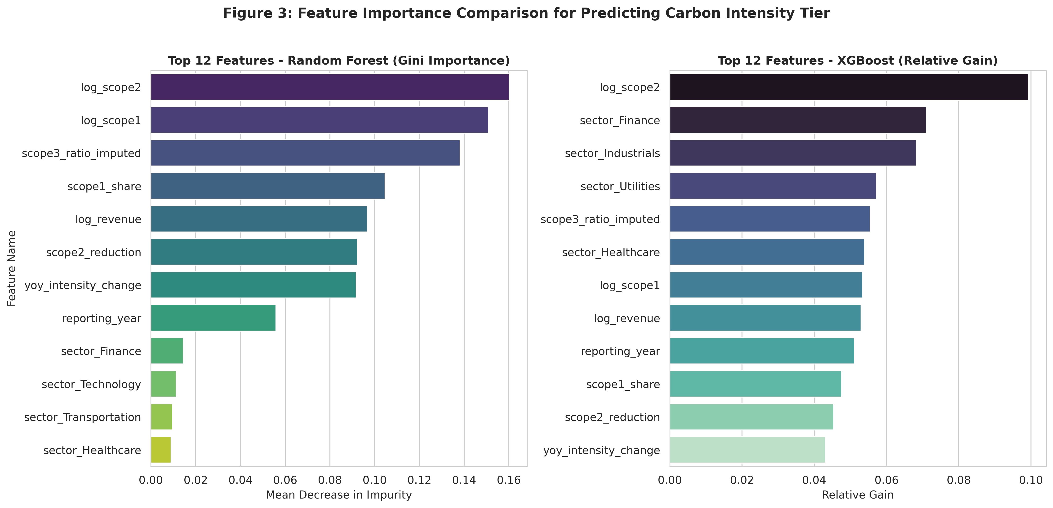
DELIVERABLE 2 — MODULE 2
Module 2: Diagnostics, ROC Curves & Feature Importance
Model Interpretability & Feature Attribution Insights
• Confusion Analysis: Tree ensembles cleanly separate Low from High tiers; errors occur predominantly at adjacent Moderate boundaries.
• Primary Predictive Drivers: `log_scope1` and `log_revenue` drive the majority of tree splits, proving scale and combustion dictate tiering.
• Secondary Signals: `scope1_share` and `scope3_ratio` serve as key intra-sector discriminators between moderate and high intensity peers.

Slide 10
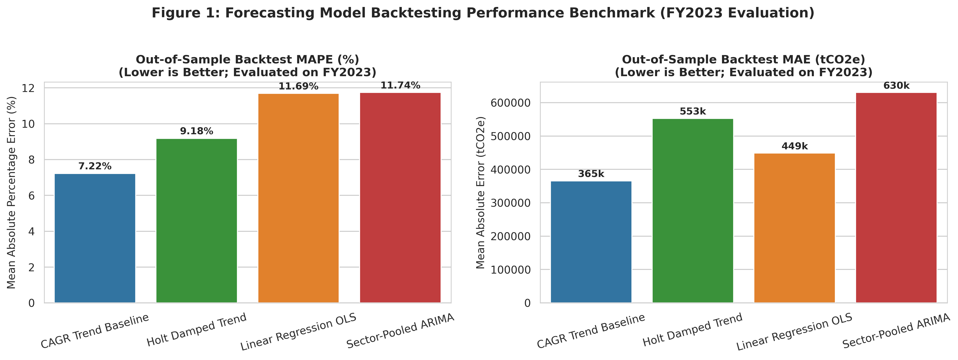
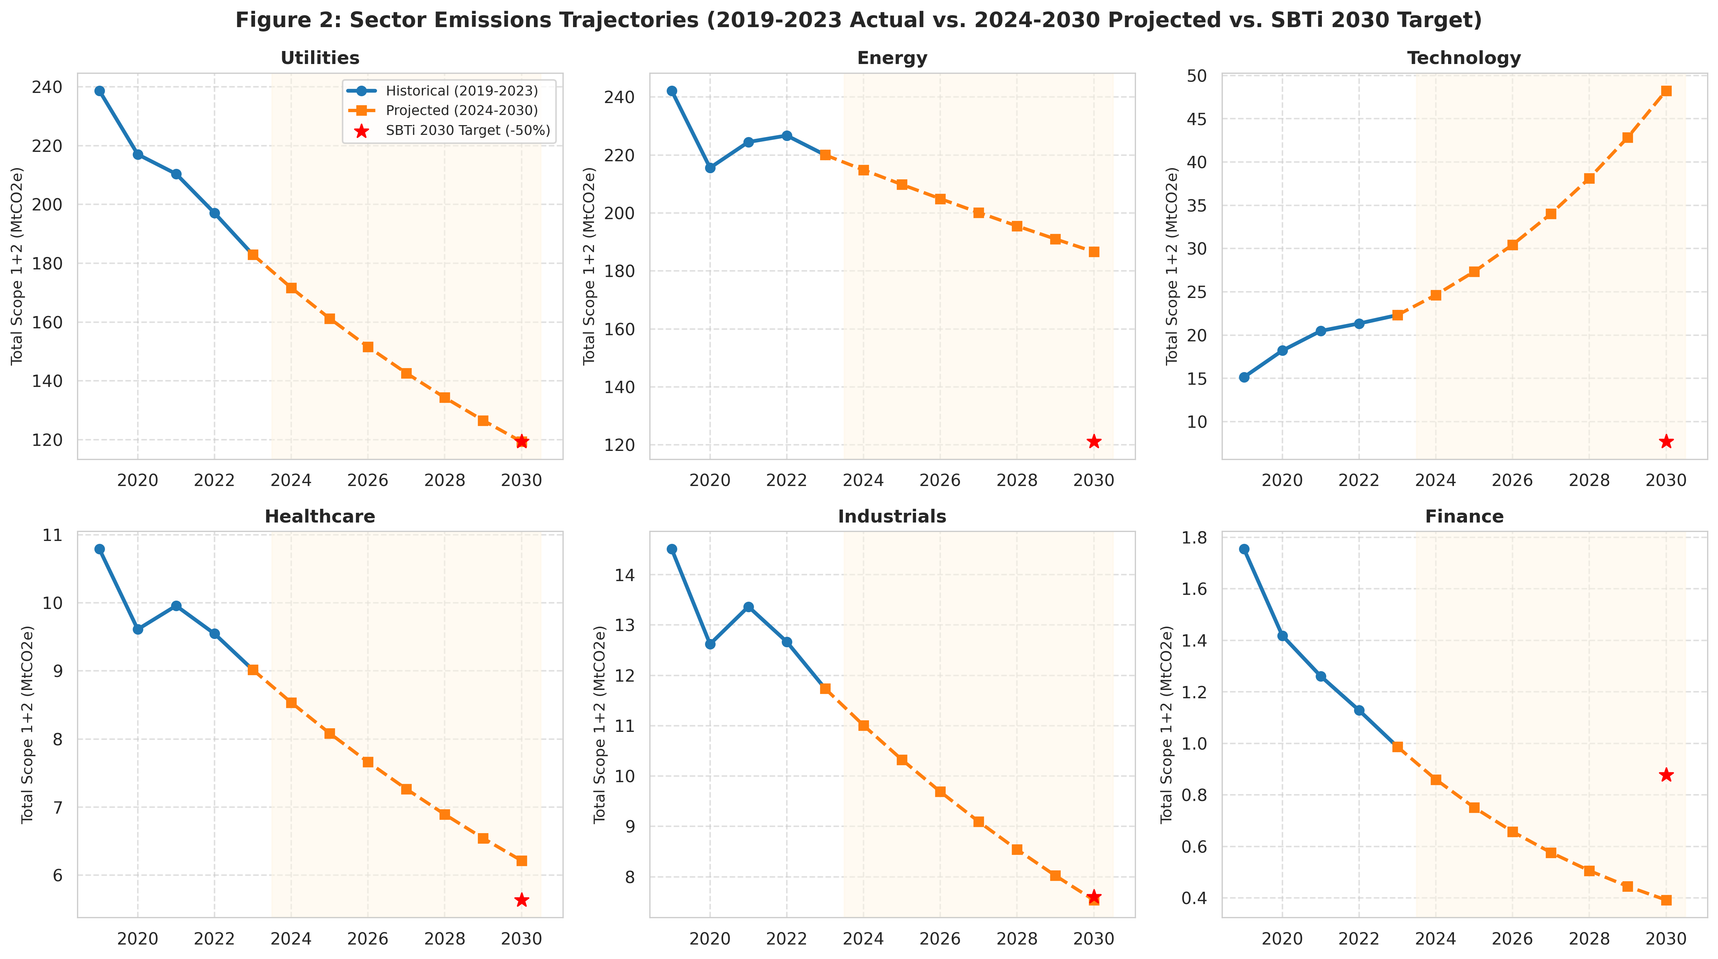
DELIVERABLE 2 — MODULE 3
Module 3: Emissions Trend Forecasting (2024–2030)
Out-of-Sample Forecasting Backtest (FY2023 Ground Truth)
• Model Selection: Bounded CAGR Baseline achieved lowest error (**7.22% MAPE**, MAE = 365k tCO2e), beating Holt Damped Trend (9.18%).
• Forward Projection: Generated Scope 1+2 emissions for 65 corporations across 7 forward years (2024–2030, 455 company-years).
• Trajectory Decoupling: Utilities show steady decarbonization via coal retirements, while Tech emissions accelerate upward.

Slide 11
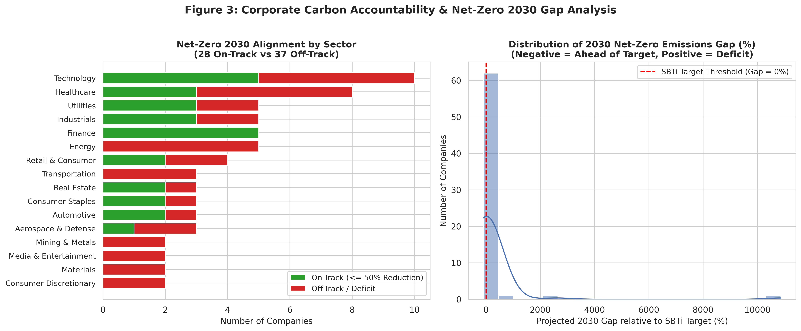
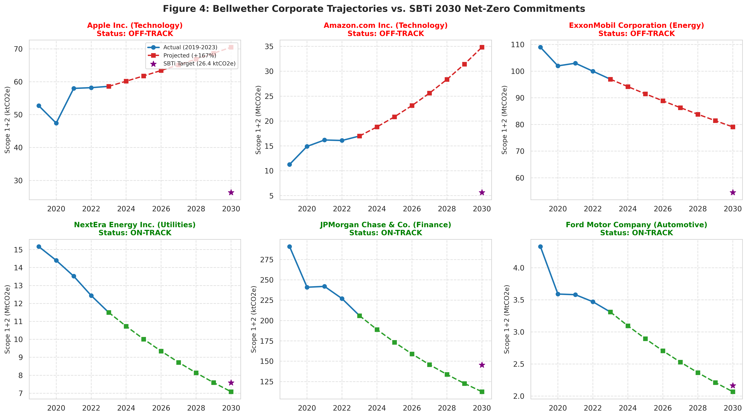
DELIVERABLE 2 — MODULE 3
Module 3: Net-Zero 2030 Target Alignment & Gap Analysis
SBTi 1.5°C 50% Reduction Commitment: On-Track vs Off-Track Reality
• Global Status: Only **43.1% (28/65) On-Track**; **56.9% (37/65) Off-Track / Facing Deficit** under current operational momentum.
• Sector Polarization: Finance is 100% On-Track, whereas Energy, Mining, and Transportation are 0% On-Track.
• Bellwether Tracking: Apple & NextEra Energy are on track for aggressive cuts; Amazon & Exxon face massive multi-megaton deficits.

Slide 12
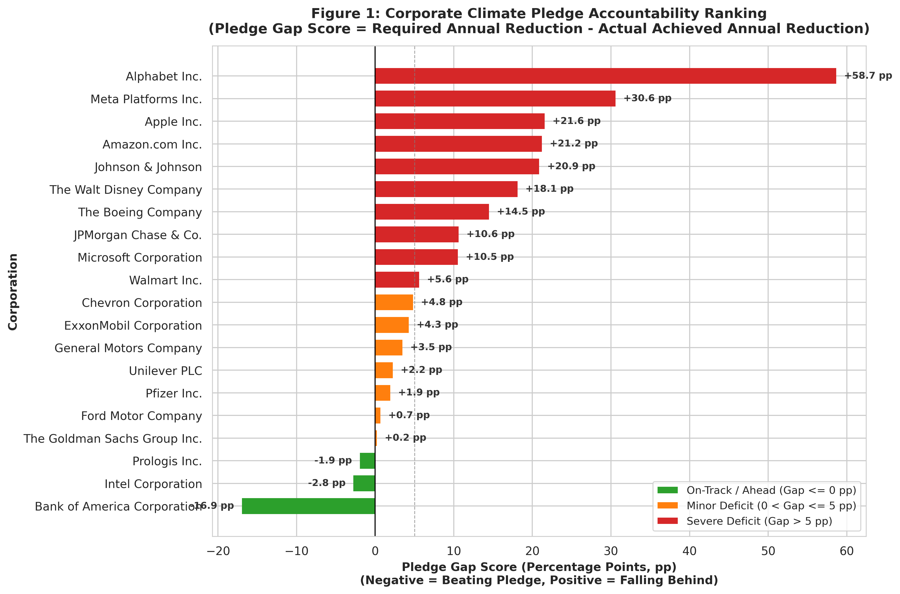
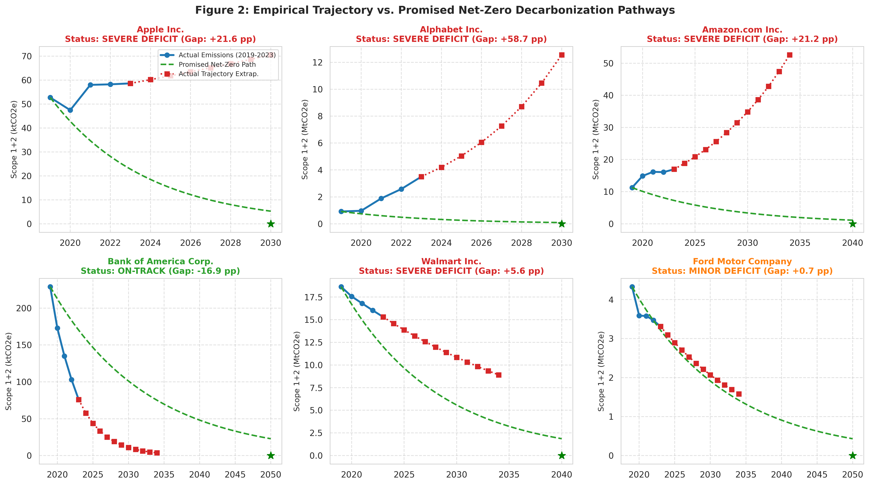
DELIVERABLE 2 — MODULE 4
Module 4: Corporate Climate Pledge vs. Actual Reality
Empirical Auditing of 20 Voluntary Corporate Climate Targets
• Accountability Tiers: Only **15% (3/20) On-Track** (Bank of America, Prologis, Intel); **50% (10/20) in Severe Deficit**.
• Implied Decarbonization Rate: A 2030 Net-Zero pledge requires a staggering 18.9%–20.6% annual compound cut in operational emissions.
• Reality Gap: Google, Amazon, and Meta show annual emissions *expansion*, creating widening deficits between promises and reality.

Slide 13
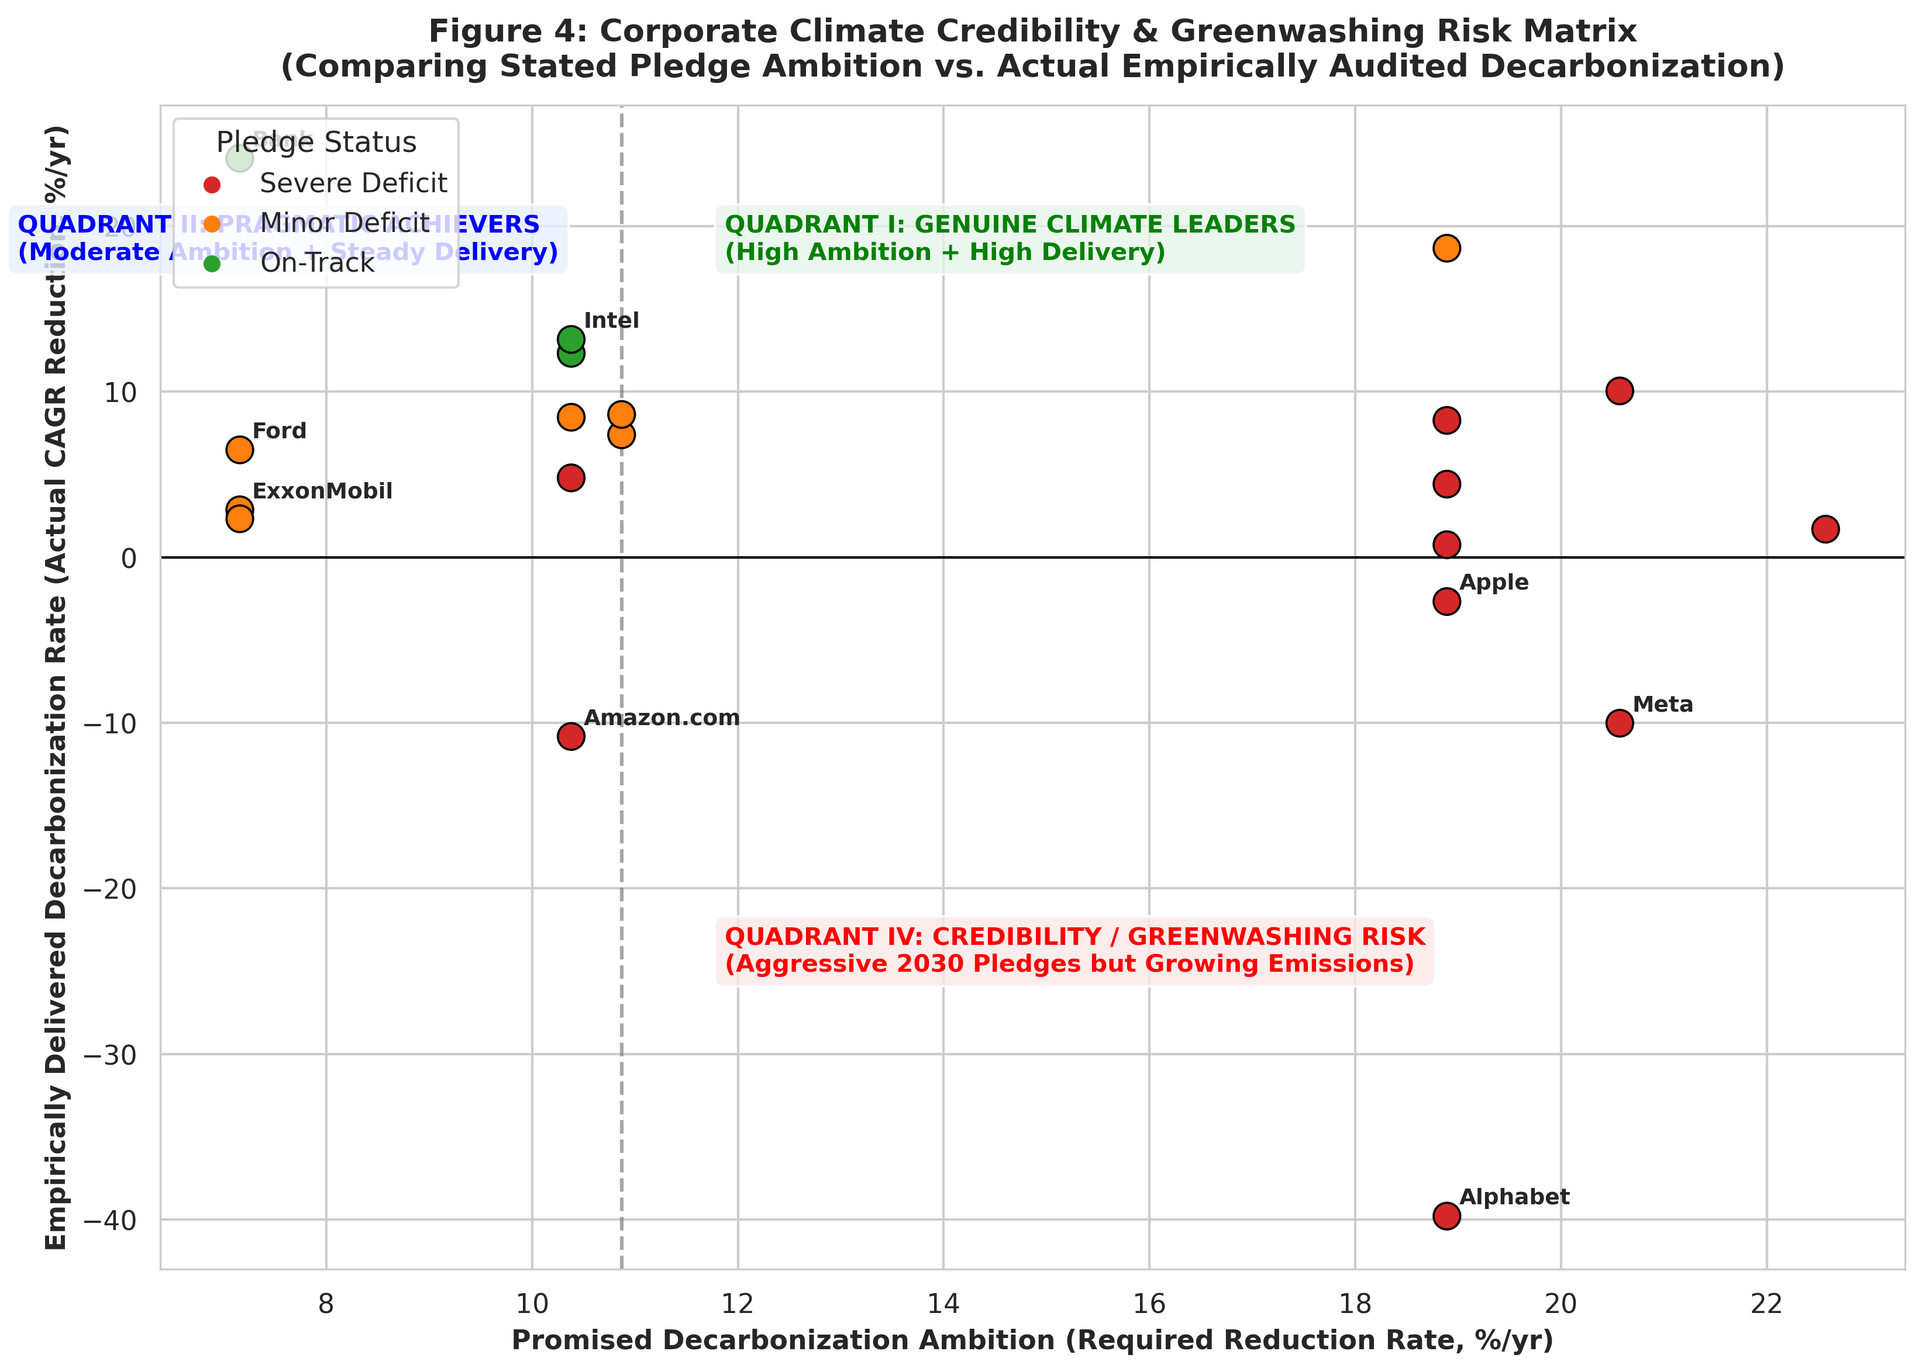
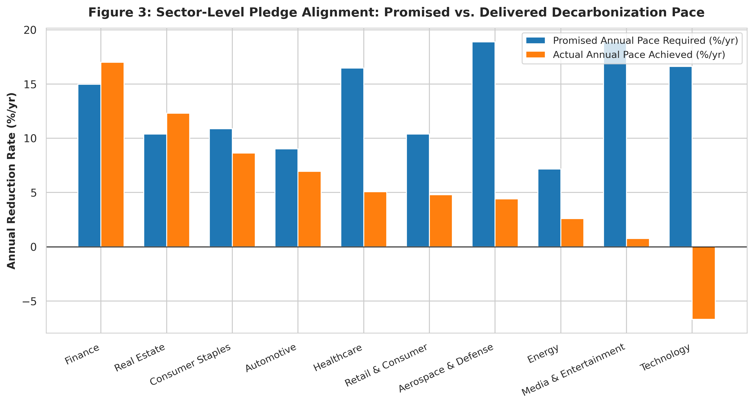
DELIVERABLE 2 — MODULE 4
Module 4: The Big Tech Paradox & Greenwashing Risk Matrix
Strategic Quadrant Analysis: Climate Credibility vs. Greenwashing
• Quadrant I (Genuine Leaders): High ambition paired with high execution (Bank of America, Prologis, Intel, Meta ops).
• Quadrant IV (Credibility / Greenwashing Risk): Alphabet (+39.8%/yr growth), Amazon (+10.8%/yr), Apple (+2.7%/yr) pledge 2030 net-zero but face surging data center load.
• Pragmatic Long-Horizon Firms: Ford, GM, and ExxonMobil set 2050 dates, requiring modest annual cuts (7%–10%/yr) yielding lower gap scores.

Slide 14
LIVE APPLICATION SHOWCASE
Interactive Streamlit Carbon Intelligence Dashboard
1. Executive Overview Tab
• KPI Banner: Total emissions tracked (2.5B+ tCO2e), average intensity (87.4 tCO2e/$M), sector breakdown.
• Interactive sector distribution boxplots with log-scale toggling.
• Top 10 highest & lowest carbon intensity corporate leaderboards.
2. Corporate Deep-Dive Tab
• Single-company selector across all 65 corporations.
• Historical multi-scope stacked area charts (Scope 1, Scope 2 Market, Scope 3).
• Decarbonization progress tracker vs FY2019 baseline.
• Data provenance cards linking directly to SEC 10-K filings.
3. Forecasting & Pledge Tab
• Dynamic 2024–2030 scenario projections.
• Real-time SBTi 50% target threshold comparison.
• Pledge gap deficit calculator showing on-track status, absolute metric tonnes gap, and greenwashing risk quadrant.

Slide 15
CONCLUSIONS & TAKEAWAYS
Final Project Outcomes, Academic Conclusions & Next Steps
Key Project Milestones Achieved
• 1. Audited Big Data Foundation: Built an uncompromised 65-company, 16-sector dataset with 100% provenance and 0 synthetic data.
• 2. Robust ML Classification: Solved multi-class intensity classification with 64.6% accuracy and 0.824 ROC-AUC using Random Forest on out-of-time test data.
• 3. Empirical Forecasting: Projected emissions through 2030 with 7.22% backtest MAPE, revealing that 56.9% of corporations are off-track for Paris targets.
• 4. Public Accountability: Demonstrated that Big Tech voluntary 2030 net-zero pledges conflict directly with AI data center electricity demand growth.
• 5. Production Pipeline: Completely containerized in 4 Jupyter notebooks, 18 publication-quality figures, and 7 clean CSV artifacts.
Academic & Practical Implications
• For Investors & ESG Funds: Provides an empirical, data-driven framework to separate genuine decarbonizers from greenwashing marketing.
• For Regulators (SEC / EU CSRD): Demonstrates the critical necessity of mandatory audited Scope 1, 2, and 3 reporting standards.
• Future Enhancements:
• - Automated SEC EDGAR XBRL scrapers for continuous real-time annual updates.
• - Scope 3 Category 1–15 granular supply chain decomposition.
• - Integration of satellite remote sensing data (e.g. MethaneSAT) for methane plume verification in energy assets.

