Slide 1

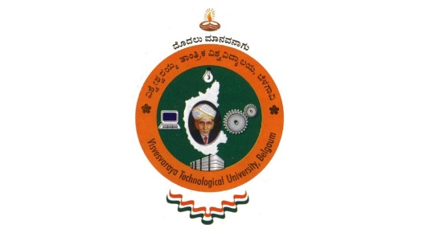
B.N.M. Institute of Technology
An Autonomous Institution under VTU
Approved by AICTE, Accredited as Grade A Institution by NAAC till 31.12.2026.
All Eligible UG branches – CSE, ECE, EEE, ISE & Mech. Engg. Accredited by NBA till 30.06.2025
Post box no. 7087, 27th cross, 12th Main, Banashankari 2nd Stage, Bengaluru- 560070, INDIA
Ph: 91-80- 26711780/81/82 Email: principal@bnmit.in, www.bnmit.org
Internship II Seminar (22ECE158)
AUTOMATIC BOTTLE FILLING
Thanushree Anand
1BG22EC112
Under the guidance of
Dr Rashmi Bhaskar
Assistant Professor
Dept. of ECE, BNMIT

Slide 2
PROBLEM STATEMENT
Design an automatic bottle filling and labeling system using an Omron CP1E PLC .
Dept. of ECE 2024-25

Slide 3
Introduction
Automation is crucial in modern industries to enhance efficiency and consistency.
Automatic bottle filling systems are essential in industries such as food and beverage, pharmaceuticals, and chemicals.
The purpose of this project is to develop a reliable and efficient bottle filling system that reduces manual intervention and improves production efficiency.
Dept. of ECE 2024-25

Slide 4
Objective and Scope
To design an automated bottle filling system that using an Omron PLC.
To improve filling accuracy and production efficiency.
To reduce the need for manual operation.
Dept. of ECE 2024-25

Slide 5
Description of project work
Software Requirements
CX-Programmer: Omron's software used for PLC programming.
Dept. of ECE 2024-25

Slide 6
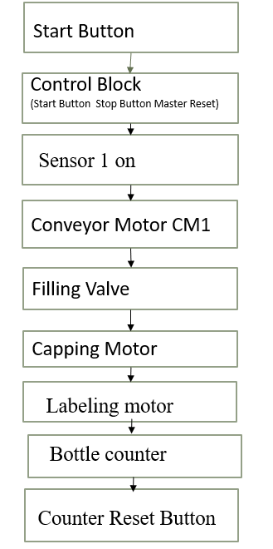
BLOCK DIAGRAM
Dept. of ECE 2024-25

Slide 7
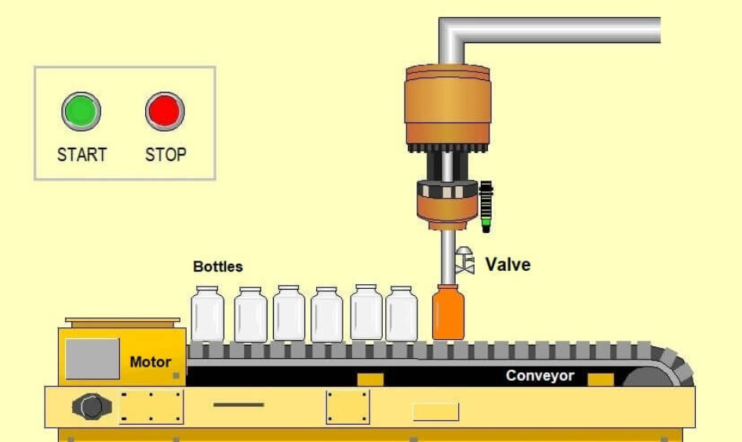
Methodology
Dept. of ECE 2024-25

Slide 8
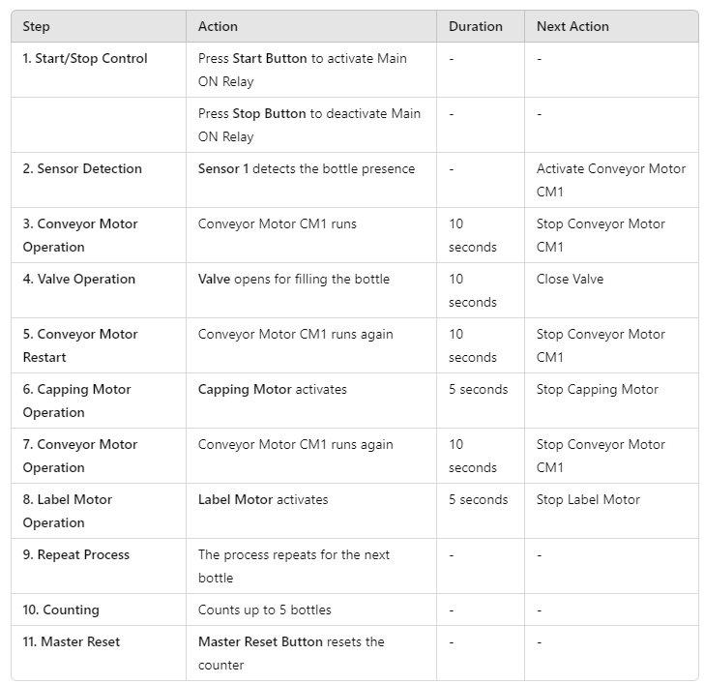
System Process and Control Table
Dept. of ECE 2024-25

Slide 9
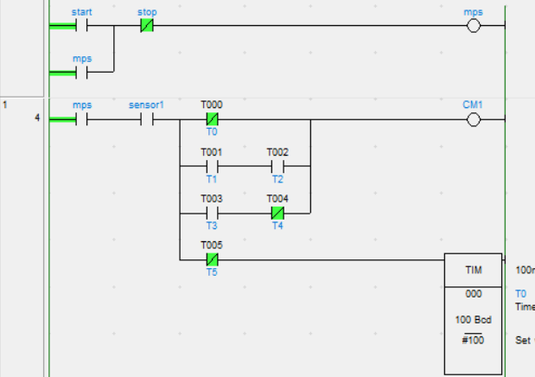
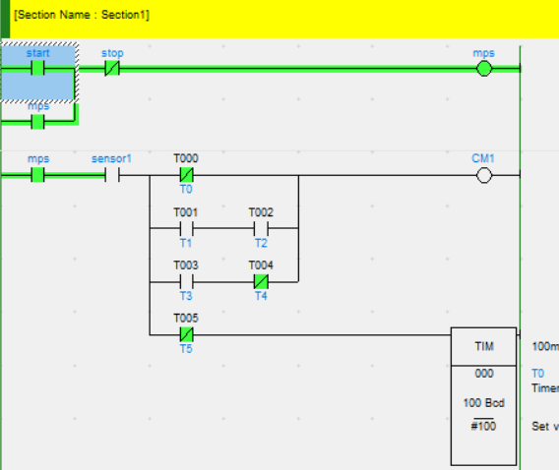
Results
Start stop control
Dept. of ECE 2024-25

Slide 10
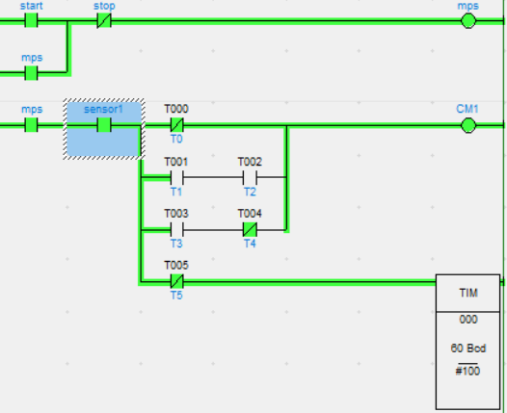
Sensor detection
Dept. of ECE 2024-25

Slide 11
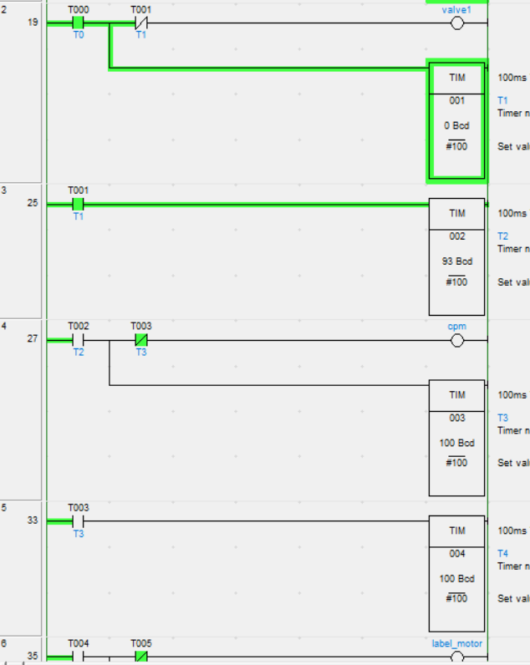
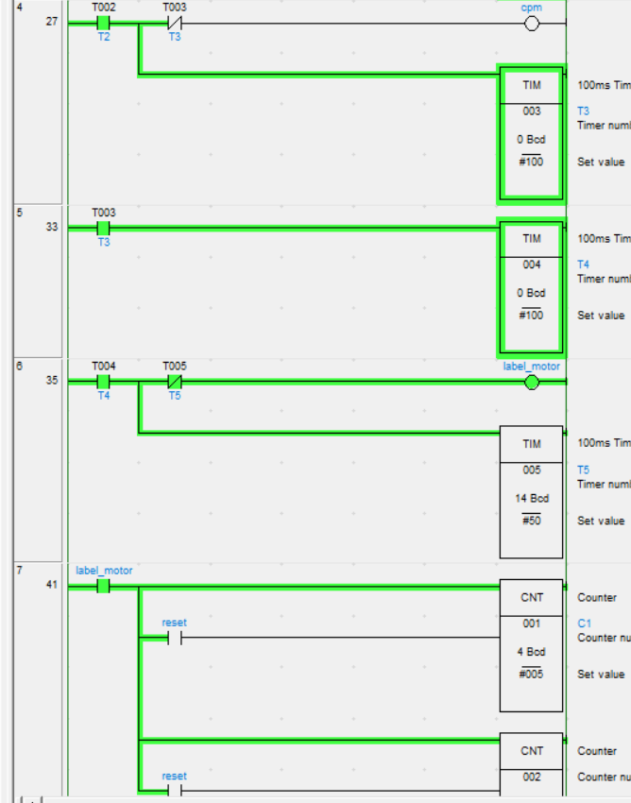
Conveyor motor operation and label motor operation

Slide 12
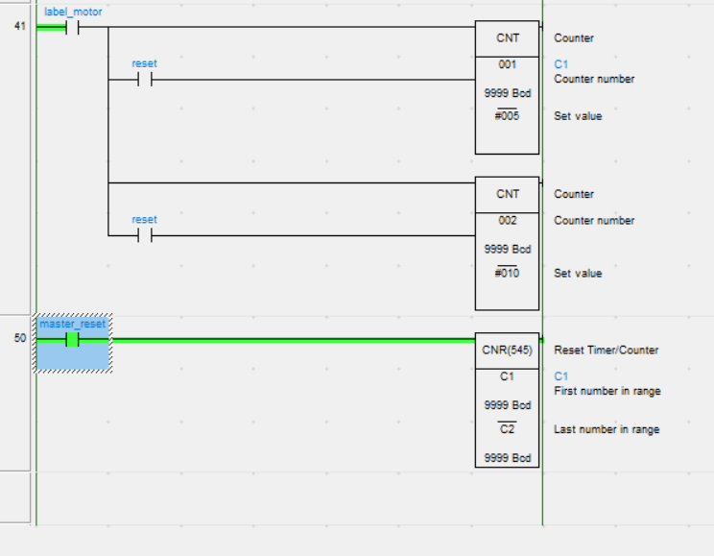
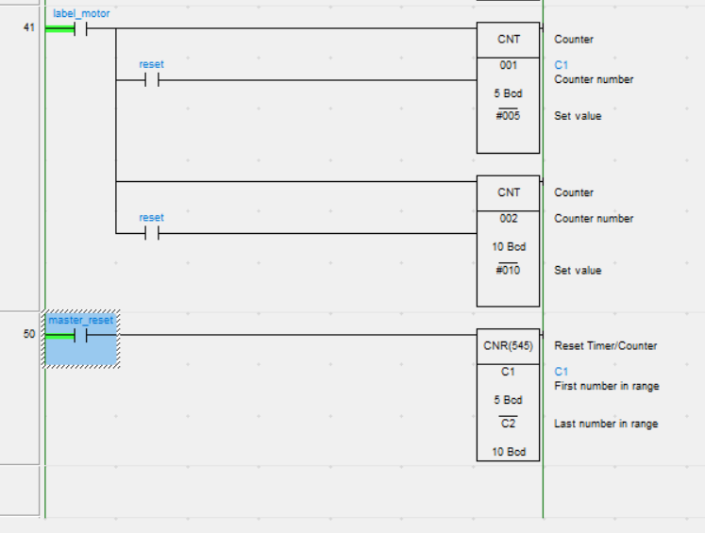
Master resetting
Dept. of ECE 2024-25

Slide 13
Conclusion
Integrating automation into the bottle filling system significantly enhanced both accuracy and efficiency, demonstrating the pivotal role of automation in modern industrial processes. This project achieved two main outcomes: it provided a practical solution for streamlined and efficient bottle filling, and it showcased the capabilities of Omron PLCs in advancing industrial automation. Overall, the project not only met its primary objectives but also offered valuable hands-on experience in PLC programming and system design, underscoring the effectiveness of automation in optimizing production workflows.
Dept. of ECE 2024-25

Slide 14
Future Enhancement
Real-time logging and performance optimization.
Upgrade models and enable remote monitoring.
Connect with packaging systems and IoT.
Enhance energy efficiency and reduce waste.

Slide 15
Thank you

