Slide 1

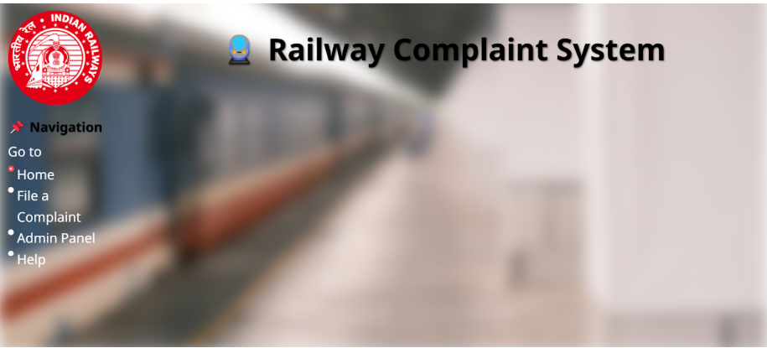
Voice to text and bucketing of complaints into correct type/sub types through AI for Indian Railways
Presented By- Vismaya MP, Thanushree NH, Manjushree MR, Sania Naveed, Mohit Varma M, Phalguna S

Slide 2
Problem Statement
Railway stations face issues: uncleanliness, faulty infrastructure, staff behavior
Current systems: Manual complaint filing is time-consuming
Limited language support excludes diverse users Irrelevant complaints overload authorities
Goal: Simplify complaint process, ensure authenticity, and improve resolution efficiency

Slide 3

Agenda
Problem Statement
- Overall Solution Diagram
- Approach & Innovations
- Technical Stack
- LLM Integration & Challenges
- Individual Contributions
- Impact of the Solution
- Future Outlook

Slide 4
Simplified Solution Diagram
USER ACCESS WEBSITE
STREAMLIT
COMPLAINT CATEGORIZATION
GOOGLE GEMINI LLM-NLP
PHONE NUMBER AND PNR NUMBER
ADMIN PANEL
REVIEW AND PROCESS COMPLAINT
INPUT COMPLAINT
(RECORD/UPLOAD AUDIO/TEXT)
STORE COMPLAINT IN DATABSE
SQLite
SPEECH-TO-TEXT PROCESSING
IF VOICE INPUT
NOTIFY AUTHORITY BY EMAIL
GOOGLE GEMINI LLM
COMPLAINT RESOLVED AND UPDATED IN DATABASE

Slide 5
Approach & Implementation
Analyzed requirements: voice input, multi-language support
Designed architecture: Streamlit frontend, Python backend
Integrated AI: Speech-to-Text & categorization
Innovations:
Voice complaint submission
AI-driven categorization
PNR validation for authenticity

Slide 6
Technical Stack
Languages: Python, HTML (UI styling)
Frameworks/Libraries:Streamlit(UI), SpeechRecognition, Google Generative AI , Smtplib (email), SQLite3 (database)
APIs: Google Gemini API, SMTP
Hardware/Cloud: Local system, SQLite database

Slide 7

LLM was used and frameworks
Railway complaint system uses Google Gemini for speech-to-text processing and possibly for complaint categorization.
5 Steps of frameworks
Problem Identification – Identifying the need for an automated railway complaint system.
Data Collection & Preprocessing – Collecting and processing voice/text complaints.
Model Selection & Development – Using Google Gemini for speech-to-text and complaint categorization.
Implementation & Integration – Integrating LLM, database (SQLite), and for notifications.
Testing & Optimization – Debugging, refining complaint classification, and ensuring smooth system workflow.

Slide 8
Challenges faced
These are the difficulties your team encountered while building the project. Some possible challenges include:
Speech recognition accuracy – Issues with different accents, background noise, or misinterpretation of words.
Categorization accuracy – Ensuring complaints are classified into correct categories & subcategories.
Database management – Handling large complaint data efficiently in MySQL/SQLite.
Integration issues – while Connecting , email automation, and database correctly.
User interface & experience – Making sure the system is easy to use for both users and admins.

Slide 9
Individual Contributions
Vismaya: SQLite database, language processing, categorization
Thanushree NH: Email system, multi-category handling
Sania & Manjushree: Report writing & formatting
Mohit & Phalguna: PPT design & content structuring

Slide 10
Impact of the Solution Proposed
Faster & More Efficient Complaint Handling
Automated speech-to-text for quick complaint registration
Categorization & subcategorization ensures complaints reach the right department
2. Improved Accessibility & User Experience
Multilingual support for diverse passengers
Voice-based complaint filing for easy access
3. Centralized & Organized Complaint Management
Database integration (SQLite) for structured storage
Admin panel for tracking & resolving complaints efficiently
4. Real-time Updates & Notifications
Automated email forwarding to relevant authorities
5.Scalability & Future Enhancements
Can handle thousands of complaints daily
Future AI enhancements for better categorization & sentiment analysis
6. Reduction in Manual Work & Costs
Automated processing reduces manual workload
Helps railway authorities focus on resolutions
7. Data-Driven Decision Making
Identifies common complaint trends for service improvements
Helps in infrastructure planning based on real data

Slide 11
Future Outlook
1. AI-Powered Complaint Resolution
Implement AI chatbots to provide instant responses for common complaints.
Use Natural Language Processing (NLP) to suggest solutions before forwarding to admins.
2. Predictive Analytics for Issue Prevention
Analyze complaint trends to identify recurring problems.
Use Machine Learning to predict & prevent issues (e.g., frequent train delays, station maintenance).
3. Mobile App Integration
Develop a dedicated mobile app for easier complaint registration.
Enable push notifications for real-time updates on complaint status.
4. Integration with Railway Systems
Connect with railway databases to fetch real-time train status and PNR verification.
Enable auto-filing of complaints for delays, cleanliness, or safety issues detected by railway staff.

Slide 12
5. Multi-Channel Support
Extend support to WhatsApp, Telegram & IVR (Interactive Voice Response) for complaint filing.
Allow users to file complaints via social media integration (Twitter/X & Facebook).
6. Sentiment Analysis for Urgency Detection
Use AI to detect urgency in complaints based on tone & keywords.
Prioritize high-severity issues (e.g., security threats, medical emergencies).
7. Blockchain for Transparency & Security
Implement blockchain-based complaint tracking for secure and tamper-proof records.

Slide 13
Demo link
https://drive.google.com/drive/folders/1MAYDAIQLHCv9H5JOiPobE0sAAai7B9eb?usp=drive_link
Repository link:-
Vismaya - https://github.com/Vismaya251/railway_complaint_AI.git
Thanushree NH-https://github.com/Vismaya251/railway_complaint_AI.git
Sania - https://github.com/sanianaveed700/railway-complaints-.git
Manjushree - https://github.com/Manjushree2006/railway_complanits-123
Mohit - https://github.com/MOHIT11118888/Railwaycomplaint.git
Phalguna - https://github.com/SPhalguna17/railwaycomplaint.git

Slide 14
THANK YOU!!!

