Slide 1

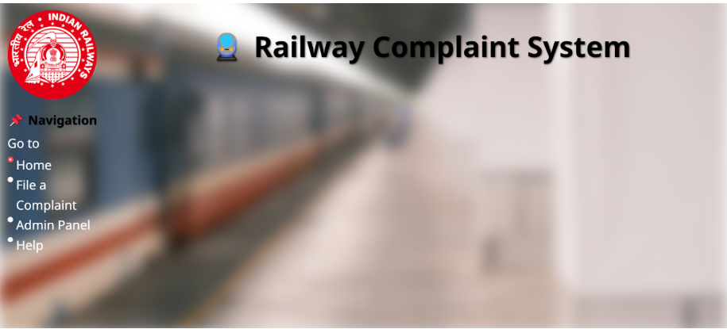
Voice to text and bucketing of complaints into correct type/sub types through AI for Indian Railways
Presented By- Vismaya MP, Thanushree NH, Manjushree MR, Sania Naveed, Mohit Varma M, Phalguna S

Slide 2
Problem Statement
Railway stations face issues: uncleanliness, faulty infrastructure, staff behavior
Current systems: Manual complaint filing is time-consuming
Limited language support excludes diverse users Irrelevant complaints overload authorities
Goal: Simplify complaint process, ensure authenticity, and improve resolution efficiency

Slide 3

Agenda
Problem Statement
- Overall Solution Diagram
- Approach & Innovations
- Technical Stack
- LLM Integration & Challenges
- Individual Contributions
- Impact of the Solution
- Future Outlook

Slide 4
Simplified Solution Diagram
USER ACCESS WEBSITE
STREAMLIT
COMPLAINT CATEGORIZATION
GOOGLE GEMINI LLM-NLP
PHONE NUMBER AND PNR NUMBER
ADMIN PANEL
REVIEW AND PROCESS COMPLAINT
INPUT COMPLAINT
(RECORD/UPLOAD AUDIO/TEXT)
STORE COMPLAINT IN DATABSE
SQLite
SPEECH-TO-TEXT PROCESSING
IF VOICE INPUT
NOTIFY AUTHORITY BY EMAIL
GOOGLE GEMINI LLM
COMPLAINT RESOLVED AND UPDATED IN DATABASE

Slide 5
Approach & Implementation
Analyzed requirements:
voice input, multi-language support
Designed architecture:
Streamlit frontend, Python backend
Integrated AI:
Speech-to-Text & categorization
Innovations:
Voice complaint submission
AI-driven categorization
PNR validation for authenticity

Slide 6

Technical Stack
Languages:
Python, HTML (UI styling)
Frameworks/Libraries:
Streamlit(UI), SpeechRecognition, Google Generative AI , Smtplib (email), SQLite3 (database)
APIs:
Google Gemini API, SMTP
Database:
SQLite database

Slide 7

LLM was used and frameworks
Railway complaint system uses Google Gemini for speech-to-text processing and possibly for complaint categorization.
5 Steps of frameworks
1. Task
Predefined Categorization
Restricted Scope
2. Context
Context Awareness.
Improved Accuracy
3. References
Categorize Complaints
Ignore Irrelevant Inputs
4. Evaluate
Accuracy Checks
Relevance Assessment
User Feedback
5. Iterate
Improve Classification Accuracy
Enhance Multi-Language Support
Optimize Processing Time & Response Quality

Slide 8

Challenges faced
Speech Recognition Accuracy
Issues with accents, background noise, and misinterpretation.
Categorization Accuracy:
Ensuring correct classification of complaints.
Database Management:
Handling large volumes of complaint data efficiently.
Integration Issues:
Problems with connecting systems, email automation, and database.
User Interface & Experience:
Ensuring ease of use for both users and admins.

Slide 9
Individual Contributions
Vismaya: SQLite database, language processing, categorization ,hands on report
Thanushree NH: Email system, multi-category handling ,hands on report
Sania & Manjushree: Report writing & formatting
Mohit & Phalguna: PPT design & content structuring

Slide 10
Impact of the Solution Proposed
Faster & More Efficient Complaint Handling
Automated speech-to-text
Categorization & subcategorization
2. Improved Accessibility & User Experience
Multilingual support
Voice-based complaint filing
3. Centralized & Organized Complaint
Management
Database integration (SQLite)
Admin panel for tracking & resolving complaints efficiently
4. Real-time Updates & Notifications
Automated email forwarding
5. Reduction in Manual Work & Costs
Automated processing reduces
Focus on Resolutions
6. Data-Driven Decision Making
Identifies common complaint trends
Helps in infrastructure planning

Slide 11
Future Outlook
1. AI-Powered Complaint Resolution
AI chatbots
Natural Language Processing (NLP)
2. Predictive Analytics for Issue Prevention
Analyze complaint trends
Machine Learning for Prediction
3. Mobile App Integration
Mobile App for Easy Registration
Push notifications

Slide 12
4. Integration with Railway Systems
Real-Time Train Status & PNR Verification
Auto-Filing of Complaints
5. Multi-Channel Support
Extend support to WhatsApp, Telegram & IVR
Social media integration
6. Sentiment Analysis for Urgency Detection
AI to detect urgency
Prioritize high-severity issues
7. Blockchain for Transparency & Security
Blockchain-Based Tracking

Slide 13
Demo link
https://drive.google.com/drive/folders/1MAYDAIQLHCv9H5JOiPobE0sAAai7B9eb?usp=drive_link
Repository link:-
Vismaya - https://github.com/Vismaya251/railway_complaint_AI.git
Thanushree NH-https://github.com/Vismaya251/railway_complaint_AI.git
Sania - https://github.com/sanianaveed700/railway-complaints-.git
Manjushree - https://github.com/Manjushree2006/railway_complanits-123
Mohit - https://github.com/MOHIT11118888/Railwaycomplaint.git
Phalguna - https://github.com/SPhalguna17/railwaycomplaint.git

Slide 14
THANK YOU!!!

