Slide 1
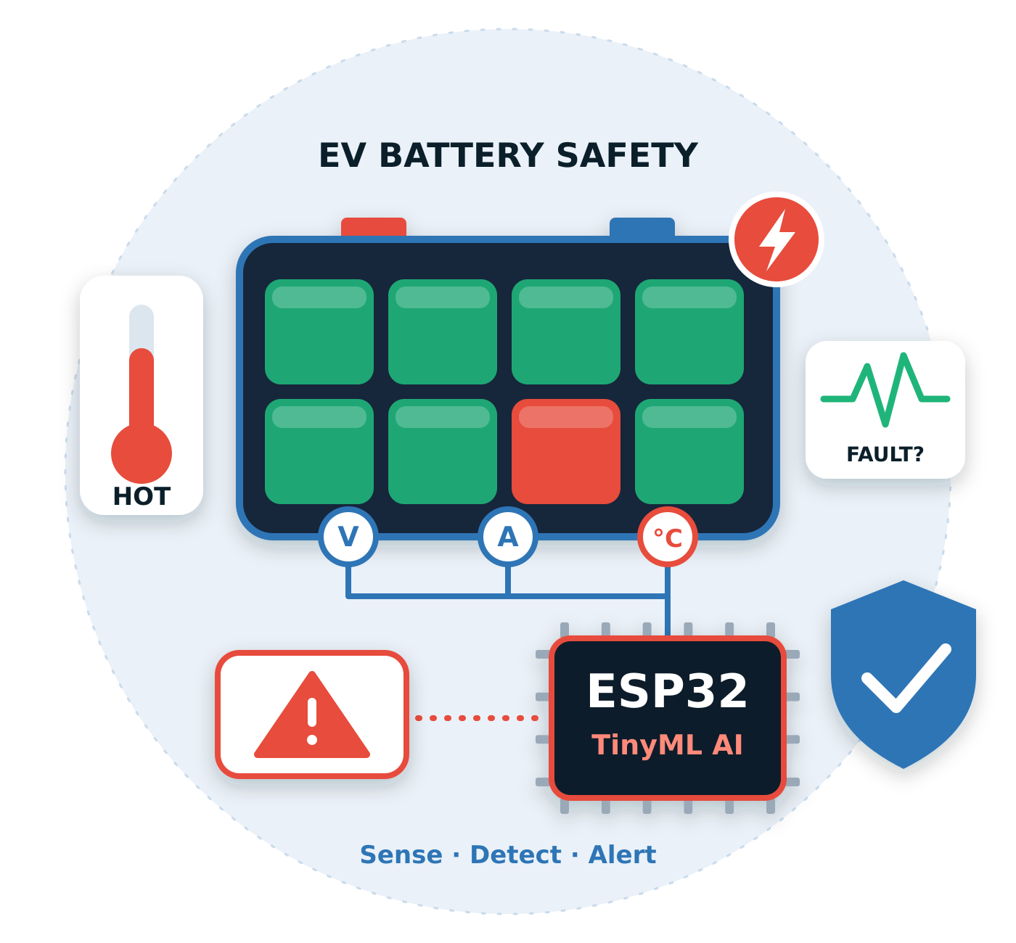
QNX Everywhere
PI-SQUARE TECH
STATE LEVEL HACKATHON
Team Name : SentineIRT
TinyML-Based Intelligent EV Battery Fault Detection and Thermal Safety Monitoring System
Real-Time Voltage, Current and Temperature Monitoring with On-Device TinyML for Safer Electric Vehicle Batteries

Slide 2
Design and Execution
Title & Team Identity
Project Name
TinyML-Based Intelligent EV Battery Fault Detection and Thermal Safety Monitoring System
Theme Selected
Automotive Safety
Team Name & City
SentineIRT
Value Proposition
An intelligent vehicle safety system that detects fire, smoke, temperature and electrical faults in real time, delivering instant GSM alerts and IoT-based monitoring for faster safety responses

Slide 3
Problem & Objective
THE PROBLEM
OUR OBJECTIVE
• Vehicle fire incidents can escalate quickly.
• Monitor temperature, smoke, flame, voltage and current.
• Detect abnormal conditions using the ESP32-based prototype.
• Delayed detection of smoke or abnormal heat can reduce response time.
• Send GSM SMS alerts and show faults on the LCD.
• Electrical abnormalities may provide early warning signs.
• Activate the cooling fan when temperature is high.
• Drivers and responders need clear, timely alerts.
• Plan a QNX real-time safety layer for future integration.
SAFETY FLOW
SENSE
DETECT
ALERT
RESPOND
EXTEND
Smoke • Flame • Temp
Abnormal condition
SMS + LCD
Cooling fan
Planned QNX layer

Slide 4
Literature Survey
1 Vehicle fire & smoke sensing
2 Multi-sensor monitoring
3 Edge intelligence / TinyML
4 Real-time safety systems
• Smoke/flame sensors support early event detection.
• Voltage and current add electrical context.
• Local inference can classify patterns near the device.
• Priority scheduling and IPC help organise safety tasks.
• Temperature sensing helps identify thermal escalation.
• Combining sensor signals can give a broader safety picture.
• Model choice and accuracy must be validated on real data.
• QNX is a planned layer in this project, not yet integrated.
RESEARCH GAP
Bring fire/smoke, thermal and electrical monitoring together with edge detection and a planned real-time safety architecture; validate the complete chain with measured tests.

Slide 5
SYSTEM ARCHITECTURE
INPUT: SENSORS
OUTPUT: ACTIONS & ALERTS
INPUT: SENSORS
OUTPUT: ACTIONS & ALERTS
PROCESSING UNIT
🔥
Flame sensor
PROCESSING UNIT
LCD
Live parameters & fault status
🔥
Flame sensor
LCD
Live parameters & fault status
Fire detection
Fire detection
ESP32
ESP32
☁
MQ-5 smoke/gas
Sensor acquisition + local logic
Buzzer
Local audible alert — planned
☁
MQ-5 smoke/gas
Sensor acquisition + local logic
Buzzer
Local audible alert — planned
Smoke / gas detection
Smoke / gas detection
🌡
DS18B20
Cooling fan
Turns on at high temperature
🌡
DS18B20
Cooling fan
Turns on at high temperature
Battery temperature
TinyML fault detection
Battery temperature
TinyML fault detection
Normal / abnormal condition
classification*
Normal / abnormal condition
classification*
⚡
Voltage divider
SIM800 GSM
SMS fault notification
⚡
Voltage divider
SIM800 GSM
SMS fault notification
Battery voltage
Battery voltage
*Include only if the model is running
on the ESP32 in your demo.
*Include only if the model is running
on the ESP32 in your demo.
↗
ACS712 current
ThingSpeak
Wi-Fi / IoT live monitoring
↗
ACS712 current
ThingSpeak
Wi-Fi / IoT live monitoring
Current monitoring
Current monitoring
POWER SUPPLY
EV battery / regulated supply for ESP32 and modules
QNX integration — FUTURE / PLANNED

Slide 6
METHODOLOGY
Sensor acquisition → edge intelligence → fault decision → alert and monitoring
01 SENSE
02 ACQUIRE
03 PRE-PROCESS
04 DETECT
05 RESPOND
06 MONITOR
Voltage
Current
Temperature
Smoke / flame
ESP32 reads
sensor values
at regular
intervals
Filter / scale
measurements
and prepare
model inputs
TinyML model
classifies normal
or abnormal
conditions*
Update LCD
Enable fan at
high temperature
Send GSM SMS
Upload readings
and fault status
to ThingSpeak
via Wi-Fi
FAULT DECISION
Compare measurements and model output with defined operating limits → display status → notify user → record data
CURRENT DEMO: LCD status • GSM SMS • cooling fan • ThingSpeak
FUTURE: validate TinyML model details and integrate a QNX safety layer

Slide 7
PARAMETERS & EXPECTED OUTPUTS
Continuous battery monitoring • Fault identification • Local and remote status
PARAMETERS MONITORED
EXPECTED OUTPUTS
Voltage
Battery voltage measurement
Battery status
Normal / abnormal indication
Current
Battery current measurement
Fault detection
Over-voltage, over-current or high temperature
Temperature
Thermal condition monitoring
Local display
LCD shows measured values and fault status
Smoke / flame
Fire or smoke event status*
Notifications
GSM SMS and ThingSpeak monitoring
Safety response: cooling fan activates at high temperature • Buzzer is planned/not yet working • Battery cut-off relay not verified

Slide 8
CONCLUSION & FUTURE SCOPE
A low-cost embedded approach for early EV battery fault awareness
CONCLUSION
FUTURE SCOPE
• Monitors key battery parameters: voltage, current and temperature.
• Validate TinyML model, dataset, fault classes and accuracy through testing.
• Uses ESP32 for local data acquisition and fault-status processing.
• Add more fault scenarios and improve detection reliability.
• Supports early identification of abnormal conditions such as over-voltage,
over-current and excessive temperature.
• Integrate and validate a QNX real-time safety layer on a supported target.
• Provides LCD status, GSM SMS alerts and ThingSpeak remote monitoring.
• Evaluate response latency, CPU/resource use and communication
reliability.
• Cooling fan activates when high temperature is detected.
• Test battery cut-off protection and complete buzzer operation before
claiming them as working features.

Slide 9
Thank you
Questions & Answers

