Slide 1
Review-3 on Carbon Sense
P.Bharath 2410030313
S.Thanveesh 2410030419
T.Nishanth 2410030462
G.Chandrakanth 2410030052
Under the Guidance of
Dr. Pavan Kumar Pagadala
Assistant Professor
Computer Science and Engineering Department
KL Hyderabad Off Campus, Aziz Nagar ,Hyderabad

Slide 2
Overview
Introduction
Objectives of the Project
Literature Review
Proposed Methodology/Architecture/Algorithm/Technique/etc
Design (diagrams)
References

Slide 3
Introduction
Carbon Sense is a platform/tool to track, monitor, and reduce carbon emissions from various human activities.
Addresses the increasing concern of climate change and global warming caused by excessive greenhouse gas emissions.
Helps individuals and organizations quantify their carbon footprint through daily activities like transportation, energy use, and consumption patterns.
Encourages sustainable practices by providing actionable insights and carbon reduction recommendations.

Slide 4
Objectives of the Project
Objectives of the Project
Measure Carbon Footprint: Accurately calculate carbon emissions for users based on activities.
Raise Awareness: Educate users about the environmental impact of their daily choices.
Promote Sustainability: Suggest eco-friendly alternatives to reduce emissions.
Data Visualization: Provide dashboards and reports for easy understanding of emissions trends.
Decision Support: Enable organizations to adopt greener policies and track progress.

Slide 5
Proposed Methodology / Architecture / Algorithm / Technique
Methodology:
Collect user activity data (transport, electricity, travel).
Use emission factors to calculate carbon output for each activity.
Aggregate data to show daily, weekly, and monthly carbon footprints.
Provide recommendations for reduction.
Architecture:
User Interface (Web/Mobile App): Input data, view reports.
Database: Store user activities and emissions.
Carbon Calculation Engine: Algorithm applies emission factors.
Analytics & Visualization Module: Charts, graphs, and insights.
Algorithm/Technique:
Activity → Emission Factor Lookup → Carbon Calculation → Aggregation → Feedback/Recommendation.
Optional AI/ML model to predict future emissions and suggest optimal actions.

Slide 6
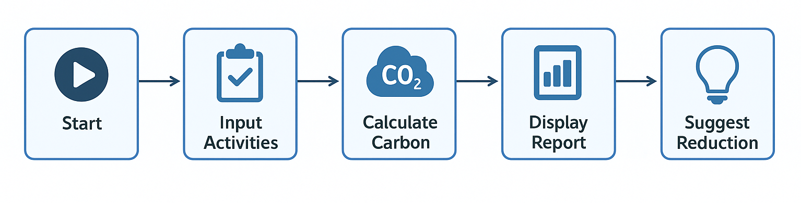
Designs
System Architecture Diagram:
Users → Input Activities → Calculation Engine → Database → Visualization Module → Recommendations.
UI Mockup:
Dashboard with total emissions, category-wise breakdown, and reduction tips.

Slide 7
References
Intergovernmental Panel on Climate Change (IPCC) Reports
Carbon Footprint Ltd, “Carbon Footprint Calculator”
Life Cycle Assessment Methodologies, ISO 14040
Research articles on carbon emission tracking tools
Journal of Cleaner Production, Sustainable Energy Reviews

Slide 8
Thank you and Any Queries

