Slide 1


Blockchain-Based Hotel Access and Stream-Pay Rental Service
Kyle Huang, Harold Than, Rose Zhao (The BlockStreamers)

Slide 2


Problem

Slide 3


Slide 4
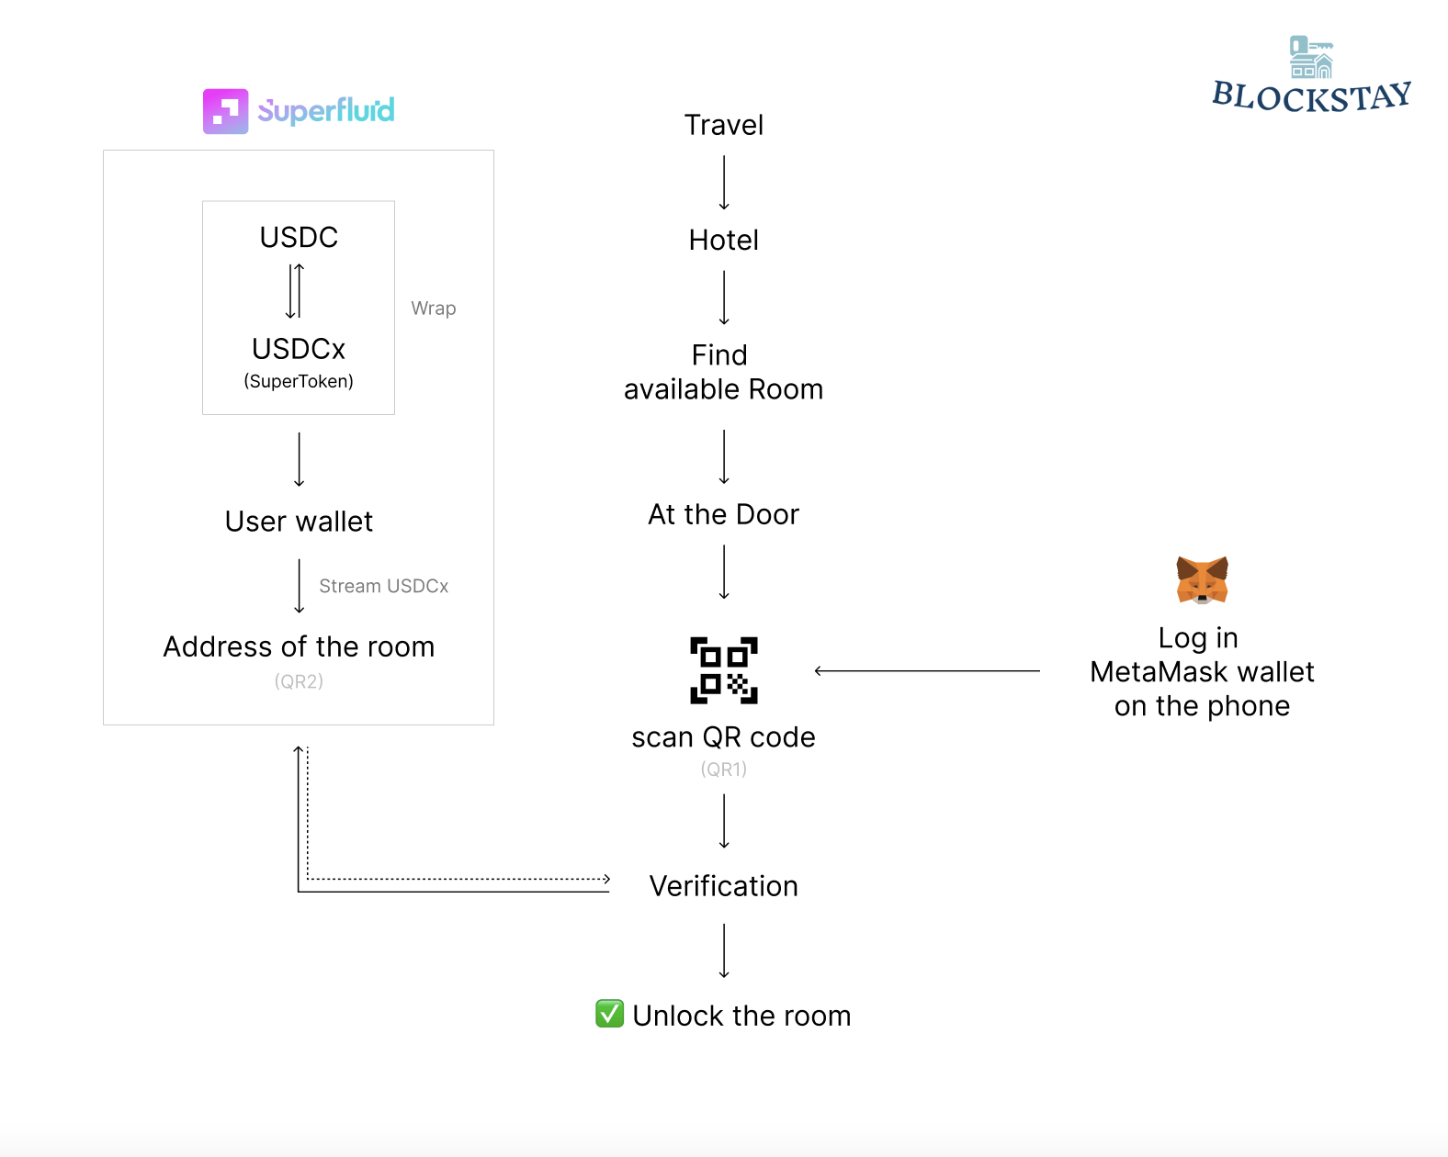

Slide 5

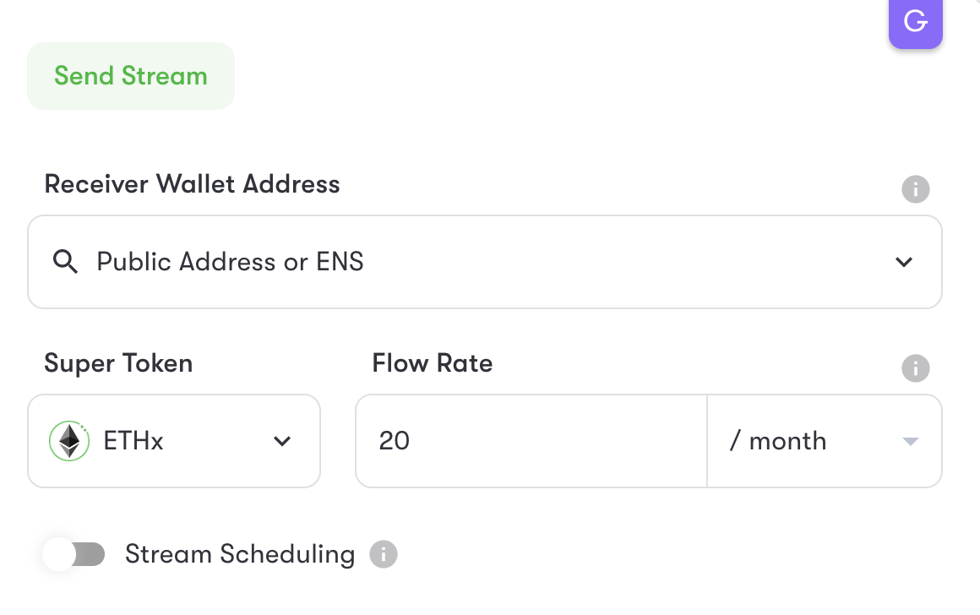
Technology Flow
Booking Process
Decentralized hotel booking platform using smart contract
Payment and confirmation
Blockchain Wallet “Stream” Payment - built on top of Superfluid
Initiate recurring payments, paid out by the second
Traditional Banking cannot achieve that
Direct payment system with no specialized infrastructure cost
Room Access
Smartphone app, IoT-enabled smart lock
Blockchain Wallet acts as secure ID-authentication

Slide 6
Stakeholder: blockchain rental services
benefits to property owners, renters, and the overall rental market
To Owners:
Secure real-time transfer with no bank fees
Cost reduction (labor and infrastructure)
To renters:
No pre-payment, flexible time subscriptions
Reduce check-in waiting time
Improve access security
Service Personalization
Overall market:
Decentralization and user control
Transparency and trust

Slide 7
Impact: blockchain rental services
can revolutionize the way people access and manage rental properties, vehicles, and equipment
Decentralized rental platforms
Secure identity verification
Transparent rental history
Tokenized rental payments
IoT and smart contracts
Reward and loyalty programs
Parking Meter
Gym Membership
Online Services
Insurance Contract
Apartment Rental
Rental Car
Shared Bike

