Slide 1

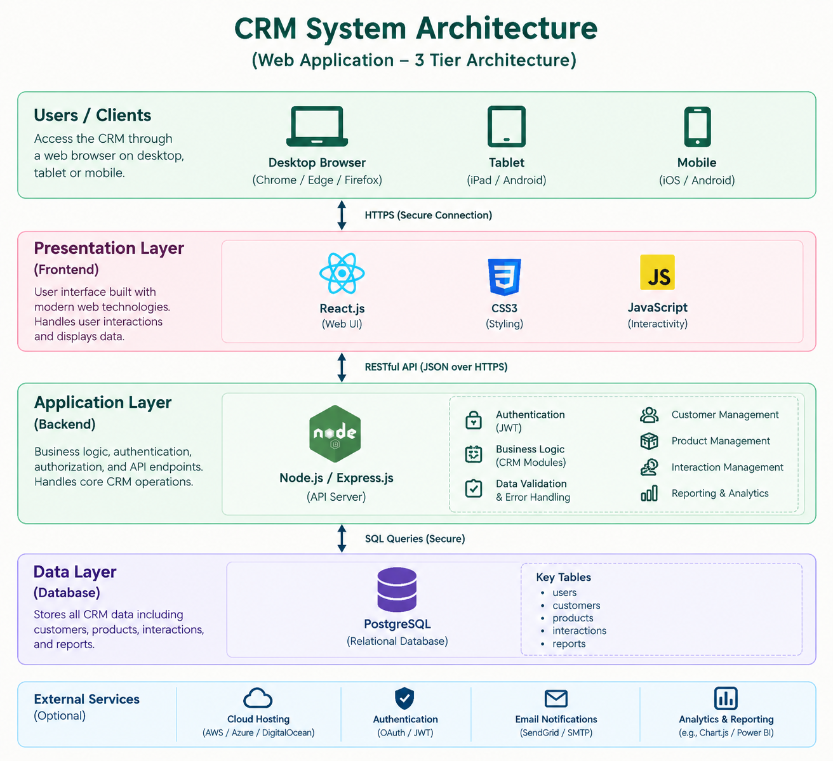
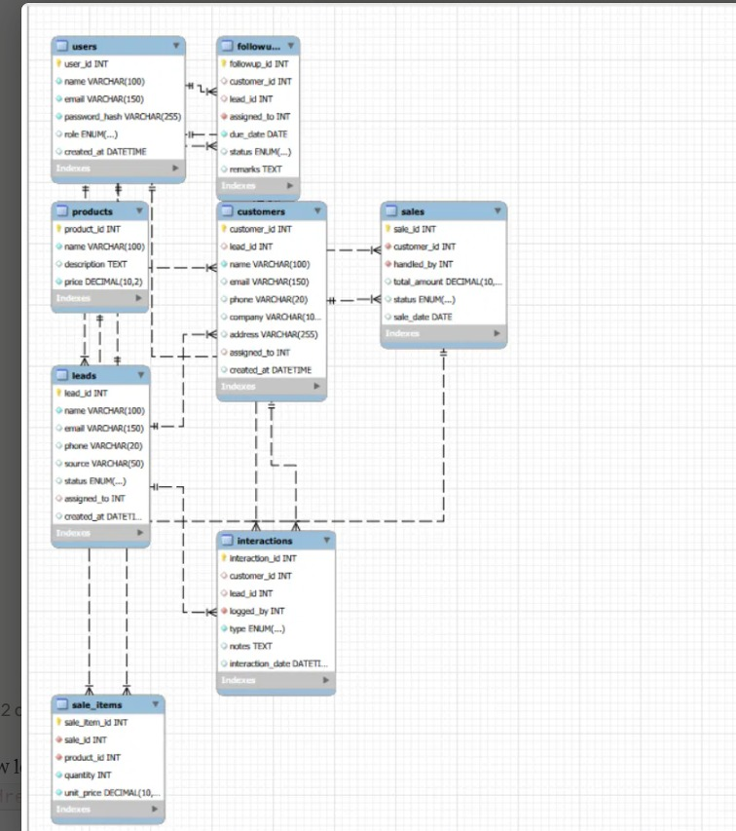
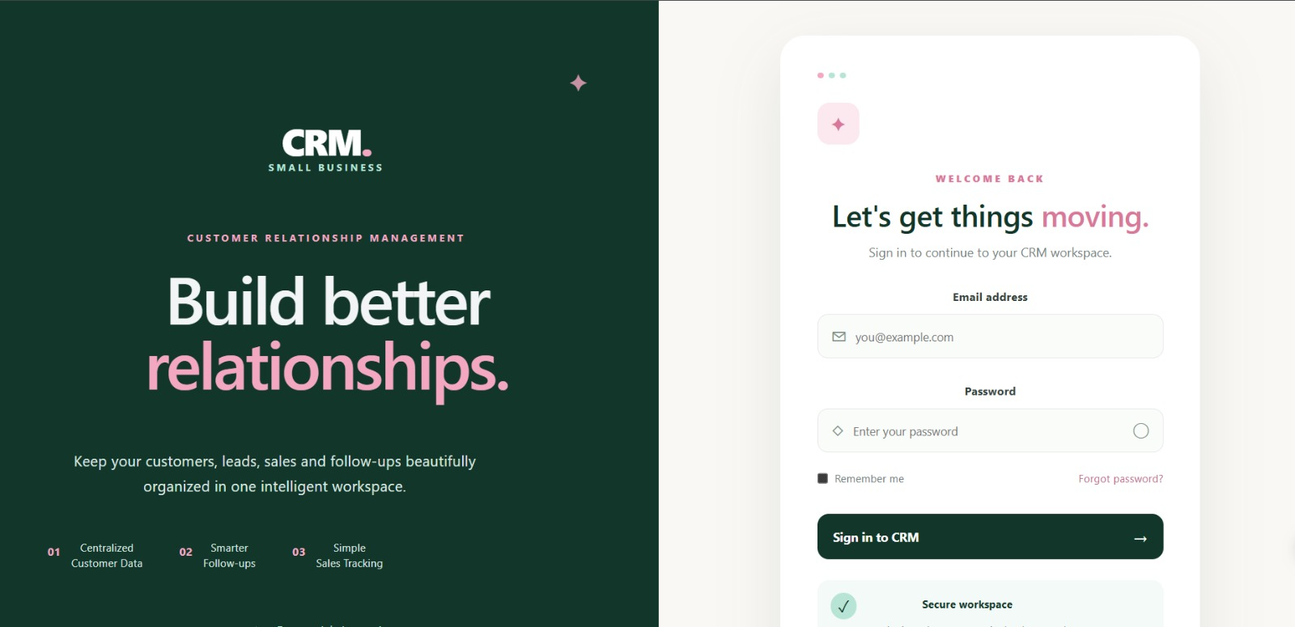
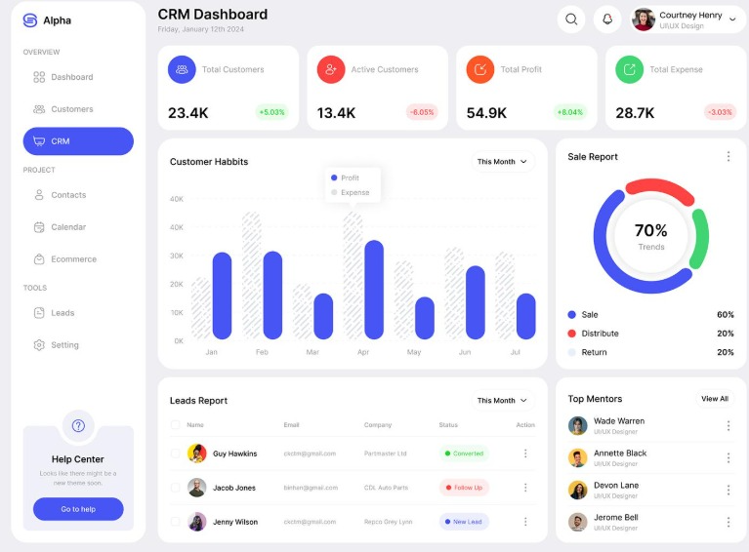
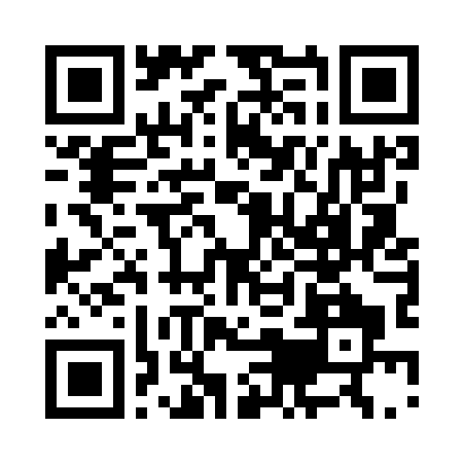
KLH Logo
[CRM FOR SMALL BUSINESS]
Team ID: [7] | Section: [S9] | Members: [Thanvi – Roll No.2520030214], [Keerthi – Roll No.2520030416], [Ashwika – Roll No.2520030224] | Guide: [Dr. Prashanthi Vegeasna]
Database Systems Engineering and Distributed Backend Development (25CS1302E) | KLH Bachupally Campus, CSE | PBL 2026-27
Abstract
Tools & Technologies
• Small businesses need an efficient way to manage customer information and business activities.
• The CRM centralizes customer records, interactions, leads, sales activities and follow-ups.
• A dashboard supports monitoring of customer and sales activities and reduces manual work.
• Frontend: HTML, CSS, JavaScript
• Backend: Java / Node.js
• Database: MySQL
• Development Tool: Visual Studio Code
• Database Management: MySQL Workbench
Problem Statement & Objectives
• Problem: spreadsheets/manual records can cause duplication, missed follow-ups and difficult retrieval.
• Objective: develop an easy-to-use CRM that organizes customer information and sales processes.
• Objective: improve customer relationship management and support better business decisions.
System Architecture
Existing vs Proposed System
Feature | Existing System | Proposed System
Customer records | Manual/spreadsheet | Centralized database
Data organization | Possible duplication | Structured records
Follow-ups | Can be missed | Tracked and scheduled
Sales activities | Nor centrally managed | Managed in CRM
Access to information | Harder to find quickly | Search/update/retrieve
ER Diagram & Database Design
Feasibility Study
• Technical: HTML, CSS, JavaScript, Java / Node.js and MySQL are specified.
• Economic: based on the project plan, an open-source / free-tier stack can be used.
• Operational: centralized records and a dashboard support easier use and maintenance.
• Schedule: designed for completion within the semester timeline.
Implementation Screenshots
Results & Testing
Conclusion
Future Scope
Expected outcome: centralized customer information and better organization of customer, lead, sales and follow-up data.
Testing focus: CRUD operations, validation and application performance.
The CRM provides a centralized way to manage customer information and reduces manual work.
It supports customers, leads, sales and follow-ups efficiently.
• Advanced sales reports and analytics.
• Automated notifications for follow-ups.
• Customer communication features.
• More dashboard and business insights.
Backend-Project repository.
References: Salesforce ,Salesforce. CRM for Small Business: Software & Tools,Oracle MySQL. MySQL 8.0 Reference Manual
Project Team Documentation
QR: GitHub

