Slide 1


Loan Default Prediction Using Random Forest and Gradient‑Boosted Trees
course MACHINE LEARNING — BTech (Academic Year 2026‑27)
By Chegireddy Thanvi - Roll: 2520030214
K Rishitha - Roll: 2520030202
Guide: Shaik Asif
Department : Computer Science & Engineering
Notes:
1

Slide 2

Problem Statement
Loan default is a major challenge for banks and financial institutions because failure to identify high-risk borrowers can lead to financial losses.
The objective of our project is to develop a machine-learning-based loan default prediction system that analyzes borrower and loan-related information and predicts whether a borrower is likely to default or repay the loan.
The model will help identify important factors associated with loan default and support more data-driven credit-risk assessment
Notes:
2

Slide 3


Abstract
Loan default prediction is vital for reducing non‑performing assets and improving lending decisions. This work builds, compares, and analyses Random Forest and Gradient‑Boosted Tree models (XGBoost / LightGBM) on cleaned historical loan data. The pipeline includes missing‑value treatment, categorical encoding, feature engineering and selection, model training with cross‑validation, and evaluation using Accuracy, Precision, Recall, F1‑Score and ROC‑AUC. Results highlight the best performing model, key predictors of default, and practical recommendations for deployment in banking workflows.
Notes:
3

Slide 4

Data & Preprocessing
Source: Historical loan CSV with applicant income, loan amount, credit history, employment status, loan term, debt‑to‑income ratio, and additional financial indicators.
Cleaning: Impute missing values (median for numerics, mode/unknown for categoricals), remove duplicates, outlier checks with IQR winsorization.
Encoding: One‑hot or target encoding for categoricals depending on cardinality; ordinal mapping for ordered features.
Scaling: StandardScaler for distance‑sensitive models; tree‑based models kept unscaled where appropriate.
Feature engineering: Debt‑to‑income ratios, employment tenure buckets, interaction terms, and missing‑value indicator flags.
Notes:
4

Slide 5


Models & Training Strategy
Two ensemble learners evaluated:
Random Forest
Ensemble of decision trees with bootstrap aggregation and feature subsampling. Hyperparameters tuned: n_estimators, max_depth, max_features, min_samples_leaf.
Gradient‑Boosted Trees (XGBoost / LightGBM)
Boosting approach adding weak learners sequentially. Tuned parameters: learning_rate, n_estimators, max_depth, subsample, colsample_bytree, regularization.
Evaluation & Validation
Stratified k‑fold cross‑validation (k=5), class imbalance handled with class weights or SMOTE. Model selection via ROC‑AUC and F1 for imbalanced outcomes.
Notes:
5

Slide 6


Evaluation Metrics
Primary metrics selected to reflect imbalanced classification:
Accuracy — overall correctness (useful when classes balanced).
Precision — fraction of predicted defaults that are true defaults (controls false alarms).
Recall (Sensitivity) — fraction of true defaults detected (controls missed risky loans).
F1‑Score — harmonic mean of precision and recall (balanced measure for imbalanced sets).
ROC‑AUC — ranking ability across thresholds; preferred for model comparison.
Use confusion matrix and threshold analysis to translate model outputs into operational lending rules.
Notes:
6

Slide 7

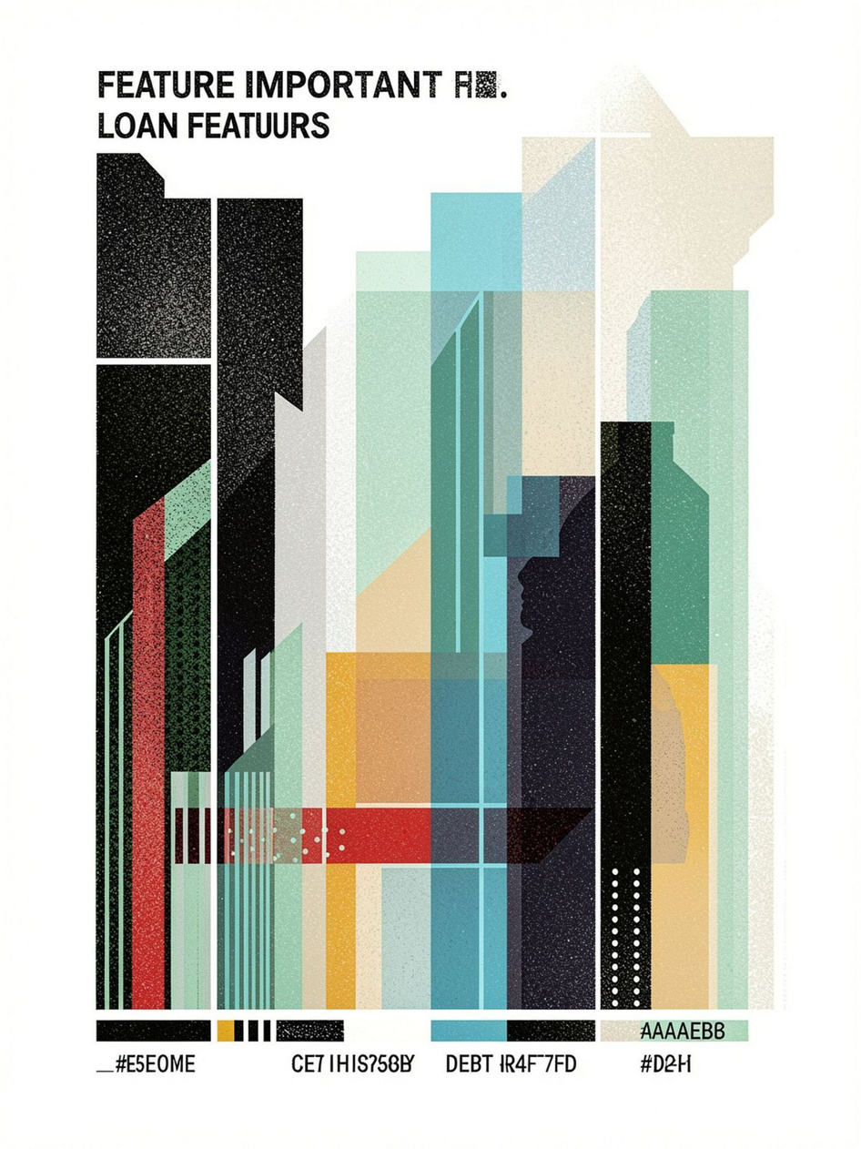
Key Findings & Feature Insights
After model training and interpretation:
Top predictive features typically: credit history, debt‑to‑income ratio, loan amount relative to income, employment tenure, number of previous delinquencies.
Tree‑based models provide feature importance and SHAP analysis to explain individual predictions — crucial for regulatory transparency.
Gradient boosting often achieves higher ROC‑AUC and better calibration, while Random Forest offers robust baseline performance with simpler tuning.
Notes:
7

Slide 8

Prototype: Report Signature & Deployment Notes
Expose model via Flask or Streamlit API for lending staff to score applications.
Store predictions and explanations (SHAP) in a database (MySQL/SQLite) for audits.
Schedule periodic retraining with rolling windows to handle concept drift.
Notes:
8

Slide 9

Modules, Objectives & Expected Outcomes
1
2
3
4
Module 1 — Data Acquisition & Exploration
Module 2 — Preprocessing & Feature Engineering
Module 3 — Model Development
Module 4 — Evaluation & Explainability
Objective: Train Random Forest and Gradient‑Boosted models with hyperparameter tuning.
Outcome: Trained models with cross‑validated performance metrics.
Objective: Evaluate generalization, calibrate thresholds, and explain predictions.
Outcome: Confusion matrices, ROC‑AUC, SHAP explanations, and decision thresholds.
Objective: Collect and understand data distributions, missingness, and class balance.
Outcome: Cleaned dataset and exploratory report with visual summaries.
Objective: Impute, encode, scale, and create informative features.
Outcome: Production‑ready feature set and transformation pipeline.
5
Module 5 — Prototype & Reporting
Objective: Build a simple scoring API and prepare final report with signature block.
Outcome: Prototype app (Flask/Streamlit), documentation, and signed project report.
Notes:
9

Slide 10
Conclusions, Limitations & Next Steps
Ensemble tree models (especially gradient boosting) reliably identify high‑risk borrowers when paired with careful preprocessing and explainability tools.
The approach supports safer lending decisions and risk mitigation.
Limitations:
Model performance depends on data quality and representativeness. Potential biases (e.g., socio‑economic proxies) must be analyzed and mitigated to meet fairness and regulatory requirements.
Conduct fairness audits and bias mitigation (adversarial debiasing, reweighing).
Integrate cost‑sensitive learning to align predictions with financial impact.
Deploy an explainable scoring service with human‑in‑the‑loop review for flagged cases.
Notes:
10

