Slide 1

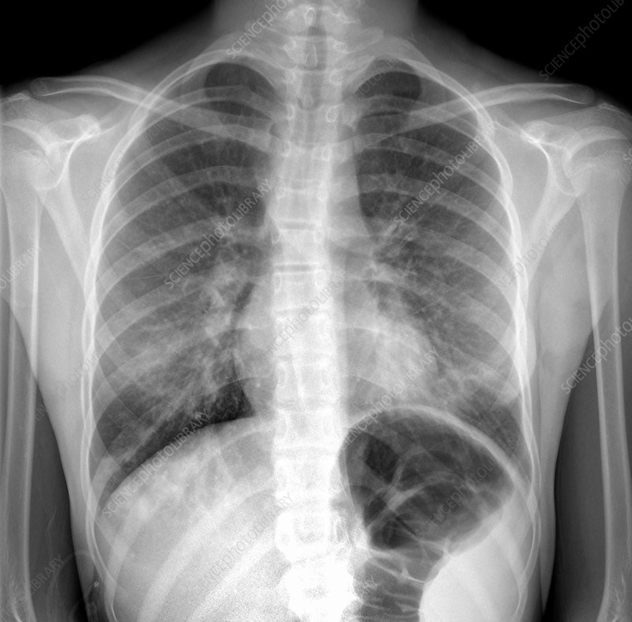
COURSE NAME:
Applied Machine Learning In Text Analysis
COURSE CODE: 24ALT3101
Project Title: Deep Learning Framework for Automated Pneumonia Detection Using Chest X-ray Images.
An Explainable AI-Based Approach for Accurate and Interpretable Pneumonia Diagnosis
Team Members:
1. Allam Greshmica - 2420030017
2. Mikkineni Thanvitha - 2420030040

Slide 2
Problem Statement
Pneumonia is a serious infection of the lungs that can cause breathing problems and other health complications if it is not detected early. Chest X-rays are commonly used to detect pneumonia, but doctors need to examine these X-rays manually, which can take time. The diagnosis can also be affected by human error and differences in doctors’ experience. In hospitals with fewer experienced radiologists, this can be an even bigger challenge.
AI can help detect pneumonia from chest X-rays quickly, but some AI models only give a result such as “Pneumonia” or “Normal” without explaining why. Therefore, we need a system that can not only detect pneumonia accurately and quickly, but also show the areas of the X-ray that influenced its decision. This makes the AI prediction easier to understand and more trustworthy for doctors.
Existing systems may provide a classification result without clearly showing which image regions influenced the prediction.

Slide 3
Objectives
Develop an automated pneumonia classification system using chest X-ray images.
Implement image preprocessing and augmentation.
Implement DenseNet-121 transfer learning for binary classification.
Evaluate the model using Accuracy, Precision, Recall, F1-score and ROC-AUC.
Apply Grad-CAM to provide visual explanations of model predictions.
Develop a local FastAPI prototype for X-ray upload and prediction.
Extend the framework in future phases using multiple datasets, architectures and natural-language explanations.

Slide 4
Literature Review
Year | Authors | Technology/Model | Description | Limitation/Gap
2021 | Adhiyaman Manickam, Jianmin Jiang, Yu Zhou, Abhinav Sagar, Rajkumar Soundrapandiyan, R. Dinesh Jackson Samuel | U-Net + ResNet50 + InceptionV3 + InceptionResNetV2 + Transfer Learning | Lung segmentation + transfer learning for pneumonia detection. | Limited dataset; no NLP explanation or integrated system.
2021 | Yan Han, Chongyan Chen, Ahmed H. Tewfik, Ying Ding, Yifan Peng | Radiomic Features + Contrastive Learning | Combined radiomic features and contrastive learning for CXR pneumonia detection. | Mainly RSNA dataset; limited multi-dataset evaluation.
2022 | Ahmed Salem Musallam, Ahmed Sobhy Sherif, Mohamed K. Hussein | DeepChest / Deep CNN | Lightweight CNN for COVID-19 and pneumonia classification. | Limited explainability; no multi-model or LLM integration.
2023 | Chiagoziem C. Ukwuoma, Zhiguang Qin, Md Belal Bin Heyat, Faijan Akhtar, Olusola Bamisile, Abdullah Y. Muaad, Daniel Addo, Mugahed A. Al-Antari | DenseNet201 + VGG16 + GoogleNet / InceptionResNetV2 + Xception + Transformer Encoder + XAI | Hybrid CNN-Transformer framework with visual explanations. | Mainly visual XAI; no natural-language reporting or web platform.
2024 | Md Fashiar Rahman, Tzu-Liang Tseng, Michael Pokojovy, Peter McCaffrey, Eric Walser, Scott Moen, Alex Vo, Johnny C. Ho | VGG16 + ROI Segmentation + Data Augmentation + ML-Grad-CAM | ROI-based classification with explainable heatmaps and severity assessment. | Heatmap-based explanation; no LLM/BERT integration.
2024 | A.N. Patel et al. / T.R. Gadekallu, R. Chengoden et al. | EfficientNet-B4 + Transfer Learning + Grad-CAM | Transfer learning for lung disease classification with visual XAI. | Single main architecture; lacks integrated NLP and deployment.

Slide 5
Research Gap Identification
Research Gap | Proposed Solution | Review-2 Status
Limited Generalization | Multiple CXR datasets | Future
Limited Model Diversity | CNN/DenseNet/EfficientNet/Transformer comparison | Future
Limited Explainability | Grad-CAM | Implemented
Natural-language explanation | BERT + LLM | Future
End-to-end system | FastAPI/web interface | Prototype implemented
Limited evaluation | Multiple metrics + confusion matrix | Implemented
Selected research gap: Limited Explainability

Slide 6
Innovation
DenseNet-121 transfer learning for pneumonia classification.
Grad-CAM based visual explainability.
Confidence-based prediction output.
Automated evaluation using multiple performance metrics.
FastAPI-based local prediction interface.
Modular architecture allowing future integration of additional datasets and models.

Slide 7
Creativity
Upload → Predict → Explain workflow.
Combines classification with visual explanation.
Displays prediction confidence.
Generates Grad-CAM visualization automatically.
Integrates deep-learning inference into a simple web interface.

Slide 8
Novelty And Feasibility
Novelty: The implementation combines DenseNet-121 chest X-ray classification with Grad-CAM explainability and a FastAPI interface in a single working prototype.
Aspect | Implementation
Development | VS Code
Programming | Python 3.11
Deep Learning | PyTorch
Model | DenseNet-121
Image Processing | Pillow / Torchvision
Evaluation | Scikit-learn
Explainability | Grad-CAM
API | FastAPI + Uvicorn
Version Control | Git + GitHub
Hardware | Local CPU environment

Slide 9
Methodology
Chest X-ray Dataset
↓
Data Preprocessing
↓
Train / Validation Split
↓
DenseNet-121 Transfer Learning
↓
Binary Classification
Normal / Pneumonia
↓
Performance Evaluation
↓
Grad-CAM Explainability
↓
FastAPI Web Prototype
Training images: 5,216
Test images: 624
Input size: 224 × 224
Classes: Normal / Pneumonia

Slide 10
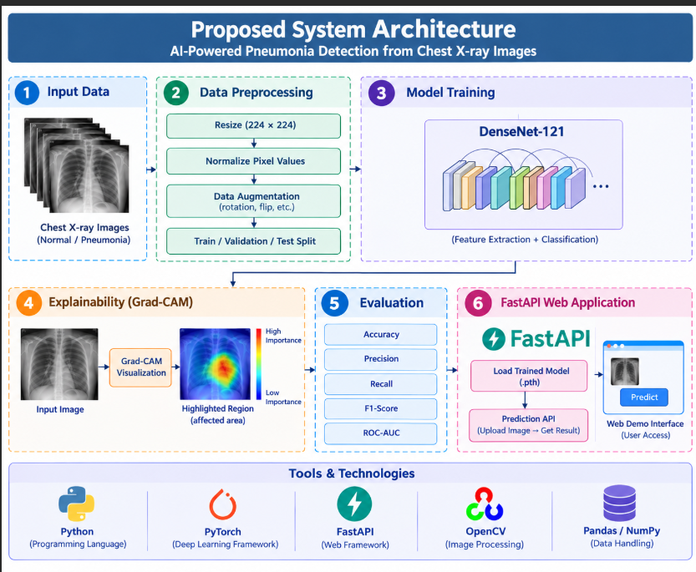
Proposed System Architecture

Slide 11
Modern Tools & Technologies
Technology | Purpose
Python | Programming
PyTorch | Deep learning
Torchvision | DenseNet-121 and transforms
Scikit-learn | Evaluation metrics
Pillow | Image loading
Grad-CAM | Explainability
FastAPI | Web/API backend
Uvicorn | Local server
VS Code | Development
Git/GitHub | Version control

Slide 12
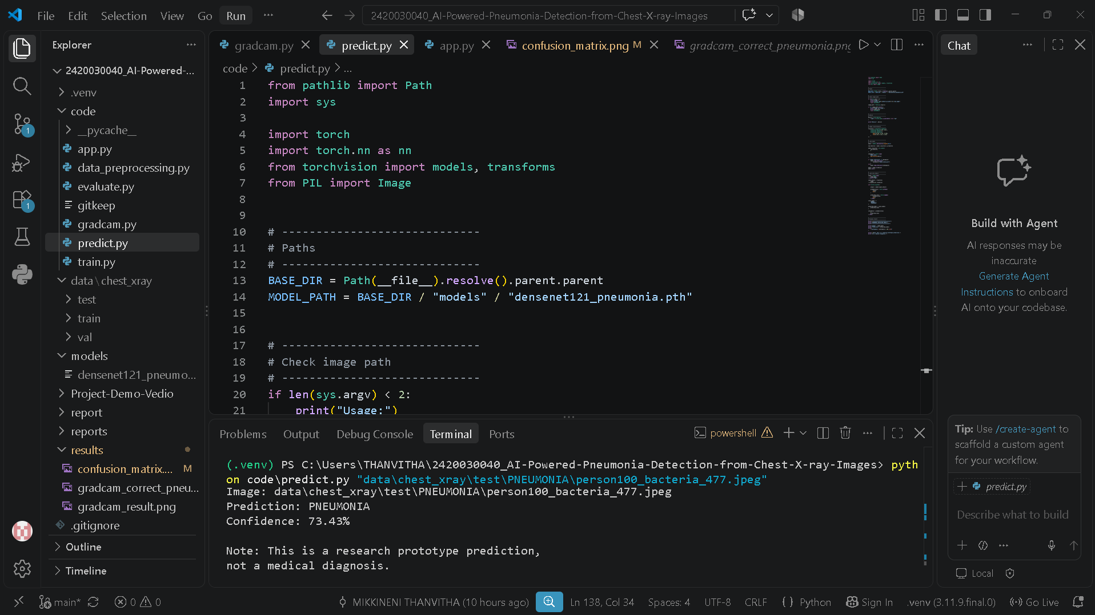
Implementation
Implementation was performed locally in VS Code using Python and a virtual environment.

Slide 13
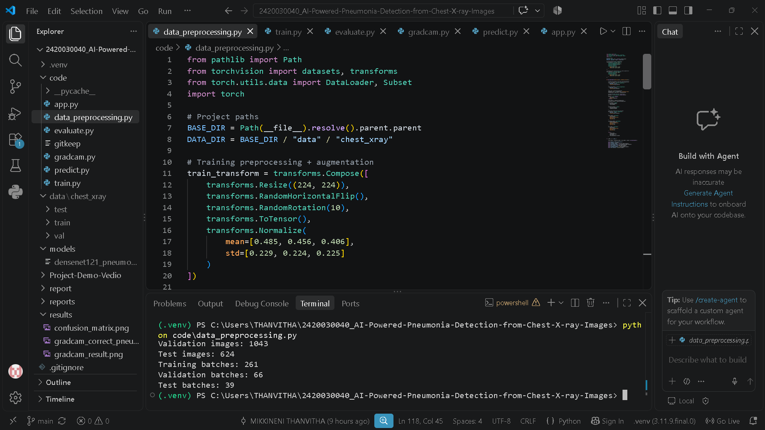
Dataset & Preprocessing
Dataset
Chest X-Ray Images (Pneumonia) dataset
NORMAL and PNEUMONIA classes
Training/validation split generated from training data
Separate test set
Resize: 224 × 224
Normalization
Random horizontal flip
Random rotation
PyTorch DataLoader

Slide 14
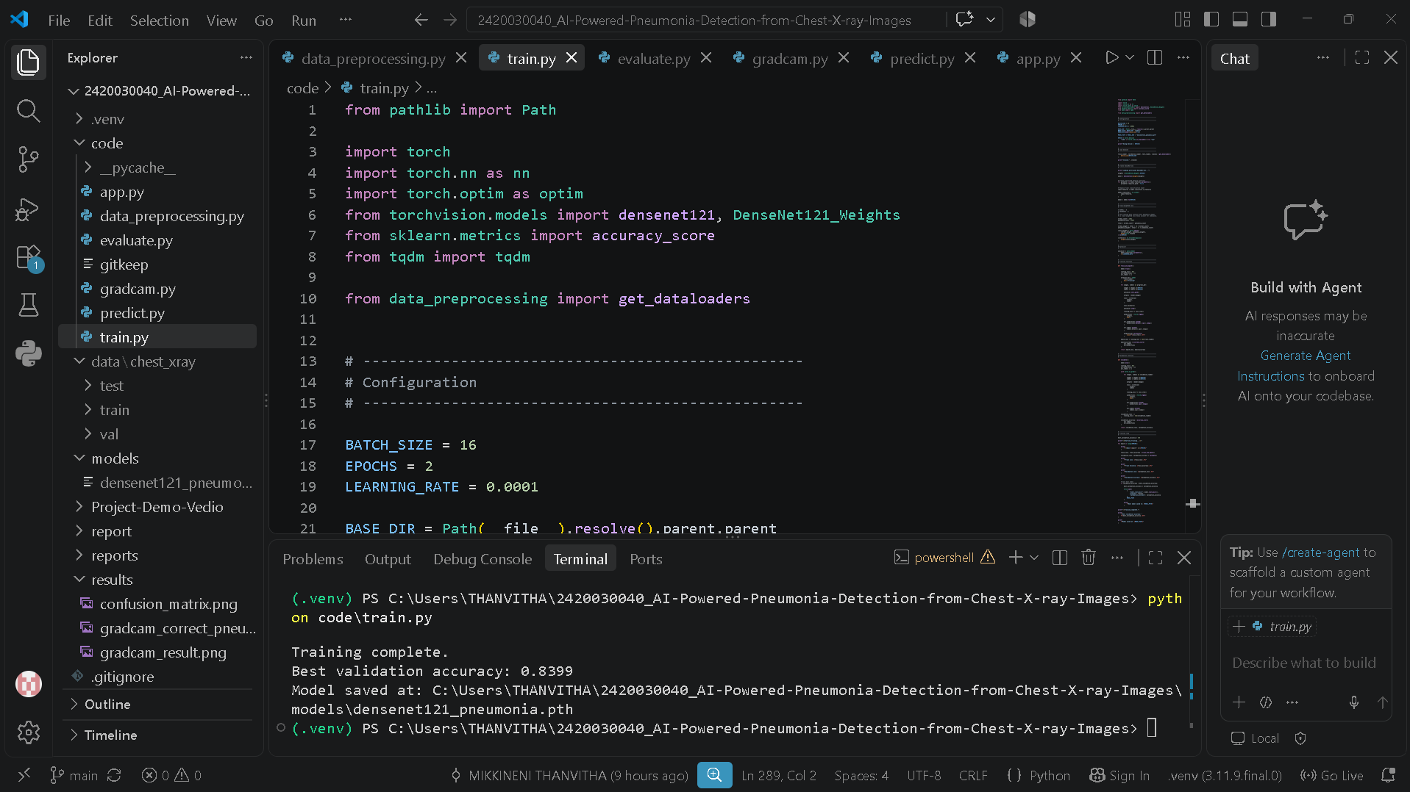
Model Implementation
Pretrained DenseNet-121
↓
Frozen Feature Extractor
↓
Classification Layer
↓
2 Classes
NORMAL / PNEUMONIA

Slide 15
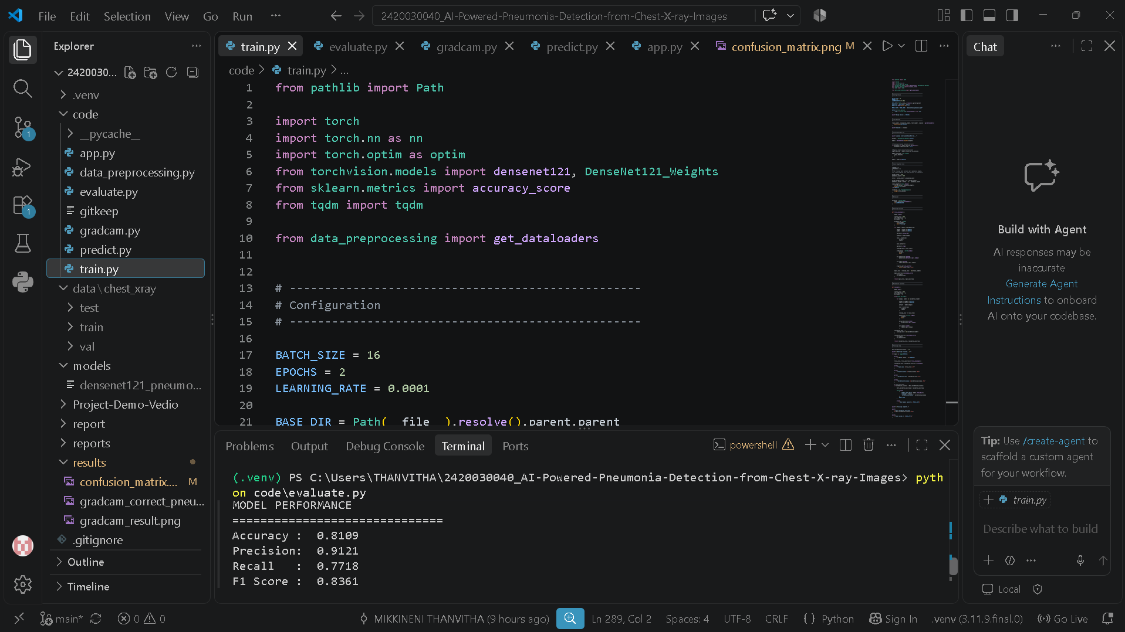
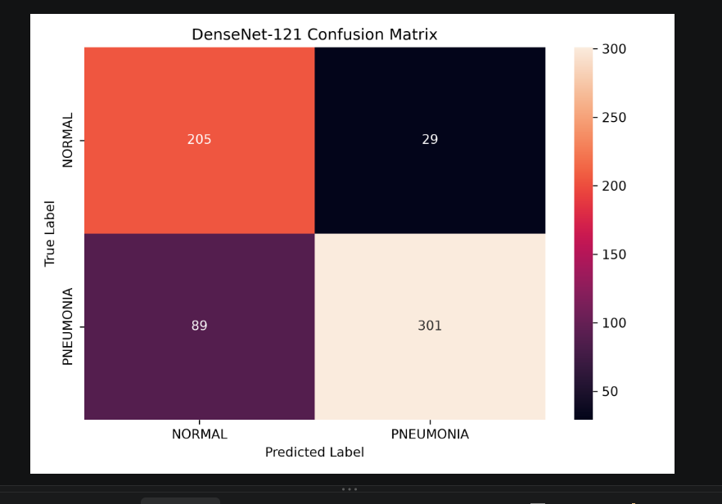
Results
Metric | Result
Accuracy | 84.13%
Precision | 89.86%
Recall | 84.10%
F1 Score | 86.89%
ROC-AUC | 91.89%
Test set: 624 images
 | Predicted
Actual |  | Normal | Pneumonia
 | Normal | 197 | 37
 | Pneumonia | 62 | 328

Slide 16
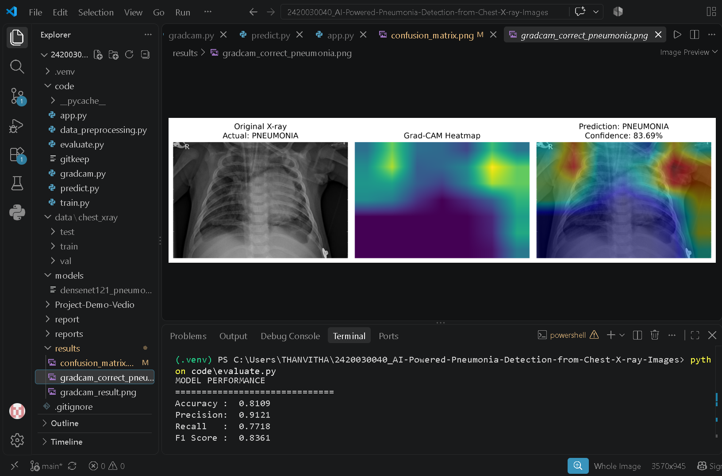
Explainable AI / Grad-CAM

Slide 17
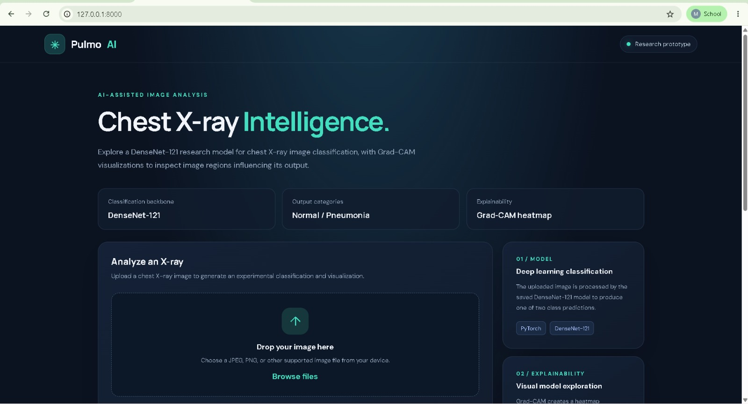
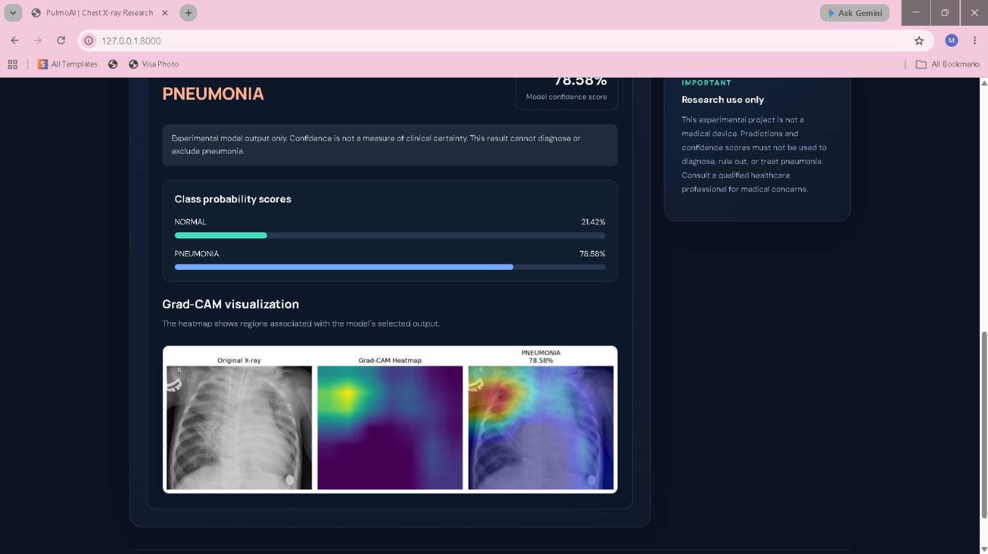
FastAPI Web Application

Slide 18
Performance Evaluation
Accuracy: 84.13%
Precision: 89.86%
Recall: 84.10%
F1 Score: 86.89%
ROC-AUC: 91.89%

Slide 19
Implementation Status / Future Work
Component | Status
Dataset preprocessing | ✅ Completed
DenseNet-121 | ✅ Completed
Model evaluation | ✅ Completed
Confusion matrix | ✅ Completed
Grad-CAM | ✅ Completed
FastAPI prototype | ✅ Completed
Multiple datasets | 🔄 Future
CNN comparison | 🔄 Future
EfficientNet | 🔄 Future
Transformer | 🔄 Future
BERT + LLM | 🔄 Future
React frontend | 🔄 Future

Slide 20
Conclusion
A working VS Code-based pneumonia detection prototype was developed using DenseNet-121 transfer learning.
The model was evaluated using multiple classification metrics.
Grad-CAM was implemented to provide visual model explanations.
A FastAPI interface was developed for image upload, prediction and explanation.
The implementation provides the foundation for future multi-dataset and multi-model experimentation.

Slide 21


