Slide 1

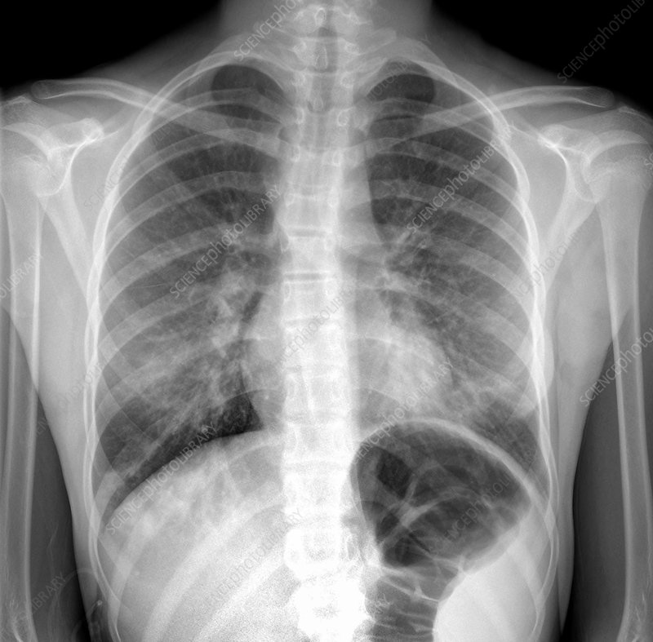
COURSE NAME: Applied Machine Learning In Text Analysis COURSE CODE: 24ALT3101
Project Title: Deep Learning Framework for Automated Pneumonia Detection Using Chest X-ray Images.
An Explainable AI-Based Approach for Accurate and Interpretable Pneumonia Diagnosis
Team Members: 1. Allam Greshmica - 2420030017 2. Mikkineni Thanvitha - 2420030040

Slide 2
Problem Statement
Pneumonia is a serious infection of the lungs that can cause breathing problems and other health complications if it is not detected early. Chest X-rays are commonly used to detect pneumonia, but doctors need to examine these X-rays manually, which can take time. The diagnosis can also be affected by human error and differences in doctors’ experience. In hospitals with fewer experienced radiologists, this can be an even bigger challenge.
AI can help detect pneumonia from chest X-rays quickly, but some AI models only give a result such as “Pneumonia” or “Normal” without explaining why. Therefore, we need a system that can not only detect pneumonia accurately and quickly, but also show the areas of the X-ray that influenced its decision. This makes the AI prediction easier to understand and more trustworthy for doctors.

Slide 3
Objectives
Main Objective:
To develop an explainable and robust deep learning framework for automated pneumonia detection from chest X-ray images by addressing the limitations identified in existing research.
Improve Generalisation: Use multiple chest X-ray datasets to improve model robustness and generalisation.
Improve Classification: Compare CNN, DenseNet-121, EfficientNet and Transformer models for accurate pneumonia detection.
Provide Explainability: Use Grad-CAM to highlight lung regions influencing the model's prediction.
Generate Understandable Explanations: Combine Grad-CAM with BERT + LLM to provide visual and textual explanations.
Ensure Reliable Evaluation: Evaluate the model using Accuracy, Precision, Recall, F1-score, ROC-AUC and Confusion Matrix.
Develop an End-to-End System: Integrate the model into a React + FastAPI application for X-ray upload, prediction, visualization and AI-assisted reporting.

Slide 4
Literature Review
Year | Authors | Technology/Model | Description | Limitation/Gap
2021 | Adhiyaman Manickam, Jianmin Jiang, Yu Zhou, Abhinav Sagar, Rajkumar Soundrapandiyan, R. Dinesh Jackson Samuel | U-Net + ResNet50 + InceptionV3 + InceptionResNetV2 + Transfer Learning | Lung segmentation + transfer learning for pneumonia detection. | Limited dataset; no NLP explanation or integrated system.
2021 | Yan Han, Chongyan Chen, Ahmed H. Tewfik, Ying Ding, Yifan Peng | Radiomic Features + Contrastive Learning | Combined radiomic features and contrastive learning for CXR pneumonia detection. | Mainly RSNA dataset; limited multi-dataset evaluation.
2022 | Ahmed Salem Musallam, Ahmed Sobhy Sherif, Mohamed K. Hussein | DeepChest / Deep CNN | Lightweight CNN for COVID-19 and pneumonia classification. | Limited explainability; no multi-model or LLM integration.
2023 | Chiagoziem C. Ukwuoma, Zhiguang Qin, Md Belal Bin Heyat, Faijan Akhtar, Olusola Bamisile, Abdullah Y. Muaad, Daniel Addo, Mugahed A. Al-Antari | DenseNet201 + VGG16 + GoogleNet / InceptionResNetV2 + Xception + Transformer Encoder + XAI | Hybrid CNN-Transformer framework with visual explanations. | Mainly visual XAI; no natural-language reporting or web platform.
2024 | Md Fashiar Rahman, Tzu-Liang Tseng, Michael Pokojovy, Peter McCaffrey, Eric Walser, Scott Moen, Alex Vo, Johnny C. Ho | VGG16 + ROI Segmentation + Data Augmentation + ML-Grad-CAM | ROI-based classification with explainable heatmaps and severity assessment. | Heatmap-based explanation; no LLM/BERT integration.
2024 | A.N. Patel et al. / T.R. Gadekallu, R. Chengoden et al. | EfficientNet-B4 + Transfer Learning + Grad-CAM | Transfer learning for lung disease classification with visual XAI. | Single main architecture; lacks integrated NLP and deployment.

Slide 5
Research Gap Identification
Gap | Existing Limitation | Our Proposed Solution
Limited Generalization | Existing models are often evaluated on limited datasets and may not generalize well. | Use NIH ChestX-ray14, RSNA and VinDr-CXR for multi-dataset evaluation.
Limited Model Diversity | Previous studies mainly use individual CNN or selected architectures. | Compare CNN, DenseNet-121, EfficientNet and Transformer models.
Limited Explainability | Existing XAI methods mainly show heatmaps without complete interpretation. | Use Grad-CAM to visualize regions influencing predictions.
Lack of Natural-Language Explanation | Most systems provide only labels, confidence scores or visual maps. | Integrate BERT + LLM to generate understandable AI-assisted summaries.
Lack of End-to-End System | Many studies focus on model accuracy rather than complete applications. | Develop React + FastAPI platform integrating prediction, XAI and reporting.
Limited Evaluation | Studies often emphasize accuracy without detailed error analysis. | Evaluate Accuracy, Precision, Recall, F1, ROC-AUC and Confusion Matrix.
Our research addresses these gaps by integrating multi-dataset learning, diverse deep-learning models, explainable AI, natural-language reporting and end-to-end deployment into a unified pneumonia detection framework.

Slide 6
Innovation
Multi-Dataset Learning: Uses NIH ChestX-ray14, RSNA and VinDr-CXR for broader evaluation.
Hybrid Deep Learning: Combines CNN, DenseNet-121, EffecientNet and Transformer models.
Explainable AI: Uses Grad-CAM to highlight pneumonia-related regions in X-rays.
AI-Assisted Explanation: Combines model results with BERT + LLM for understandable summaries.
End-to-End Platform: Integrates Prediction, explanation and reporting through React + FastAPI.
Comprehensive Evaluation: Uses multiple performance and error-analysis metrics.

Slide 7
Creativity
Visual + Textual Explanation: Provides both Grad-CAM heatmaps and AI-generated text.
Multiple Model Comparison: Identifies the most effective architecture for pneumonia detection.
Cross-Dataset Testing: Tests model performance across different CXR datasets.
User-Friendly Interface: Converts complex AI predictions into simple visual and textual outputs.
Confidence-Based Results: Displays prediction probability along with the classification.
Interactive Workflow: Upload → Predict → Explain → Generate Summary.

Slide 8
Novelty
Unified Framework: Combines multiple deep-learning architectures in one pneumonia detection framework.
Multi-Dataset Approach: Evaluates robustness across three different CXR datasets.
Dual Explainability: Combines Grad-CAM visual explanation + LLM textual explanation.
AI-Assisted Reporting: Converts prediction outputs into an understandable summary.
Model-to-Application Integration: Connects the trained model directly with a web-based interface.
Research-to-Deployment Approach: Goes beyond model accuracy toward a usable end-to-end system.

Slide 9
Feasibility
Aspect | Feasibility
Datasets | Publicly available CXR datasets: NIH, RSNA and VinDr-CXR
Technology | Python, PyTorch/TensorFlow, OpenCV, FastAPI and React
Models | Pre-trained models enable transfer learning with manageable training requirements
Explainability | Grad-CAM provides an established XAI approach
Deployment | FastAPI backend + React frontend supports web-based implementation
Resources | Can be developed using GPU/cloud environments such as Google Colab
Time | Can be completed through phased development and testing

Slide 10
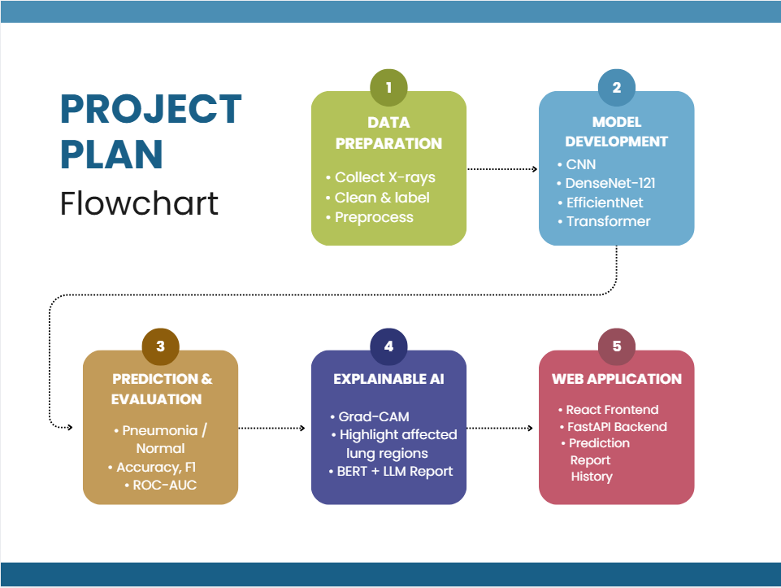

Slide 11


