Slide 1



AGROVOLTAIC CANOPY FOR PROTECTION AND SUSTAINABLE FARMING
GUIDE :DR.M.MEENAKSHI DEVI
TEAM :
1.THANWIN S S (230391771052118)
2.CHANDRU PM (2303917710521304)
3.KUBERAESHWARAN S (2303917710521307)
4.MUKILAN A (2303917710521311)
DEPARTMENT : EEE
DATE : 16/10/2026
TCE - EEE - 22EE690 - Project
1
Notes:
Say in one sentence: the panels should make electricity AND let the crops below get enough light, so the tilt angle is decided every few seconds from sensor data. Be clear about REAL and SIM: DHT11, soil moisture and rain are real sensors on the prototype; sunlight (pyranometer) and plant light (PAR) are simulated and can be moved with scroll bars.

Slide 2
Prototype demo: how the system works
PROTOTYPE DEMO | 20
From the sensor to the decision, in five steps
1 Sense
2 Send
3 Decide
4 Act
5 Show
DHT11, soil probe and rain sensor read the field
>
ESP board sends one line per second over USB
>
MATLAB picks the best panel angle (rules + search)
>
Panel angle, irrigation pump and MPPT voltage
>
Dashboard shows numbers, graphs and the reason in words
Input | Where it comes from | Status | Proof / how
Air temperature, humidity | DHT11 on the ESP board | REAL | datasheet accuracy: 2 C and 5 % RH; checked against a thermometer on the day
Soil moisture | soil probe -> analog pin | REAL | two-point calibration: dry in air = 0 %, wet in water = 100 %
Rain | rain sensor module | REAL | wet plate gives rain = 1; sets the 3 degree slope for harvesting
Sunlight (pyranometer) | scroll bar, or sun model | SIM | sun position from date, time and latitude; clearness index from NASA POWER
Plant light (PAR) | scroll bar, or 0.45 x 4.57 x sunlight | SIM | about 45 % of sunlight is PAR; 4.57 micromol per joule (standard conversion)
Wind | scroll bar | SIM | safety rule: 15 m/s or more turns the panels edge-on (90 degrees)
Notes:
Walk the five steps left to right. Then the table: green REAL rows are measured, orange SIM rows are simulated. The sun model uses the standard solar-position equations (Duffie and Beckman) with the monthly clearness index of TCE from NASA POWER; diffuse split by the Erbs correlation. The PAR conversion is a standard textbook value. The last line is for the live numbers read from the board on the day.

Slide 3
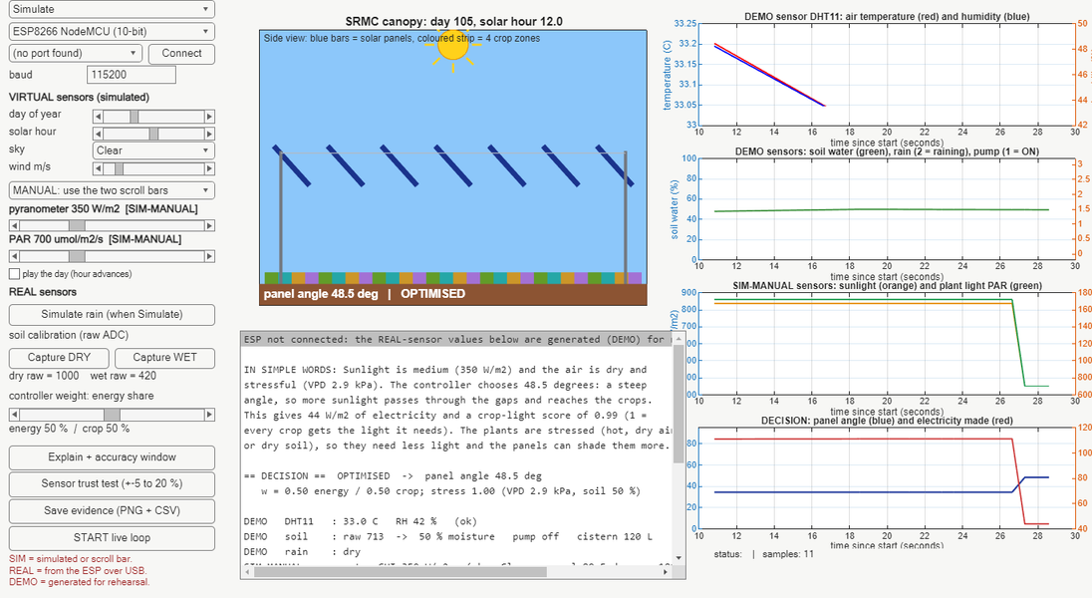
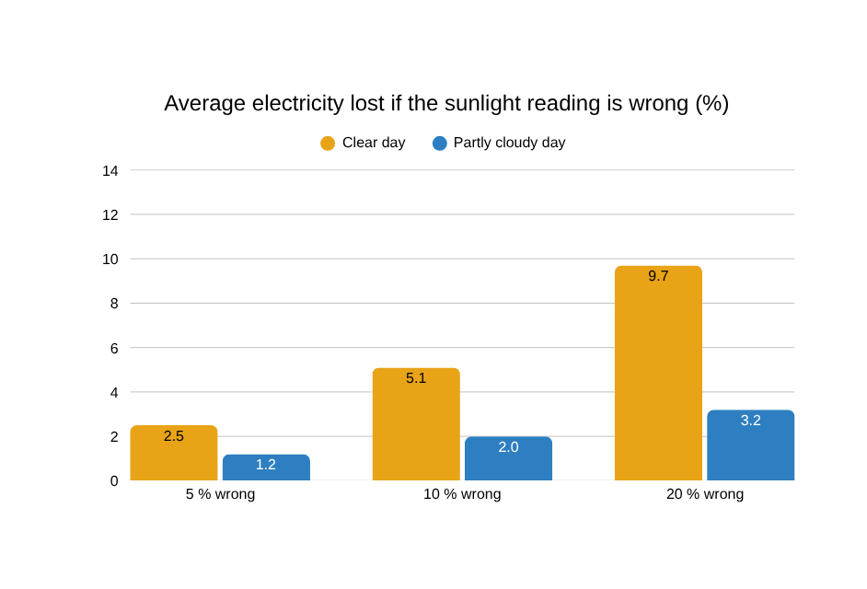
Prototype demo: the two simulated sensors
PROTOTYPE DEMO | 20
Move the scroll bar and watch the angle, the electricity and the irrigation react
• Dim sky (300 W/m2): panels go steep (55.5 degrees) to give crops light; electricity 36 W/m2
• Bright sky (1000 W/m2): flatter (39.5 degrees); electricity 124 W/m2
• Real sensors later: the serial line takes two extra numbers and replaces the simulated ones
PROOF: how it works and where it comes from
• Sun position: standard solar equations; sky clearness for TCE: NASA POWER monthly data
• PAR = 0.45 x 4.57 x sunlight (standard conversion); the dashboard flags it if PAR / sunlight is far from 2.06
• Same equations were checked against the PVGIS service: +5.0 % per year
Notes:
Answer to "can we trust the simulated sensors?": they are not measurements, they are controllable inputs built on standard equations. What we CAN prove: (1) the equations match the PVGIS service within +5.0 % per year; (2) we measured what a wrong reading costs: on a clear day a 5 % error loses 2.5 % of the electricity on average, a 10 % error 5.1 % (worst single half-hour 35 %); (3) the dashboard flags inconsistent sunlight/PAR readings; (4) real sensors plug in without changing the code. Numbers: results/sensor_trust_study.csv.

Slide 4
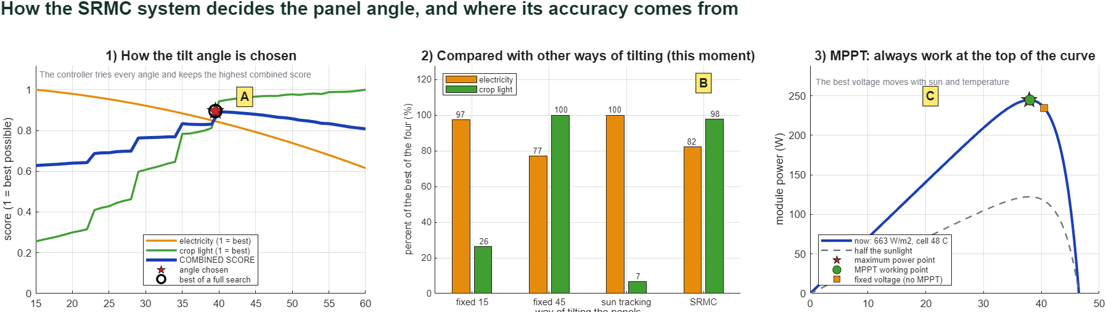
Prototype demo: how the tilt angle is chosen
PROTOTYPE DEMO | 20
It tries every angle from 15 to 60 degrees and keeps the one with the best combined score
Rules first (safety and water)
Then the search (graph 1)
Stress changes the need
• Wind 15 m/s or more: panels edge-on (90 degrees)
• Rain detected: 3 degree slope, rain goes to the tank
• Night: rest at 15 degrees
• Amber line: electricity at each angle
• Green line: light that reaches the crops
• Blue line: combined score = 0.5 x electricity + 0.5 x crop light; red star = the angle chosen
• Hot, dry air (VPD above 2.5 kPa) or dry soil: crops need less light
• The panels can then shade more and make more electricity
• Dry soil: pump on below 35 %, off at 55 %
PROOF
• Accuracy point A: the chosen angle is compared with a full search of every 0.5 degree step. Clear noon: difference 0.0 degrees. Worst case tested: 3 degrees, with the score within 0.02 % (a flat top). Light and shadow come from the same equations checked against Blender 3-D ray tracing (mean difference 0.010).
Notes:
Graph 1 is the heart of the system. The controller evaluates electricity (amber) and crop light (green) for each angle, joins them into one score (blue) and takes the highest point. The black circle is the best angle found by trying every 0.5 degrees; the red star is what the controller chose. The shadow and electricity values come from the physics functions that were checked against PVGIS and Blender.

Slide 5
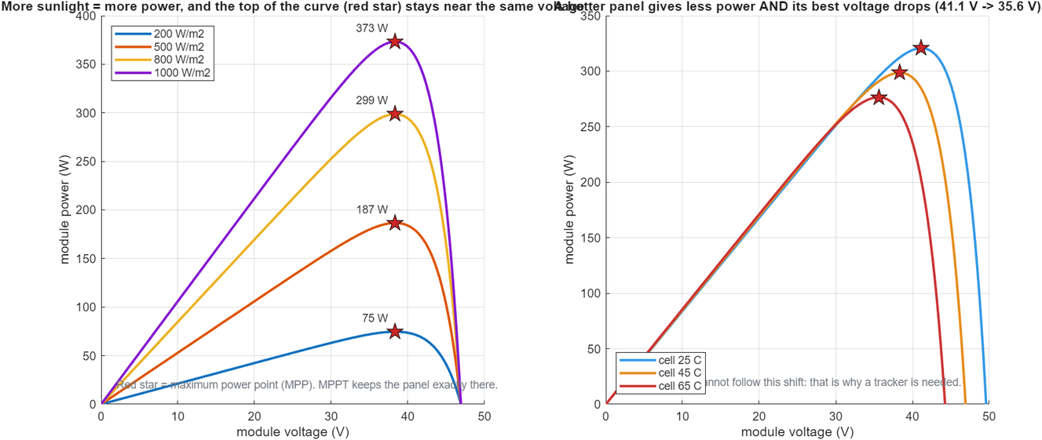
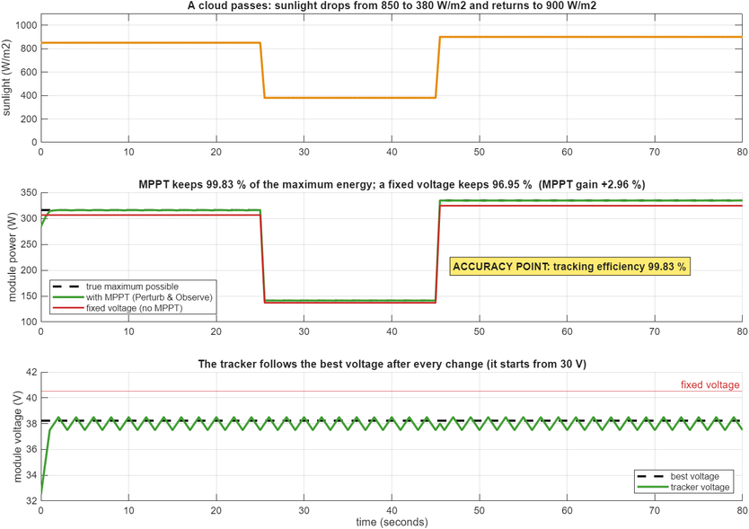
Prototype demo: MPPT at maximum power
PROTOTYPE DEMO | 20
Maximum power point tracking, Perturb and Observe
What it is
What MPPT does
What we gain
A solar panel gives the most power at one voltage (red star). That voltage moves with sunlight and cell temperature.
A small controller nudges the voltage up and down and keeps the point where power is highest.
Cloud test: MPPT keeps 99.83 % of the maximum energy; a fixed voltage keeps 96.95 % (gain +2.96 %).
PROOF
• Model: single-diode PV model of a typical 400 W module (Isc 10.5 A, Voc 49.6 V, Vmp 40.5 V; replace with your datasheet). Tracker: Perturb and Observe, 0.5 V steps. Hotter cell: best voltage falls from 41.1 V (25 C) to 35.6 V (65 C).
• Accuracy point C: tracking efficiency 99.83 %. Tested in MATLAB (5 MPPT tests pass). This is a model of the tracker, not yet a hardware DC-DC converter.
Notes:
MPPT is the electronics that makes sure the panel works at its maximum power point. Our main energy numbers already assume the panel works there; this slide shows how the tracker achieves it and how much it is worth compared with a fixed voltage. Be honest: this is a software model of a typical module; the hardware converter is future work.

Slide 6
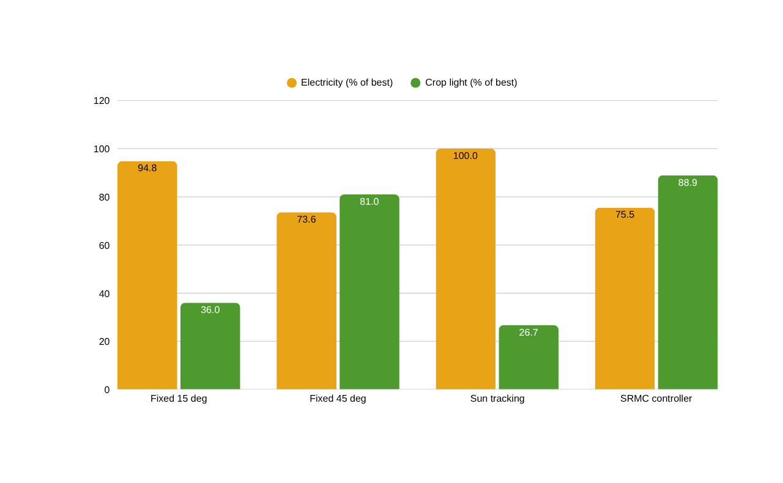
Validation: electricity and crop light together
VALIDATION | 10
Each bar is a percentage of the best way for that quantity; simulated day, 6 to 18 h
In simple words
• Sun tracking: most electricity, but the crops get only 27 % of the light they need.
• Fixed 45 degrees: crops fine, electricity 74 % of best.
• SRMC controller: 75 % of the best electricity and 89 % of the best crop light.
• Against fixed 45 degrees: electricity +2.5 %, crop light +9.7 %.
Other days (same controller) | Electricity | Crop light
Partly cloudy day | 78 % of best | 97 % of best
Hot, dry day (plant stress) | 79 % of best | 88 % of best
PROOF: how it works and where it comes from
• Simulated day same functions as the dashboard
• Sun tracking is only a reference: our panels have two positions
• Files: results/day_comparison.csv, fig_energy_vs_crop_clear_day.png
Notes:
Read the chart as: there is a trade-off. Pure tracking maximises electricity but starves the crops (27 % of the light target). The controller gives up about a quarter of the maximum electricity to give the crops about 89 % of their light, and it beats a fixed 45 degree panel on both. The 50/50 weight is adjustable in the dashboard (energy share scroll bar). The equal-weight average favours the controller by construction, so the weight must be chosen by the farmer or operator.

Slide 7
Validation: accuracy points and proof
VALIDATION | 10
Every number: what it means, and where it comes from
 | Accuracy point | Number | Where it comes from
A | Angle chosen vs full 0.5 degree search | 0.0 degrees at clear noon (worst tested 3 degrees, score within 0.02 %) | search built into the dashboard (Explain window)
B | Gain over a fixed 45 degree panel | electricity +2.5 %, crop light +9.7 % (clear day) | results/day_comparison.csv
C | MPPT tracking efficiency | 99.83 % (fixed voltage 96.95 %) | results/mppt_study.md
D | Real sensors | DHT11: 2 C, 5 % RH (datasheet). Bench: ______ C vs ______ C | datasheet; thermometer check on the day
E | Solar and shadow equations | +5.0 % per year vs PVGIS; shadow difference 0.010 vs Blender | PVGIS service; Blender Cycles ray tracing
F | Simulated-sensor error | wrong by 5 %: 2.5 % less electricity; by 10 %: 5.1 % (worst half-hour 35 %) | results/sensor_trust_study.csv
T | Software tests of every rule | 29 of 29 pass | results/test_results.md, sensor_and_mppt_tests.md
What we do NOT claim
• Sunlight and PAR are simulated, not measured
• No field data yet; the tilt is shown on screen only
• MPPT and module data are for a typical 400 W module
Notes:
This is the proof slide. Letters A to F match the labelled badges on the Explain window of the dashboard, so you can point to them live. Row D has blanks to fill with the bench numbers measured on the day. Close with the honest limits.

Slide 8
Feasibility and practical constraints
FEASIBILITY | 5
What can be built and shown now, and what is still open
Area | Where we are now (Review 0) | Constraint / next step
Sensors | DHT11, soil and rain are real on the prototype | Pyranometer and PAR are simulated; real ones plug into the same serial line
Controller | Runs live in MATLAB from the ESP serial data | Panel angle shown on screen only; no motor yet
Structure | SS316 wire-rope canopy, screened with IS 875 wind (39 m/s) | 12.5 m spans fail, a 5 m rope grid passes; screening only, not a certified design
Power electronics | MPPT works as a software model of a typical 400 W module | Hardware DC-DC converter is future work
Site and data | TCE ground, Madurai; NASA POWER sun data; PVGIS check +5.0 % | Needs a season of field data to confirm
Feasible now: low cost, simulation first

Slide 9
SDG mapping and cost effectiveness
SDG AND COST | 5
Four goals served, with a very low prototype cost
SDG 7 Clean energy
SDG 2 Zero hunger
SDG 6 Clean water
SDG 13 Climate action
Panels make electricity over the farm
Crops still get the light they need
Rain is harvested to a tank for irrigation
Land produces food and power together
Prototype item | Approx. cost (Rs)
NodeMCU ESP8266 | 350
ESP32 (spare board) | 500
DHT11 + soil sensor + rain sensor | 300
Wires, breadboard, USB cable | 150
Total (approximate) | about 1,300
Why it is cost effective:
Software is free or from the college (Arduino IDE, Blender, MATLAB licence)
Everything is tested on the computer before any steel or panel is bought
Prices are market estimates; replace with real bills. Full-scale cost and farmer income: Review 5.

Slide 10
Time management and progress tracking
TIME MGMT | 5
Review 0 is complete; Reviews 1 to 5 are planned
Review | Work | Status
0 (today) | Prototype sensors + MATLAB dashboard, MPPT, tests | Done: 29 of 29 tests pass
1 | Design and CAD (wire canopy, drawings, parts list) | Planned
2 | Solar and shadow study (sun path, shading) | Planned
3 | Digital twin (3-D live model) | Planned
4 | Control and simulation (full-year runs) | Planned
5 | Economics, final report and viva | Planned
Next: wire the boards, read real DHT11 / soil / rain values, and fill the bench numbers in the accuracy table.

Slide 11
Response to questions: likely questions
QUESTIONS | 5
Short, honest answers
Question | Answer
Are the pyranometer and PAR values real? | No. They are simulated with scroll bars from standard sun equations; a 10 % error costs about 5 % of electricity (clear day).
How do you know the model is right? | Checked against PVGIS (+5.0 % per year) and Blender ray tracing (shadow difference 0.010).
Why not simply track the sun? | Tracking gives most electricity but crops get only 27 % of their light; the controller gives 75 % and 89 %.
What does MPPT add? | 99.83 % of maximum energy, against 96.95 % with a fixed voltage.
What is not done yet? | Real light sensors, a motor, a hardware MPPT converter and field data.

Slide 12
THANK YOU
TCE - EEE - 22EE690 - Project
8

